Slide 1
String Handling in Python
Python string is the collection of the characters surrounded by single quotes, double quotes, or triple quotes.
The computer does not understand the characters; internally, it stores manipulated character as the combination of the 0's and 1's.
Each character is encoded in the ASCII or Unicode character. So we can say that Python strings are also called the collection of Unicode characters.

Slide 2
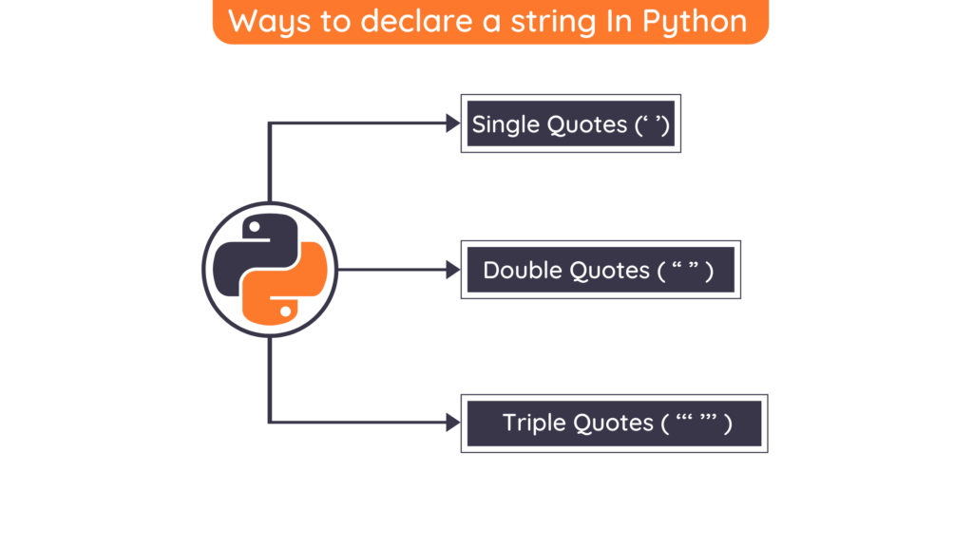

Slide 3
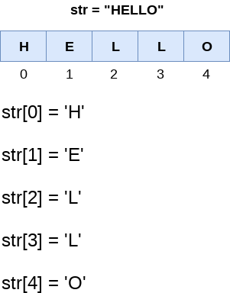
Strings indexing and splitting

Slide 4
in Python, the slice operator [] is used to access the individual characters of the string.
we can use the : (colon) operator in Python to access the substring from the given string
We can do the negative slicing in the string;
it starts from the rightmost character, which is indicated as -1.
The second rightmost index indicates -2, and so on.

Slide 5
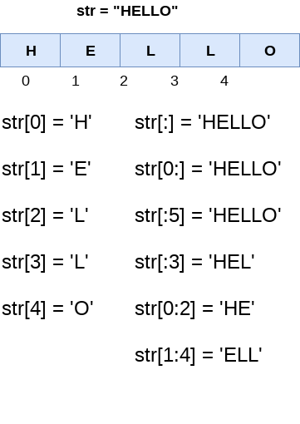

Slide 6
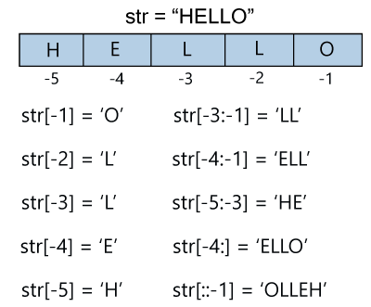

Slide 7
Deleting the String
As we know that strings are immutable.
We cannot delete or remove the characters from the string.
But we can delete the entire string using the del keyword.

