Slide 1







KATHMANDU UNIVERSITY
Wi-Fi Link
Department of Computer Science and Engineering • Dhulikhel, Kavre
Web Dashboard
IoT Based
Home Automation System
Built with an ESP32 microcontroller and a self-hosted web dashboard
PROJECT TEAM
Smart Lighting
Auto Fan Control
Nishant Sah
041125-25
Dipra Shrestha
041136-25
Sandesh Shrestha
041141-25
Samin Tharu
041155-25
Grishma Thapa
038007-24
Relay Switching
Code: ENGG 102 | Year I / Sem II • July 27, 2026
DHT22 Sensor

Slide 2






AGENDA
What We'll Cover
Problem & Objectives
System Design
The gap in traditional home switches and what we set out to build
Architecture, data model, and how a command flows through the system
Hardware & Software
Prototype & Testing
Components used and the firmware/dashboard stack
Breadboard build, enclosure, and validation across 5 test stages
Results & Limitations
Future Work & Conclusion
What works today, and what the system can't do yet
Voice feedback module and where this goes next
IoT Based Home Automation System | Kathmandu University
2

Slide 3




THE PROBLEM
Traditional Switches Can't Keep Up
Most homes still rely on manual, wall-mounted switches and ageing wiring. This works, but it comes with real limitations for modern, fast-paced households:
No remote control
No automation
Appliances can only be switched at the wall — not from a phone or PC
Fans and other appliances don't respond to real temperature or humidity
Expensive commercial options
Vendor lock-in
Existing smart-home kits are costly and often locked to a vendor's app
Many systems depend on third-party cloud apps the user can't customize
IoT Based Home Automation System | Kathmandu University
3

Slide 4



PROJECT GOALS
Objectives — All Achieved
Design and develop a smart home automation system using the ESP32 microcontroller
Control multiple electrical appliances using a 4-channel relay module through a web dashboard
Use a DHT22 sensor to automatically switch a fan on or off based on temperature and humidity
Enable remote monitoring and control of all relays through a custom web-based interface hosted on the ESP32
IoT Based Home Automation System | Kathmandu University
4

Slide 5
RELATED WORK
How This Compares
Reference
Reference
Approach
Approach
Key Difference
Key Difference
Anusha et al. (2024)
ESP32 + relay + sensor monitoring over Wi-Fi
Reliable switching, but no self-hosted dashboard shown
Kakani et al. (2024)
ESP32 relay control via the Blynk mobile app
Convenient, but depends on a third-party app/account
This Project
ESP32 + relay + DHT22 + self-hosted dashboard + planned voice feedback
Fully independent, no cloud/app dependency
IoT Based Home Automation System | Kathmandu University
5

Slide 6
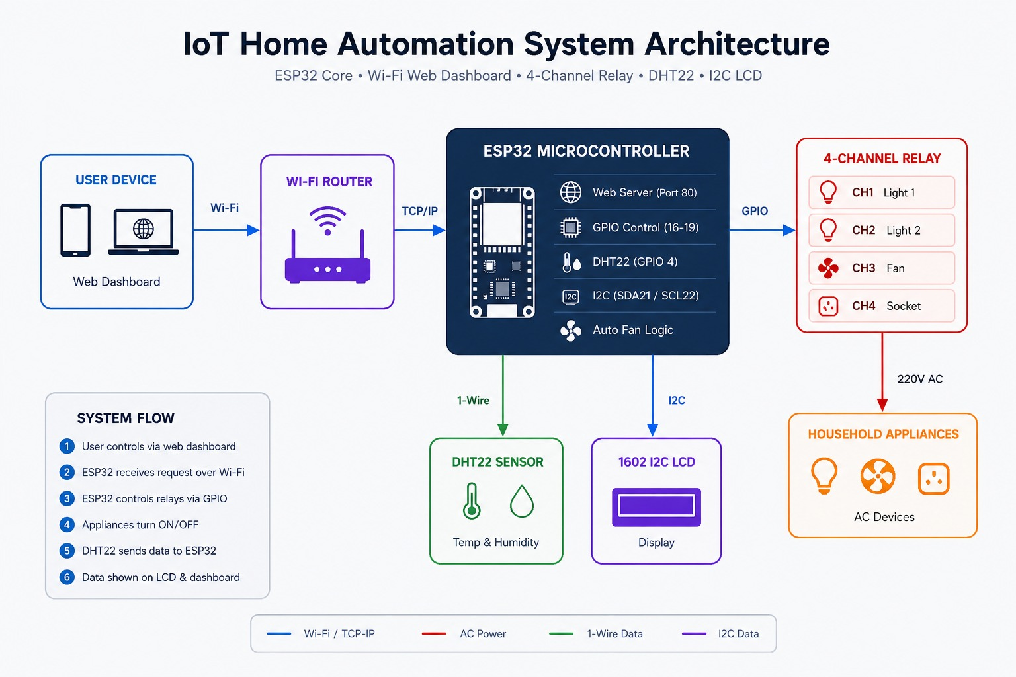
SYSTEM DESIGN
System Architecture
The ESP32 sits at the center, bridging the user's browser, the relay-controlled appliances, and the DHT22 sensor — all over the home Wi-Fi network, with no cloud involved.
IoT Based Home Automation System | Kathmandu University
6

Slide 7


METHODOLOGY
How It Works
1. Tap
2. Send
3. Process
4. Switch
User taps a control on the web dashboard
Command travels over home Wi-Fi as an HTTP request
ESP32 receives it and selects the right relay channel
Relay switches the appliance ON or OFF
In parallel: automatic fan control
The ESP32 continuously polls the DHT22 sensor. Whenever temperature or humidity crosses the configured threshold, it automatically toggles the fan relay and updates the dashboard — independent of any manual command.
IoT Based Home Automation System | Kathmandu University
7

Slide 8
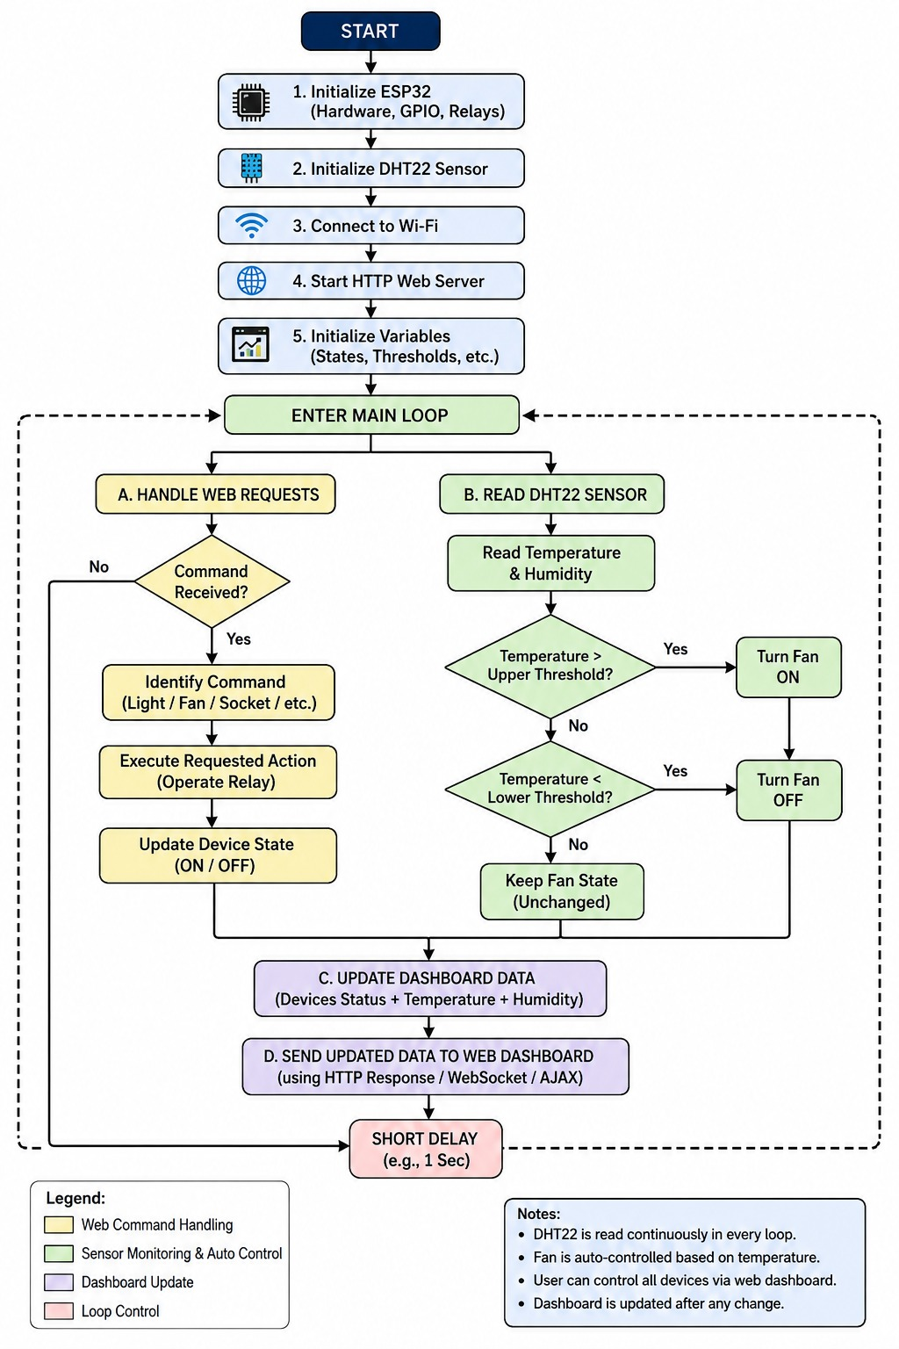
SYSTEM DESIGN
System Flow Diagram
IoT Based Home Automation System | Kathmandu University
8

Slide 9
BUILD PROCESS
Methodology & Implementation Steps
1
2
3
4
5
Requirements
Analysis
Hardware
Selection
Circuit
Design
Web Server
Firmware
GPIO & Relay
Firmware
6
7
8
9
10
Sensor
Integration
Dashboard
UI (HTML/CSS)
Integration &
End-to-End Test
Debugging &
Optimization
Voice Module
(Future Phase)
Firmware developed in Embedded C/C++ using the Arduino core for ESP32; each phase was verified before moving to the next, catching issues such as GPIO mapping errors and Wi-Fi reconnect bugs early.
IoT Based Home Automation System | Kathmandu University
9

Slide 10
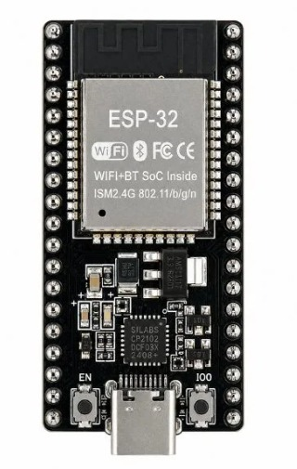
COMPONENTS
Key Hardware & Software Components
HARDWARE
ESP32 Dev Board
Dual-core 240 MHz, Wi-Fi + Bluetooth, main controller
4-Channel Relay Module
5V coil, 10A/250V AC per channel
DHT22 Sensor
±0.5°C temp, ±2-5% RH, single-wire digital
I2C LCD (16×2)
Displays live Wi-Fi & status locally
5V/2A Power Supply
Powers ESP32 and relay module
Breadboard & Jumper Wires
Prototyping connections
IoT Based Home Automation System | Kathmandu University
10

Slide 11
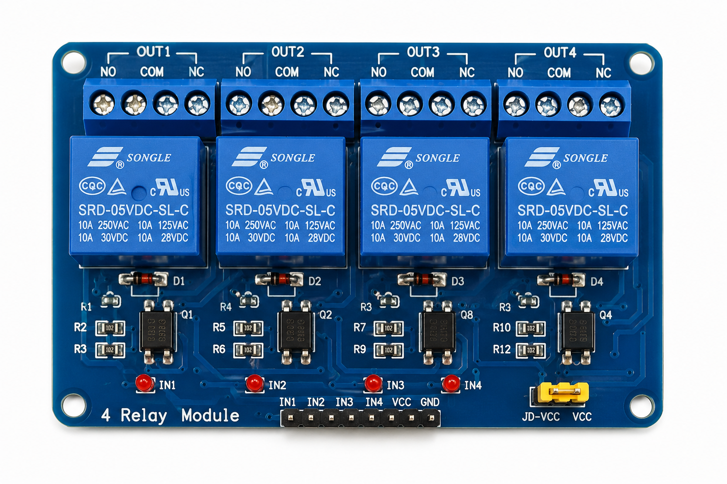
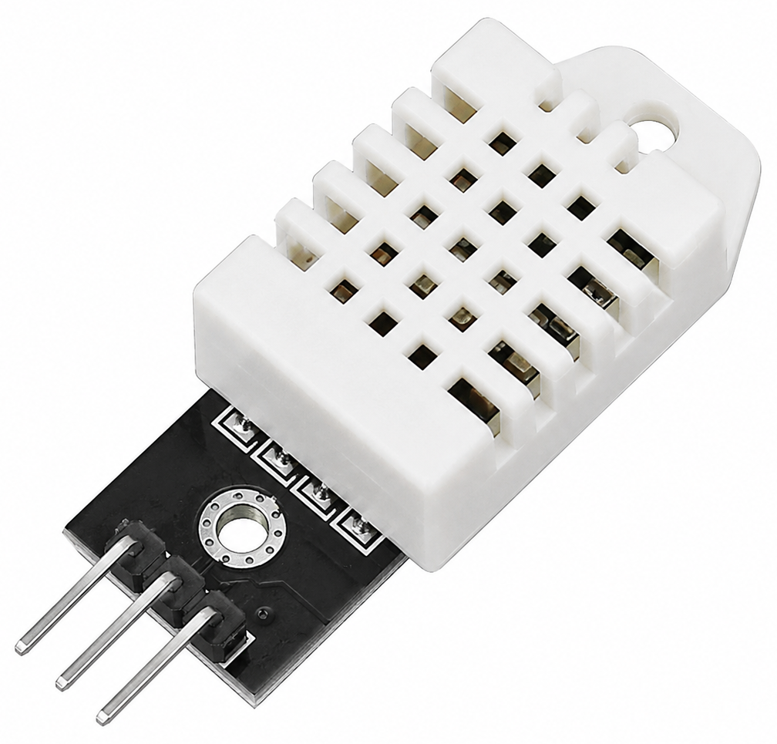
4-Channel Relay Module
DHT22 Sensor
IoT Based Home Automation System | Kathmandu University
11

Slide 12
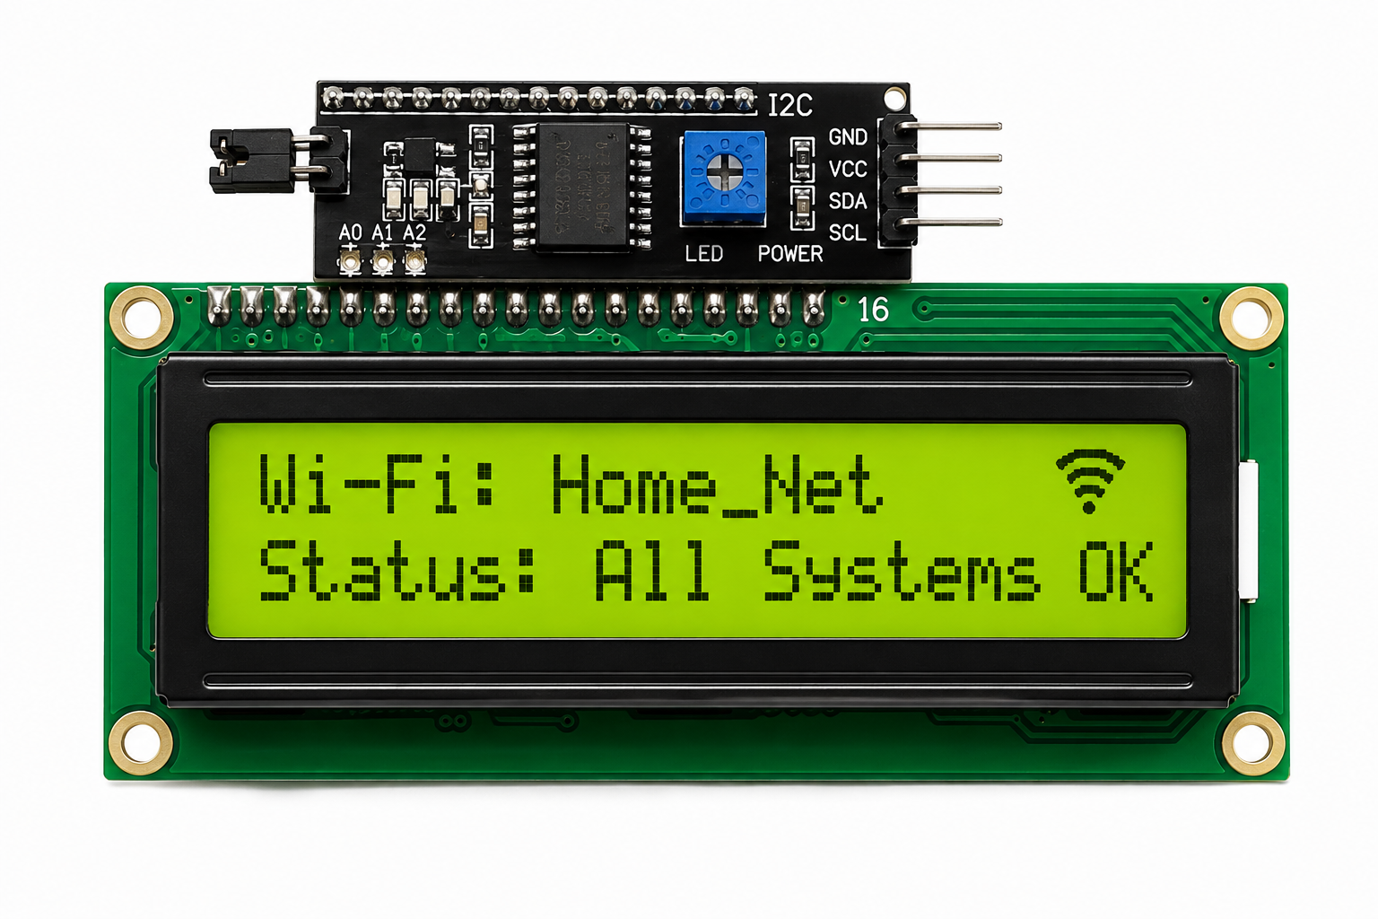
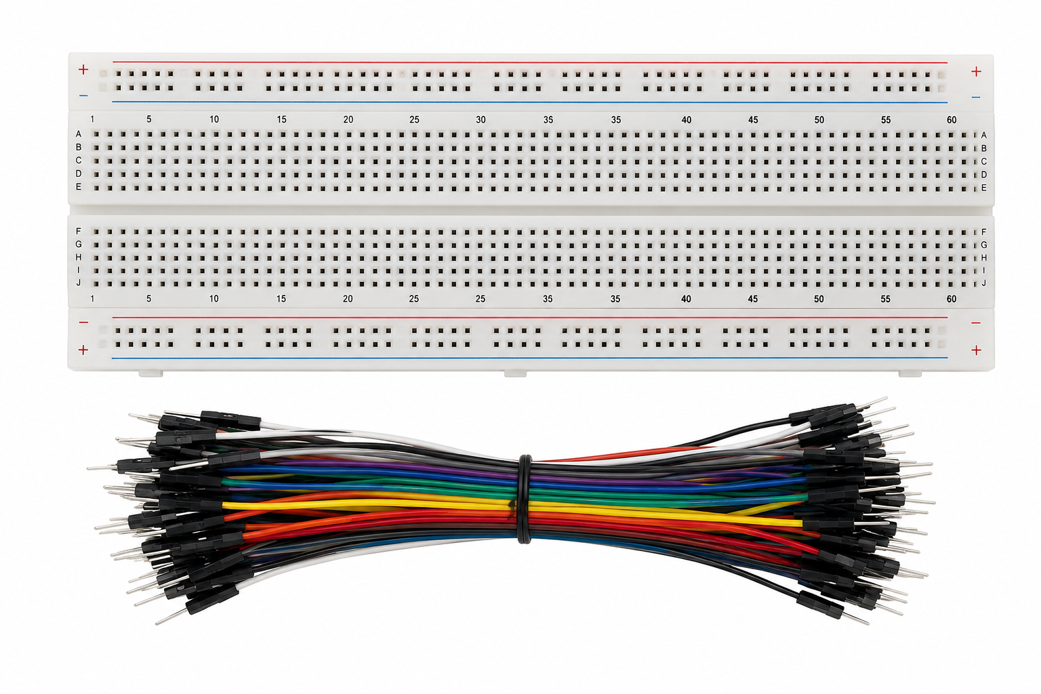
I2C LCD (16×2)
Breadboard & Jumper Wires
✓
✓
✓
IoT Based Home Automation System | Kathmandu University
12

Slide 13
SOFTWARE & TOOLS
Arduino Core for ESP32 (C/C++)
Wi-Fi, web server, GPIO, sensor firmware
HTML5 + CSS3
Dashboard structure & styling, served by ESP32
WebServer Library
Routes HTTP requests to relay/sensor handlers
Adafruit DHT Sensor Library
Reads DHT22 & drives auto-fan logic
Arduino IDE
Build, flash & serial debug
IoT Based Home Automation System | Kathmandu University
13

Slide 14
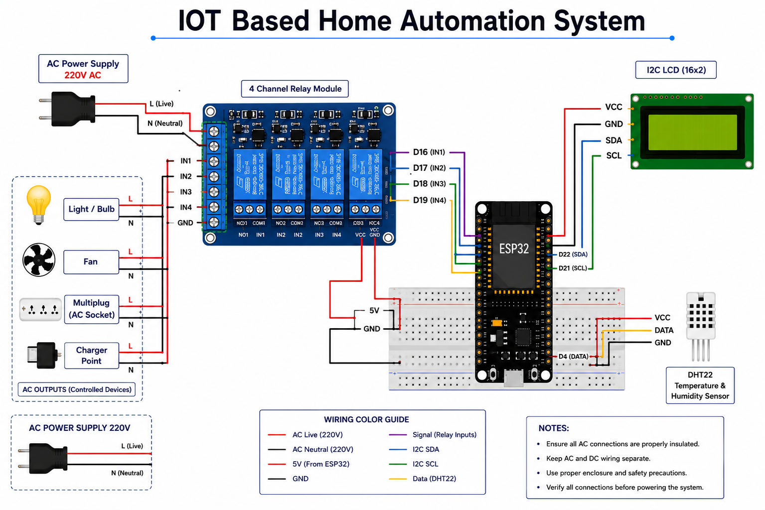
TECHNICAL DESIGN
Circuit Schematic & Wiring Diagram
Signal | ESP32 Pin | Drives
Relay IN1–IN4 | D16, D17, D18, D19 | Light 1/2, Fan, Socket
DHT22 Data | GPIO 4 (D4) | Temp & humidity sensor
I2C SDA / SCL | Dedicated I2C pins | 16×2 LCD status display
IoT Based Home Automation System | Kathmandu University
14

Slide 15
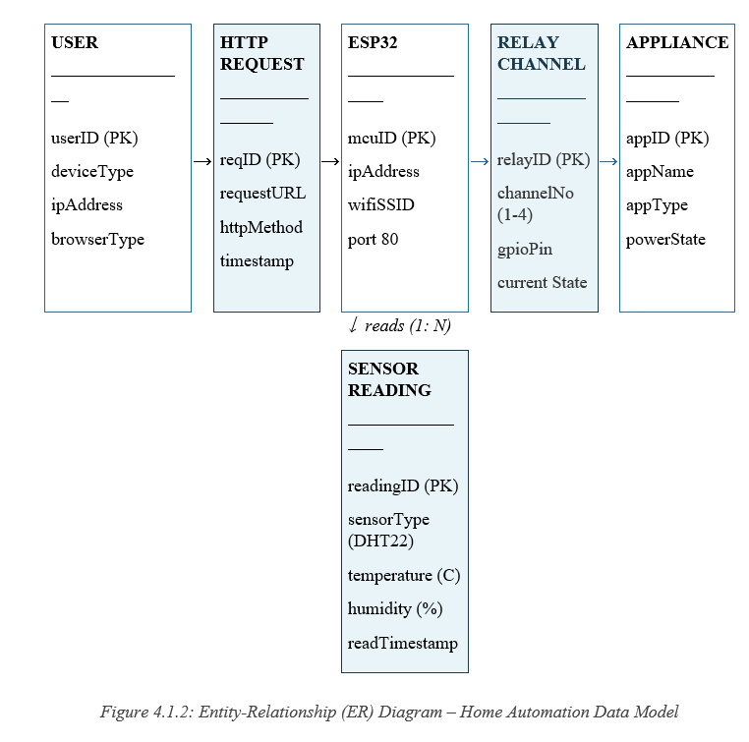
SYSTEM DESIGN
Data Model
Six entities model how a request flows from the user through the ESP32 to the relays, appliances, and sensor readings.
IoT Based Home Automation System | Kathmandu University
15

Slide 16
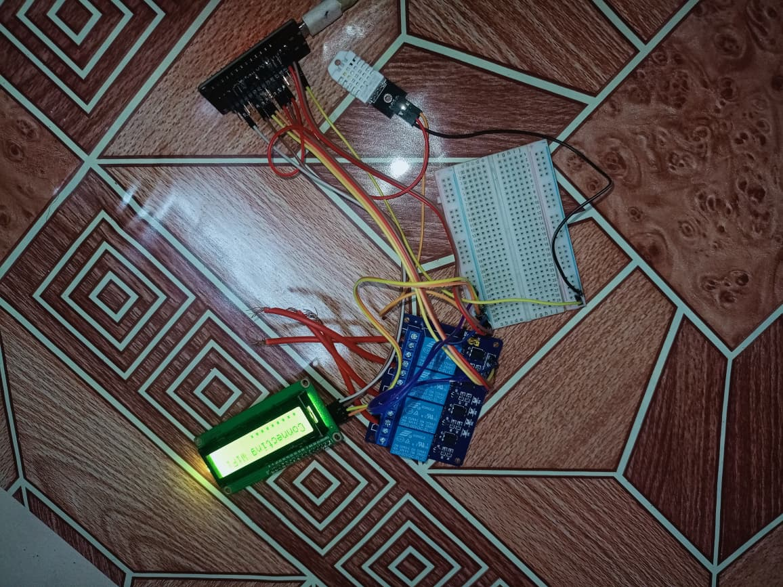
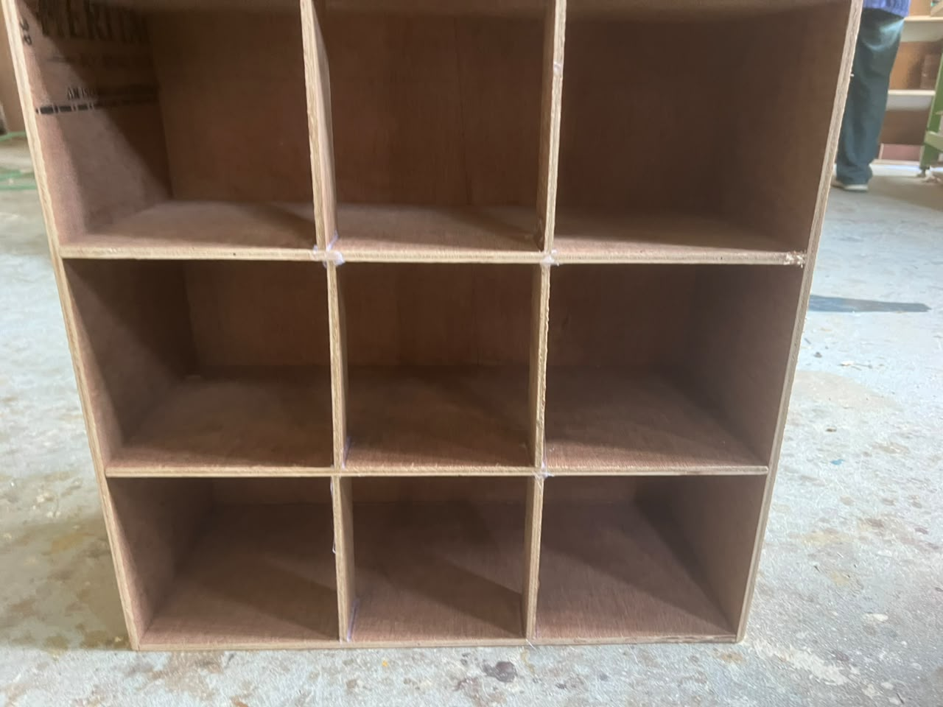
IMPLEMENTATION
Prototype Build
Running breadboard prototype
Wooden enclosure (wood + paint work)
ESP32, 4-channel relay, DHT22 and LCD status display, all wired and powering up.
Compartmentalized plywood frame keeping mains wiring isolated from low-voltage electronics.
IoT Based Home Automation System | Kathmandu University
16

Slide 17
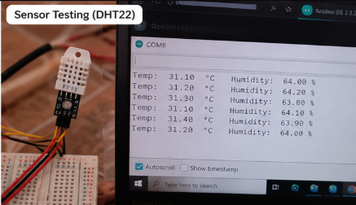
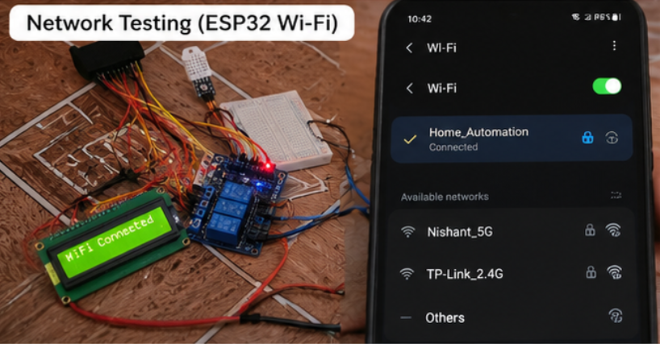
VALIDATION
Testing, Verification & Results
Sensor Testing DHT22
Network Testing Wi-Fi
✓
IoT Based Home Automation System | Kathmandu University
17

Slide 18
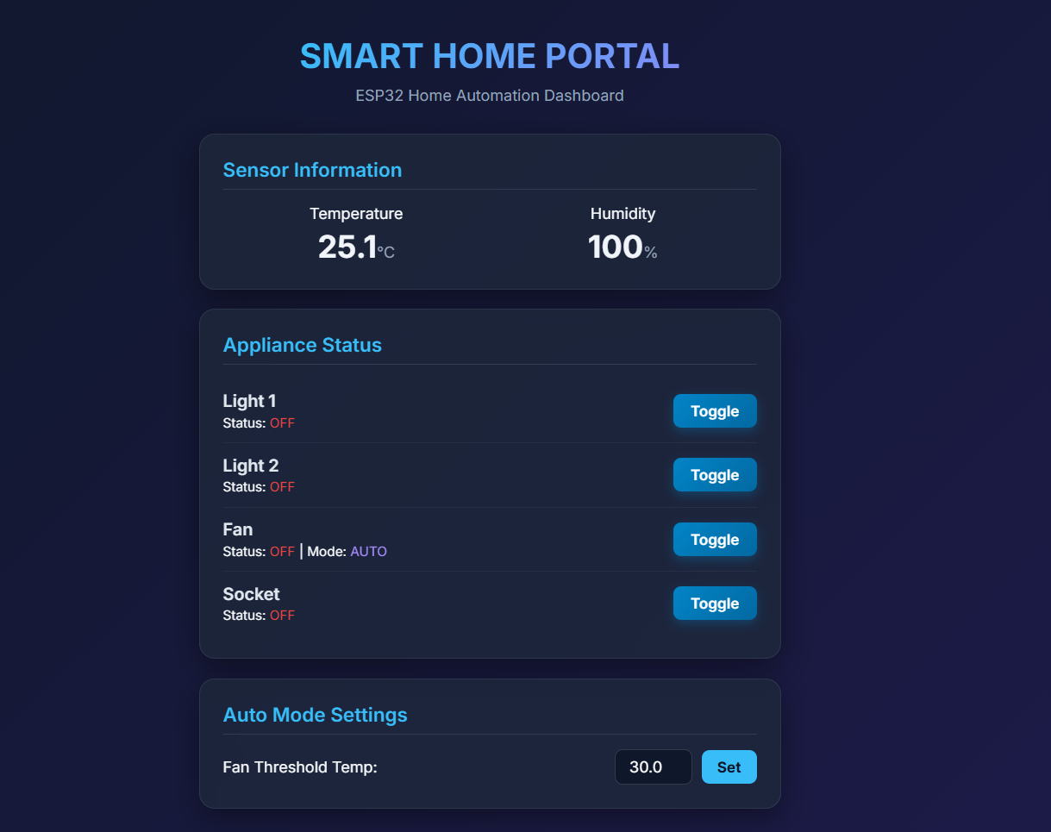
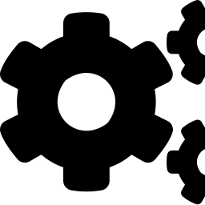
SYSTEM DESIGN
Web Dashboard Interface
Live sensor readout
Real-time temperature and humidity from the DHT22
Per-appliance toggle
Manual ON/OFF control for all 4 relay channels
Auto-mode threshold
User-configurable temperature setpoint for the fan
No app, no cloud
Served directly by the ESP32 over the home Wi-Fi network
IoT Based Home Automation System | Kathmandu University
18

Slide 19
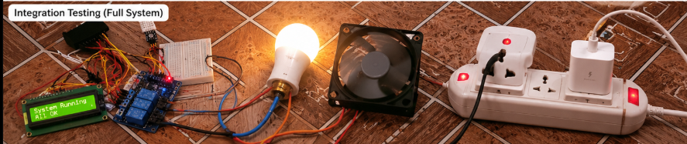
Integration Testing
Full System
Light, fan & socket run together, with the dashboard reflecting state in real time.
IoT Based Home Automation System | Kathmandu University
19

Slide 20
RESULTS
What the Prototype Delivers
4
±0.5°C
0
5
Appliances
Sensor accuracy
Cloud services
Test stages
controlled independently via relay channels
DHT22 temperature reading precision
fully self-hosted on the ESP32
unit, sensor, network, dashboard, integration
Testing confirmed that relay switching, sensor readings, Wi-Fi connectivity, and the dashboard all function reliably together — meeting every objective set out in Chapter 1 of the report.
IoT Based Home Automation System | Kathmandu University
20

Slide 21



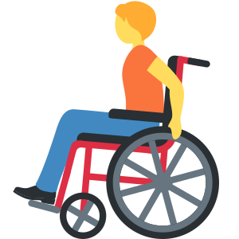


IMPACT
Real-World Applications & Target Audience
Designed for everyday people and real-life spaces.
1
Residential Smart Homes
2
Rental Apartments
3
Elderly & Senior Citizens
Makes daily life easier by allowing remote control of lights, fans, and other appliances from a phone or computer.
Perfect for rented spaces—no permanent wiring changes needed. Just plug, set up, and control.
Allows appliances to be controlled easily without reaching wall switches, promoting safety and independence.
4
People with Disabilities
5
Students & Hobbyists
6
Small Offices & Labs
Enables greater independence by providing easy remote control of home appliances from any accessible device.
An affordable and open platform to learn, explore, and build IoT and embedded systems.
Helps automate and control appliances from one place, improving convenience & saving energy.
IoT Based Home Automation System | Kathmandu University
21

Slide 22


HONEST ASSESSMENT
Limitations
Wi-Fi dependent
No external/cloud access
Remote/manual control is unavailable if the home wifi network goes down
Cannot be controlled from outside the local Wi-Fi network (e.g. mobile data)
Fixed threshold logic
Relay power rating
Uses a fixed temperature threshold only.
Rated for 10A/250V AC per channel — not suitable for higher-power appliances
Voice module not yet integrated
Breadboard-only validation
INMP441/MAX98357A wiring has started but isn't in the working prototype
Not yet evaluated for long-term Reliability
Not ready for Permanent Installation
IoT Based Home Automation System | Kathmandu University
22

Slide 23
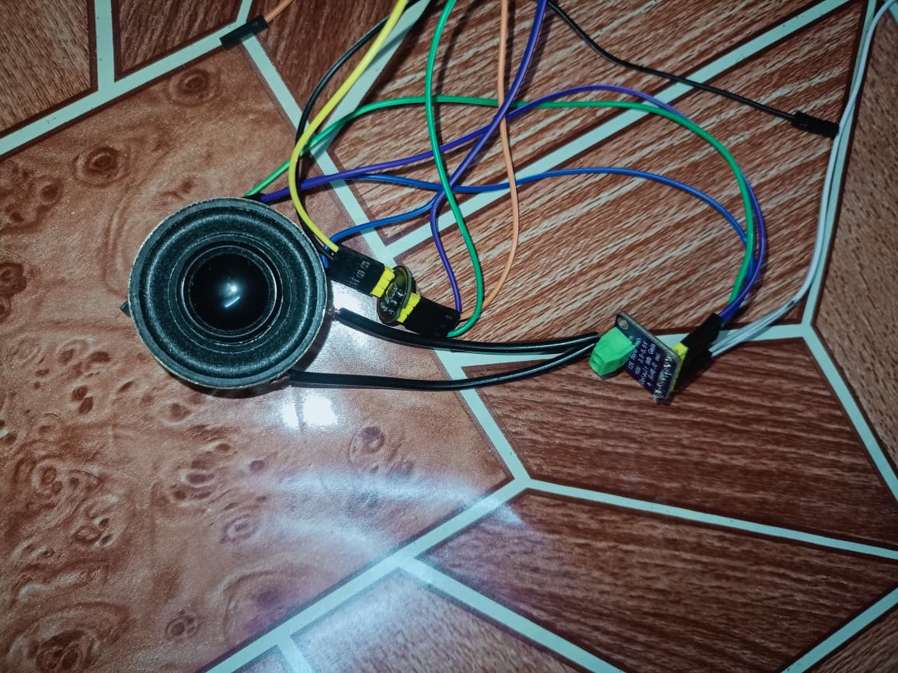
ROADMAP
Future Work & Upgrades
1
Voice Feedback Module
2
Cloud & Remote Access
Uses an INMP441 microphone and MAX98357A amplifier to give voice announcements (e.g., "Fan turned on").
Control the system from anywhere using the Internet.
4
3
Smart Scheduling
4
Dedicated Mobile App
Set automatic ON/OFF schedules for appliances
Schedule appliances to operate automatically at specific times.
Develop an Android/iOS(Smart Phones) app for easier control and monitoring.
5
6
IoT Based Home Automation System | Kathmandu University
23

Slide 24

LIVE DEMONSTRATION
Prototype Walkthrough
Toggling appliances from the dashboard, live sensor readings, and automatic fan control — demonstrated on the physical prototype
IoT Based Home Automation System | Kathmandu University
24

Slide 25
CONCLUSION
A Self-Hosted, Affordable Path to a Smart Home
This project set out to design and build a self-hosted, affordable home automation system around the ESP32, and the working breadboard prototype demonstrates that goal has been met. Four appliances can be controlled remotely through a custom web dashboard, a DHT22 sensor automatically manages a fan based on real environmental readings, and none of it depends on a third-party cloud service or mobile app.
All 4 objectives from Chapter 1 met and validated through testing
Fully self-hosted — no cloud dependency, no vendor lock-in
Voice-feedback module already underway as the next enhancement
IoT Based Home Automation System | Kathmandu University
25

Slide 26
Thank You
Questions & Discussion
PROJECT TEAM
Nishant Sah • Sandesh Shrestha • Dipra Shrestha • Samin Tharu • Grishma Thapa
Kathmandu University, Department of Computer Science and Engineering |
IoT Based Home Automation System — ENGG 102 Project Defense
IoT Based Home Automation System | Kathmandu University
26

Slide 27

Questions & Discussion
IoT Based Home Automation System | Kathmandu University
27

