Slide 1








KATHMANDU UNIVERSITY
Wi-Fi Link
Department of Computer Science and Engineering • Dhulikhel, Kavre
Web Dashboard
IoT Based
Home Automation System
Built with an ESP32 microcontroller and a self-hosted web dashboard
Working Prototype
PROJECT TEAM
Smart Lighting
Auto Fan Control
Nishant Sah
041125-25
Dipra Shrestha
041136-25
Sandesh Shrestha
041141-25
Samin Tharu
041155-25
Grishma Thapa
038007-24
SUBMITTED TO Mr. Santosh Shaha
Relay Switching
Code: ENGG 102 | Year I / Sem II • July 27, 2026
DHT22 Sensor

Slide 2






AGENDA
What We'll Cover
Problem & Objectives
System Design
The gap in traditional home switches and what we set out to build
Architecture, data model, and how a command flows through the system
Hardware & Software
Prototype & Testing
Components used and the firmware/dashboard stack
Breadboard build, enclosure, and validation across 5 test stages
Results & Limitations
Future Work & Conclusion
What works today, and what the system can't do yet
Voice feedback module and where this goes next
IoT Based Home Automation System
2

Slide 3
01 INTRODUCTION
Introduction & Problem Statement
Why This Project
THE PROBLEM
The rapid growth of IoT has transformed how we interact with everyday living spaces.
Low-cost boards like the ESP32 combine Wi-Fi + Bluetooth, making DIY home automation more accessible than ever.
Many homes still use traditional manual switches.
Manual systems cannot be controlled remotely or automatically.
Most commercial smart-home systems are expensive and vendor-locked.
1
No Remote Control
Traditional switches cannot be operated from a phone or PC. Or remotely.
2
Vendor Lock-In
Closed hardware and application software is used by most commercial systems.
3
High Cost
The cost of commercial smart home systems is high for many families.
4
No Climate Response
Fans and household appliances do not react automatically to temperature or humidity.
IoT Based Home Automation System | Kathmandu University
2

Slide 4
02 RELATED WORK
Literature Review
How this project's approach compares with recent ESP32-based home automation research.
System | Control Method | Sensor-Driven Automation | Cloud / 3rd-Party Dependency
Anusha et al. (2024) | Relay module, Wi-Fi | Yes — sensor monitoring | No
Kakani et al. (2024) | Blynk mobile app | No | Yes — Blynk cloud + account
This Project | Self-hosted ESP32 web dashboard | Yes — DHT22 auto fan control | No — fully local network
Gap Identified
Existing work either depends on a third-party app/cloud for control, or offers a self-hosted dashboard with only basic on/off switching. Very few projects combine a self-hosted dashboard, sensor-driven automation, and planned voice feedback in one low-cost prototype — the gap this project addresses.
IoT Based Home Automation System | Kathmandu University
3

Slide 5
03 GOALS
Project Objectives
1
Design a Smart Core
2
Control Appliances Remotely
Design a Smart Home Automation System Using ESP32.
Control various appliances using 4-channels relay using a web interface.
3
Automate Climate Response
4
Enable Remote Monitoring
Control a fan according to temperature and humidity using DHT22 sensor automatically.
Control all relays remotely using a web interface hosted by the ESP32.
IoT Based Home Automation System | Kathmandu University
4

Slide 6
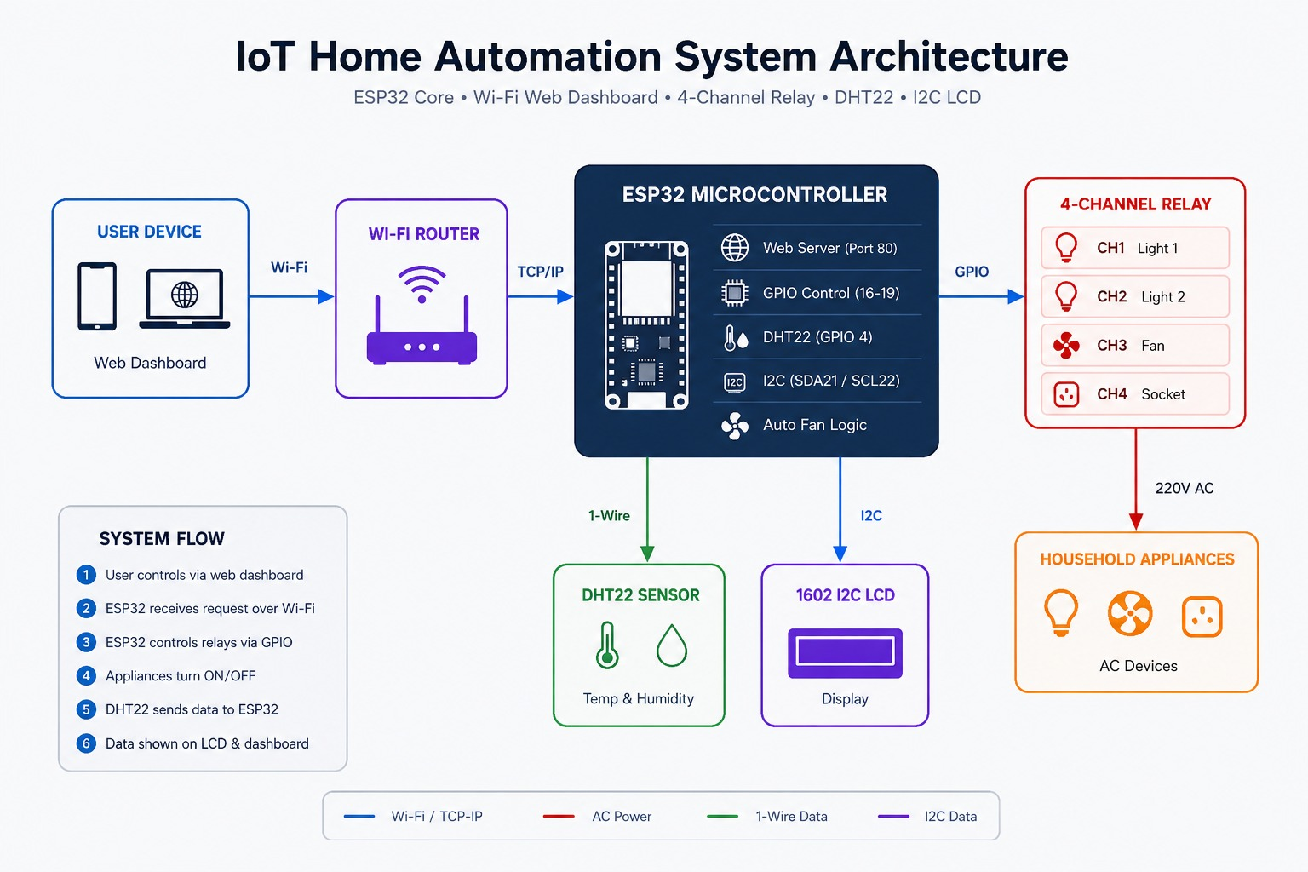
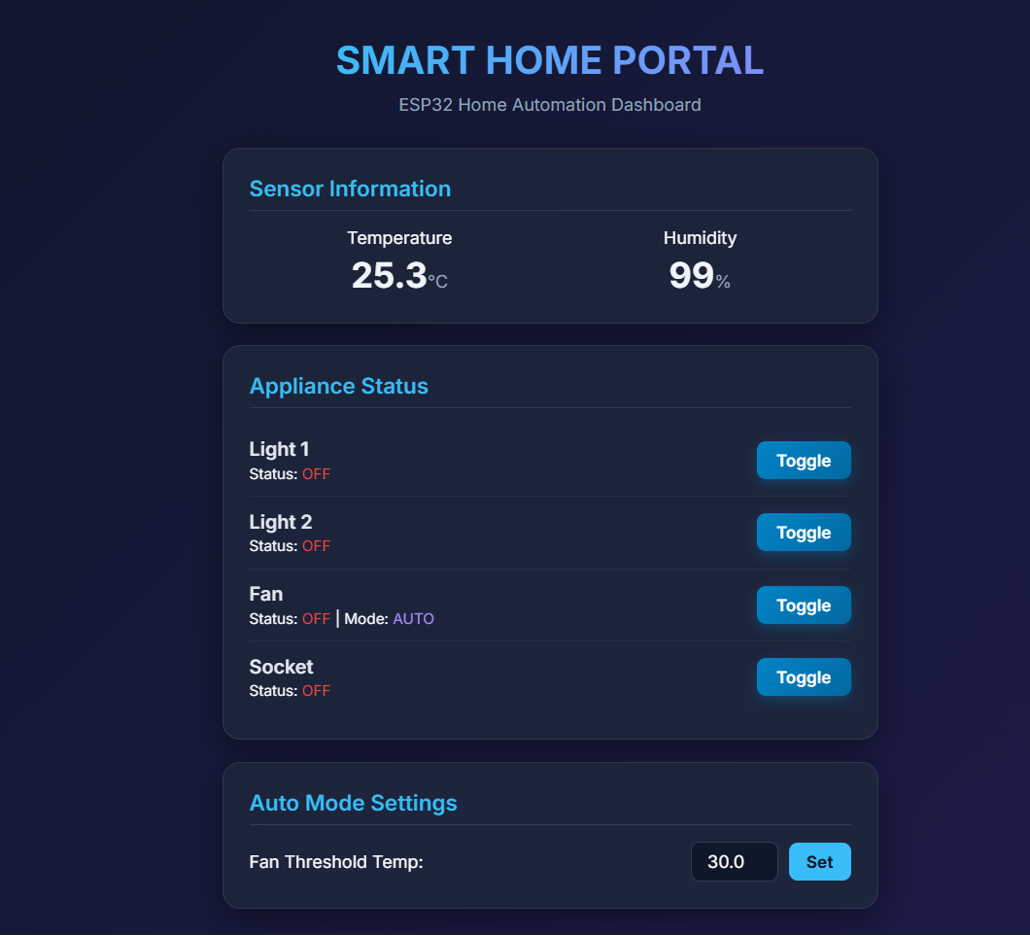
04 ARCHITECTURE
System Architecture
IoT Based Home Automation System | Kathmandu University
5

Slide 7
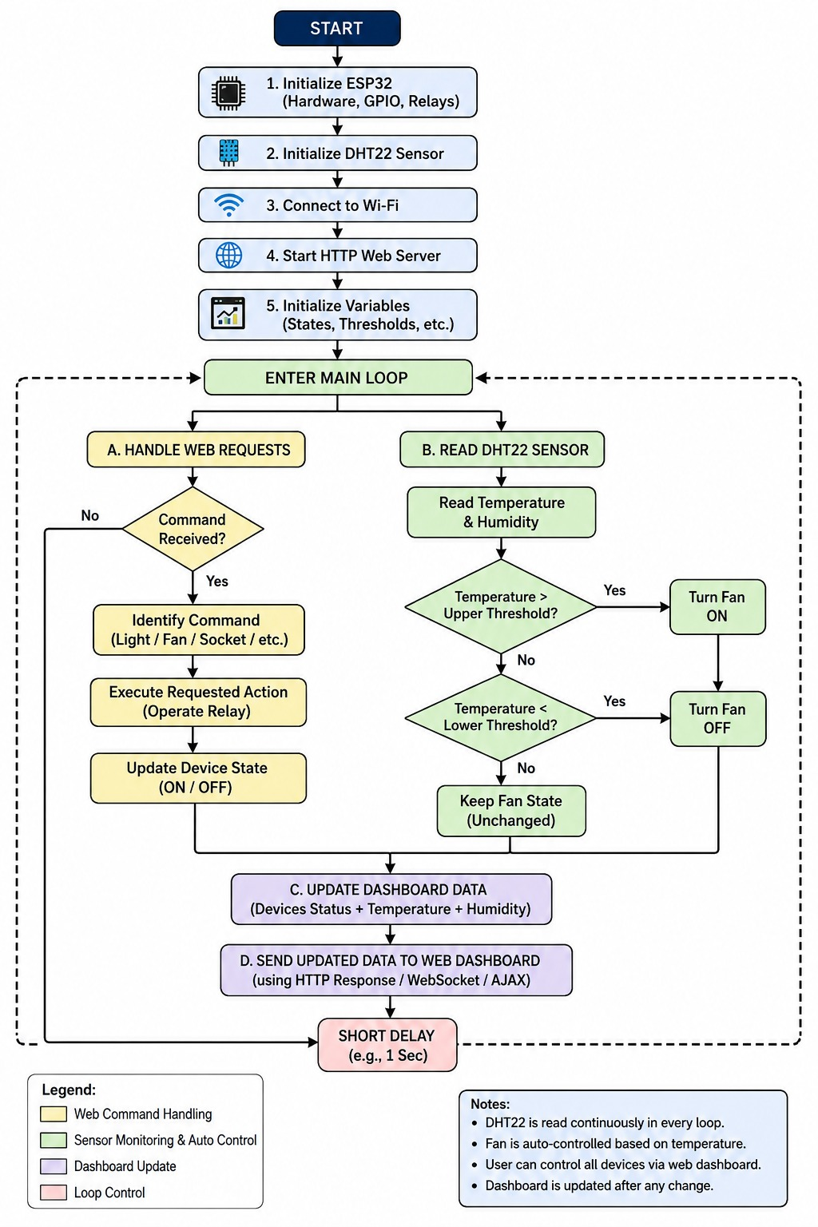
SYSTEM DESIGN
System Flow Diagram
IoT Based Home Automation System
8

Slide 8
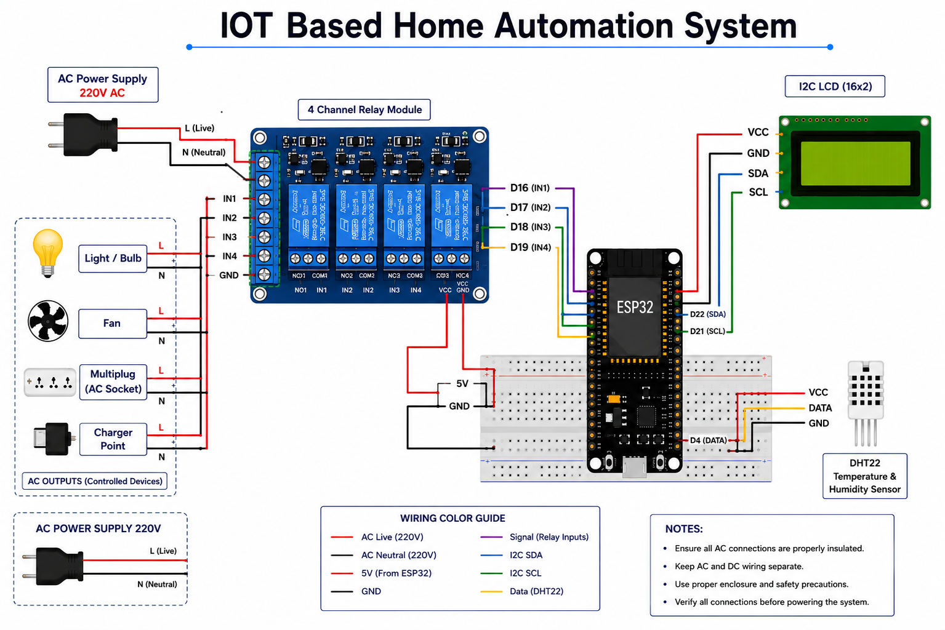
05 TECHNICAL DESIGN
Circuit Schematic & Wiring Diagram
Signal | ESP32 Pin | Drives
Relay IN1–IN4 | D16, D17, D18, D19 | Light 1/2, Fan, Socket
DHT22 Data | GPIO 4 (D4) | Temp & humidity sensor
I2C SDA / SCL | Dedicated I2C pins | 16×2 LCD status display
WIRING & SAFETY NOTES
AC live/neutral wiring kept fully separate from low-voltage DC signal wiring.
5V/GND shared via breadboard power rails across ESP32, relay module & DHT22.
Relay rated 10A/250V AC per channel — fits standard household loads.
Enclosure physically isolates mains wiring from control electronics.
IoT Based Home Automation System | Kathmandu University
6

Slide 9
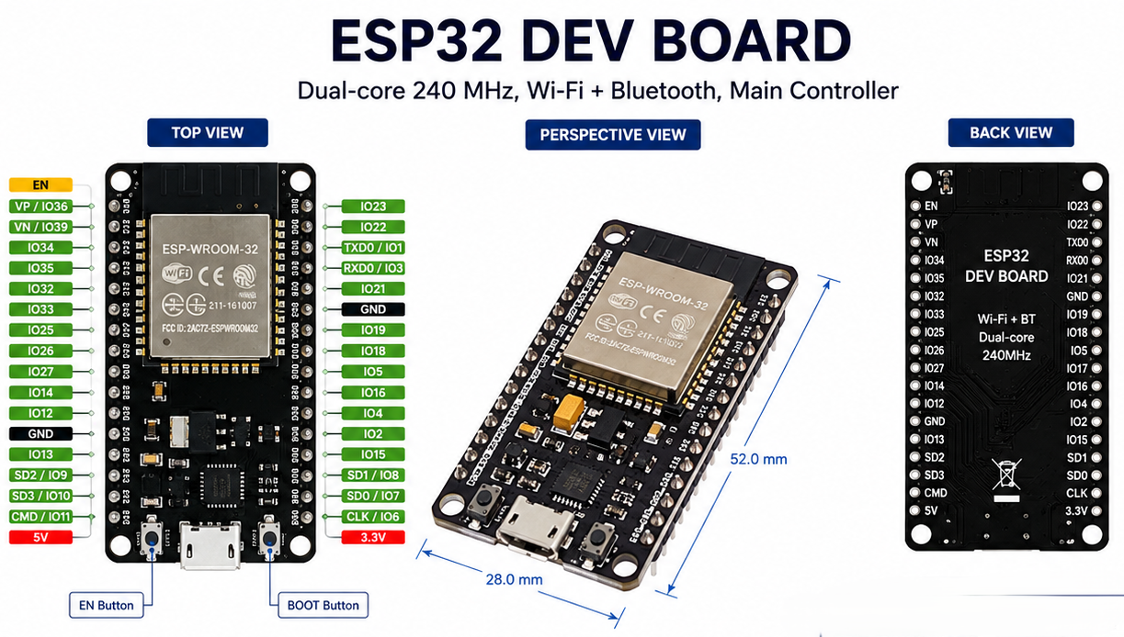
06 COMPONENTS
Key Hardware & Software Components
HARDWARE
ESP32 Dev Board
Dual-core 240 MHz, Wi-Fi + Bluetooth, main controller
4-Channel Relay Module
5V coil, 10A/250V AC per channel
DHT22 Sensor
±0.5°C temp, ±2-5% RH, single-wire digital
I2C LCD (16×2)
Displays live Wi-Fi & status locally
5V/2A Power Supply
Powers ESP32 and relay module
Breadboard & Jumper Wires
Prototyping connections
IoT Based Home Automation System | Kathmandu University
7

Slide 10
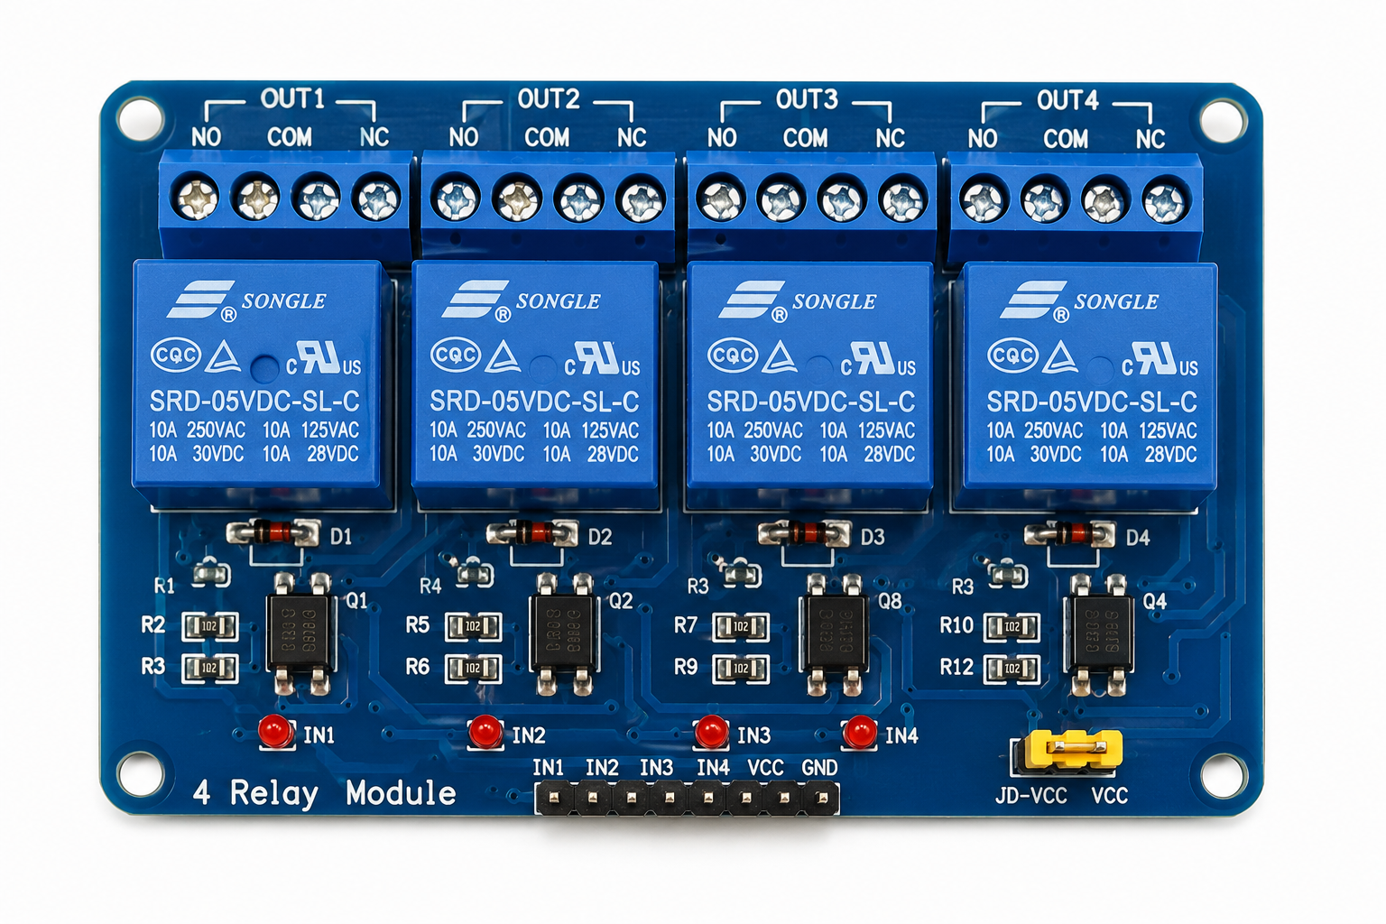
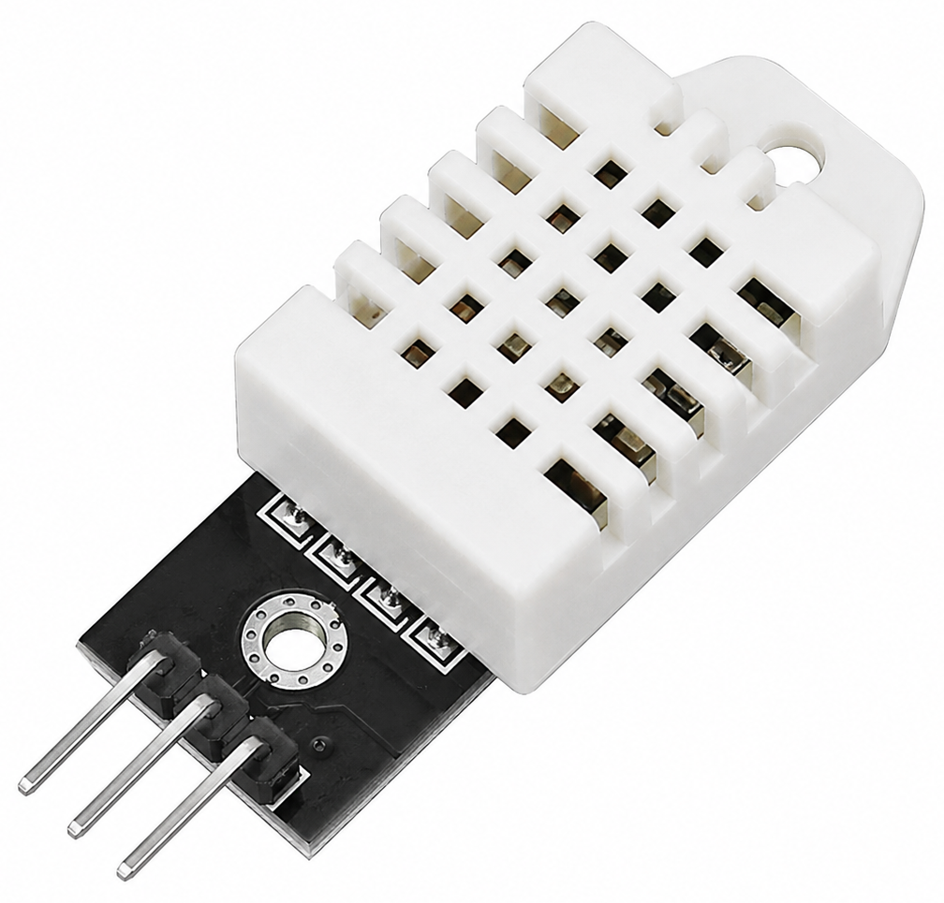
4-Channel Relay Module
DHT22 Sensor

Slide 11
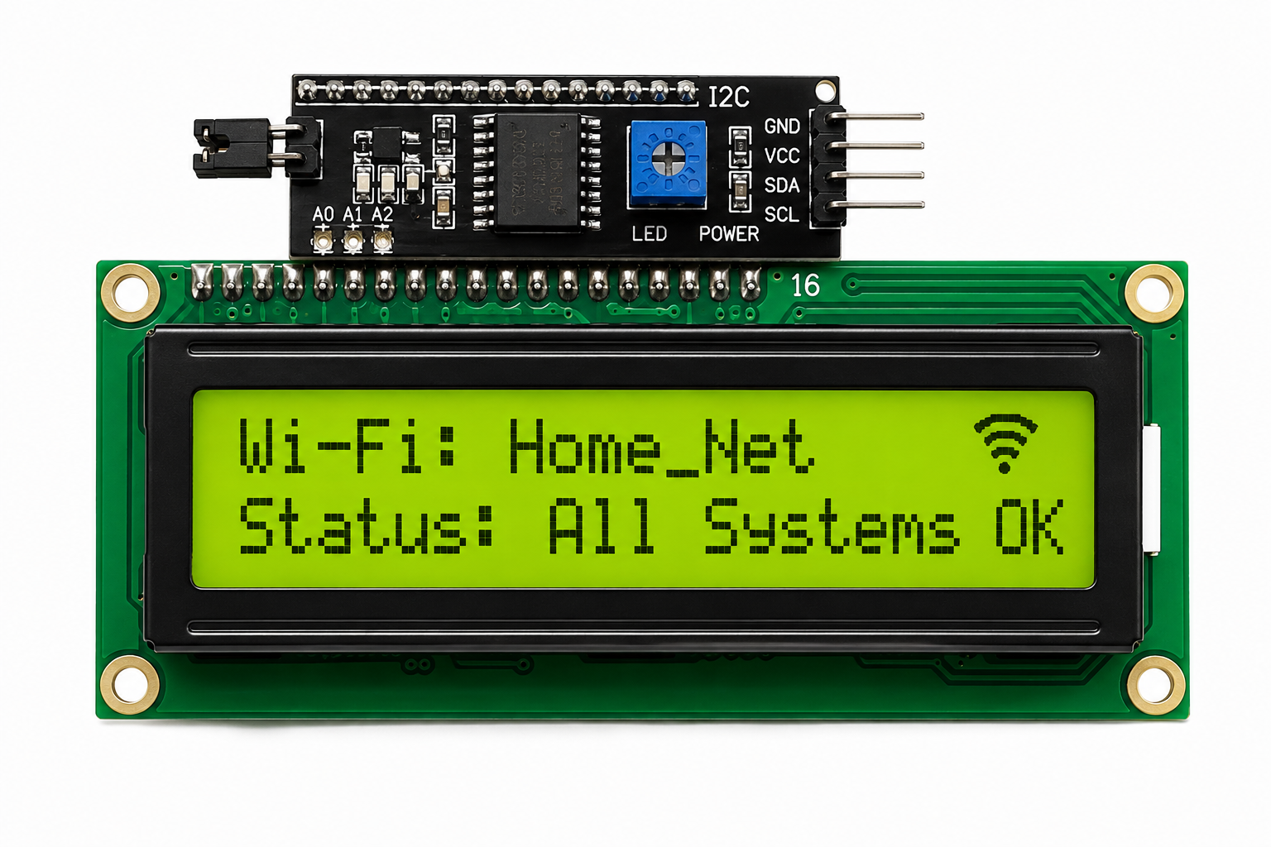
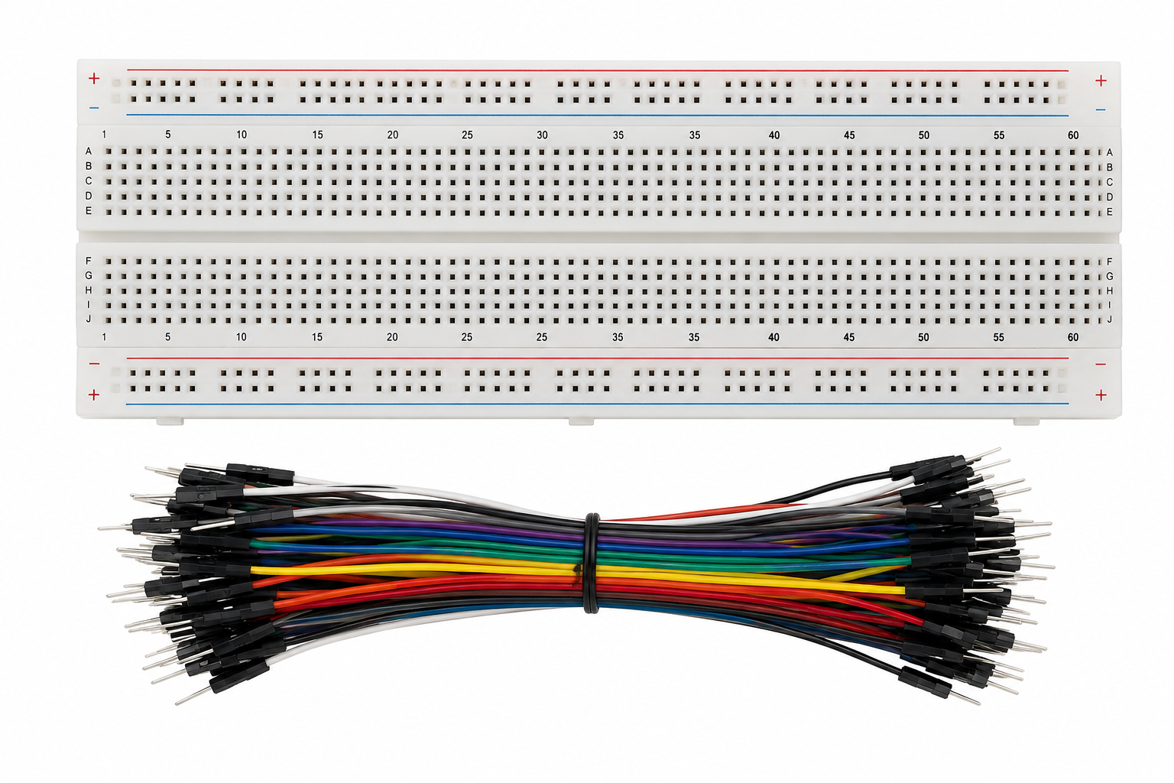
I2C LCD (16×2)
Breadboard & Jumper Wires
✓
✓
✓

Slide 12
SOFTWARE & TOOLS
Arduino Core for ESP32 (C/C++)
Wi-Fi, web server, GPIO, sensor firmware
HTML5 + CSS3
Dashboard structure & styling, served by ESP32
ESPAsyncWebServer Library
Routes HTTP requests to relay/sensor handlers
Adafruit DHT Sensor Library
Reads DHT22 & drives auto-fan logic
Xtensa GCC Toolchain
Cross-compiles firmware for ESP32
Arduino IDE / PlatformIO + esptool
Build, flash & serial debug

Slide 13
07 BUILD PROCESS
Methodology & Implementation Steps
1
2
3
4
5
Requirements
Analysis
Hardware
Selection
Circuit
Design
Web Server
Firmware
GPIO & Relay
Firmware
6
7
8
9
10
Sensor
Integration
Dashboard
UI (HTML/CSS)
Integration &
End-to-End Test
Debugging &
Optimization
Voice Module
(Future Phase)
Firmware developed in Embedded C/C++ using the Arduino core for ESP32; each phase was verified before moving to the next, catching issues such as GPIO mapping errors and Wi-Fi reconnect bugs early.
IoT Based Home Automation System | Kathmandu University
8

Slide 14
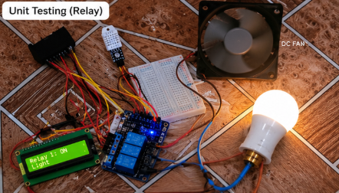
08 CAPABILITIES
Core Features & Functionalities
SMART HOME PORTAL — LIVE UI
1
Remote Appliance Control
Control 4 devices (light, fan, multiplug, and socket) from any browser using the same Wi-Fi network.
2
Automatic Fan Control
Monitor temperature and humidity with a DHT22 sensor and automate the fan’s operation.
3
Live Web Dashboard
View live data from the sensors, ON/OF status of the appliances, and change the temperature threshold in one web dashboard.
Actual ESP32-hosted dashboard: live temperature/humidity, per-appliance status, and auto-mode threshold control.
4
Fully Self-Hosted
Operate all the systems on the ESP32 without using any cloud services or external applications.
IoT Based Home Automation System | Kathmandu University
9

Slide 15
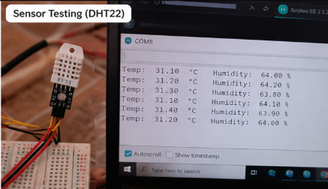
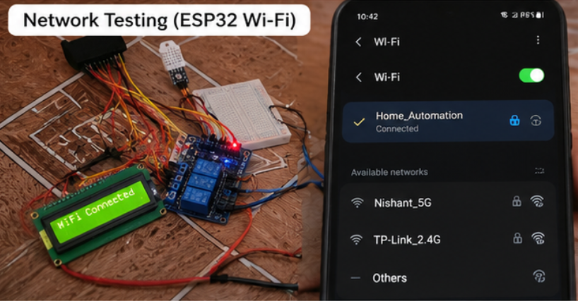
09 VALIDATION
Testing, Verification & Results
Sensor Testing DHT22
Network Testing Wi-Fi
✓
IoT Based Home Automation System | Kathmandu University
10

Slide 16
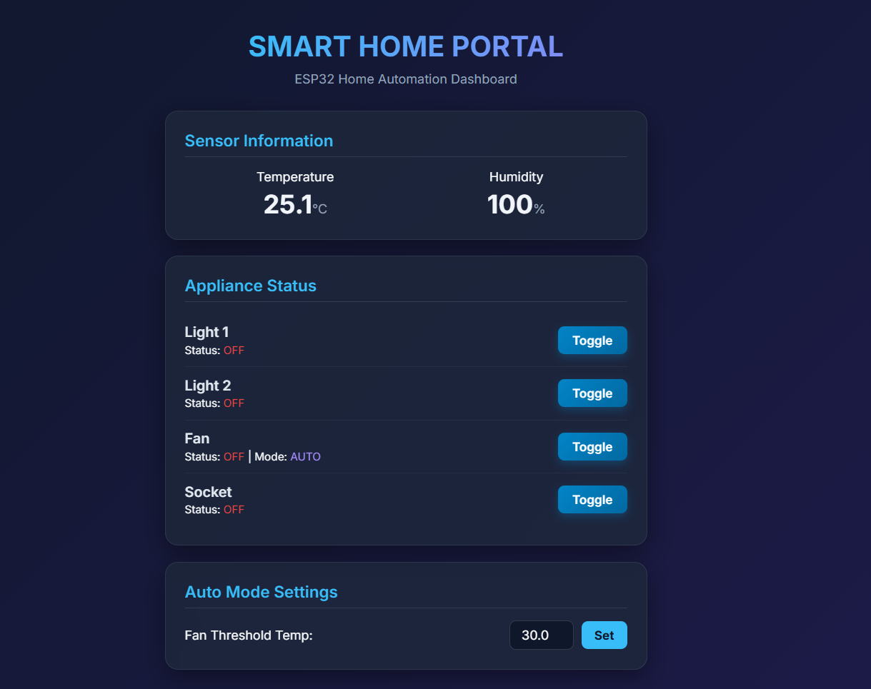
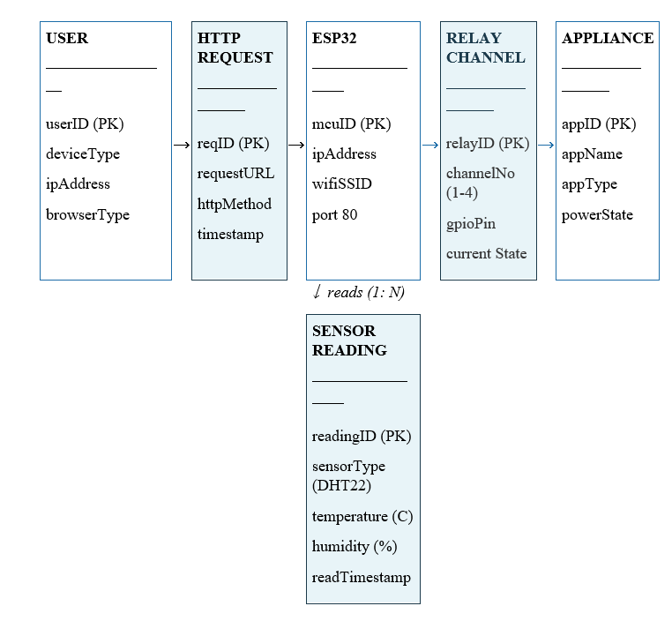
Dashboard Testing Web UI
Unit Testing Relay

Slide 17
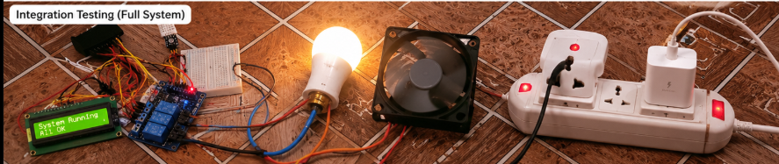
Integration Testing
Full System
Light, fan & socket run together, with the dashboard reflecting state in real time.

Slide 18
10 BUDGET
Cost Analysis & Bill of Materials
Component | Qty | Est. Unit Cost (USD) | Est. Subtotal (USD)
ESP32 Dev Board | 1 | $6 – 9 | ~$8
4-Channel Relay Module | 1 | $3 – 5 | ~$4
DHT22 Temp/Humidity Sensor | 1 | $4 – 8 | ~$6
I2C LCD Display (16×2) | 1 | $3 – 5 | ~$4
5V/2A Power Supply | 1 | $3 – 5 | ~$4
Breadboard, Jumper Wires, Misc. | 1 set | $4 – 6 | ~$5
Enclosure (Plywood, Paint) | 1 | $5 – 8 | ~$6
Estimated Total | — | — | ~$37
BUDGET TAKEAWAY
~$35–40
for a fully working, self-hosted 4-appliance smart-home prototype
IoT Based Home Automation System | Kathmandu University
11

Slide 19
11 IMPACT
Real-World Applications & Target Audience
1
2
3
Residential Smart Homes
Rental Apartments
Elderly & Accessibility
Everyday households upgrading manual switches to remote, app-free control.
Non-invasive setup that plugs into existing wiring without permanent modification.
Lets appliances be operated without reaching a wall switch, aiding mobility-limited users.
4
5
6
Students & Hobbyists
Small Offices & Labs
Energy-Conscious Users
An affordable, open, and fully customizable platform for learning embedded IoT development.
Automated climate response and centralized appliance control for shared spaces.
Automatic fan control based on real conditions helps avoid unnecessary appliance runtime.
IoT Based Home Automation System | Kathmandu University
12

Slide 20
12 HONEST ASSESSMENT
System Limitations
Fully dependent on the home Wi-Fi network — if it goes down, remote/manual control from a browser is unavailable.
!
No cloud integration yet, so the system cannot be controlled or monitored from outside the local network (e.g., mobile data).
!
Automatic fan control uses a single fixed hysteresis threshold, not a configurable schedule or multi-zone logic.
!
Relay module is rated for 10A/250V AC per channel — not suited to higher-power appliances without extra hardware.
!
The voice-feedback module (INMP441/MAX98357A) is a planned enhancement, not yet integrated into the working prototype.
!
Tested on a breadboard prototype only; long-term reliability in a permanent installation has not yet been evaluated.
!
IoT Based Home Automation System | Kathmandu University
13

Slide 21
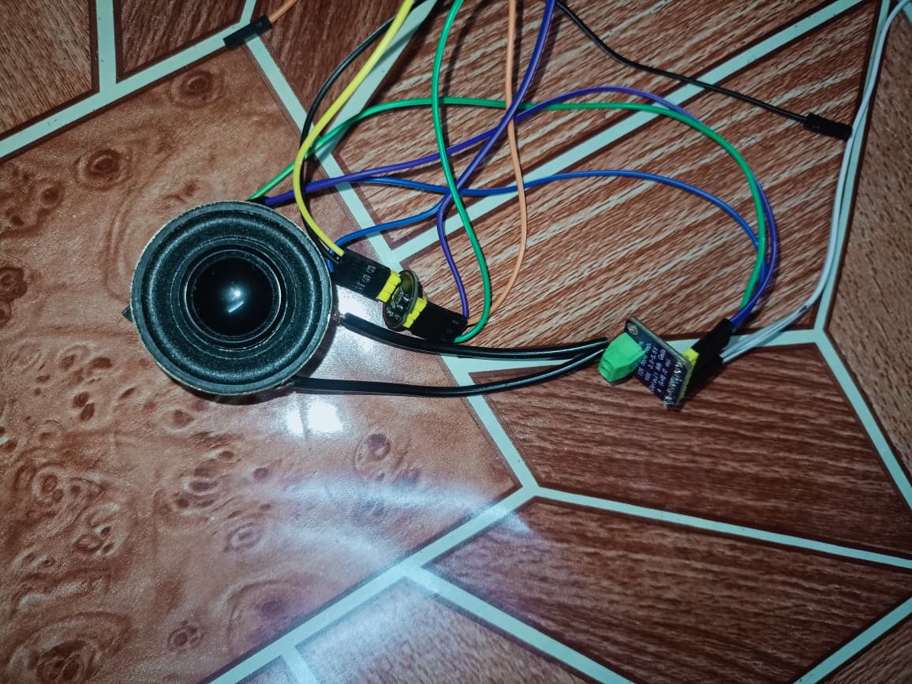
13 ROADMAP
Future Work & Upgrades
1
Voice Feedback Module
2
Cloud & Remote Access
INMP441 MEMS microphone + MAX98357A I2S amplifier to announce status changes aloud (e.g. "Fan turned on"). Early wiring already underway.
Extend beyond the local network so the dashboard can be reached securely over mobile data.
3
Configurable Scheduling
4
Companion Mobile App
Replace the single fixed threshold with a configurable schedule and multi-zone automation logic.
A native or PWA mobile experience layered on top of the existing self-hosted web dashboard.
5
Energy Monitoring
6
Higher-Power Load Support
Add current-sensing to track and report per-appliance power consumption over time.
Additional hardware (contactors/SSRs) to safely extend control to higher-power appliances.
IoT Based Home Automation System | Kathmandu University
14

Slide 22
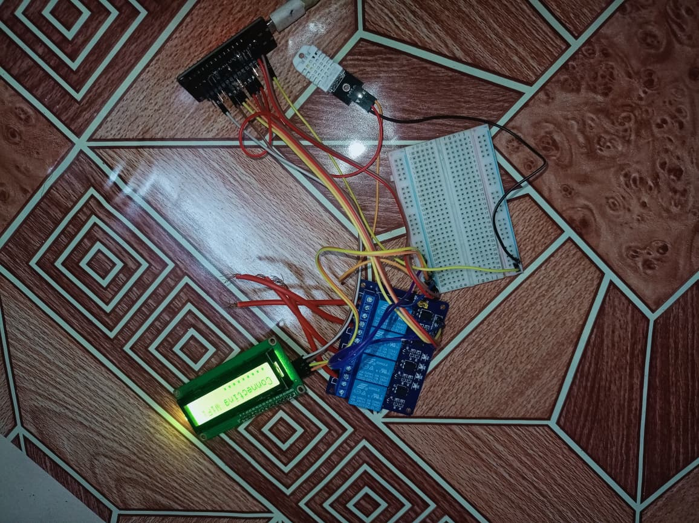
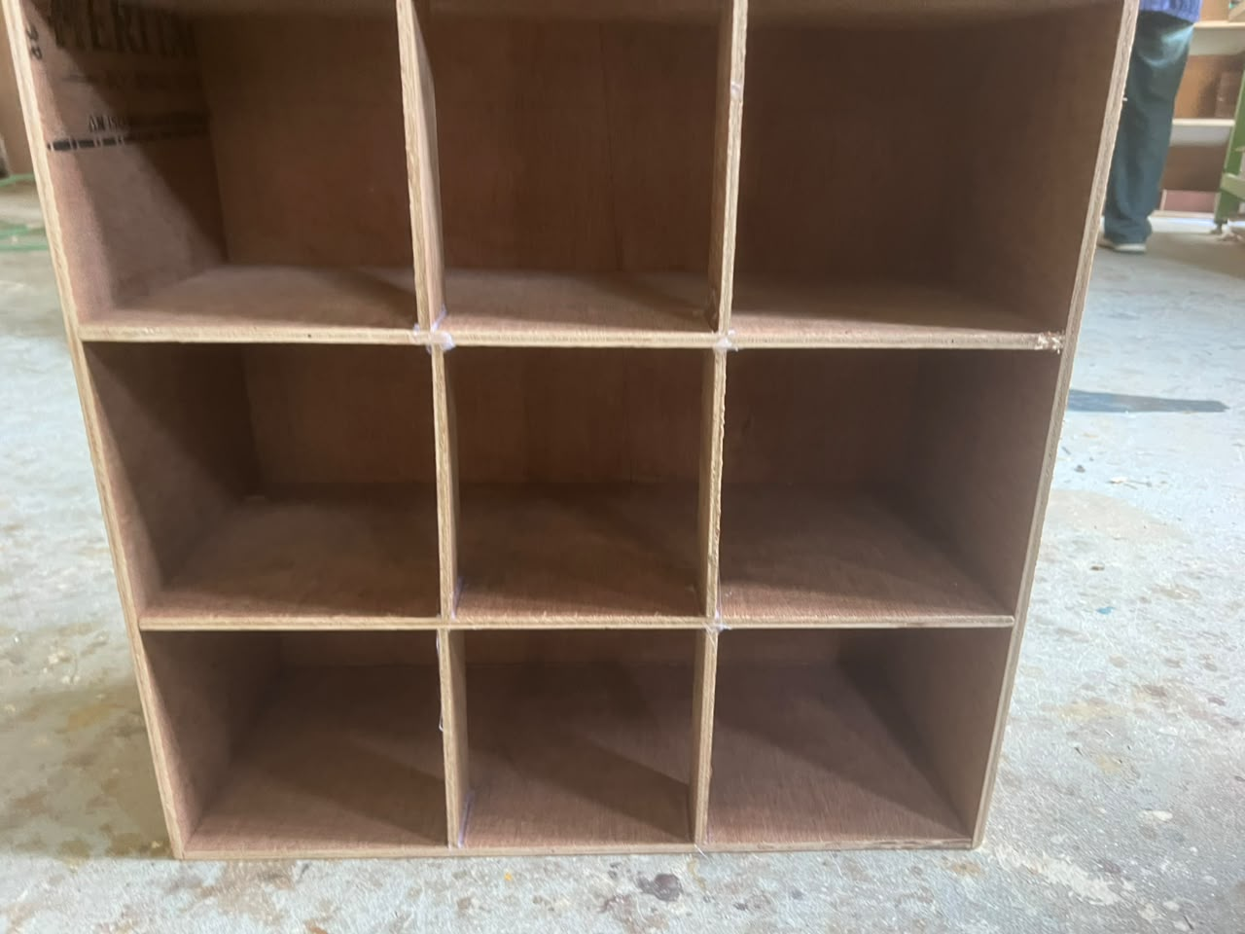
14 IMPLEMENTATION
Prototype Build
Running breadboard prototype
Wooden enclosure (wood + paint work)
ESP32, 4-channel relay, DHT22 and LCD status display, all wired and powering up.
Compartmentalized plywood frame keeping mains wiring isolated from low-voltage electronics.
IoT Based Home Automation System
14

Slide 23

15 LIVE DEMONSTRATION
Prototype Walkthrough
Toggling appliances from the dashboard, live sensor readings, and automatic fan control — demonstrated on the physical prototype

Slide 24
16 RESULTS
What the Prototype Delivers
4
±0.5°C
0
5
Appliances
Sensor accuracy
Cloud services
Test stages
controlled independently via relay channels
DHT22 temperature reading precision
fully self-hosted on the ESP32
unit, sensor, network, dashboard, integration
Testing confirmed that relay switching, sensor readings, Wi-Fi connectivity, and the dashboard all function reliably together — meeting every objective set out in Chapter 1 of the report.
IoT Based Home Automation System
18

Slide 25
Thank You
Questions & Discussion
IoT Based Home Automation System — ENGG 102 Project Proposal Defense

Slide 26

APPENDIX
Anticipated Viva Questions
Common questions the panel may ask, with concise answers to have ready

