Slide 1
Khaleelullah Hussaini Syed
SME | Mentor | Corporate Trainer
GitHub : https://github.com/TechieSyed
Automation Testing Using
Selenium & C#

Slide 2
Agenda
Introduction to automation testing
Role of selenium in automation testing
Setting up testing environment in visual studio 2022
Writing and executing a basic test
Testing a contact form

Slide 3
Automation Testing - Introduction
Automation testing utilizes software tools to perform tests automatically which simulates user actions and interactions with the software eliminating human errors leading to more reliable and accurate results

Slide 4
Automation Testing - Benefits
Benefits of automation testing
  Speed
  Cost Saving
  Efficiency
  Accuracy

Slide 5
Automation Testing - Selenium
Selenium is a widely used open-source framework for web application testing. It supports multiple programming languages and browsers. It allowing testers to automate browser interactions and validate web elements

Slide 6
Automation Testing - Selenium Suite
Selenium is not just one tool or API but it composes many tools.
  WebDriver
  IDE
  Grid

Slide 7
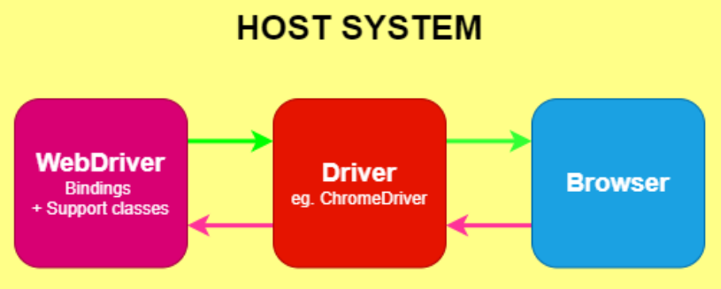
Automation Testing - Selenium WebDriver
It provides a programming interface that allows you to interact with web browsers programmatically
WebDriver communicates directly with the browser using browser-specific drivers (e.g., ChromeDriver, FirefoxDriver) to control and automate browser actions
Supports various programming languages like Java, C#, Python, Ruby, and JavaScript

Slide 8
Selenium – IWebDriver interface
The IWebDriver is implemented by specific browser driver classes (e.g., ChromeDriver, FirefoxDriver, EdgeDriver) in Selenium C#
WebDriver methods throw WebDriverException and NoSuchElementException, among other exceptions
Common Methods and Properties
void Navigate().GoToUrl(string url) | Navigates the browser to the specified URL
void Close() | Closes the current browser window or tab
void Quit() | Quits the WebDriver instance, closing all associated windows and ending the session
string Url | Gets or sets the current URL of the web page
string Title | Gets the title of the web page

Slide 9
Selenium – Locator Strategies
Ways to identify one or more specific elements in the DOM.
Selenium provides support for these 8 traditional location strategies in WebDriver
Note: Selenium 4 introduces Relative Locators (previously called as Friendly Locators). These locators are helpful when it is not easy to construct a locator for the desired element
Title | Example
ID Locator | By.Id(“id”)
Name Locator | By.Name(“name”)
Class Name Locator | By.ClassName(“classname”)
Tag Name Locator | By.TagName(“tag”)
Link Text Locator | By.LinkText(“text”)

Slide 10
Selenium – Finders
Provides ways to identify one or more specific elements in the DOM to obtain it’s reference.
Finders returns the reference to the DOM elements as an object to IWebElement interface
Webdriver.FindElement(locator): Finds the first web element that matches the specified locator strategy.
Webdriver.FindElements(locator): Finds all web elements that match the specified locator strategy and returns a collection of elements.

Slide 11
Selenium – Interacting with IWebElement
The IWebElement interface in Selenium C# represents an individual web element on a web page.
It provides methods to interact with and retrieve information about specific elements.
Property/Method | Description
TagName | Gets the HTML tag name of the element.
Text | Gets the visible text of the element.
Enabled | Gets a value indicating whether the element is enabled for user interaction.
Click() | Performs a left-click action on the element.
SendKeys() | Sends keystrokes to the element, simulating user input.
Clear() | Clears the text or input value of the element.
Submit() | Submits a form associated with the element

Slide 12
DEMO

