Slide 1
Database Management System
Courier Delivery Tracking System
Team Details:
Gaurav : 2410991148
Gauri : 2410991151
GodsWill : 2410991158
Chitkara University Institute of Engineering and Technology,
Chitkara University, Punjab

Slide 2
Table of Contents
Introduction
Problem Overview
Scope of Project
Objectives
Significance of project
Relations with Entities
ER Diagram
Relations Queries
References
Conclusion

Slide 3
Introduction
In today’s era, courier and logistics are vital for e-commerce and trade
Manual courier systems face challenges:
Delays & inefficiency
Errors in tracking & delivery
No real-time visibility
This system ensures:
Real-time parcel tracking
Centralized data management
Improved customer satisfaction

Slide 4
Problem Overview
Manual inefficiency in record keeping
No real-time tracking of consignments
Data redundancy and errors
Poor resource allocation
Limited scalability
Security issues
Low customer satisfaction

Slide 5
Scope of Project
Maintain records of:
Clients
Consignments
Staff
Payments
Real-time parcel tracking
Employee task management
Admin monitoring and reporting
Role-based access control
Scalable database design

Slide 6
Objectives
Centralized Data Management
Efficient Data Retrieval
Real-Time Parcel Tracking
Role-Based Access Control
Error Reduction
Improved Transparency
Scalability & Flexibility
Enhanced Customer Satisfaction

Slide 7
Significance of the Project
Streamlines courier operations
Increases accuracy and efficiency
Enhances transparency
Saves time & reduces effort
Builds customer trust
Strengthens data security
Supports scalability for future growth

Slide 8
Relationships
Client ↔ Consignment (1:M)
Client ↔ Transaction (1:M)
Consignment ↔ Shipment (1:M)
Staff ↔ Shipment (1:M)
Consignment ↔ Transaction (1:1)

Slide 9
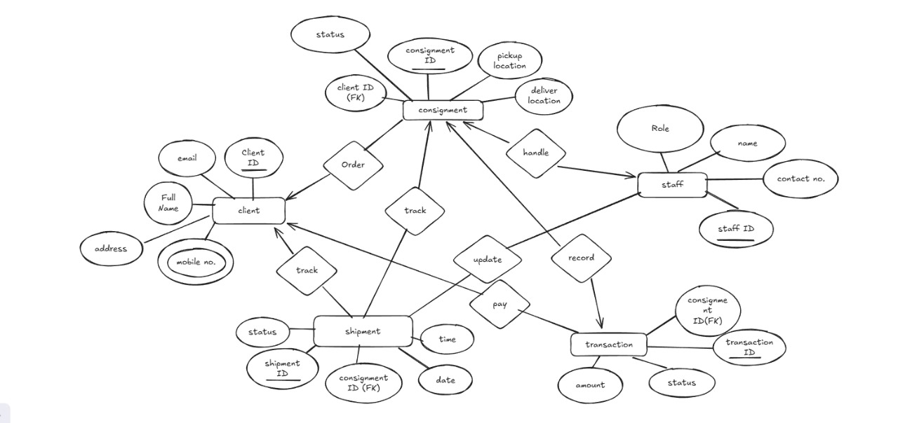
ER Diagram

Slide 10
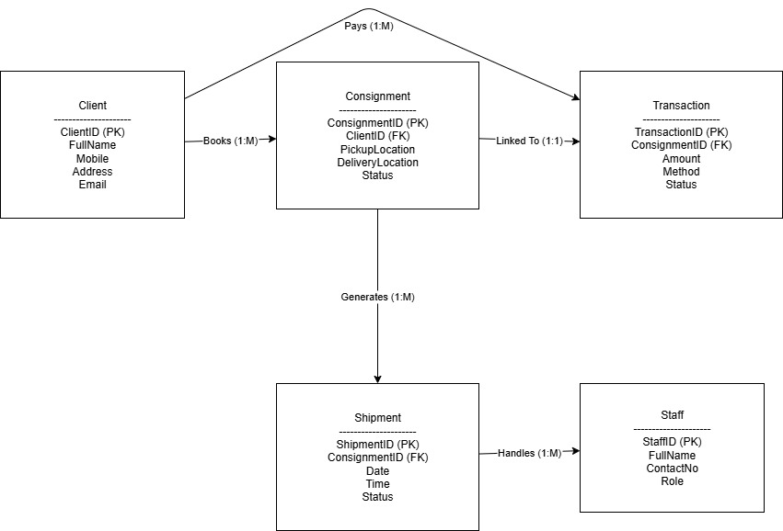
Data Schema

Slide 11
Database Schema
Client (ClientID, FullName, Mobile, Address, Email)
Consignment (ConsignmentID, ClientID, PickupLocation, DeliveryLocation, Status)
Shipment (ShipmentID, ConsignmentID, Date, Time, Status)
Staff (StaffID, FullName, ContactNo, Role)
Transaction (TransactionID, ConsignmentID, Amount, Method, Status)

Slide 12
Relation Algebra Queries
List all clients:- π ClientID, FullName, Email (Client)
Find clients living in "Delhi":- σ Address="Delhi" (Client)
Get clients with mobile numbers starting with "98":- σ Mobile LIKE "98%" (Client)
Find clients who ordered consignments: π ClientID, FullName (Client ⨝ Consignment)
Find clients who did not order any consignments: π ClientID, FullName (Client) − π ClientID, FullName (Client ⨝ Consignment)
List all consignments with pickup & delivery: π ConsignmentID, PickupLocation, DeliveryLocation (Consignment)
Find consignments with status "Pending": σ Status="Pending" (Consignment)
Get consignments where pickup="Mumbai" and delivery="Delhi": σ PickupLocation="Mumbai" ∧ DeliveryLocation="Delhi" (Consignment)
Find consignments of a specific client (ClientID=5): σ ClientID=5 (Consignment
Count number of consignments per client: γ ClientID, COUNT(ConsignmentID) (Consignment)

Slide 13
Relation Algebra Queries
11. List all shipments and their status: π ShipmentID, Status (Shipment)
12. Find shipments completed on "2025-01-01": σ Date="2025-01-01" ∧ Status="Completed" (Shipment)
13. Show shipments linked to consignments: π ShipmentID, ConsignmentID (Shipment ⨝ Consignment)
14.Get shipments still "In Transit": σ Status="In Transit" (Shipment)
15. Find clients whose consignments are still in transit: π FullName (Client ⨝ Consignment ⨝ Shipment σ Status="In Transit")
16. List all staff names and roles: π FullName, Role (Staff)
17. Find staff with role "Delivery Boy": σ Role="Delivery Boy" (Staff)
18. Get staff who handled at least one shipment: π StaffID, FullName (Staff ⨝ Shipment)
19. Find staff who never handled a shipment: π StaffID, FullName (Staff) − π StaffID, FullName (Staff ⨝ Shipment)
20. List staff and consignments they handled: π FullName, ConsignmentID (Staff ⨝ Shipment ⨝ Consignment)

Slide 14
Relation Algebra Queries
21. List all transactions with amount: π TransactionID, Amount (Transaction)
22. Find transactions greater than ₹5000: σ Amount > 5000 (Transaction)
23. Get transactions made via "UPI": σ Method="UPI" (Transaction)
24. Find successful transactions: σ Status="Successful" (Transaction)
25. Show client names with their payment details: π FullName, Amount, Method (Client ⨝ Consignment ⨝ Transaction)

Slide 15
References
W3Schools SQL Documentation
GeeksforGeeks DBMS Tutorials
Database System Concepts by Silberschatz, Korth, Sudarshan

Slide 16
Conclusion
The Courier Delivery Tracking System provides:
Centralized data management for clients, consignments, staff, and payments
Real-time tracking to improve transparency and efficiency
Automation that reduces manual errors and delays
Role-based access ensuring security and proper responsibility distribution
Overall, the system improves customer satisfaction, operational efficiency, and scalability for future needs.

Slide 17
Thank You!

