Slide 1
TECHLAUNCHER / LEAF ANALYZER
LEAF ANALYZER / SPRINT 5
Sprint 5
Review
Hyperspectral Image Inspector
What we built and what we learned
Sources: LEAF-150 · Backlog · Commit ac71613
01
Notes:
This is our Sprint 5 review. We will show the main features we finished, how we used last sprint’s feedback, and what we want to do next. The evidence is from Jira, GitHub and our weekly reports and reflections. This is our progress as of 28 August. Sprint 5 is still active, so we are not saying that every task is finished.
[Sources]
- https://leaf2qr.atlassian.net/browse/LEAF-150 (Sprint field: Sprint 5, started 21 August; scheduled end 4 September AEST)
- https://leaf2qr.atlassian.net/wiki/spaces/L/pages/18284545
- https://github.com/Techlauncher-LeafAnalyzer/Hyperspectral-Image-Inspector/commit/ac7161342dbb661c9f5efbfd9de5a554ee4c6141
- Sprint 4 feedback: supplied by the team in the presentation brief.
[/Sources]

Slide 2
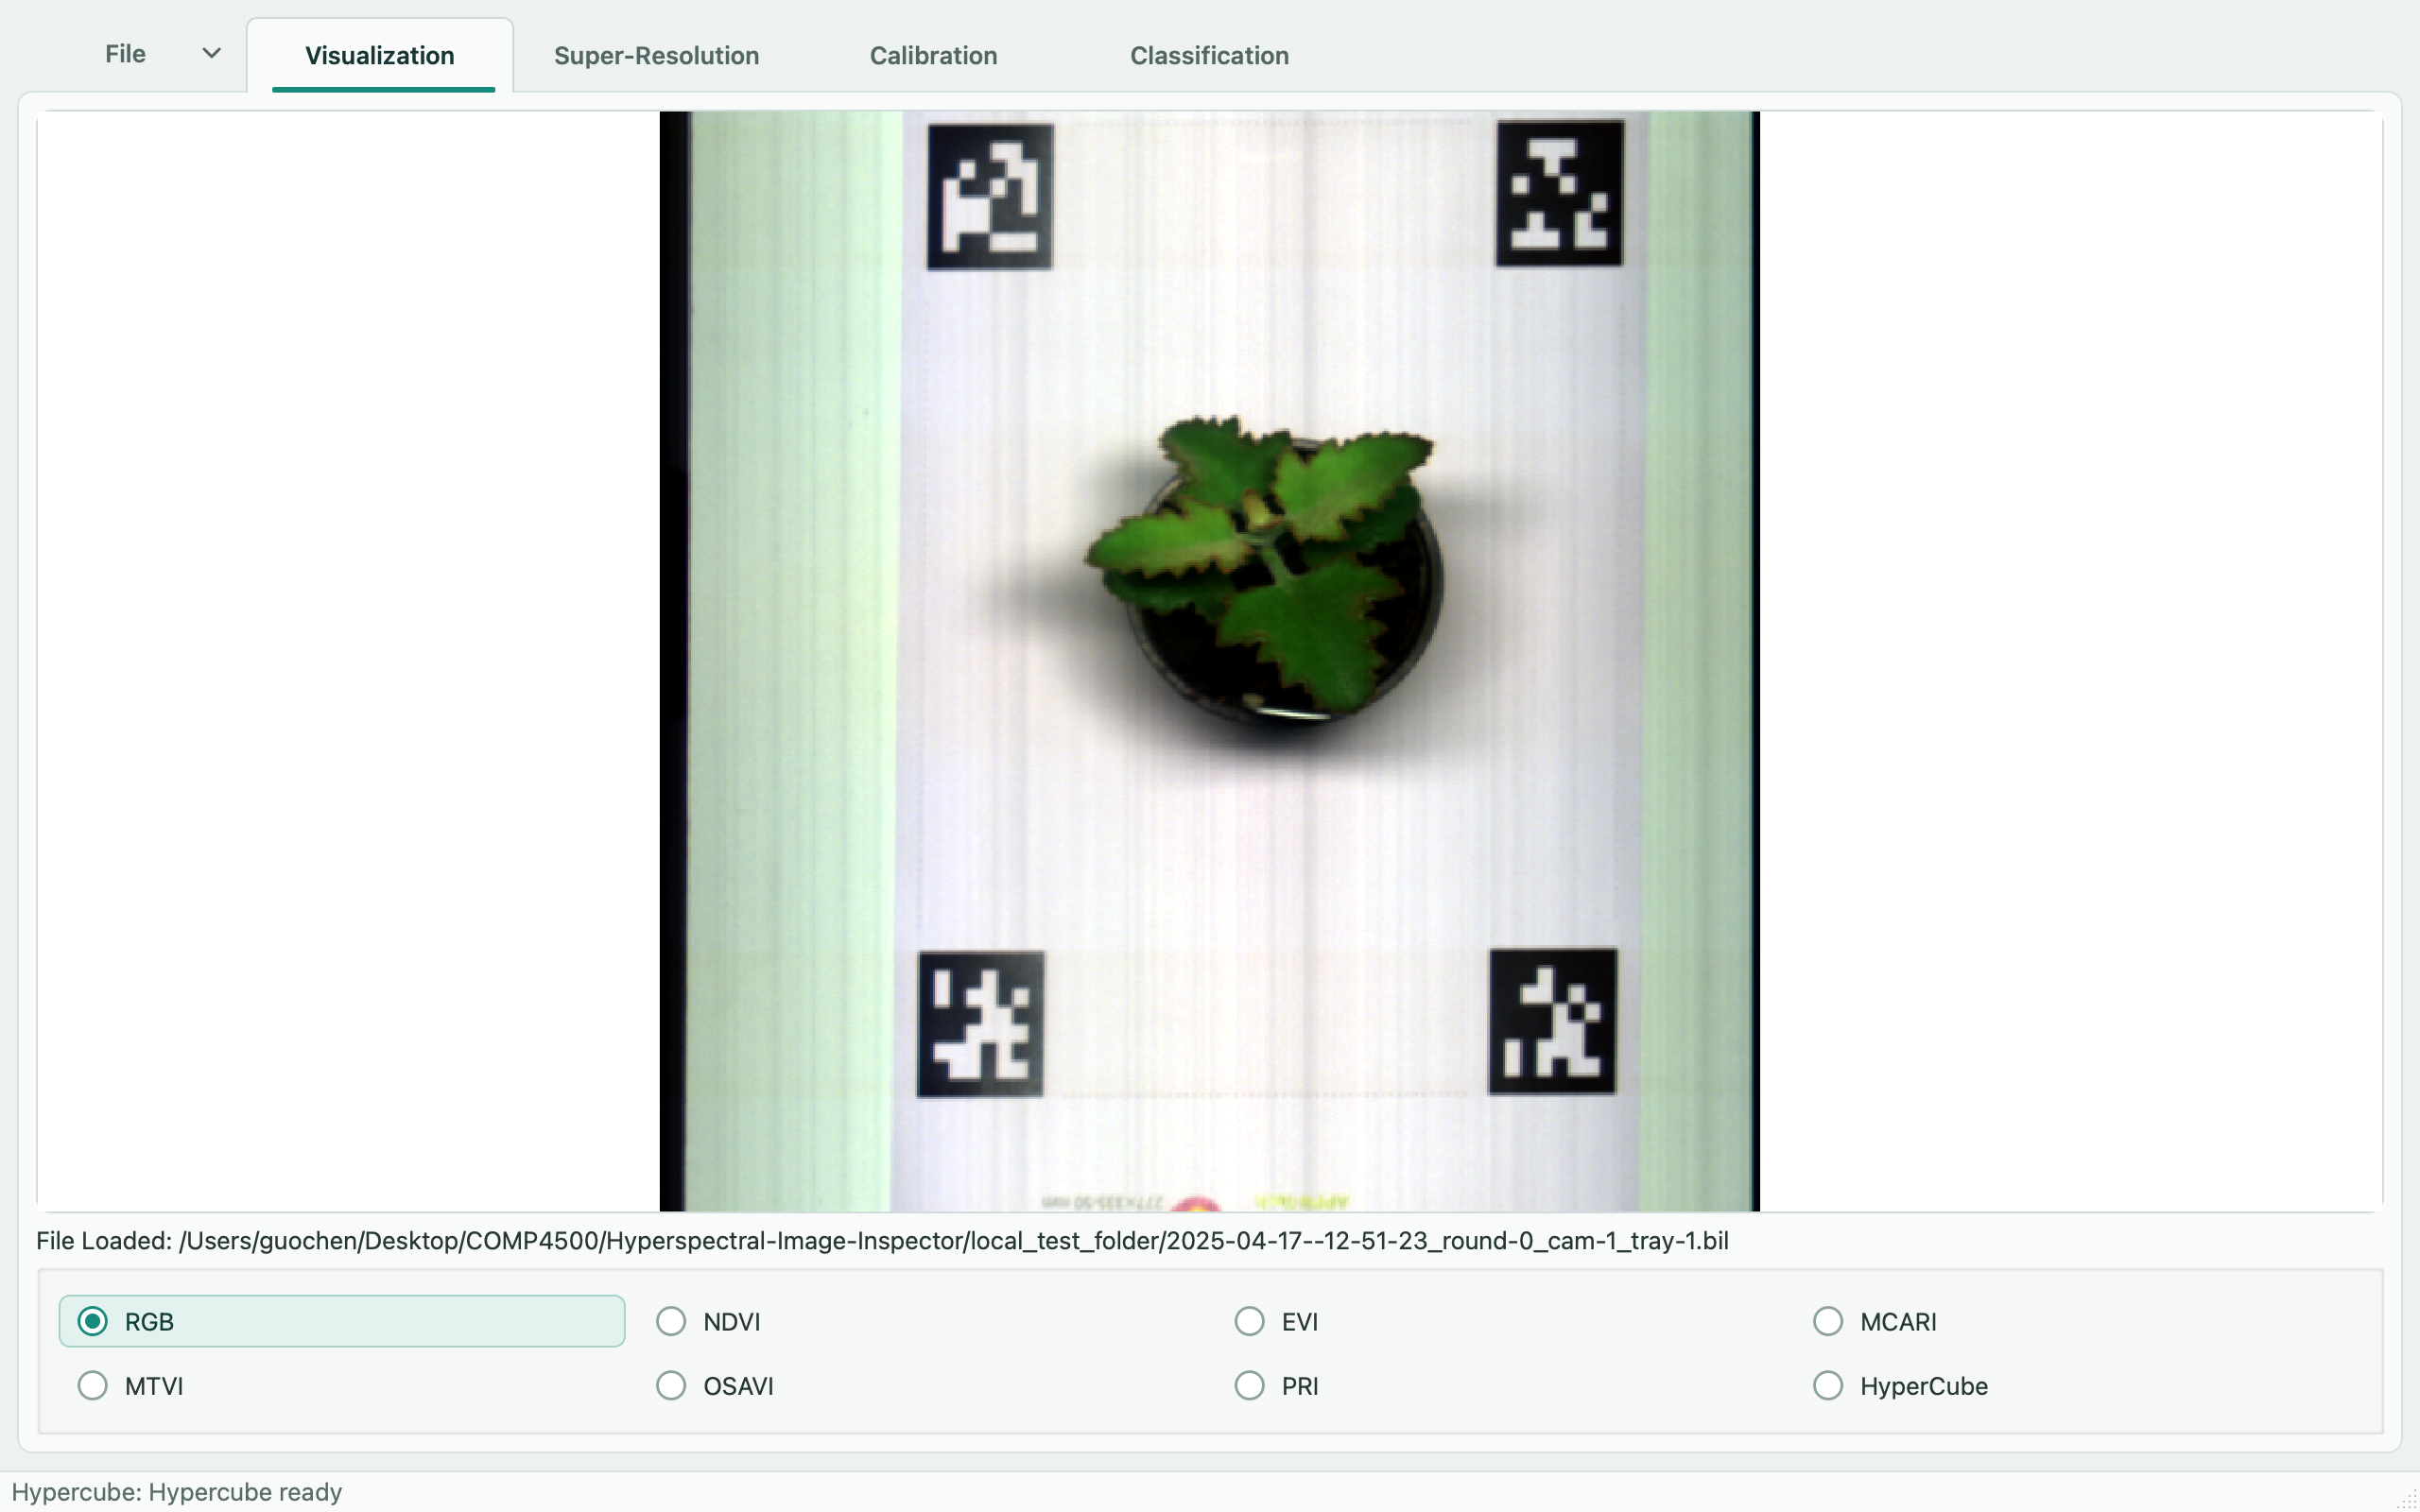
SPRINT 5 OVERVIEW
LEAF ANALYZER / SPRINT 5
Visualization and SR now work
7 image views
RGB + six vegetation indices
Inspect pixels and spectra.
Save the current view.
Also finished
3D Hypercube, 2× SR
and classification.
We also fixed crop scaling and added tests and GitHub checks.
Sources: PR #24 · PR #29 · PR #33 · PR #34 · PR #36 · Backlog · Week 5 report
02
Notes:
We connected RGB and six vegetation index views to the interface. We can inspect pixel values, plot a spectrum and save the view. Hypercube and real super resolution are also connected. Classification was merged on 28 August. Some of the model code and basic cropping existed before this sprint. This sprint added integration work and fixes. We still need to check scientific accuracy and get the client’s review.
[Sources]
- https://github.com/Techlauncher-LeafAnalyzer/Hyperspectral-Image-Inspector/pull/24
- https://github.com/Techlauncher-LeafAnalyzer/Hyperspectral-Image-Inspector/pull/29
- https://github.com/Techlauncher-LeafAnalyzer/Hyperspectral-Image-Inspector/pull/33
- https://github.com/Techlauncher-LeafAnalyzer/Hyperspectral-Image-Inspector/pull/34
- https://github.com/Techlauncher-LeafAnalyzer/Hyperspectral-Image-Inspector/pull/36
- https://leaf2qr.atlassian.net/wiki/spaces/L/pages/18284545
- https://leaf2qr.atlassian.net/wiki/spaces/L/pages/19726337
- Screenshots: real project UI or browser captures taken 28 August 2026; cropped only for placement. Actual application with the real tray capture loaded in RGB view.
[/Sources]

Slide 3
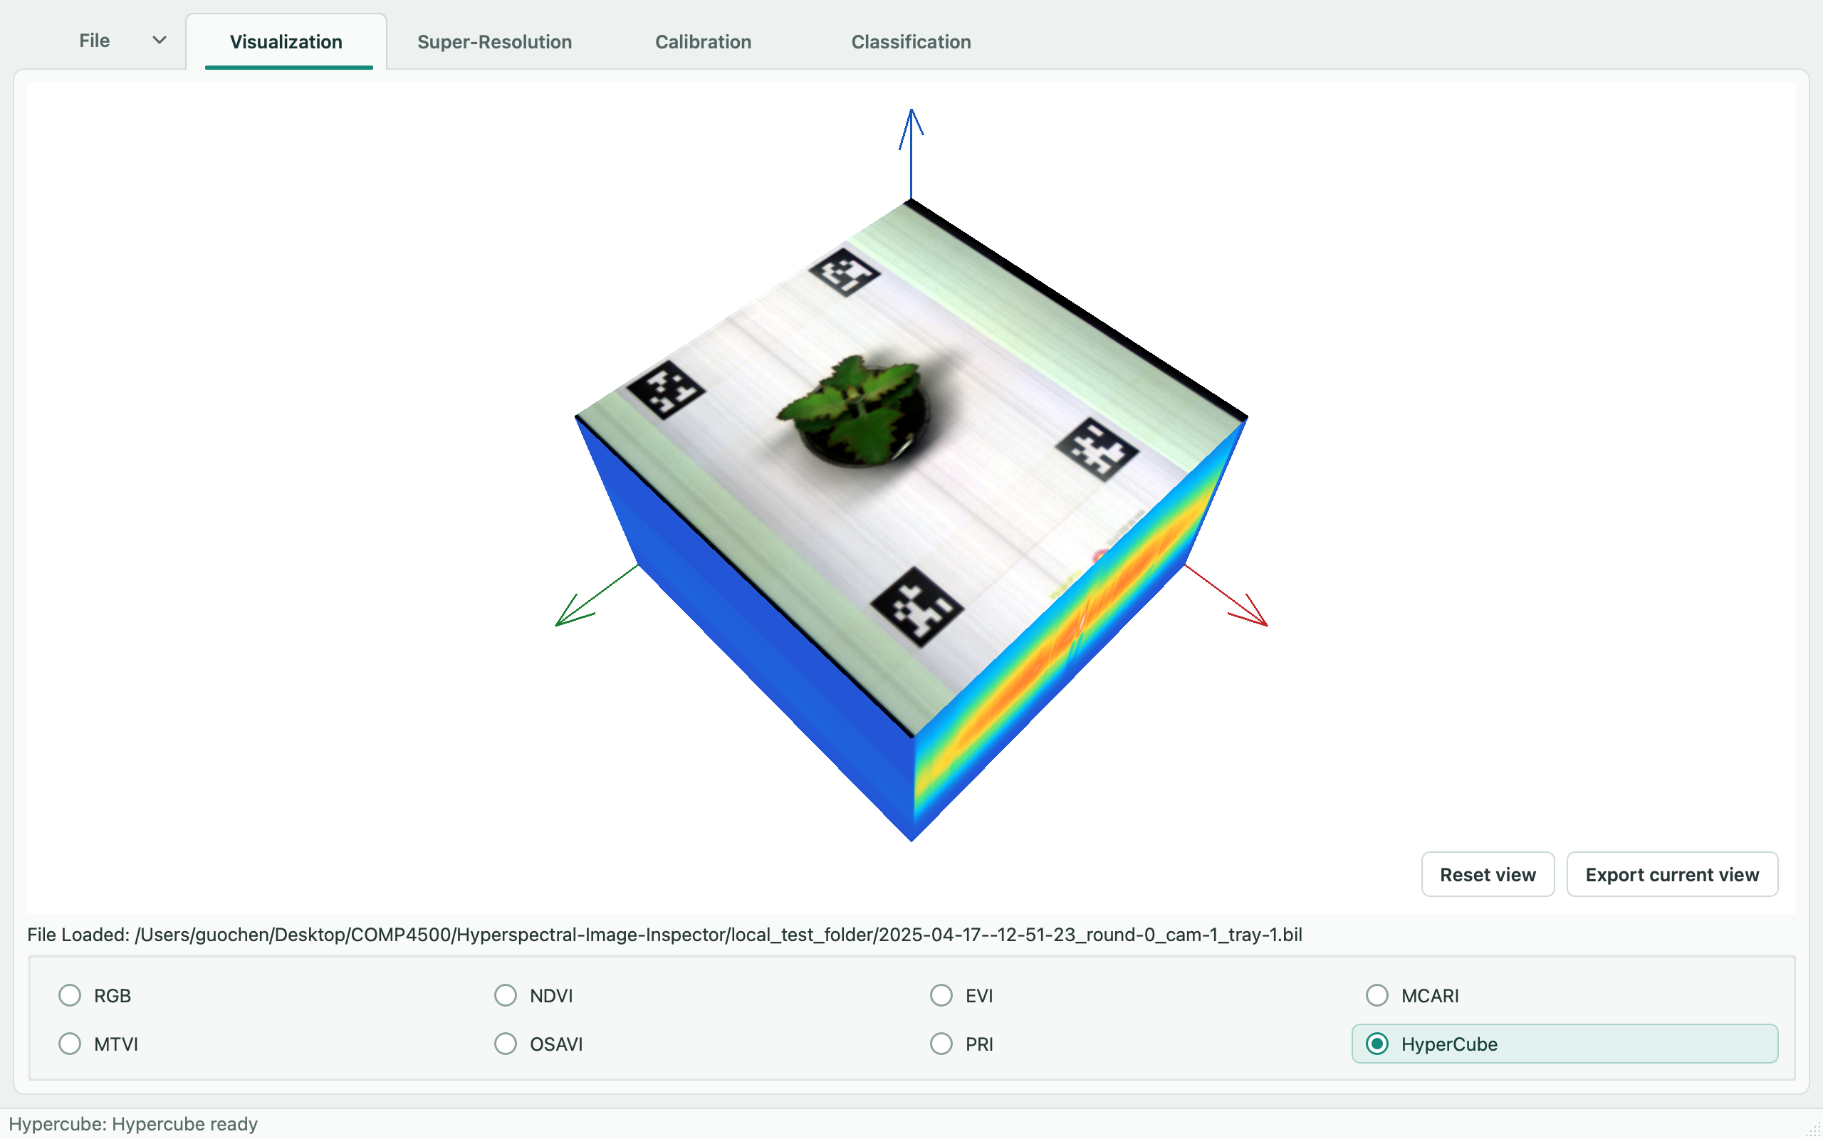
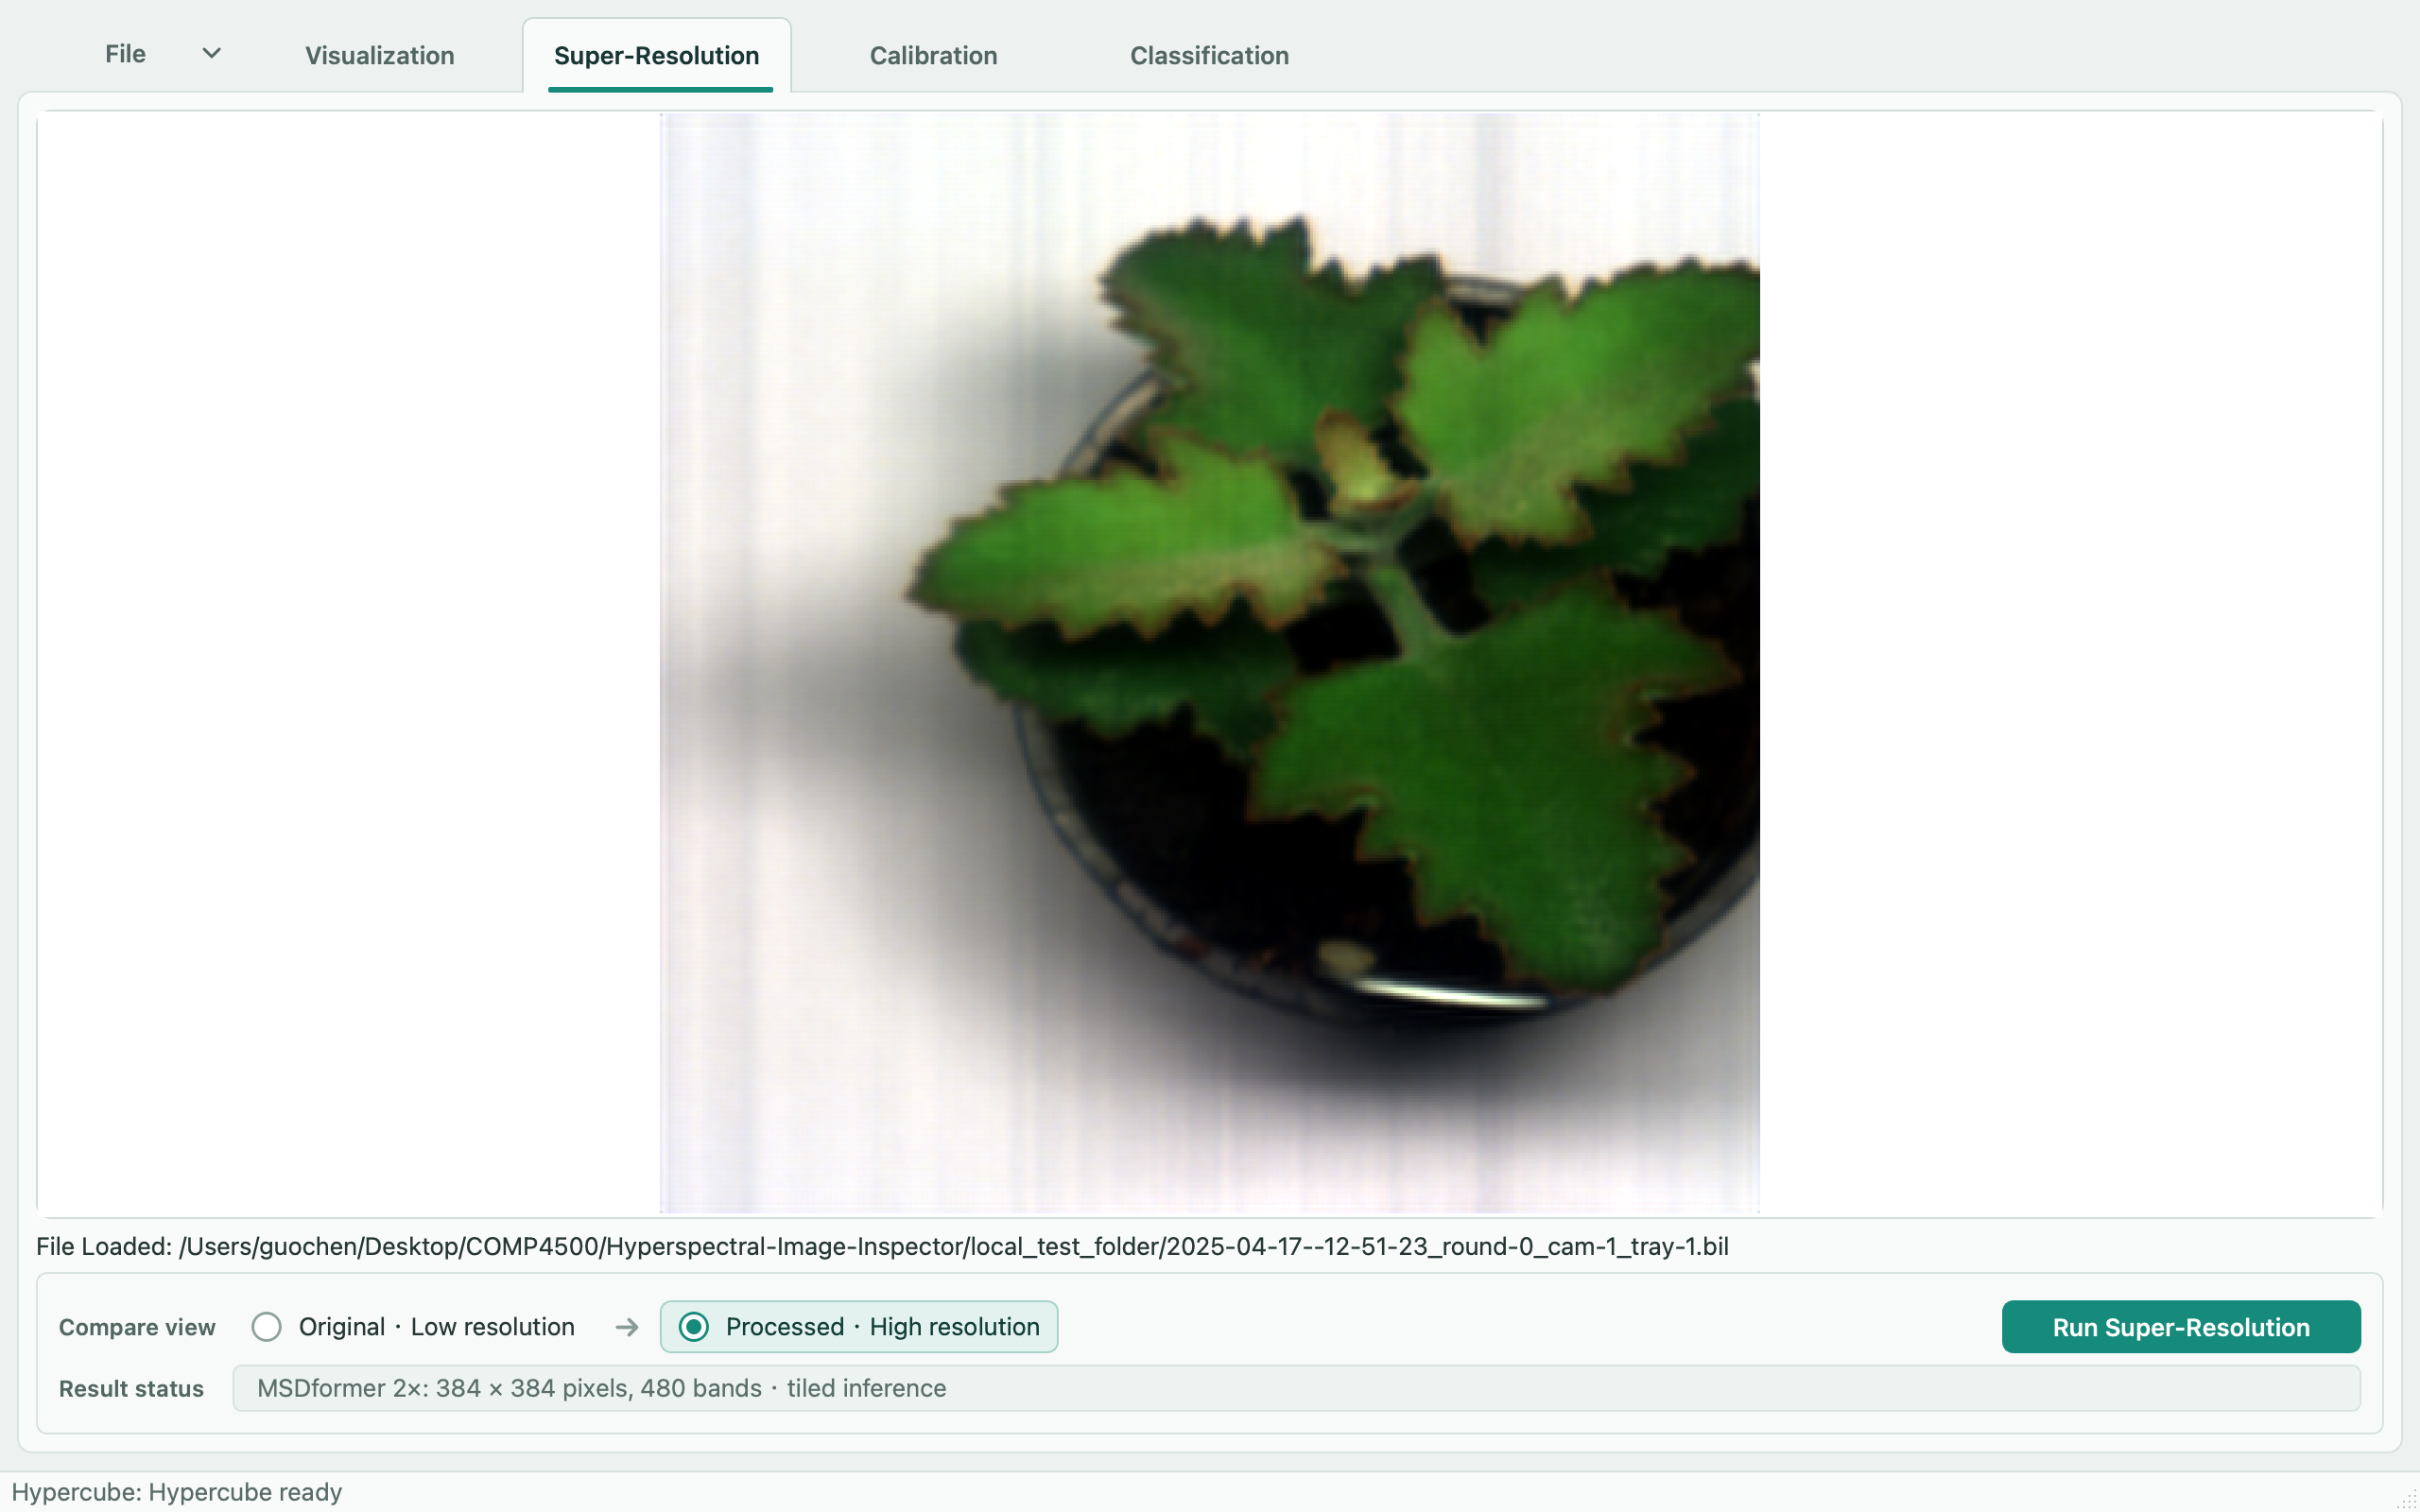
WHAT WE DELIVERED
LEAF ANALYZER / SPRINT 5
Hypercube and SR in the app
3D Hypercube
Super Resolution
Rotate, zoom and save the view.
SR demo: 192 × 192 → 384 × 384.
All 480 bands are kept.
These screenshots show the features running. They do not prove scientific accuracy.
Sources: PR #18 · PR #24 · PR #29 · PR #30 · PR #31 · PR #32 · PR #33 · PR #34 · PR #36 · Classification API · SR setup
03
Notes:
These are real screenshots of the app, using a local hyperspectral capture. Hypercube lets us rotate and zoom the cube and save the view. Super resolution uses the existing 480-band model and doubles the image width and height. We can compare the original and processed image. The SR screenshot uses a small crop to keep the demo manageable. These pictures show that the features run; they do not prove that the output is scientifically accurate.
[Sources]
- https://github.com/Techlauncher-LeafAnalyzer/Hyperspectral-Image-Inspector/pull/18
- https://github.com/Techlauncher-LeafAnalyzer/Hyperspectral-Image-Inspector/pull/24
- https://github.com/Techlauncher-LeafAnalyzer/Hyperspectral-Image-Inspector/pull/29
- https://github.com/Techlauncher-LeafAnalyzer/Hyperspectral-Image-Inspector/pull/30
- https://github.com/Techlauncher-LeafAnalyzer/Hyperspectral-Image-Inspector/pull/31
- https://github.com/Techlauncher-LeafAnalyzer/Hyperspectral-Image-Inspector/pull/32
- https://github.com/Techlauncher-LeafAnalyzer/Hyperspectral-Image-Inspector/pull/33
- https://github.com/Techlauncher-LeafAnalyzer/Hyperspectral-Image-Inspector/pull/34
- https://github.com/Techlauncher-LeafAnalyzer/Hyperspectral-Image-Inspector/pull/36
- https://github.com/Techlauncher-LeafAnalyzer/Hyperspectral-Image-Inspector/blob/ac7161342dbb661c9f5efbfd9de5a554ee4c6141/docs/model_classification_api.md
- https://github.com/Techlauncher-LeafAnalyzer/Hyperspectral-Image-Inspector/blob/ac7161342dbb661c9f5efbfd9de5a554ee4c6141/docs/super-resolution.md
- Screenshots: real project UI or browser captures taken 28 August 2026; cropped only for placement. Actual interactive Hypercube view of the real tray capture. Actual super-resolution result from a crop of the real 480-band capture.
[/Sources]

Slide 4
STAKEHOLDER ENGAGEMENT
LEAF ANALYZER / SPRINT 5
Client feedback guided our work
Last sprint: write down meeting actions and report what happened.
CLIENT ASKED FOR
OUR TASKS
WHAT WE CHANGED
SR that is more reliable
and uses all the bands.
Guochen · LEAF-152
Ryan · LEAF-158
Real model output, a cancel
button and safer error handling.
An easier interface
for image analysis.
Guochen · LEAF-149
Ryan · LEAF-154 / 155
Clearer menus, colour values
and a statistics window.
The backlog and Week 5 report show the progress. We still need the client to review the results.
Sources: Client meeting · Requirements · Client meeting 7 · LEAF-152 · LEAF-158 · LEAF-149 · LEAF-154 · LEAF-155 · Backlog · Week 5 report
04
Notes:
Last sprint, we were asked to track meeting actions more clearly. The client had asked for a better interface and more reliable super resolution using all the bands. We linked that work to Jira tasks and reported progress in the backlog and Week 5 report. The menu, statistics window and colour values also make the app easier to use. These needs came from earlier client records. We have not found a new client sign-off for the finished changes.
[Sources]
- https://leaf2qr.atlassian.net/wiki/spaces/L/pages/16580683
- https://leaf2qr.atlassian.net/wiki/spaces/L/pages/16416770
- https://leaf2qr.atlassian.net/wiki/spaces/L/pages/15630342
- https://leaf2qr.atlassian.net/browse/LEAF-152
- https://leaf2qr.atlassian.net/browse/LEAF-158
- https://leaf2qr.atlassian.net/browse/LEAF-149
- https://leaf2qr.atlassian.net/browse/LEAF-154
- https://leaf2qr.atlassian.net/browse/LEAF-155
- https://leaf2qr.atlassian.net/wiki/spaces/L/pages/18284545
- https://leaf2qr.atlassian.net/wiki/spaces/L/pages/19726337
[/Sources]

Slide 5
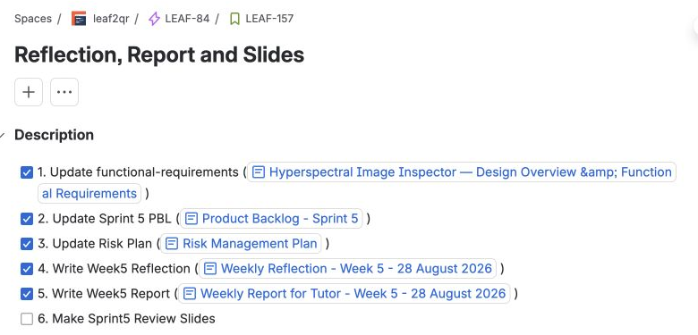
STAKEHOLDER ENGAGEMENT
LEAF ANALYZER / SPRINT 5
We recorded the tutor’s action items
21 August: log our time, reflect each week and keep the risk plan up to date.
1. Write it down
Tutor meeting notes
2. Assign a task
LEAF-157 · Guochen
3. Report progress
Week 5 report + linked documents
The checklist keeps our project documents and review tasks in one place.
Sources: Tutor meeting · LEAF-157 · Week 5 report · Week 5 reflection · Risk plan · Backlog
05
Notes:
The tutor asked us to log our time, reflect each week and update the risk plan. Guochen’s Jira task, LEAF-157, has a checklist and links to the project documents. The Week 5 report records the progress. This makes it easier for the tutor to open the task and find the related work. The written follow-up is there, but we should still record the final outcome of each action.
[Sources]
- https://leaf2qr.atlassian.net/wiki/spaces/L/pages/18645003
- https://leaf2qr.atlassian.net/browse/LEAF-157
- https://leaf2qr.atlassian.net/wiki/spaces/L/pages/19726337
- https://leaf2qr.atlassian.net/wiki/spaces/L/pages/19726345
- https://leaf2qr.atlassian.net/wiki/spaces/L/pages/6193171
- https://leaf2qr.atlassian.net/wiki/spaces/L/pages/18284545
- Sprint 4 stakeholder feedback supplied in the brief.
- Screenshots: real project UI or browser captures taken 28 August 2026; cropped only for placement. Actual LEAF-157 Jira task with its documentation checklist and owner.
[/Sources]

Slide 6
PLANNING AND ORGANISATION
LEAF ANALYZER / SPRINT 5
Everyone had clear tasks
Ryan
Guochen
Jingyi
Pengyun
UI, Hypercube, crop fixes
and shared SR results.
SR, UI changes
and project reports.
Image display models
and supervised classification.
Hypercube components,
K-means and classification UI.
LEAF-146–148, 150
LEAF-153–156, 158
LEAF-149, 152, 157
LEAF-125–131
LEAF-160–162, 164
LEAF-132–139
LEAF-159, 163, 165–166
Hypercube needed rework
21 Aug: Hypercube moved back to In Progress.
28 Aug: the working version was merged in PR #29.
Next time, we will allow time to connect the model and UI, then test them together.
Sources: Backlog · Week 4 reflection · Week 5 reflection · LEAF-150 · PR #28 · PR #29 · PR #36
06
Notes:
Each person had assigned tasks in Jira. Ryan worked mainly on the UI and integration fixes. Guochen worked on SR, UI changes and reporting. Jingyi worked on models and supervised classification. Pengyun worked on Hypercube components and classification. Hypercube needed another pass before the model and interface worked together. It moved back to In Progress on 21 August, then the working version was merged on 28 August. We need to plan time for this kind of integration.
[Sources]
- https://leaf2qr.atlassian.net/wiki/spaces/L/pages/18284545
- https://leaf2qr.atlassian.net/wiki/spaces/L/pages/18448410
- https://leaf2qr.atlassian.net/wiki/spaces/L/pages/19726345
- https://leaf2qr.atlassian.net/browse/LEAF-150 (status history)
- https://github.com/Techlauncher-LeafAnalyzer/Hyperspectral-Image-Inspector/pull/28
- https://github.com/Techlauncher-LeafAnalyzer/Hyperspectral-Image-Inspector/pull/29
- https://github.com/Techlauncher-LeafAnalyzer/Hyperspectral-Image-Inspector/pull/36
[/Sources]

Slide 7
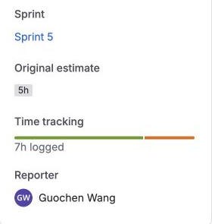
PLANNING AND ORGANISATION
LEAF ANALYZER / SPRINT 5
We compared estimates and logged time
Examples from completed Jira tasks
TASK
ESTIMATE*
LOGGED
DIFF.
LEAF-150 · Hypercube
5h
6h
+1h
LEAF-152 · SR
5h
7h
+2h
LEAF-149 · Menu
40m
40m
0
LEAF-153 · Crop scale
30m
15m
−15m
LEAF-155 · Colours
2h
40m
−80m
*Current estimates. SR changed from 3h to 5h. Hypercube was estimated during review.
Next sprint: keep the first estimate and record why it changes. Allow time for integration and tests.
Sources: LEAF-150 · LEAF-152 · LEAF-149 · LEAF-153 · LEAF-155
07
Notes:
We can now compare estimates with logged time for some tasks. Hypercube shows five hours estimated and six logged. SR shows five and seven. The menu task matched its estimate, and two smaller UI fixes took less time than estimated. There is a limit to this comparison: SR’s estimate changed from three to five hours, and Hypercube was estimated during review. Next sprint, we should keep the first estimate, record changes and include integration and testing time.
[Sources]
- https://leaf2qr.atlassian.net/browse/LEAF-150 (estimate, worklog and history)
- https://leaf2qr.atlassian.net/browse/LEAF-152 (estimate, worklogs and history)
- https://leaf2qr.atlassian.net/browse/LEAF-149
- https://leaf2qr.atlassian.net/browse/LEAF-153
- https://leaf2qr.atlassian.net/browse/LEAF-155
- Jira query: project = LEAF AND sprint = "Sprint 5"; 45 returned issues; snapshot 28 August 2026.
- Differences computed as logged actual minus the current original-estimate field; not an independently recorded retrospective metric.
- Screenshots: real project UI or browser captures taken 28 August 2026; cropped only for placement. Actual LEAF-152 Jira time tracking showing 5h estimate and 7h logged.
[/Sources]

Slide 8
PLANNING AND ORGANISATION
LEAF ANALYZER / SPRINT 5
We updated the risk plan each week
Reviewed on 21 and 28 August. Next review: 4 September.
MAIN RISK
WHAT WE HAVE DONE
WHAT WE STILL NEED
Large files · Critical
Run work in the background.
Process SR in smaller tiles.
Measure time, memory and disk
use with full-size captures.
Wrong results · Critical
Write down the model’s limits
and the data it expects.
Compare results with known
values and suitable test data.
Different PCs · High
Run tests on Ubuntu in CI.
Show why tests are skipped.
Test SR and 3D graphics
on the target Windows PC.
We still need to put a person’s name against each role in the risk plan.
Sources: Risk plan · SR setup · Week 5 reflection
08
Notes:
We updated the risk plan on 21 and 28 August. Large files may use too much memory or disk space. The app runs long tasks in the background, and SR processes smaller tiles. We also need to check whether the scientific results are correct and whether the app works on the client’s Windows PC. Ubuntu CI does not answer those questions. Next, we need real measurements, reference tests and a named person for each risk.
[Sources]
- https://leaf2qr.atlassian.net/wiki/spaces/L/pages/6193171 (R2, R3, R4, R11; next-review actions)
- https://github.com/Techlauncher-LeafAnalyzer/Hyperspectral-Image-Inspector/blob/ac7161342dbb661c9f5efbfd9de5a554ee4c6141/docs/super-resolution.md
- https://leaf2qr.atlassian.net/wiki/spaces/L/pages/19726345
[/Sources]

Slide 9
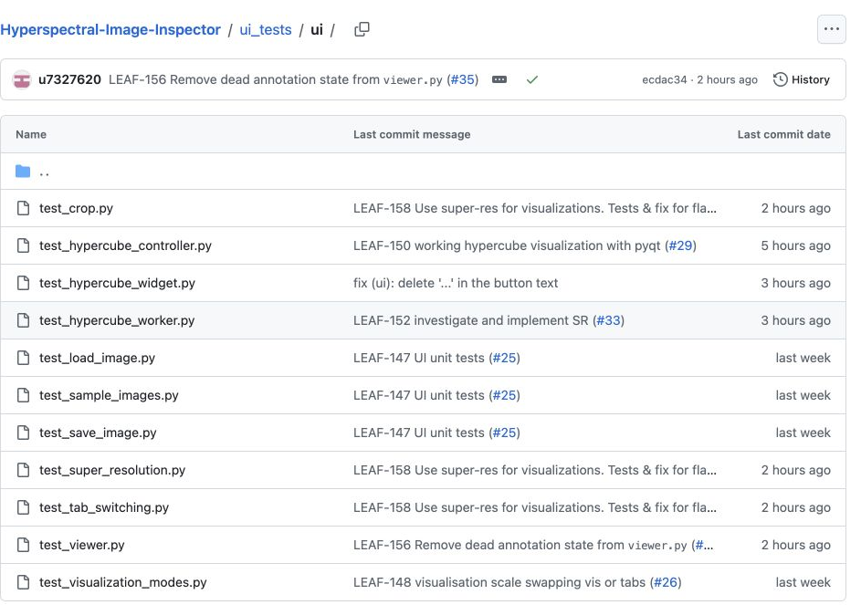
EXECUTION AND QUALITY
LEAF ANALYZER / SPRINT 5
We added tests for common user actions
Last sprint: add unit tests and integration tests.
Model and component tests
Check Hypercube geometry,
SR output size and cancellation.
UI tests
Load, crop, undo and save.
Switch views and compare SR.
Local check in pytorch_env: 125 tests passed on 28 August.
Still needed: more classification tests and checks against known scientific results.
Sources: PR #25 · Test setup · Crop tests · SR UI tests · SR model tests · PR #36 · LEAF-113 · UI test files
09
Notes:
Last sprint’s feedback asked for unit and integration tests. LEAF-147 and PR 25 added the test setup, and later work added more checks. The suite covers loading, cropping, undoing, switching views and saving. It also checks SR and Hypercube behaviour. These tests help us catch old bugs when the code changes. We still need more dedicated classification tests and checks against known scientific results. We also reran the full local suite in pytorch_env for this review: all 125 tests passed.
[Sources]
- https://github.com/Techlauncher-LeafAnalyzer/Hyperspectral-Image-Inspector/pull/25
- https://github.com/Techlauncher-LeafAnalyzer/Hyperspectral-Image-Inspector/blob/ac7161342dbb661c9f5efbfd9de5a554ee4c6141/ui_tests/conftest.py
- https://github.com/Techlauncher-LeafAnalyzer/Hyperspectral-Image-Inspector/blob/ac7161342dbb661c9f5efbfd9de5a554ee4c6141/ui_tests/ui/test_crop.py
- https://github.com/Techlauncher-LeafAnalyzer/Hyperspectral-Image-Inspector/blob/ac7161342dbb661c9f5efbfd9de5a554ee4c6141/ui_tests/ui/test_super_resolution.py
- https://github.com/Techlauncher-LeafAnalyzer/Hyperspectral-Image-Inspector/blob/ac7161342dbb661c9f5efbfd9de5a554ee4c6141/ui_tests/core/test_super_resolution_model.py
- https://github.com/Techlauncher-LeafAnalyzer/Hyperspectral-Image-Inspector/pull/36
- https://leaf2qr.atlassian.net/browse/LEAF-113
- Local verification 28 August: .venv/bin/python -m pytest -q -rs at ecdac34; 114 passed, 11 skipped (PyTorch unavailable).
- Local verification on 28 August 2026: conda pytorch_env; QT_QPA_PLATFORM=offscreen python -m pytest -q; 125 passed in 10.14s.
- https://github.com/Techlauncher-LeafAnalyzer/Hyperspectral-Image-Inspector/tree/ac7161342dbb661c9f5efbfd9de5a554ee4c6141/ui_tests/ui
- Screenshots: real project UI or browser captures taken 28 August 2026; cropped only for placement. Actual GitHub test directory with crop, load, save, SR, Hypercube and mode tests.
[/Sources]

Slide 10
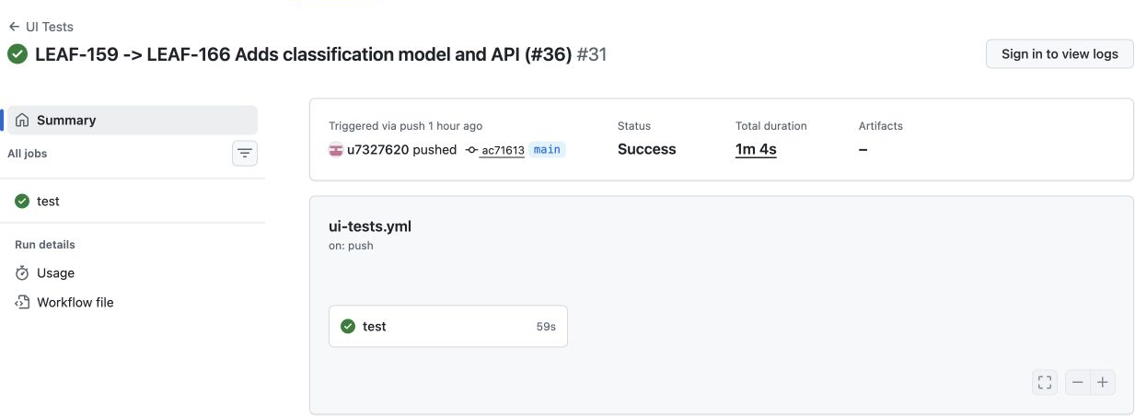
EXECUTION AND QUALITY
LEAF ANALYZER / SPRINT 5
GitHub runs our tests automatically
105 passed
20 skipped
Checks run on PRs
and pushes to main.
11 skips need PyTorch.
9 need real sample files.
We added CI. Automatic deployment is not set up yet.
Sources: PR #25 · CI workflow · CI run · Test packages
10
Notes:
GitHub Actions runs our tests for pull requests and pushes to main. The main run after the classification merge passed: 105 tests passed and 20 were skipped. Eleven skipped tests need PyTorch, and nine need real sample files that are not in the repository. So a green check is useful, but it does not mean every feature was tested. We have CI now; automatic deployment is not set up.
[Sources]
- https://github.com/Techlauncher-LeafAnalyzer/Hyperspectral-Image-Inspector/pull/25
- https://github.com/Techlauncher-LeafAnalyzer/Hyperspectral-Image-Inspector/blob/ac7161342dbb661c9f5efbfd9de5a554ee4c6141/.github/workflows/ui-tests.yml
- https://github.com/Techlauncher-LeafAnalyzer/Hyperspectral-Image-Inspector/actions/runs/33145582110
- https://github.com/Techlauncher-LeafAnalyzer/Hyperspectral-Image-Inspector/blob/ac7161342dbb661c9f5efbfd9de5a554ee4c6141/requirements-dev.txt
- Latest CI log: collected 125 items; 105 passed, 20 skipped in 8.08s.
- Temporary checkout verification at ac71613 on 28 August: 105 passed, 20 skipped; no PyTorch and no real samples.
- Screenshots: real project UI or browser captures taken 28 August 2026; cropped only for placement. Actual successful GitHub Actions UI Tests run at ac71613 on 28 August.
[/Sources]

Slide 11
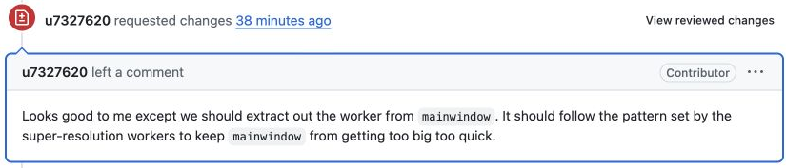
EXECUTION AND QUALITY
LEAF ANALYZER / SPRINT 5
Code review helped us tidy the code
28 August: Ryan asked for a change before approving PR #36.
What we did
We moved the classification code out of the main window
and into its own controller.
PR #36 was approved and merged. CI passed. More classification tests are still needed.
Sources: PR #36 · Review request · Approval · Commit c285154 · CI run · Week 5 report · Week 5 reflection
11
Notes:
This is one example of code review changing our work. Ryan asked us to move the classification worker out of the main window. The code was moved into a separate controller, then the review was approved and PR 36 was merged. The main CI run also passed. Earlier reports said this PR was still open because they were written before the merge. The PR did not add dedicated classification test files, so that still needs attention.
[Sources]
- https://github.com/Techlauncher-LeafAnalyzer/Hyperspectral-Image-Inspector/pull/36
- https://github.com/Techlauncher-LeafAnalyzer/Hyperspectral-Image-Inspector/pull/36#pullrequestreview-5048104584
- https://github.com/Techlauncher-LeafAnalyzer/Hyperspectral-Image-Inspector/pull/36#pullrequestreview-5048223876
- https://github.com/Techlauncher-LeafAnalyzer/Hyperspectral-Image-Inspector/commit/c285154ac5a1699da66058b6511dbbbc006d60b0
- https://github.com/Techlauncher-LeafAnalyzer/Hyperspectral-Image-Inspector/actions/runs/33145582110
- https://leaf2qr.atlassian.net/wiki/spaces/L/pages/19726337
- https://leaf2qr.atlassian.net/wiki/spaces/L/pages/19726345
- Asset: actual GitHub browser screenshot captured 28 August 2026; cropped only for layout.
[/Sources]

Slide 12
REFLECTION AND IMPROVEMENT
LEAF ANALYZER / SPRINT 5
We recorded problems and followed up
PROBLEM
WHAT WE LEARNED
WHAT HAPPENED NEXT
Hypercube was not ready
on 21 August.
Test the model and UI
together before calling it done.
The working version was
merged in PR #29 on 28 Aug.
Crop scaling and timing
caused bugs.
Check the view after cropping
and wait for UI changes in tests.
PR #30 fixed crop fit.
PR #34 fixed flaky tests.
Tutor asked for regular
reflection and risk updates.
Write down what went wrong
and what to do next.
Weekly logs on 21 and 28 Aug;
LEAF-157 links the documents.
Next time, each action should include who owns it and a link to the result.
Sources: Week 4 reflection · Week 5 reflection · Tutor meeting · LEAF-157 · PR #29 · PR #30 · PR #34 · Risk plan
12
Notes:
We have weekly reflection pages for 21 and 28 August, with team notes and each person’s reflection. They record problems such as unfinished Hypercube integration, crop scaling and flaky tests. Later pull requests show the fixes. The tutor’s feedback also led to regular reflection and risk updates. This is a useful start. We should keep adding an owner and a result link to each action, rather than only marking it done.
[Sources]
- https://leaf2qr.atlassian.net/wiki/spaces/L/pages/18448410
- https://leaf2qr.atlassian.net/wiki/spaces/L/pages/19726345
- https://leaf2qr.atlassian.net/wiki/spaces/L/pages/18645003
- https://leaf2qr.atlassian.net/browse/LEAF-157
- https://github.com/Techlauncher-LeafAnalyzer/Hyperspectral-Image-Inspector/pull/29
- https://github.com/Techlauncher-LeafAnalyzer/Hyperspectral-Image-Inspector/pull/30
- https://github.com/Techlauncher-LeafAnalyzer/Hyperspectral-Image-Inspector/pull/34
- https://leaf2qr.atlassian.net/wiki/spaces/L/pages/6193171
[/Sources]

Slide 13
SPRINT 4 FEEDBACK → SPRINT 5 EVIDENCE
LEAF ANALYZER / SPRINT 5
How we used last sprint’s feedback
FEEDBACK
WHAT WE CHANGED
RESULT / NEXT STEP
Track meeting actions
Linked Jira tasks, meeting notes and reports.
LEAF-157 tracks the tutor’s action items.
Easier to follow progress.
Client review is still needed.
Improve estimates
Added estimates and worklogs
for selected tasks.
We can compare the time.
Keep the first estimate.
Add tests and CI
Added pytest / Qt tests and GitHub Actions.
PR #25 and later fixes show the work.
Checks run automatically.
Test more models and PCs.
Keep a reflection log
Added team and individual reflections
on 21 and 28 August.
Problems have written actions.
Keep checking the results.
We made progress in all four areas. Testing and CI are the clearest improvements.
Sources: Tutor meeting · Week 4 reflection · Week 5 reflection · Backlog · Risk plan · LEAF-157 · LEAF-150 · LEAF-152 · PR #25 · CI run
13
Notes:
This slide brings the four areas together. We linked meeting actions to tasks and reports, added time records, introduced automated tests and CI, and kept weekly reflection logs. Testing and CI have the clearest evidence because the code and run history are available. The other areas improved too, but we still need client review, better first estimates and clearer action outcomes. We should keep working on these next sprint.
[Sources]
- Sprint 4 feedback and HD criteria: supplied by the team in the presentation brief.
- https://leaf2qr.atlassian.net/wiki/spaces/L/pages/18645003
- https://leaf2qr.atlassian.net/wiki/spaces/L/pages/18448410
- https://leaf2qr.atlassian.net/wiki/spaces/L/pages/19726345
- https://leaf2qr.atlassian.net/wiki/spaces/L/pages/18284545
- https://leaf2qr.atlassian.net/wiki/spaces/L/pages/6193171
- https://leaf2qr.atlassian.net/browse/LEAF-157
- https://leaf2qr.atlassian.net/browse/LEAF-150
- https://leaf2qr.atlassian.net/browse/LEAF-152
- https://github.com/Techlauncher-LeafAnalyzer/Hyperspectral-Image-Inspector/pull/25
- https://github.com/Techlauncher-LeafAnalyzer/Hyperspectral-Image-Inspector/actions/runs/33145582110
[/Sources]

Slide 14
SPRINT 6 GOALS AND PLAN
LEAF ANALYZER / SPRINT 5
Our plan for Sprint 6
GOAL
WHY
NEXT ACTION
1 Finish calibration
Use calibrated data
in the app.
Jingyi: algorithm, LEAF-115.
Guochen: UI and checks, LEAF-116.
2 Test classification
Make sure the new feature
keeps working.
Add model and UI tests. Check masks
after SR, cropping and reloading.
3 Check the results
A good-looking image
may still be wrong.
Add LEAF-113 reference tests.
Check the SR model’s data needs.
4 Test on real PCs
Find memory, disk
and graphics problems.
Run SR and Windows/3D tests.
Measure time and memory use.
5 Review with the client
Check that the changes
meet their needs.
Demo the app and record actions.
Agree priorities and first estimates.
These are proposed goals. We will confirm priorities, owners and time before the sprint starts.
Sources: LEAF-105 · LEAF-115 · LEAF-116 · LEAF-113 · LEAF-163 · LEAF-164 · PR #36 · Week 5 report · Week 5 reflection · Risk plan
14
Notes:
For Sprint 6, we propose five goals. Finish calibration, add classification tests, check results against reference data, test on the target hardware, and show the app to the client. The existing calibration tasks name Jingyi for the algorithm and Guochen for the UI. The other priorities come from remaining work and the Week 5 report. Before we start, we should confirm the order, owners and estimates with the team and client.
[Sources]
- https://leaf2qr.atlassian.net/browse/LEAF-105
- https://leaf2qr.atlassian.net/browse/LEAF-115
- https://leaf2qr.atlassian.net/browse/LEAF-116
- https://leaf2qr.atlassian.net/browse/LEAF-113
- https://leaf2qr.atlassian.net/browse/LEAF-163
- https://leaf2qr.atlassian.net/browse/LEAF-164
- https://github.com/Techlauncher-LeafAnalyzer/Hyperspectral-Image-Inspector/pull/36
- https://leaf2qr.atlassian.net/wiki/spaces/L/pages/19726337
- https://leaf2qr.atlassian.net/wiki/spaces/L/pages/19726345
- https://leaf2qr.atlassian.net/wiki/spaces/L/pages/6193171
- Proposed process changes derived from the estimate-history audit; not claimed as prior team commitments.
[/Sources]

