Slide 1


Slide 2


Slide 3
JavaScript
The DOM – Document Object Model
Muhammad Umar Ahmad

Slide 4
DOM - Document Object Model
The DOM is an organization chart, created automatically by the browser when your web page loads, for the whole web page.
All the things on your web page—the tags, the text blocks, the images, the links, the tables, the style attributes, and more—have spots on this organization chart
In the DOM organization chart, everything represents a node
Muhammad Umar Ahmad

Slide 5
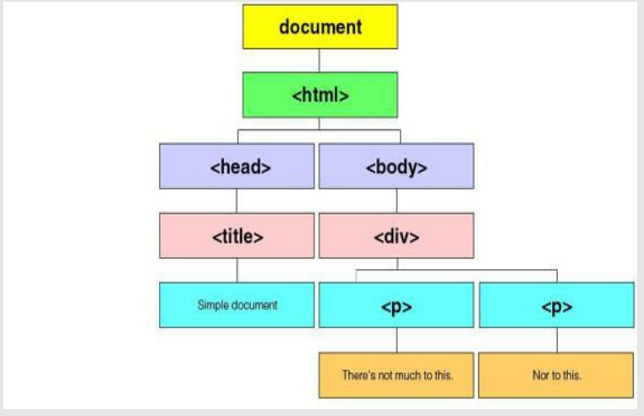
DOM - Document Object Model

Slide 6
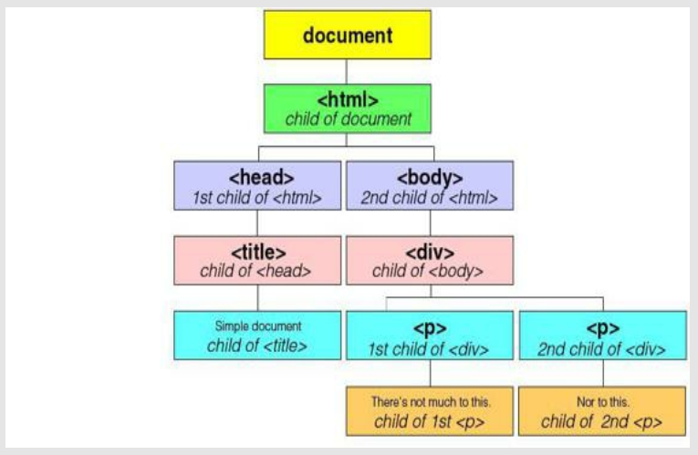
The DOM: Parents and children

Slide 7
The DOM: Finding children
var para = document.getElementById(“para1");
var paras = document.getElementsByTagName("p");
var para = moreParagraphs.childNodes[1];
Muhammad Umar Ahmad

Slide 8
The DOM: More ways to target elements
var first = moreParagraphs.firstChild
var last = moreParagraphs.lastChild
Var second = first.nextSibling;
var second = last.previousSibling
var parent = last.parentNode
Muhammad Umar Ahmad

Slide 9
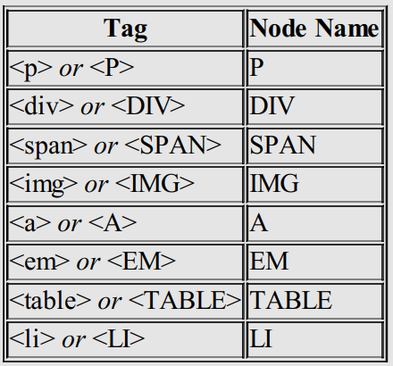
The DOM: Node Type & Node Name
var nType = para1.nodeType
var nName = para1.nodeName
On the other hand, if the node is a text node,
the name of the node is always #text—in lower-case
Muhammad Umar Ahmad

Slide 10
The DOM: Attributes
<img id=“image” src=“apple.jpg" alt=“Apple" height="42" width="42">
var hasHeight = image.hasAttribute(“height");
var attVal = image.getAttribute("height");
image.setAttribute(“height, “100");
Muhammad Umar Ahmad

Slide 11
The DOM: Attributes
<img id=“image” src=“apple.jpg" alt=“Apple" height="42" width="42">
var list = document.getElementById(“image").attributes;
var nName = list[2].nodeName;
var nValue = list[2].nodeValue;
Muhammad Umar Ahmad

Slide 12
The DOM: Adding Nodes
var newParagraph = document.createElement("p");
var newTxt = document.createTextNode("Hello!");
newParagraph.appendChild(newTxt);
newParagraph.setAttribute("class", "regular");
var moreParagraphs = document.getElementById('moreParagraphs');
moreParagraphs.appendChild(newParagraph);
Muhammad Umar Ahmad

Slide 13
The DOM: Inserting Nodes
var newParagraph = document.createElement("p");
var newTxt = document.createTextNode("Hello!");
newParagraph.appendChild(newTxt);
newParagraph.setAttribute("class", "regular");
var moreParagraphs = document.getElementById('moreParagraphs');
moreParagraphs.insertBefore(newParagraph, moreParagraphs.firstChild);
Muhammad Umar Ahmad

Slide 14
The DOM: Removing Nodes
var moreParagraphs = document.getElementById('moreParagraphs');
moreParagraphs.removeChild(moreParagraphs.firstChild);
Muhammad Umar Ahmad

Slide 15
The DOM: Junk artifacts
Let’s Demo to understand this………….
Muhammad Umar Ahmad

Slide 16
Thank you
Muhammad Umar Ahmad

