Slide 1
Analog to Digital Converters
Byron Johns
Danny Carpenter
Stephanie Pohl
Harry “Bo” Marr
October 4, 2005

Slide 2
Presentation Outline
Introduction: Analog vs. Digital?
Examples of ADC Applications
Types of A/D Converters
A/D Subsystem used in the microcontroller chip
Examples of Analog to Digital Signal Conversion
Successive Approximation ADC

Slide 3
First Presenter
Byron Johns

Slide 4
Analog Signals
Analog signals – directly measurable quantities in terms of some other quantity
Examples:
Thermometer – mercury height rises as temperature rises
Car Speedometer – Needle moves farther right as you accelerate
Stereo – Volume increases as you turn the knob.

Slide 5
Digital Signals
Digital Signals – have only two states. For digital computers, we refer to binary states, 0 and 1. “1” can be on, “0” can be off.
Examples:
Light switch can be either on or off
Door to a room is either open or closed

Slide 6
Examples of A/D Applications
Microphones - take your voice varying pressure waves in the air and convert them into varying electrical signals
Strain Gages - determines the amount of strain (change in dimensions) when a stress is applied
Thermocouple – temperature measuring device converts thermal energy to electric energy
Voltmeters
Digital Multimeters

Slide 7
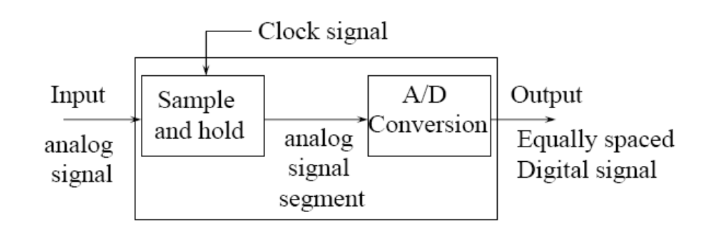
Just what does an
A/D converter DO?
Converts analog signals into binary words

Slide 8
Analog → Digital Conversion
2-Step Process:
Quantizing - breaking down analog value is a set of finite states
Encoding - assigning a digital word or number to each state and matching it to the input signal

Slide 9
Step 1: Quantizing
Example:
You have 0-10V signals. Separate them into a set of discrete states with 1.25V increments. (How did we get 1.25V? See next slide…)
Output States | Discrete Voltage Ranges (V)
0 | 0.00-1.25
1 | 1.25-2.50
2 | 2.50-3.75
3 | 3.75-5.00
4 | 5.00-6.25
5 | 6.25-7.50
6 | 7.50-8.75
7 | 8.75-10.0

Slide 10
Quantizing
The number of possible states that the converter can output is:
N=2^{n}
where n is the number of bits in the AD converter
Example: For a 3 bit A/D converter, N=2³=8.
Analog quantization size:
Q=(Vmax-Vmin)/N = (10V – 0V)/8 = 1.25V

Slide 11
Encoding
Here we assign the digital value (binary number) to each state for the computer to read.
Output States | Output Binary Equivalent
0 | 000
1 | 001
2 | 010
3 | 011
4 | 100
5 | 101
6 | 110
7 | 111

Slide 12
Accuracy of A/D Conversion
There are two ways to best improve accuracy of A/D conversion:
increasing the resolution which improves the accuracy in measuring the amplitude of the analog signal.
increasing the sampling rate which increases the maximum frequency that can be measured.

Slide 13
Resolution
Resolution (number of discrete values the converter can produce) = Analog Quantization size (Q)
(Q) = Vrange / 2^n, where Vrange is the range of analog voltages which can be represented
limited by signal-to-noise ratio (should be around 6dB)
In our previous example: Q = 1.25V, this is a high resolution. A lower resolution would be if we used a 2-bit converter, then the resolution would be 10/2^2 = 2.50V.

Slide 14
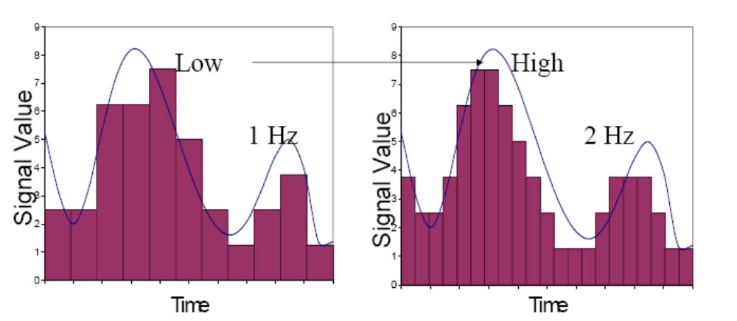
Sampling Rate
Frequency at which ADC evaluates analog signal. As we see in the second picture, evaluating the signal more often more accurately depicts the ADC signal.

Slide 15
Aliasing
Occurs when the input signal is changing much faster than the sample rate.
For example, a 2 kHz sine wave being sampled at 1.5 kHz would be reconstructed as a 500 Hz (the aliased signal) sine wave.
Nyquist Rule:
Use a sampling frequency at least twice as high as the maximum frequency in the signal to avoid aliasing.

Slide 16
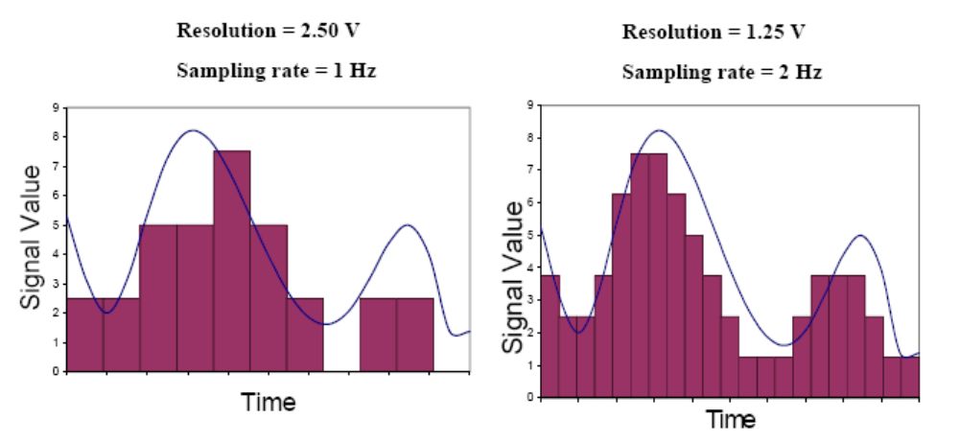
Overall Better Accuracy
Increasing both the sampling rate and the resolution you can obtain better accuracy in your AD signals.

Slide 17
A/D Converter Types _{By Danny Carpenter}
Converters
  Flash ADC
  Delta-Sigma ADC
  Dual Slope (integrating) ADC
  Successive Approximation ADC

Slide 18
Flash ADC
Consists of a series of comparators, each one comparing the input signal to a unique reference voltage.
The comparator outputs connect to the inputs of a priority encoder circuit, which produces a binary output

Slide 19
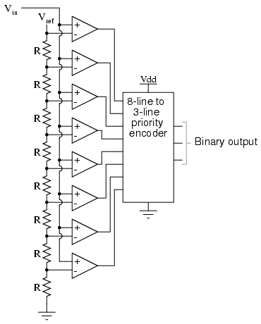
Flash ADC Circuit

Slide 20
How Flash Works
As the analog input voltage exceeds the reference voltage at each comparator, the comparator outputs will sequentially saturate to a high state.
The priority encoder generates a binary number based on the highest-order active input, ignoring all other active inputs.

Slide 21
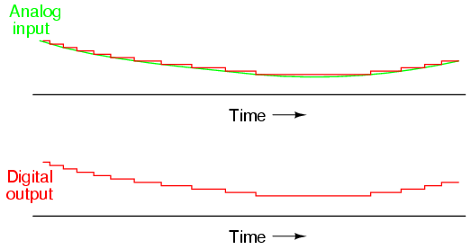
ADC Output

Slide 22
Flash
Advantages
Simplest in terms of operational theory
Most efficient in terms of speed, very fast
    limited only in terms of comparator and gate propagation delays
Disadvantages
Lower resolution
Expensive
For each additional output bit, the number of comparators is doubled
    i.e. for 8 bits, 256 comparators needed

Slide 23
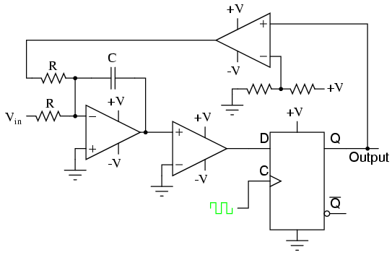
Sigma Delta ADC
Over sampled input signal goes to the integrator
Output of integration is compared to GND
Iterates to produce a serial bit stream
Output is serial bit stream with # of 1’s proportional to V_{in}

Slide 24
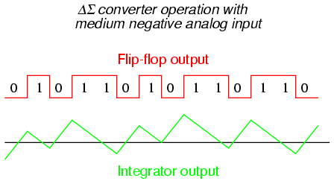
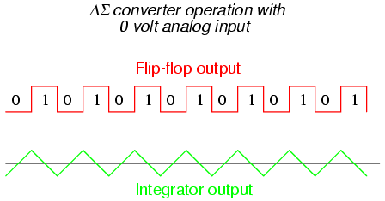
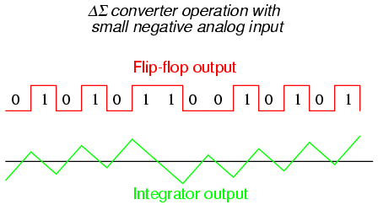
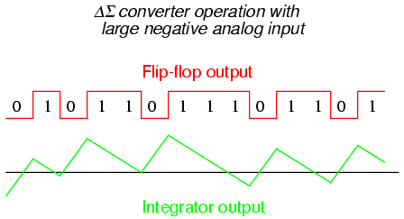
Outputs of Delta Sigma

Slide 25
Sigma-Delta
Advantages
High resolution
No precision external components needed
Disadvantages
Slow due to oversampling

Slide 26



Dual Slope Converter
V_{in}
t_{FIX}
t_{meas}
t
The sampled signal charges a capacitor for a fixed amount of time
By integrating over time, noise integrates out of the conversion
Then the ADC discharges the capacitor at a fixed rate with the counter counts the ADC’s output bits. A longer discharge time results in a higher count

Slide 27
Dual Slope Converter
Advantages
Input signal is averaged
Greater noise immunity than other ADC types
High accuracy
Disadvantages
Slow
High precision external components required to achieve accuracy

Slide 28
Successive Approximation ADC _{By Stephanie Pohl}
A Successive Approximation Register (SAR) is added to the circuit
Instead of counting up in binary sequence, this register counts by trying all values of bits starting with the MSB and finishing at the LSB.
The register monitors the comparators output to see if the binary count is greater or less than the analog signal input and adjusts the bits accordingly

Slide 29
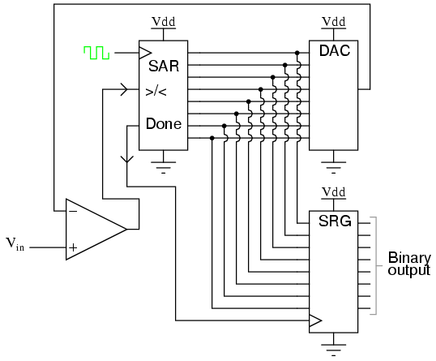
Successive Approximation ADC Circuit

Slide 30
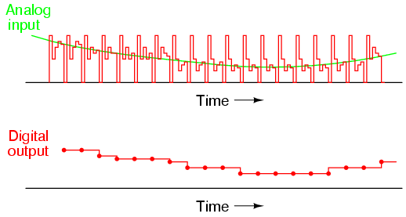
Output

Slide 31
Successive Approximation
Advantages
Capable of high speed and reliable
Medium accuracy compared to other ADC types
Good tradeoff between speed and cost
Capable of outputting the binary number in serial (one bit at a time) format.
Disadvantages
Higher resolution successive approximation ADC’s will be slower
Speed limited to ~5Msps

Slide 32
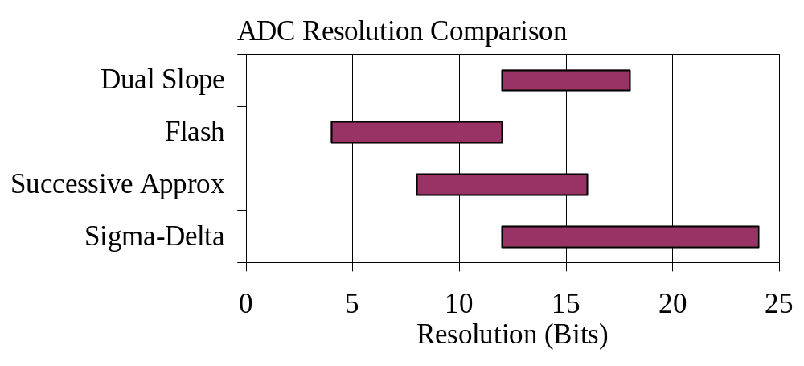
ADC Types Comparison
Type | Speed (relative) | Cost (relative)
Dual Slope | Slow | Med
Flash | Very Fast | High
Successive Appox | Medium – Fast | Low
Sigma-Delta | Slow | Low

Slide 33
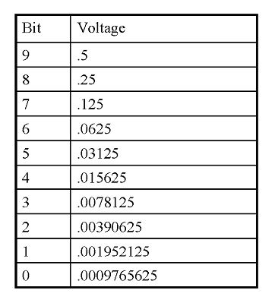
Successive Approximation Example
10 bit resolution or 0.0009765625V of Vref
Vin= .6 volts
Vref=1volts
Find the digital value of Vin

Slide 34
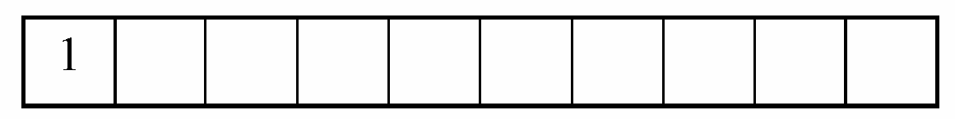
Successive Approximation
MSB (bit 9)
  Divided V_{ref} by 2
  Compare V_{ref} /2 with V_{in}
  If V_{in} is greater than V_{ref} /2 , turn MSB on (1)
  If V_{in} is less than V_{ref} /2 , turn MSB off (0)
  V_{in} =0.6V and V=0.5
  Since V_{in}>V, MSB = 1 (on)

Slide 35

Successive Approximation
Next Calculate MSB-1 (bit 8)
  Compare V_{in}=0.6 V to V=V_{ref}/2 + V_{ref}/4= 0.5+0.25 =0.75V
  Since 0.6<0.75, MSB is turned off
Calculate MSB-2 (bit 7)
  Go back to the last voltage that caused it to be turned on (Bit 9) and add it to V_{ref}/8, and compare with V_{in}
  Compare V_{in} with (0.5+V_{ref}/8)=0.625
  Since 0.6<0.625, MSB is turned off

Slide 36
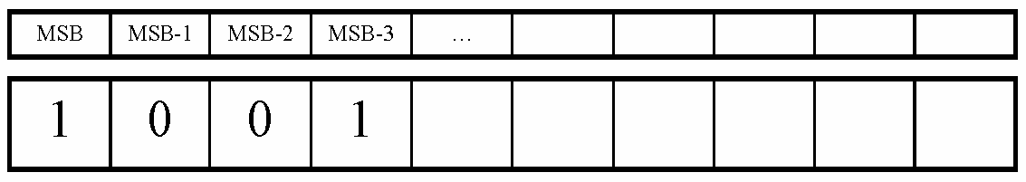
Successive Approximation
Calculate the state of MSB-3 (bit 6)
  Go to the last bit that caused it to be turned on (In this case MSB-1) and add it to V_{ref}/16, and compare it to V_{in}
  Compare V_{in} to V= 0.5 + V_{ref}/16= 0.5625
  Since 0.6>0.5625, MSB-3=1 (turned on)

Slide 37
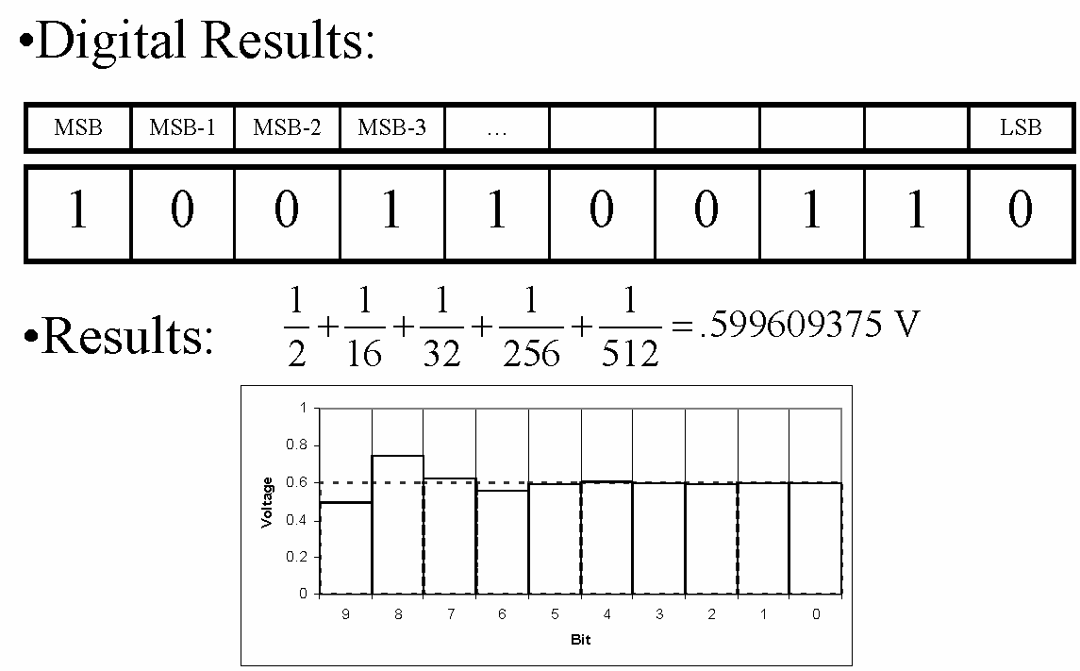
Successive Approximation
This process continues for all the remaining bits.

Slide 38
The HC11 and ADC
By Harry “Bo” Marr

Slide 39
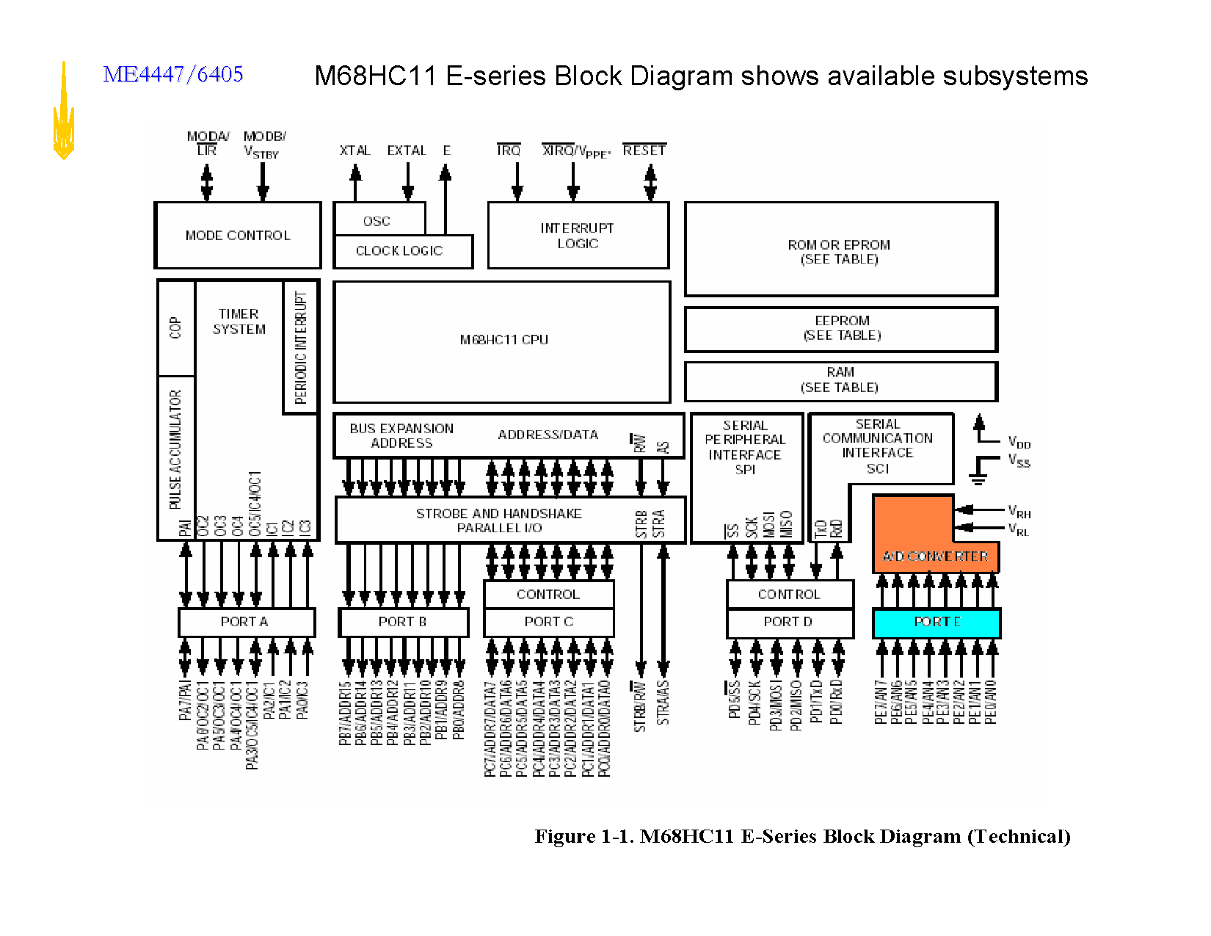

Slide 40
ADC Flow Diagram in HC11
8 channel/bit input
VRL = 0 volts
VRH = 5 volts
Digital input on PE
Pin:
7
6
5
4
3
2
1
0
Port E (analog input)
ADR1 - result 1
Analog Multiplexer
ADR2 - result 2
Result Register Interface
A/D Converter
ADR3 - result 3
ADR4 - result 4

Slide 41
Stuctural Diagram of ADC on HC11
PE0
AN0
PE1
AN1
PE2
AN2
PE3
AN3
PE4
AN4
PE5
AN5
PE6
AN6
PE7
AN7
ANALOG MUX
8-bits CAPACITIVE DAC WITH SAMPLE AND HOLD
V_{RH}
SUCCESSIVE APPROXIMATION REGISTER AND CONTROL
V_{RL}
INTERNAL DATA BUS
SCAN
MULT
CCF
CD
CC
CB
CA
ADCTL A/D CONTROL
RESULT REGISTER INTERFACE
ADR1
ADR2
ADR3
ADR4
P 64 M68HC11 Family Data Sheet

Slide 42
ADC by Clock cycle
Conversion Sequence
E Clock cycles:
Sample (12)
Bit 7 (4)
6 (2)
_ (2)
0 (2)
End (2)
ADPU = 1
Successive approximation
1st, ADR1
2nd, ADR2
3rd, ADR3
4th, ADR4
CCF
0
32
64
96

Slide 43
Output States | Discretized Voltage Range | Binary Coded Equivalent
0 | 0 - 19.5 mV | $00
1 | 19.6 - 39.0 mV | $01
2 | 39.1 - 58.5 mV | $02
… | … | …
255 | 4.98 - 5.0 V | $FF
HC11 => 8 bits => 2⁸ = 256
HC11 accepts 0 – 5V range
Voltage Range = (V_{RH} – V_{RL})/255 * State

Slide 44
ADCTL Register
$1030
CCF |No Op| SCAN |MULT | CD | CC | CB | CA
Read
0
0
0
0
0
0
0
0
-
Bit:
7
6
5
4
3
2
1
0
CCF: (1) after conversion cycle, (0) when written to.
SCAN: Continuous (1) or Not (0)
MULT: Multi-Channel (1) or Single Channel (0)
  0 = Single Channel is read 4 times
CD:CC:CB:CA = 0000 – 0111 Chooses input channel
    Chooses Channel Group when MULT = 1
Pg 27 – 28 in Reference Manual

Slide 45
Options Register
$1039
ADPU |CSEL | IRQE |DLY | CME | NoOp| CR1 | CR0
1
-
1
0
0
1
0
0
Bit:
7
6
5
4
3
2
1
0
ADPU: Power up (1) wait 100ms, No conversion (0)
CSEL: use internal system clock (1), use E-clock (0)
IRQE: Falling Edge interupt (1), low level interrupt (0)
DLY: Delay enabled (1), Delay disabled (0)
CME: Monitor Clock (1), Don’t monitor clock (0)
CR[1:0] = Divide E clock by 1, 4, 16, 64.
pg 38 in reference manual

Slide 46
Analog to Digital Results Register: $1031 - $1034
ADR2 ($1032)
0
0
0
0
0
0
1
0
Bit:
7
6
5
4
3
2
1
0
Register $1032 = $02
Options Register ($1039) = $80
ADCTL Register ($1030) = $00
Just read in signal between 19.2 – 39.0 mV on pin E1!

Slide 47
OPTION ($1039)
ADPU
CSEL
IREQ
DLY
CME
0
CR1
CR2
ADCTL ($1030)
CCF
0
SCAN
MULT
CD
CC
CB
CA
OPTION EQU $1039
ADCTL EQU $1030
ADR1 EQU $1031
ADRESULT RMB 1
Turn on charge pump and select clock source
ORG $2000
LDAA #$80 ;ADPU=1,CSEL=0
STAA OPTION ; “
Delay for charge pump to stabilize
LDY #30 ;delay for 105 μs
DELAY DEY
BNE DELAY
  LDAA #$10 ;SCAN=0,MULT=1,CHAN GRP=00
  STAA ADCTL ; start conversion
Set ADCTL to start conversion
  LDX #ADCTL ;check for complete flag
  BRCLR 0,X #$80 * ;CCF is bit 7
Wait until conv. complete
  LDAA ADR1 ;read chan. 0
  STAA ADRESULT ;store in result
  SWI
Read result

Slide 48
References
Ron Bishop, “Basic Microprocessors and the 6800”, Hayden Book Company Inc., 1979
Motorola, “MC68HC11E Family Data Sheet”, Motorola, Inc., Rev. 5, 2003.
Motorola, “MC68HC11 Reference Manual”, Motorola, Inc., Rev. 4, 2002.
Motorola, “MC68HC11 Programming Reference Guide”, Motorola, Inc., Rev. 2, 2003.

Slide 49

Any Questions?

