Slide 1

Introduction to
Analog-Digital-Converter
Mr. Amit Kumar Singh
Assistant Professor
ECE Dept.
BCE Bhagalpur

Slide 2
Agenda
Introduction
Characteristic Values of ADCs
Nyquist-Rate ADCs
Oversampling ADC
Practical Issues
Low Power ADC Design
Analog Digital Converter

Slide 3
Introduction
ADC = Analog-Digital-Converter
Conversion of audio signals (mobile micro, digital music records, ...)
Conversion of video signals (cameras, frame grabber, ...)
Measured value acquisition (temperature, pressure, luminance, ...)
Analog Digital Converter

Slide 4
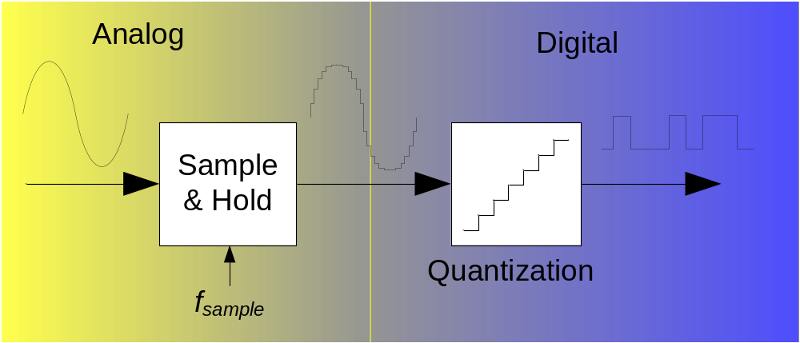
ADC - Scheme
Analog input can be voltage or current (in the following only voltage)
Analog input can be positive or negative (in the following only positive)
Analog Digital Converter

Slide 5
2. Characteristic Values of ADCs
Which values characterize an ADC?
What kind of errors exist?
What is aliasing?
Analog Digital Converter

Slide 6
ADC Values
Resolution N: number of discrete values to represent the analog values (in Bit)
  8 Bit = 2⁸ = 256 quantization level,
  10 Bit = 2¹⁰ = 1024 quantization level
Reference voltage V_{ref}: Analog input signal V_{in} is related to digital output signal D_{out} through V_{ref} with:
V_{in} = V_{ref} · (D₀2⁻¹ + D₁2⁻² + … + D_{N-1}2^{-N})
  Example: N = 3 Bit, V_{ref} = 1V, D_{out} = ‘011’
  => V_{in} = 1V · ( 2⁻² + 2⁻³) = 1V · (0.25 + 0.125) = 0.375V
V_{in}
ADC
D_{out} = D₀D₁…D_{N-1}
V_{ref}
Analog Digital Converter

Slide 7
ADC Values cont’d
V_{LSB} : Minimum measurable voltage difference in ideal case (LSB – least significant Bit)
  V_{LSB} = V_{ref} / 2^{N}
  V_{in} = V_{LSB} (D₀2^{N-1} + D₁2^{N-2} + … + D_{N-1}2⁰)
  Example: N = 3 Bit, V_{ref} = 1V, D_{out} = ‘011’
  => V_{LSB} = 1V / 2³ = 0.125V
  => V_{in} = 0.125V · ( 2¹ + 2⁰) = 0.125V · 3 = 0.375V
ΔV: Voltage difference between two logic level
  Ideal: all ΔV = V_{LSB}
V_{FSR} : Difference between highest and lowest measurable voltages (FSR – full scale range)
Analog Digital Converter

Slide 8
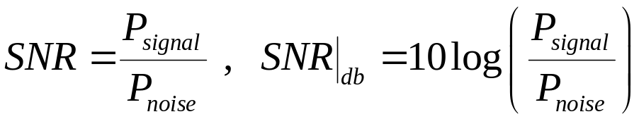
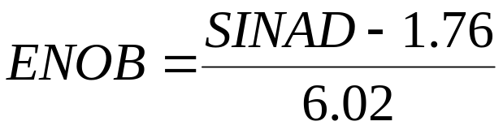
ADC Values cont’d
SNR: Signal to Noise Ratio
  Ratio of signal power to noise power
ENOB: Effective Number of Bits
  Effective resolution of ADC under observance of all noise and distortions
  SINAD (SIgnal to Noise And Distortion) → ratio of fundamental signal to the sum of all distortion and noise (DC term removed)
  Comparison of SINAD of ideal and real ADC with same word length
Analog Digital Converter

Slide 9
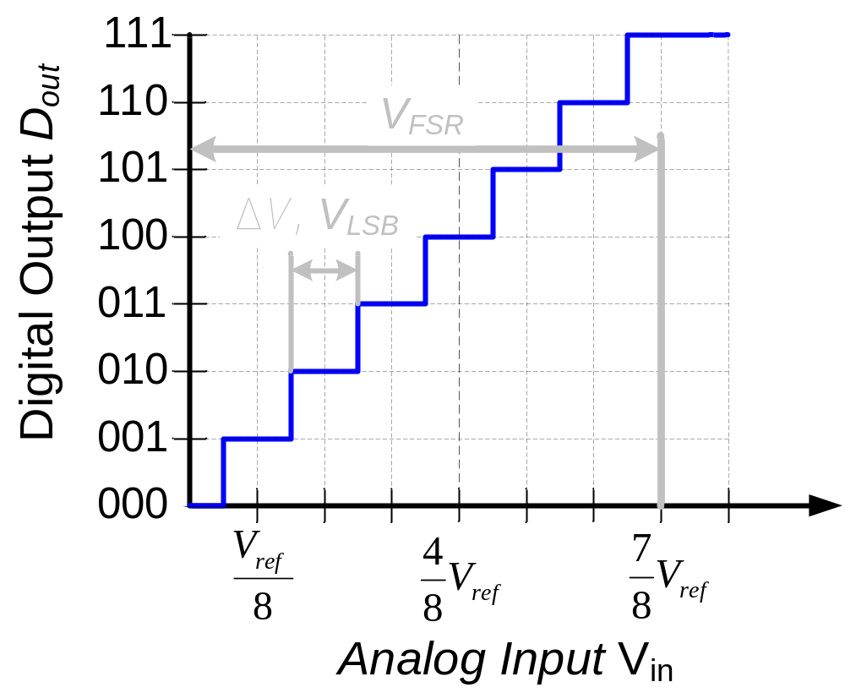
Ideal ADC
Analog Digital Converter

Slide 10
Further ADC Values
Bandwidth: Maximum measurable frequency of the input signal
Power dissipation
Conversion Time: Time for conversion of an analog value into a digital value (interesting in pipeline and parallel structures)
Sampling rate (f_{samp}): Rate at which new digital values are sampled from the analog signal (also: sample
Errors: Quantization, offset, gain, INL, DNL, missing codes, non-monotonicity…
Analog Digital Converter

Slide 11
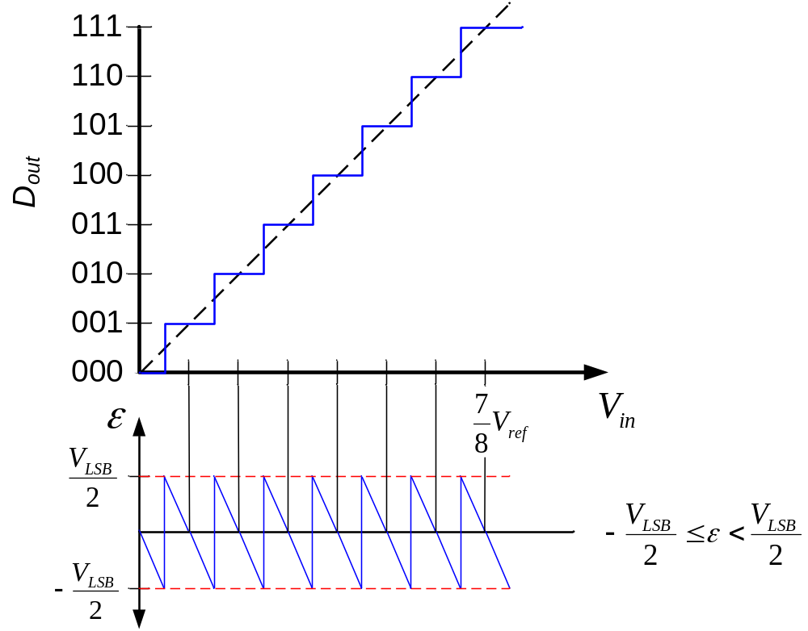
Quantization Error ε
Analog Digital Converter

Slide 12
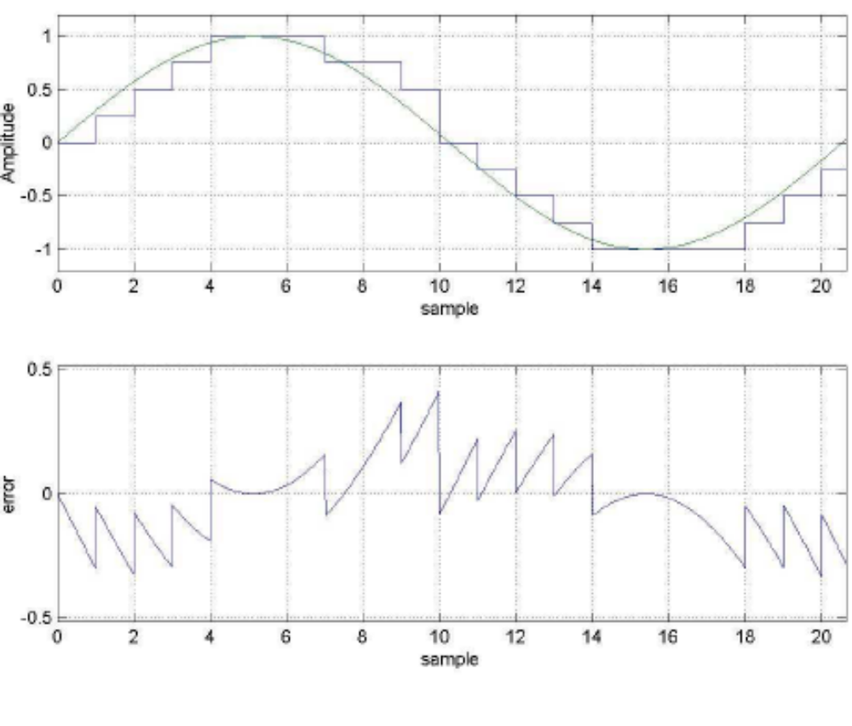
Quantization Error (3-Bit Flash)
Amplitude
sample
Error
sample
Eugenio Di Gioia, Sigma-Delta-A/D-Wandler, 2007
Analog Digital Converter

Slide 13
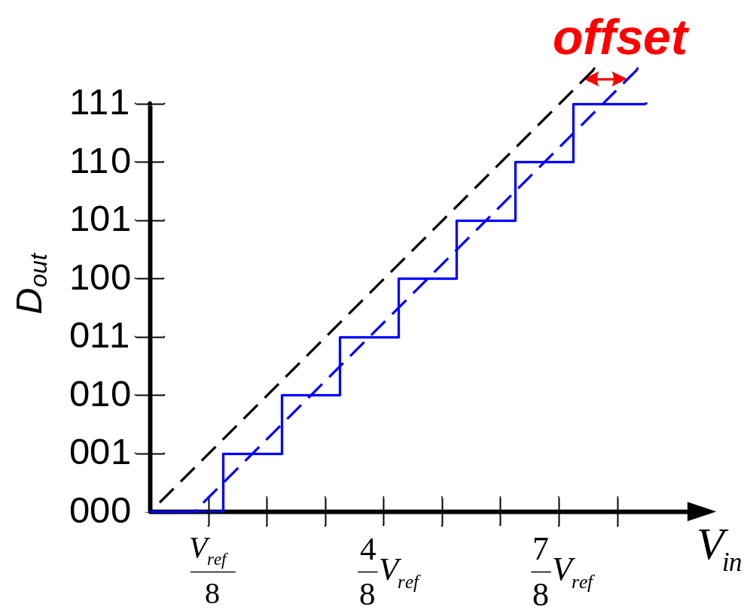
Offset Error
Parallel shift of the whole curve
E.g. caused by difference in ground line voltages
Analog Digital Converter

Slide 14
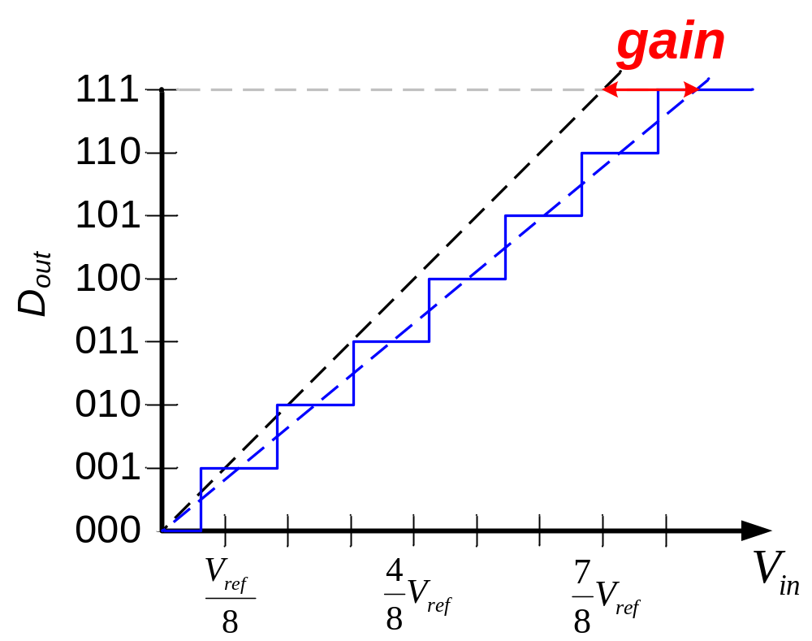
Gain Error
Corresponds to too small or to large but equal ΔV
E.g. caused by too small or too large V_{ref}
Analog Digital Converter

Slide 15
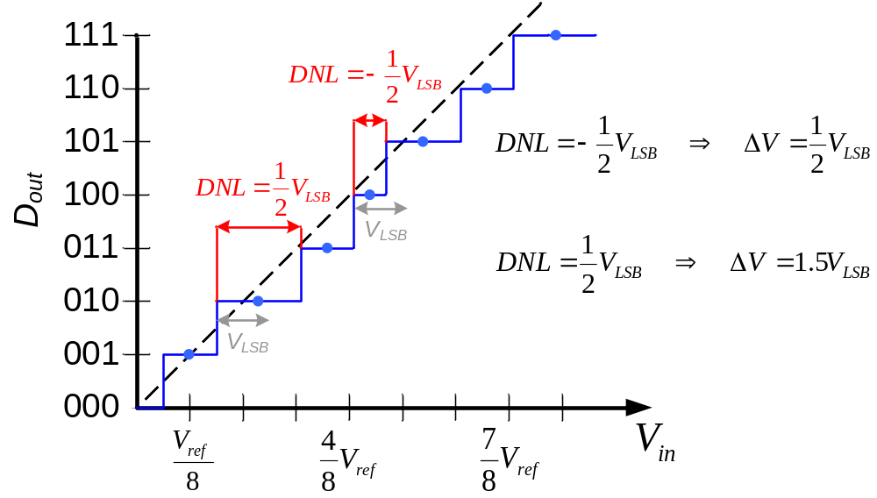
Differential Non-Linearity (DNL)
Deviation of ΔV from V_{LSB} value (in V_{LSB})
Defined after removing of gain
E.g. Caused by mismatch of the reference elements
Analog Digital Converter

Slide 16
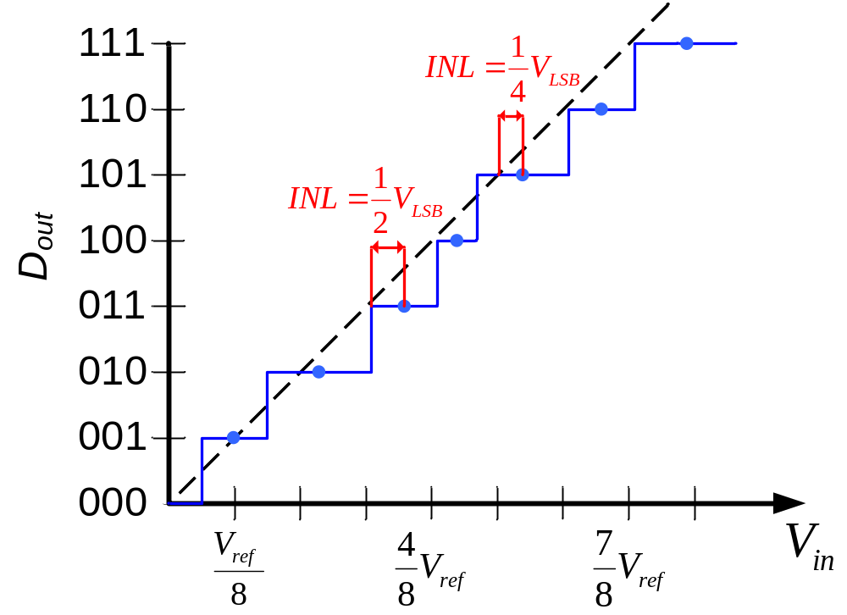
Integral Non-Linearity (INL)
Deviation from the straight line (best-fit or end-point) (in V_{LSB})
Defined after removing of gain and offset
E.g. caused by mismatch of the reference elements
Analog Digital Converter

Slide 17
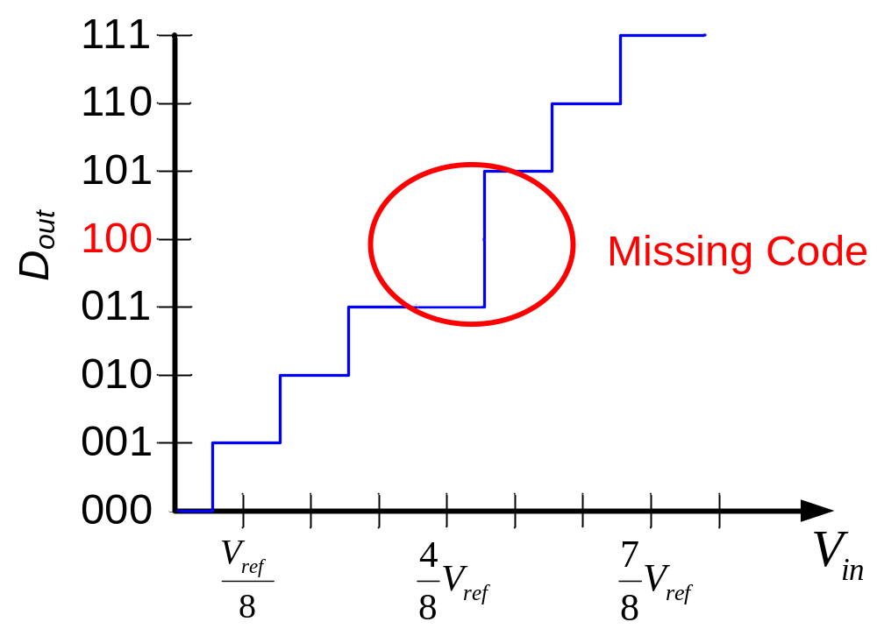
Missing Codes
Some bit combinations never appear
Occurs, if maximum DNL > 1 V_{LSB} or maximum INL > 0.5 V_{LSB}
Analog Digital Converter

Slide 18
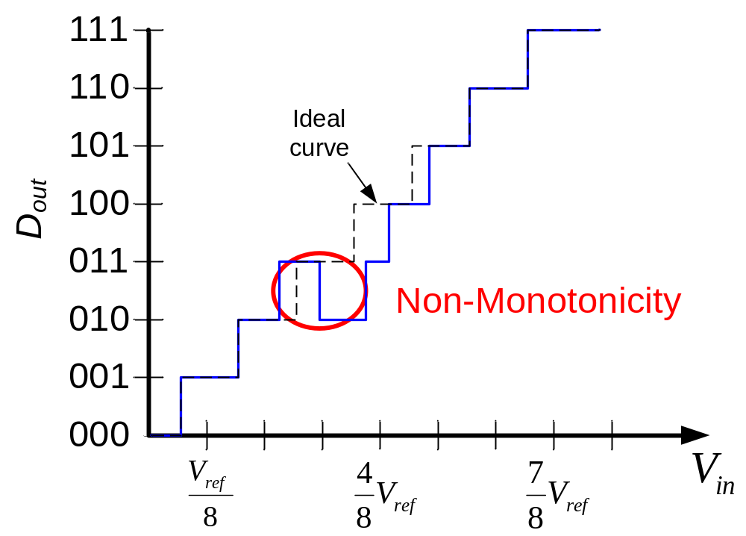
Non-Monotonicity
Lower conversion result for a higher input voltage
Includes that same conversion may result from two separate voltage ranges
Analog Digital Converter

Slide 19
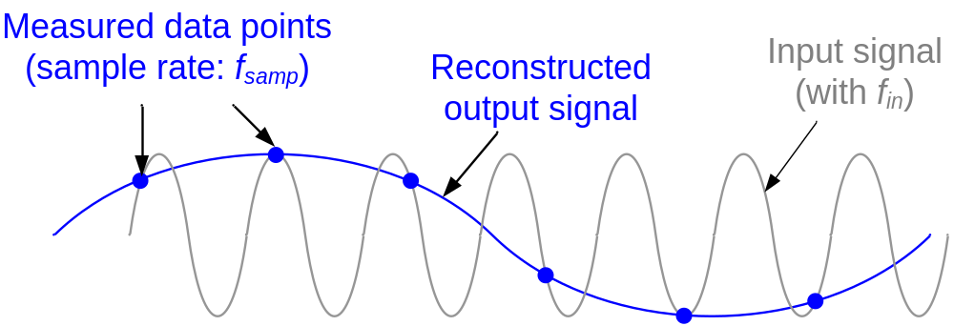
Aliasing
Too small sampling rate f_{samp} (under-sampling) can lead to aliasing ( = frequency of reconstructed signal is to low)
Nyquist criterion:
  f_{samp} more than two times higher than highest frequency component f_{in} of input signal: f_{samp} > 2·f_{in}
Analog Digital Converter

Slide 20
3. Nyquist-Rate ADCs
How can Nyquist-rate ADCs be grouped?
What is a dual slope ADC?
What is a successive approximation ADC?
What is an algorithmic ADC?
What is a flash ADC?
What is a pipelined ADC?
What are the pros and cons of the Nyquist-rate ADCs?
Analog Digital Converter

Slide 21
Nyquist-Rate ADCs
Sampling frequency f_{samp} is in the same range as frequency f_{in} of input signal
Low-to-medium speed and high accuracy ADCs
  Integrating
Medium speed and medium accuracy ADCs
  Successive Approximation
  Algorithmic
High speed and low-to-medium accuracy ADCs
  Flash
  Two-Level Flash
  Pipelined
Analog Digital Converter

Slide 22
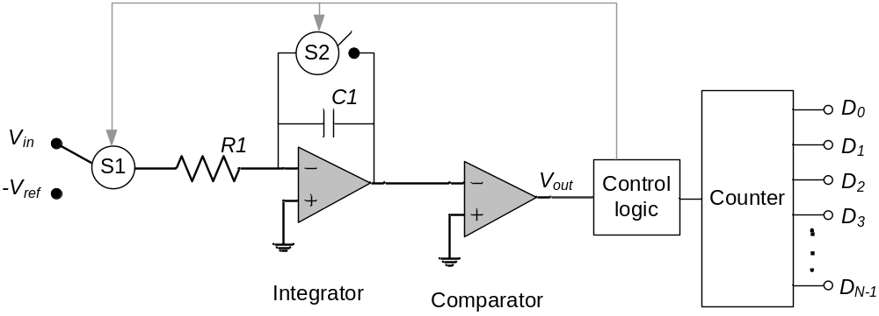
Integrating (Dual Slope) ADCs
Phase 1: Integration (capacitor C1) of V_{in} in known time T_{load}
  Q_{load} = V_{in} / R1 · T_{load}
Phase 2: Integration of reference voltage -V_{ref} until V_{out} = 0 and estimation of time ΔT
  Q_{ref} = -V_{ref} / R1 · ΔT = -Q_{load} => V_{in} = V_{ref} · ΔT / T_{load}
Independent of R1 und C1!
Analog Digital Converter

Slide 23
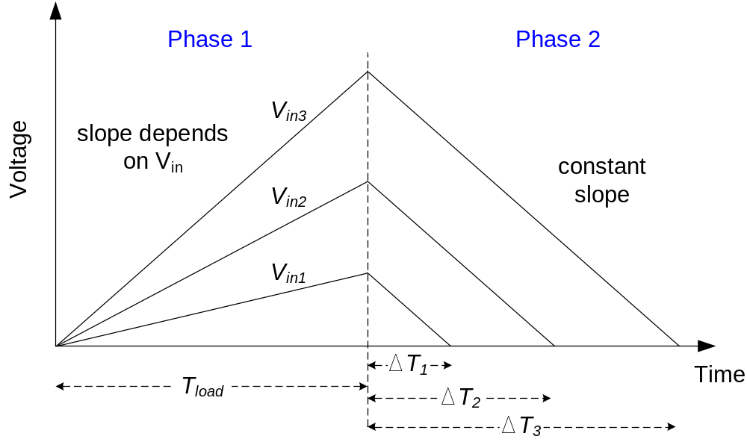
Integrating (Dual Slope) ADCs cont’d
Analog Digital Converter

Slide 24
Integrating ADCs: pros and cons
✓ Simple structure (comparator and integrator are the only analog components)
✓ Low Area / Low Power
✗ Slow
✗ Time intervals are not constant
Analog Digital Converter

Slide 25
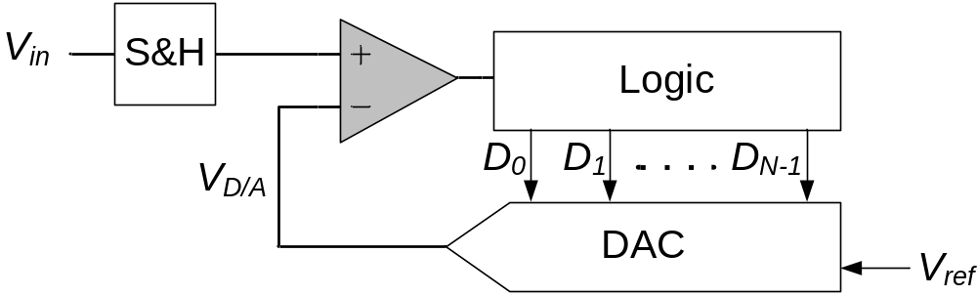
Successive Approximation ADC
Generate internal analog signal V_{D/A}
Compare V_{D/A} with input signal V_{in}
Modify V_{D/A} by D₀D₁D₂…D_{N-1} until closest possible value to V_{in} is reached
Analog Digital Converter

Slide 26
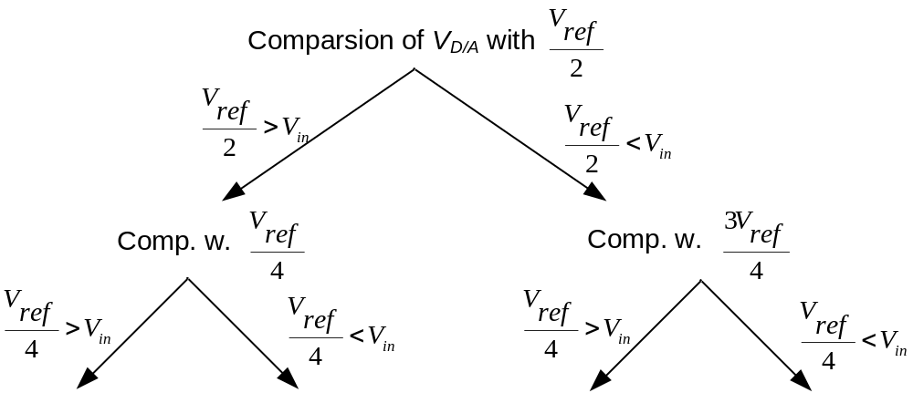
Successive Approximation ADC cont’d
Analog Digital Converter

Slide 27
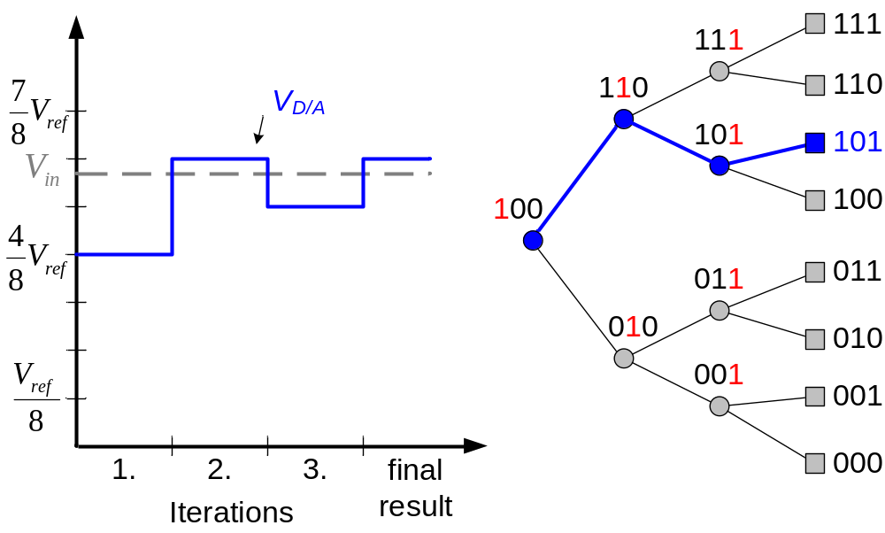
Successive Approximation ADC cont’d
P. Fischer, VLSI-Design - ADC und DAC, Uni Mannheim, 2005
Analog Digital Converter

Slide 28
Successive Approx.: pros and cons
✓ Low Area / Low Power
✗ High effort for DAC
✗ Early wrong decision leads to false result
Analog Digital Converter

Slide 29
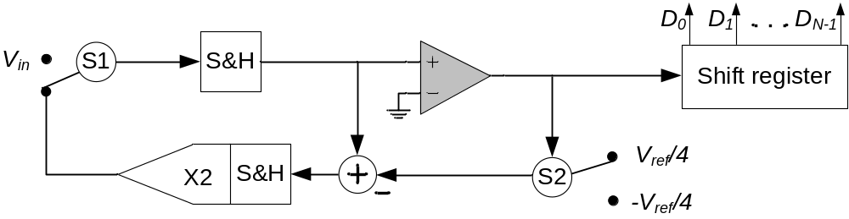
Algorithmic ADC
Same idea as successive approximation ADC
Instead of modifying V_{ref} → doubling of error voltage (V_{ref} stays constant)
Analog Digital Converter

Slide 30
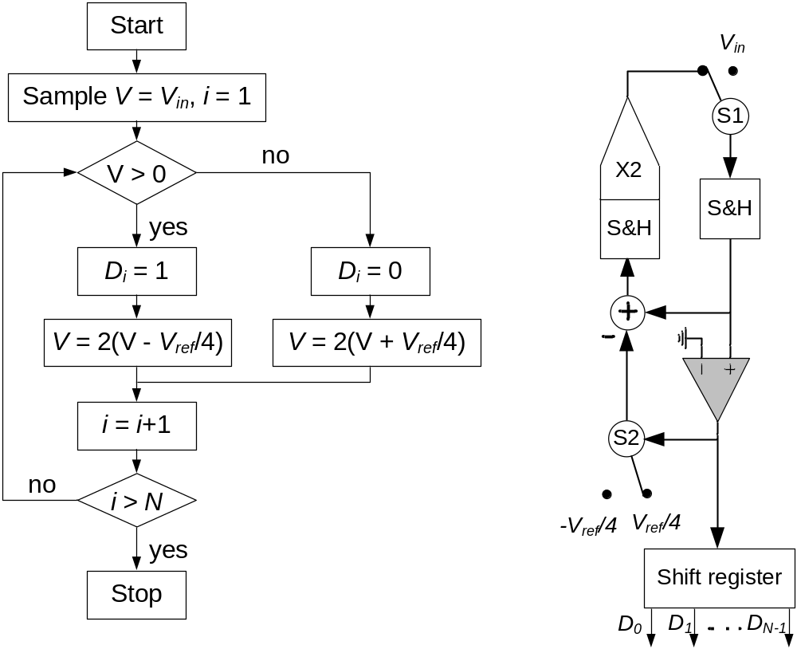
Algorithmic ADC con’t
D.A.. Johns, K. Martin, Analog Integrated Circuit design, John Wiley & Sons, 1997
Analog Digital Converter

Slide 31
Algorithmic ADC: pros and cons
✓ Less analog circuitry than Succ. Approx. ADC
✓ Low Power / Low Area
✗ High effort for multiply-by-two gain amp
Analog Digital Converter

Slide 32
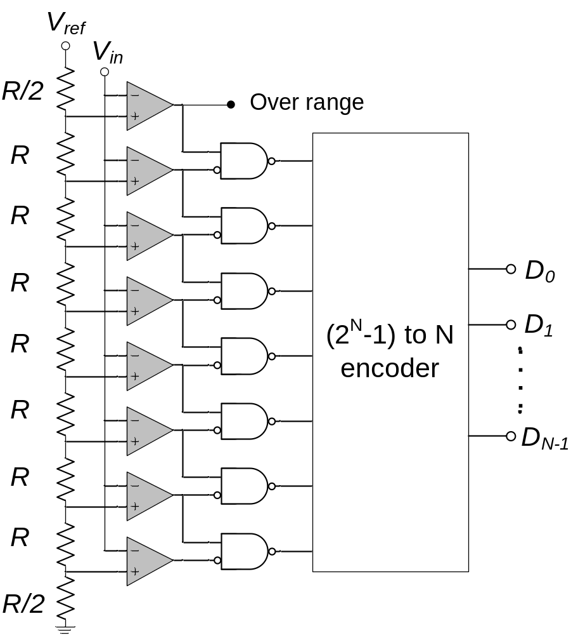
Flash ADC
V_{in} connected with 2^{N} comparators in parallel
Comparators connected to resistor string
Thermometer code
R/2-resistors on bottom and top for 0.5 LSB offset
Analog Digital Converter

Slide 33
Some Flash ADC design issues
Input capacitive loading on V_{in}
Switching noise if comparators switch at the same time
Resistors-string bowing by input currents of bipolar comparators (if used)
Bubble errors in the thermometer code based on comparator’s metastability
Analog Digital Converter

Slide 34
Flash ADC: pros and cons
✓ Very fast
✗ High effort for the 2^{N} comparators
✗ High Area / High Power
 Recommended for 6-8 Bit and less
Analog Digital Converter

Slide 35
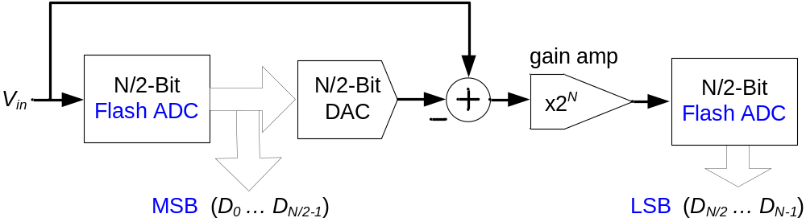
Two-Level Flash ADC
Conversion in two steps:
  Determination of MSB-Bits and reconverting of digital signal by DAC
  Subtraction from V_{in} and determination of LSB-Bits
F.e. 8-Bit-ADC: Flash: 2⁸=256 comparators, Two-level: 2·2⁴ = 32 comparators
Analog Digital Converter

Slide 36
Two-Level Flash ADC: pros and cons
✓ Same throughput as Flash ADC
✓ Less area, less power, less capacity loading than Flash ADC
✓ Easy error-correction after first stage
✗ Larger latency delay than Flash ADC
✗ Design of N/2-Bit-DAC
 Currently most popular approach for high-speed/medium accuracy ADCs
Analog Digital Converter

Slide 37
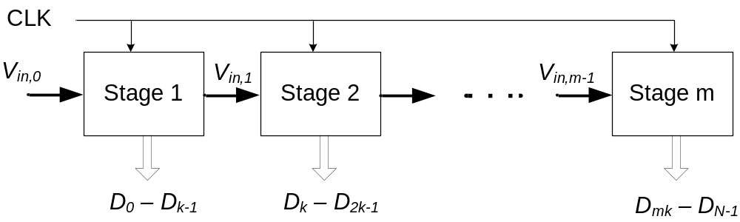
Pipelined ADCs
Extension of two-level architecture to multiple stages (up-to 1 Bit per stage)
Each stage is connected with CLK-signal
 Pipelined conversion of subsequent input signals
 First result after m CLK cycles (m - amount of stages)
Stages can be different
Analog Digital Converter

Slide 38
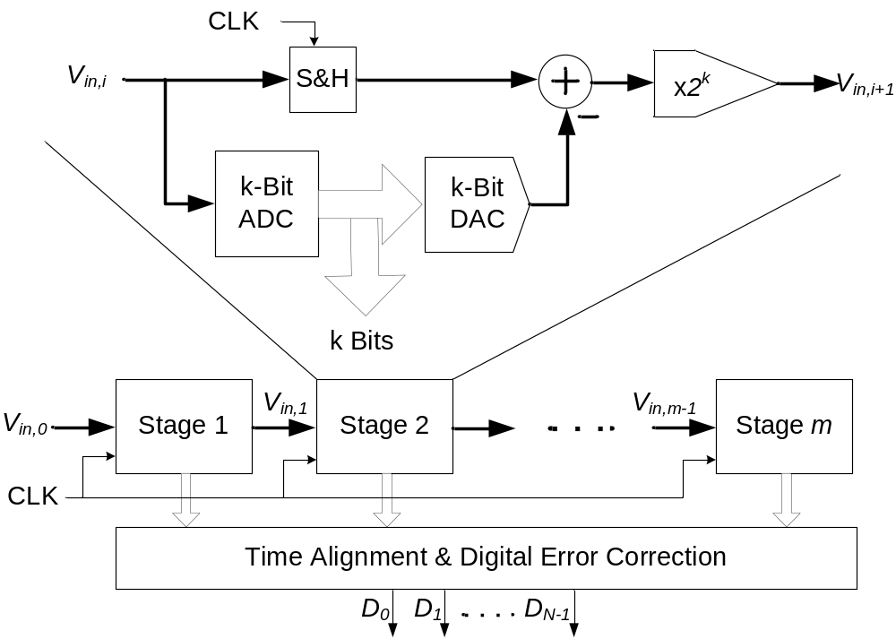
Pipelined ADCs: Scheme
Analog Digital Converter

Slide 39
Pipelined ADC: pros and cons
✓ High throughput
✓ Easy upgrade to higher resolutions
✗ High demands on speed and accuracy on gain amplifier
✗ High CLK-frequency needed
✗ High Power
Analog Digital Converter

Slide 40
4. Oversampling ADCs
What are the problems of the quantization noise?
How does oversampling work?
What is noise shaping?
What is a sigma-delta ADC?
Analog Digital Converter

Slide 41
Quantization Error ε (recap)
Analog Digital Converter

Slide 42
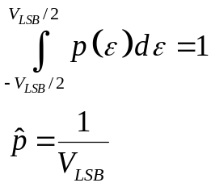
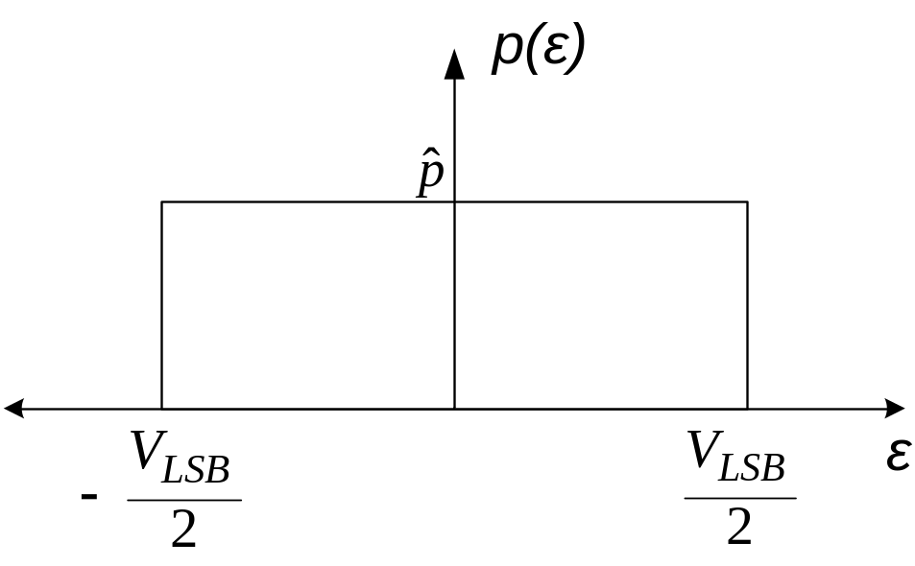
Quantization Noise
Quantization error ε with probability density p(ε) can be approximated as uniform distribution
Analog Digital Converter

Slide 43
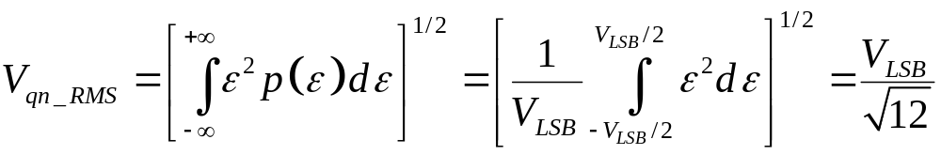
Quantization Noise cont’d
Quantization noise reduces Signal-Noise-Ration (SNR) of ADC
Estimation of SNR with Root Mean Square (RMS) of input signal (V_{in_RMS}) and of noise signal (V_{qn_RMS})
  SNR = V_{in_RMS} / V_{qn_rms}
Every additional Bit halves V_{LSB} → V_{qn_RMS} decreases by 6 dB with every new Bit
F.e. V_{in} is sinusoidal wave → SNR = (6.02 N + 1.76) dB
Analog Digital Converter

Slide 44
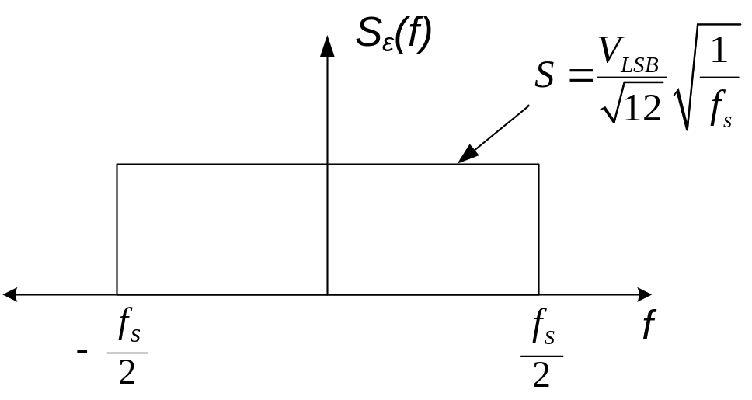
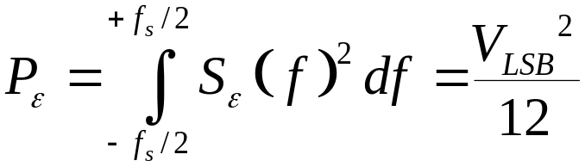
Quantization Noise cont’d
Quantization noise can be approximated as white noise
Spectral density S_{ε}(f) of quantization noise is constant over whole sampling frequency f_{s}
Quantization noise power
Analog Digital Converter

Slide 45
Quantization Error (3-Bit Flash, recap)
Amplitude
sample
Error
sample
Eugenio Di Gioia, Sigma-Delta-A/D-Wandler, 2007
Analog Digital Converter

Slide 46
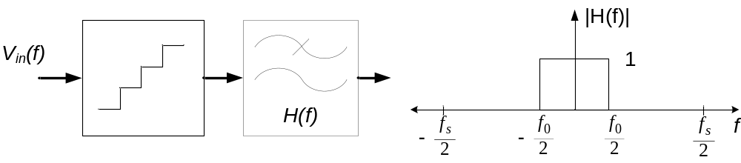
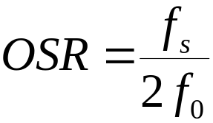
Oversampling (OS)
Quantized signal is low-pass filtered to frequency f₀
  elimination of quantization noise greater than f₀
Oversampling rate (OSR) is ratio of sampling frequency f_{s} to Nyquist rate of f₀
Analog Digital Converter

Slide 47
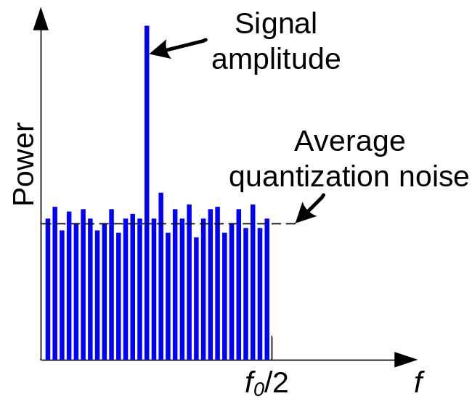
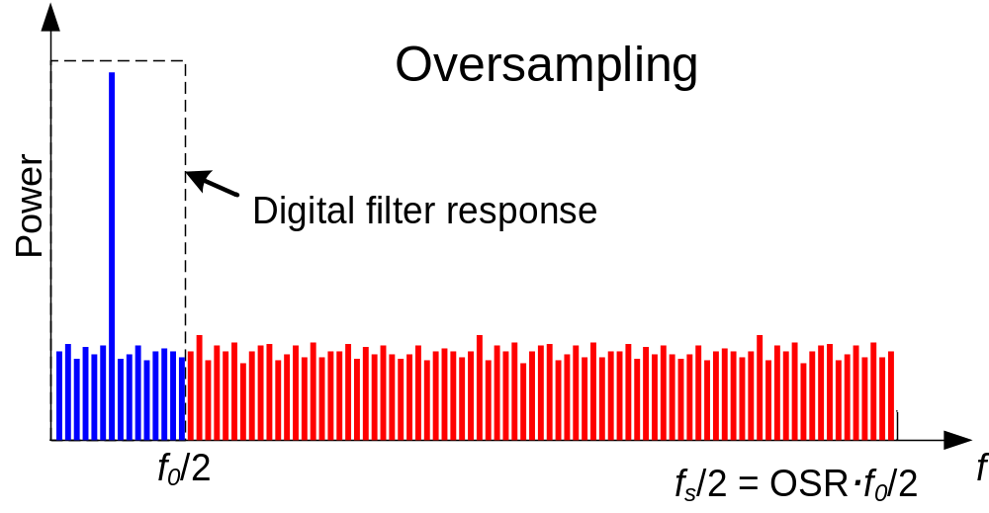
OS in Frequency Domain
Analog Digital Converter

Slide 48
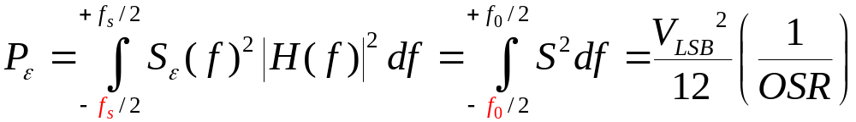
Oversampling cont’d
Quantization noise power P_{ε} results to:
Doubling of f_{s} increases SNR by 3 dB
Equivalently to a increase of resolution by 0.5 Bits
F.e. V_{in} is sinusoidal wave
  SNR = (6.02 N + 1.76 + 10log [OSR]) dB
Analog Digital Converter

Slide 49
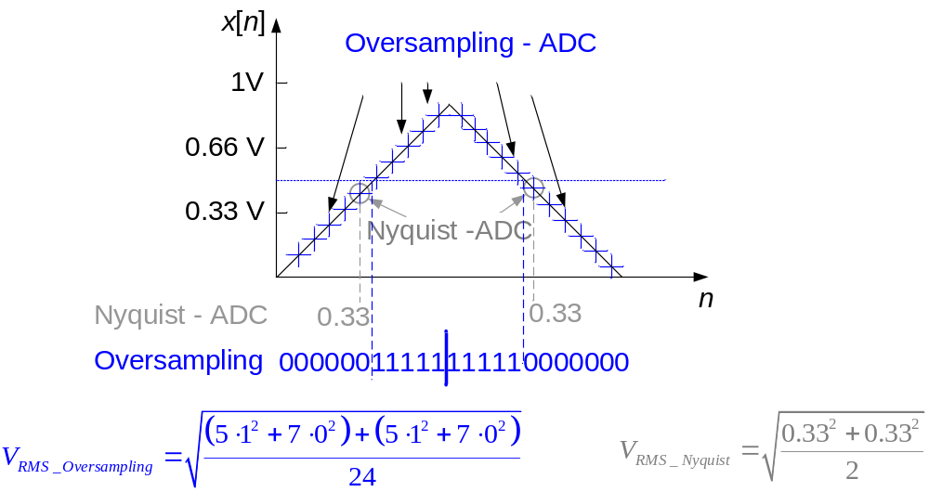
OS signal reconstruction
Signal results from relation of “0”s and “1”s
Analog Digital Converter

Slide 50
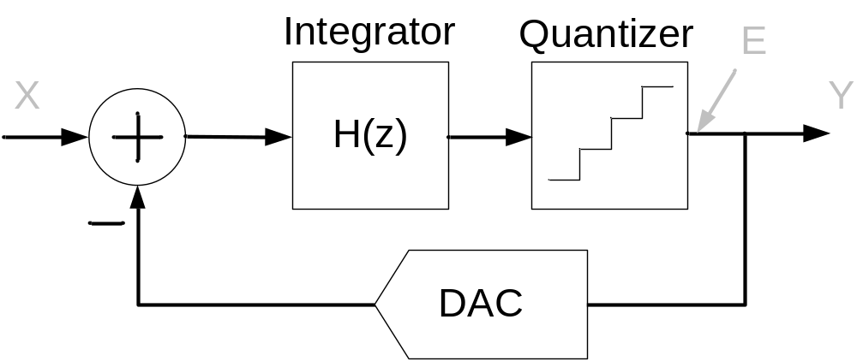
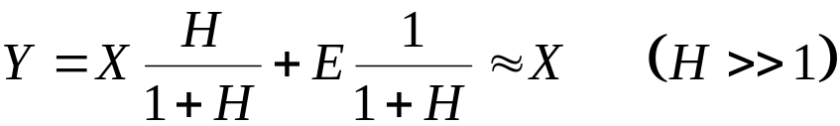
Noise Shaping (NS)
Next trick: feedback loop
Quantization noise signal is negative coupled with input
Based on high gain of closed-loop at low frequencies:
  Quantization noise reduced at low frequencies
  Quantization noise is ”shaped” = moved to higher frequencies
Analog Digital Converter

Slide 51
Noise Shaping cont’d
Oversampling and noise shaping:
  Doubling of f_{s} increases SNR by 9 dB
  Equivalently to a increase of resolution by 1.5 Bits
F.e. V_{in} is sinusoidal wave
  SNR = (6.02 N + 1.76 – 5.17 + 30log [OSR]) dB
up to f_{in} = 100 kHz (and more)
  1-Bit Quantizer (Comperator)
  1-Bit DAC
Analog Digital Converter

Slide 52
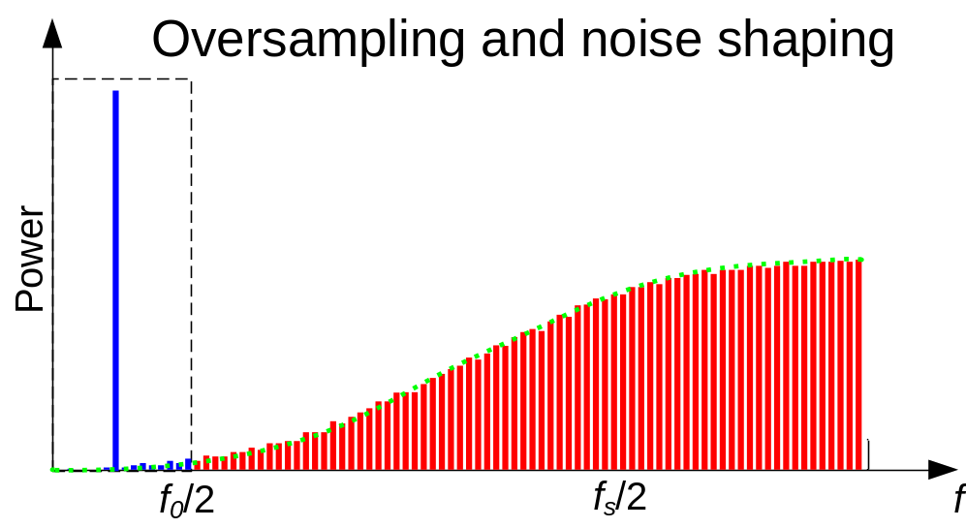
OS and NS in Frequency Domain
Analog Digital Converter

Slide 53
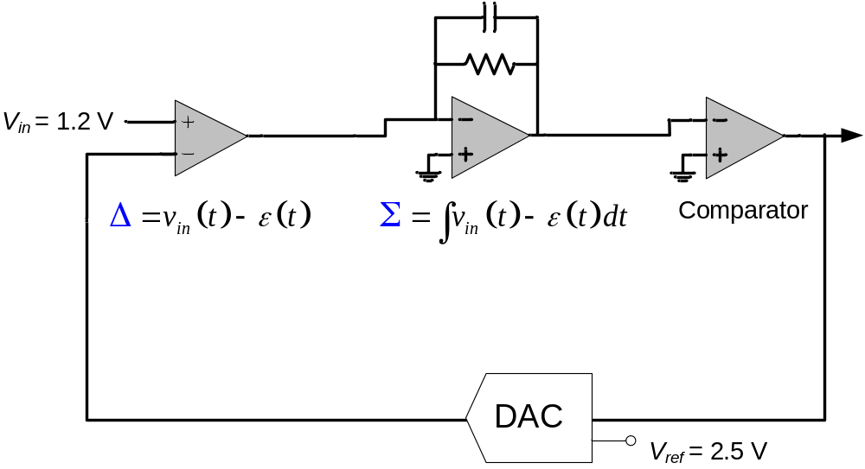
Sigma Delta ADC Example
1.2
-1.3
3.7
-1.3
1.2
-0.1
3.6
2.3
1
0
1
1
2.5
-2.5
2.5
2.5
Analog Digital Converter

Slide 54
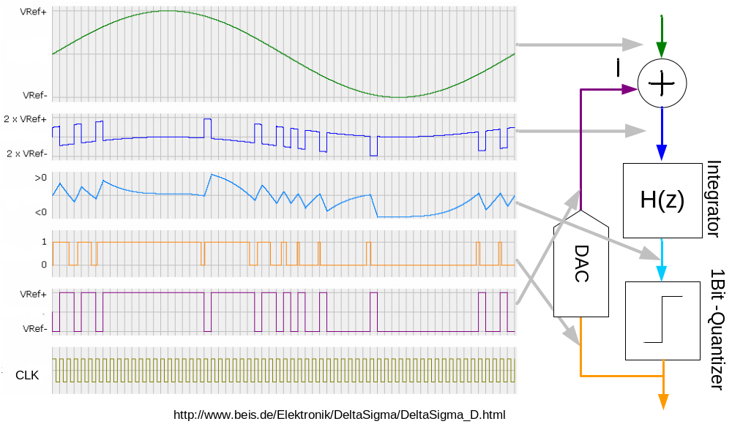
Sigma Delta ADC Example (Curves)
Analog Digital Converter

Slide 55
Sigma Delta ADC: pros and cons
✓ High resolution
✓ Less effort for analog circuitry
✗ Low speed
✗ High CLK-frequency
 Currently popular for audio applications
Analog Digital Converter

Slide 56
5. Practical issues
What are the performance limitations of ADCs?
What are the differences between PCB- and IC-designs?
Are there hints to improve the ADC design?
What are S&H circuits?
Analog Digital Converter

Slide 57
Performance Limitations
Analog circuit performance limited by:
High-frequency behavior of applied components
Noise
  Crosstalk (analog ↔ analog, analog ↔ digital)
  Power supply coupling
  Thermal noise (white noise)
Parasitic components (capacitances, inductivities)
Wire delays
Analog Digital Converter

Slide 58
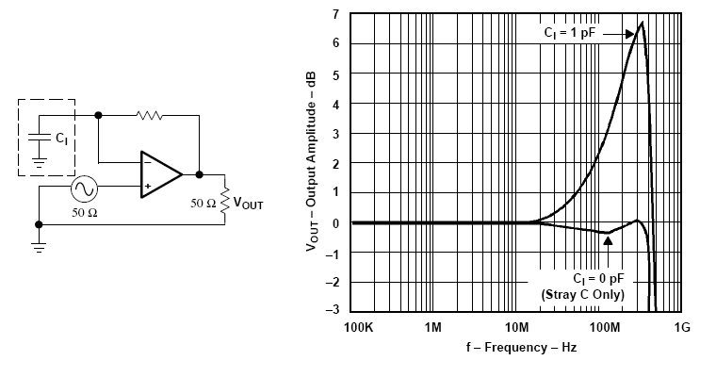
Parasitic Component Example
Effect of 1pF capacitance on inverting input of an opamp:
Mancini, Opamps for everyone, Texas Instr., 2002
Analog Digital Converter

Slide 59
Noise Demands Examples
Example 1: V_{ref} = 5V, 10 Bit resolution
 V_{LSB} = 5V / 2¹⁰ = 5V / 1024 = 4.9 mV
 Every noise must be lower than 4.9 mV
Example 2: V_{ref} = 5V, 16 Bit resolution
 V_{LSB} = 5V / 2¹⁶ = 5V / 65536 = 76 µV
 Every noise must be lower than 76 µV
Analog Digital Converter

Slide 60
PCB- versus IC-Design
PCB: Printed Circuit Board, IC: Integrated Circuit
Noise in PCB-circuits much higher than in ICs
Influences of parasitics in PCB-circuits much higher than in ICs
High-frequency behavior of PCB-circuits much worse than of ICs
Wire delays in PCB much higher than in ICs
High accuracy, high speed, high bandwidth ADCs only possible in ICs!
Analog Digital Converter

Slide 61
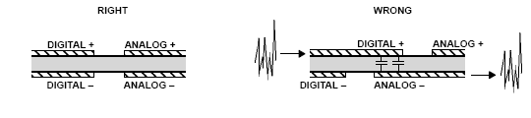
Some Hints for Mixed Signal Designs
For PCB and IC:
Keep ground lines separate!
Don’t overlap digital and analog signal wires!
Don’t overlap digital and analog supply wires!
Locate analog circuitry as close as possible to the I/O connections!
Choose right passive components for high-frequency designs! (only PCB)
Mancini, Opamps for everyone, Texas Instr., 2002
Analog Digital Converter

Slide 62
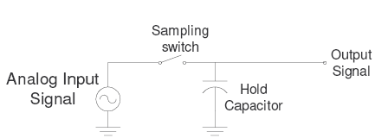
Sample and Hold Circuits
S&H circuits hold signal constant for conversion
A sample and a hold device (mostly switch and capacitor)
Demands:
  Small RC-settling-time (voltage over hold capacitor has to be fast stable at < 1 LSB)
  Exact switching point (else “aperture-error”)
  Stable voltage over hold capacitor (else “droop error”)
  No charge injection by the switch
Analog Digital Converter

Slide 63
6. Low Power ADC Design
What are the main components of power dissipation?
How can each component be reduced?
What are the differences between power and energy?
Analog Digital Converter

Slide 64
Power Dissipation
Two main components:
Dynamic power dissipation (P_{dyn})
  Based on circuit’s activity
  Square dependency on supply voltage V_{DD}²
  Dependent on clock frequency f_{clk}
  Dependent on capacitive load C_{load}
  Dependent on switching probability α
 P_{dyn} = V_{DD}² · C_{load} · f_{clk} · α
Static power dissipation (P_{static})
  Constant power dissipation even if circuit is inactive
  Steady low-resistance connections between VDD und GND (only in some circuit technologies like pseudo NMOS)
  Leakage (critical in technologies ≤ 0.18 µm)
Analog Digital Converter

Slide 65
Low Power ADC Design
Reduction of V_{DD}:
  Highest influence on power (P ~ V_{DD}²)
  Sadly, delay increases (t_{d} ~ 1/V_{DD} )
  Sadly, loss of maximal amplitude → SNR goes down
  Possible solutions:
    Different supply voltages within the design
    Dynamic change of V_{DD} depending on required performance
Reduction of f_{clk}:
  Dynamic change of f_{clk}
Analog Digital Converter

Slide 66
Low Power ADC Design cont’d
Reduction of C_{load}:
  C_{load} depends on transistor count and transistor size, wire count and wire length
  Possible Solutions:
    Reduction of amount evaluating components
    Sizing of the design = all transistor get minimum size to reach desired performance
    Intelligent placing and routing
Analog Digital Converter

Slide 67
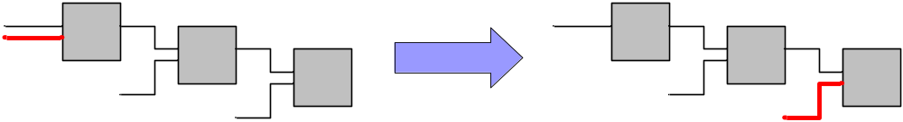
Low Power ADC Design cont’d
Reduction of α:
  Activity = possibility that a signal changes within one clock cycle
  Possible Solutions:
    Clock gating → no clock signal to inactive blocks
    High active signals connected to the end of blocks
    Asynchronous designs
Analog Digital Converter

Slide 68
Which ADC for Low Power?
If low speed: Dual Slope ADC
  Area is independent of resolution
  Less components
  Problem: Counter
If medium / high speed: mixed solutions
  Popular: pipelined ADC with SAR
  Pipelined solutions allows reduction of V_{DD}
  Long latency but high throughput
Analog Digital Converter

Slide 69
Power vs. Energy
Power consumption in Watts
  Power = voltage · current at a specific time point
  Peak power:
    Determines power ground wiring designs and Packaging limits
    Impacts of signal noise margin and reliability analysis
Energy consumption in Joules
  Energy = power · delay (joules = watts * seconds)
  Rate at which power is consumed over time
  Lower energy number means less power to perform a computation at the same frequency
Analog Digital Converter

Slide 70
Power vs. Energy cont’d
Power is height of curve
Watts
Approach 1
Approach 2
time
Energy is area under curve
Watts
Approach 1
Approach 2
time
Analog Digital Converter

Slide 71
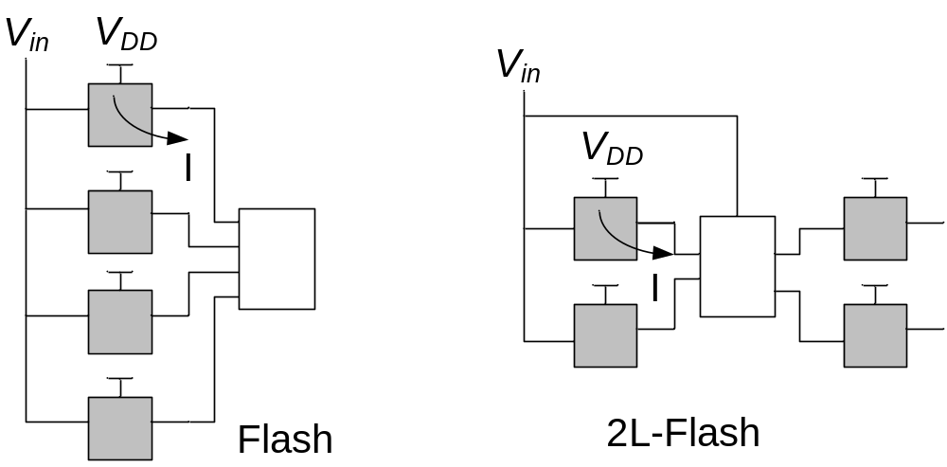
Power vs. Energy: Simple Example
Shaded blocks are ignored
Dissipation for one input signal:
 | V_{DD} | I (each gray block) | Delay | Power | Energy
Flash | 1 V | 1 µA | 1 ns | 4 µW | 4 fJ
2L-Flash | 1 V | 1 µA | 2.5 ns | 2 µW | 5 fJ
Analog Digital Converter

Slide 72
Low Power ADCs Conclusion
There is no patent solution for low power ADCs!
Every solution depends on the specific task.
Before optimization analyze the problem:
  Which resolution?
  Which speed?
  What are the constraints (area, energy, V_{DD}, V_{in},…)?
  Which technology can be used?
Think also about unconventional solutions (dynamic logic, asynchronous designs, …).
Analog Digital Converter

Slide 73
Open Questions
Is there another way to design low power ADCs?
Is it recommended to reduce the analog part and put more effort in the digital part?
How do I achieve a high SNR with low power ADCs?
Is it better to have only one block with high frequency or many blocks with low frequency?
How can asynchronous designs help me?
How do I realize a low power ADC in sub-micron technologies?
Analog Digital Converter

Slide 74
Basic ADC Literature
[All02] P. E. Allen, D. R. Holberg, “CMOS Analog Circuit Design”, Oxford University Press, 2002
[Azi96] P.M. Aziz, H. V. Sorensen, J. Van der Spiegel, "An Overview of Sigma-Delta Converters" IEEE Signal Processing Magazine, 1996
[Eu07] E. D. Gioia, “Sigma-Delta-A/D-Wandler”, 2007
[Fi05] P. Fischer, “VLSI-Design 0405 - ADC und DAC”, Uni Mannheim, 2005
[Man02] Mancini, “Opamps for everyone”, Texas Instr., 2002
[Joh97] D. A. Johns, K. Martin, “Analog Integrated Circuit design”, John Wiley & Sons, 1997
[Tan00] S. Tanner, “Low-power architectures for single-chip digital image sensors”, dissertation, University of Neuchatel, Switzerland, 2000.
Analog Digital Converter

Slide 75
More Questions?

Slide 76
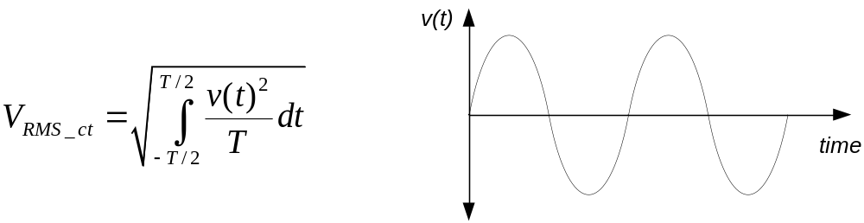
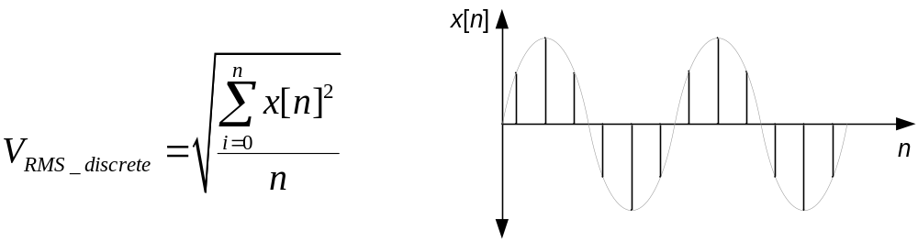
Signal Reconstruction
Continuous time (input signal):
Discrete (reconstructed by ADC):
RMS: root mean square
Analog Digital Converter

Slide 77
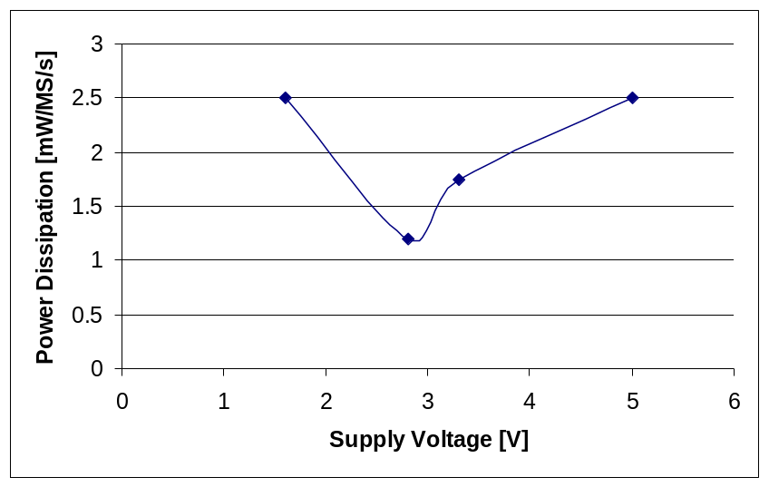
Voltage supply reduction [Tan00]
For analog design, it is shown that a voltage supply reduction does not always lead to a power consumption reduction for several reasons:
  Threshold of MOS transistors.
  Loss of maximal amplitudes (SNR degradation).
  Limits of conduction in analog switches.
  Low speed of MOS transistors.
  Limited stack of transistors.
Power consumption of 10-bit S-C 1.5 bit/stage pipelined ADCs in
function of the voltage supply.
[Tan00] S. Tanner, Low-power architectures for single-chip digital image sensors, dissertation, University of Neuchatel, Switzerland, 2000.
Analog Digital Converter

