Slide 1
ReactJS

Slide 2
What is REACT
1. Javascript library to build Dynamic and interactive user interfaces
2. developed at facebook in 2011
3. Currently most widely used JS library for front-end development
4. Used to create single page application

Slide 3
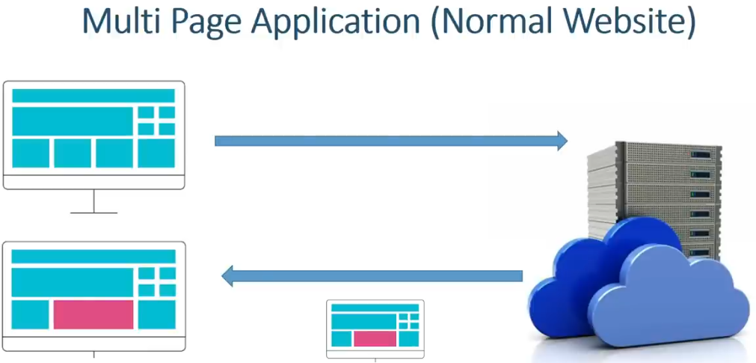

Slide 4


Slide 5
Working of DOM
1. Browser takes HTML and create DOM
2. JS helps us modify DOM based on user actions or events
3. In big applications, working with DOM becomes complicated

Slide 6
Problems with JS
1.React has a simpler mental model
2.JS is cumbersome
3.JS is error-prone
4.JS is hard to maintain

Slide 7
Working with REACT
1. No need to worry about querying and updating DOM
2. React creates a webpage with small and reusable components
3. React will take care of creating and updating DOM elements
4. It saves a lot of time

Slide 8
JS Vs React
JS is imperative: You define steps to reach your desire state
React is declarative : You define the target UI state and then React figures out how to reach that state.

Slide 9
Introduction to Components
React application is a tree of components with App Component as the root bringing everything together.

Slide 10
Install Latest Node
1. Search Download NodeJS-- Node is working as a light server for react

Slide 11
Create a React App
1. Official tool is CRA (Create React APP)
2. Vite is a modern tool to create React Project
3. Vite produces Quick and Small bundle size
4. Vite: Use npm run dev to launch dev server
5. Use npm start for CRA
on terminal
npm create vite@latest

Slide 12
Project Structure
node_modules: dependencies are installed as node packages
public/ directory: contains static files that don't change
src/ Directory: main folder for React code
1. components/: Reusable parts of the UI , like buttons or headers.
2. assets/: images , fonts and other static files
3. styles/: CSS or stylesheets
package.json contains information about this project like name , version , dependencies on other react packages.
vite.config.js contains vite config
package-lock.json-- maintains the current values of various dependencies used in the project

Slide 13
Our First App
Component is a simple function
./App.jsx
function App(){
return <h1>Hello World </h1>
}
export default App

Slide 14
Types of Components
Class Components:
1.Stateful: Can manage State
2. Lifecycle: Access to lifecycle methods
3. Verbose: More boilerplate code
4. Not preferred anymore
Functional Components:
1. Initially Stateless
2. Can use Hooks for state and effects
3. Simpler and more concise
4. More Popular

Slide 15
Importing and Exporting a component
You cannot place all components in one file or root component file. You need to move various components out of root component file.
This will make them more modular and reusable in other files
You can move a component in three steps:
  Make a new JS file to put the components in.
  Export your function component from that file (using either default or named exports).
  Import it in the file where you’ll use the component (using the corresponding technique for importing default or named exports).

Slide 16
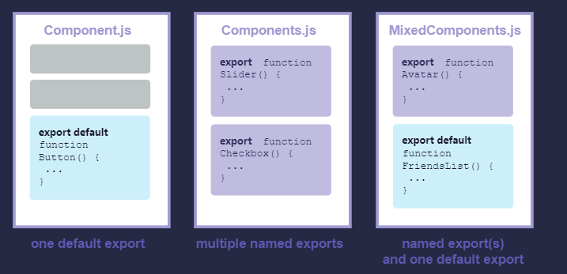
Importing and Exporting components
There are two primary ways to export values with JavaScript: default exports and named exports.
A file can have no more than one default export, but it can have as many named exports as you like.

Slide 17
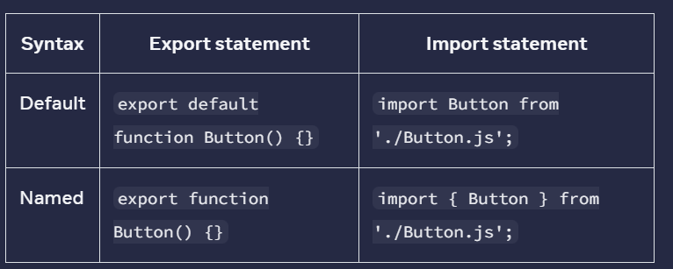
Importing and Exporting components

Slide 18
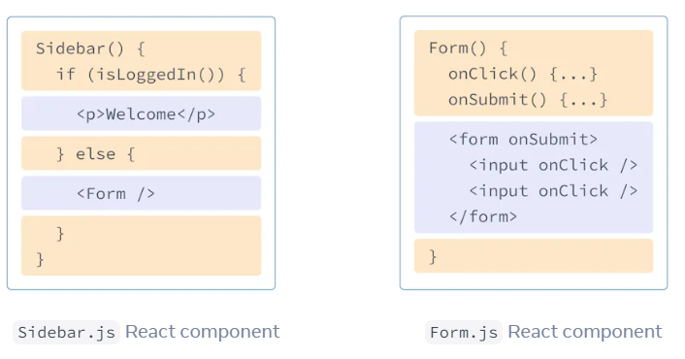
JSX
JSX is a syntax extension for JavaScript that lets you write HTML-like markup inside a JavaScript file.
In React, rendering logic and markup live together in the same place—components.
JSX determines how the UI will look wherever the component is used.
JSX stands for Javascript XML
JSX gets converted to regular JavaScript

Slide 19
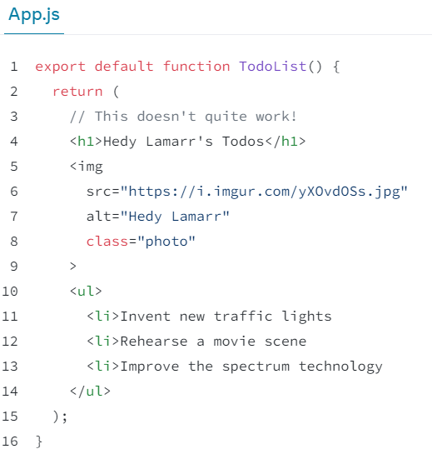
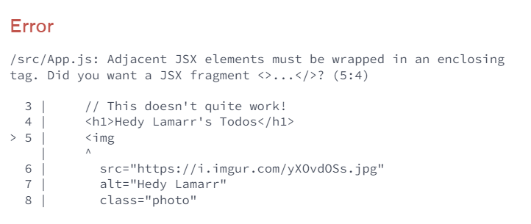
Converting HTML to JSX
Many times valid HTML pasted in component gives you error

Slide 20
The Rules of JSX
Return a single root element
To return multiple elements from a component, wrap them with a single parent tag.
2. Close all the tags
JSX requires tags to be explicitly closed: self-closing tags like <img> must become <img />, and wrapping tags like <li>oranges must be written as <li>oranges</li>.
3.In React, many HTML and SVG attributes are written in camelCase. For example, instead of stroke-width you use strokeWidth. Since class is a reserved word, in React you write className
4. Use a JSX Converter
https://transform.tools/html-to-jsx

Slide 21
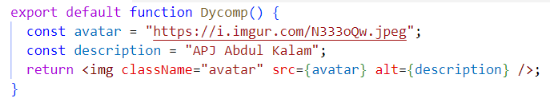
Dynamic Components
JSX allows the creation of dynamic and interactive UI components
Using { } , we can embed any JS expression directly within JSX. This includes variables , function calls and more.

Slide 22
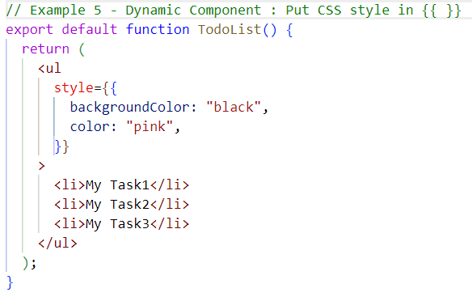
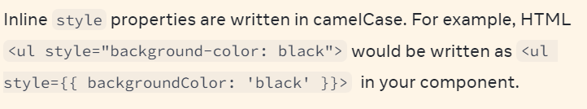
Dynamic Components
You can insert CSS using double curly {{}} in JSX

Slide 23
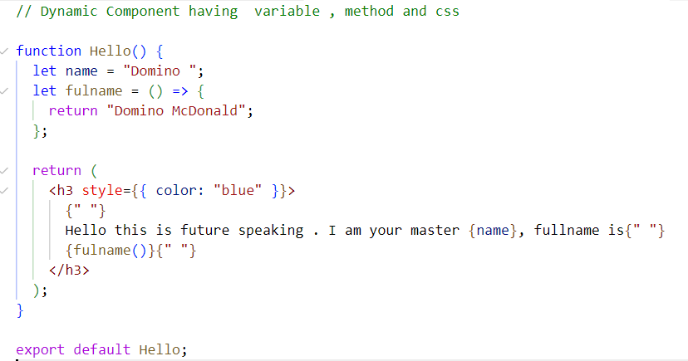
Dynamic Components
You can have method in the JSX using {}

Slide 24
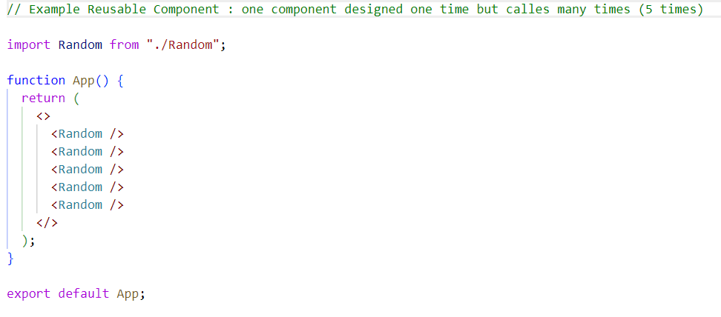
Reusable Components

Slide 25
Including Bootstrap
Mobile-first design for all device
Pre-styled elements like buttons and navbars etc.
Modify default styles as needed
Consistent look across browsers
https://getbootstrap.com/
To install -- npm i bootstrap@5.3.3
Import “bootstrap/dist/css/bootstrap.min.css”

Slide 26
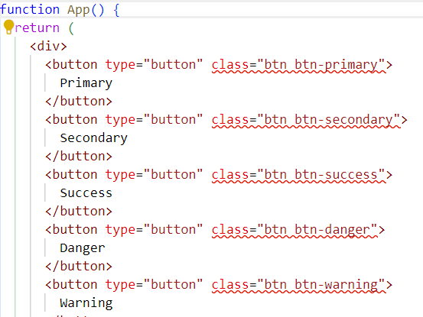
Including Bootstrap

Slide 27
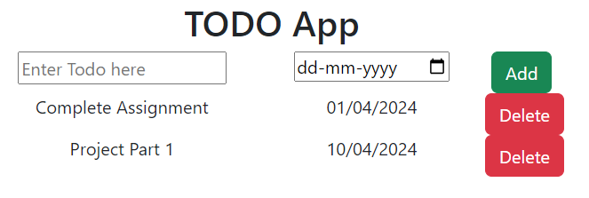
Project: TODO APP UI
In one component APP.JSX

Slide 28
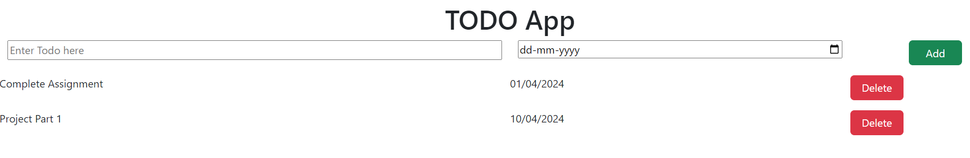
Project: TODO APP UI
Using different component and CSS

Slide 29
MAP Method
Render lists from array data
Transform array items into JSX
Inline Rendering: Directly inside JSX
[items.map(item => <l1 key={item.id}</li>
Assign unique key for optimized re-renders
<div key={item.id}>{item.name}</div>

Slide 30
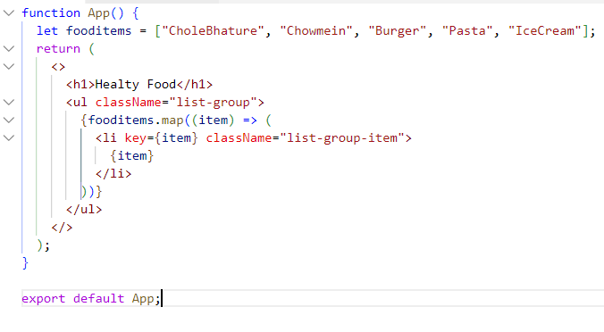
MAP Method

Slide 31
Conditional Rendering
Your components will often need to display different things depending on different conditions.
In React, you can conditionally render JSX using JavaScript syntax like if statements, &&, and ? : operators.
If-else statements
Ternary operators
Logical operators
{ condition && <div> Write Something </div> }
{!condition ? <div> Error do it again <div> : <div> Congratulations</div>

Slide 32
Conditional Rendering
function Ifelse() {
//let food = ["Chapati", "Milk", "Dal", "Fruits", "Dosa"];
let food = [];
if (food.length === 0) {
return <h1>Please Give Me Food</h1>;
}
return (
<>
<h3>My Fav Food List</h3>
<ul className="list-group list-group-flush">
{food.map((item) => (
<li key={item} className="list-group-item">
{item}
</li>
))}
</ul>
</>
);
}

Slide 33
Props
React components use props to communicate with each other.
Every parent component can pass some information to its child components by giving them props.
Props might remind you of HTML attributes, but you can pass any JavaScript value through them, including objects, arrays, and functions.
Parent Component
Child 1
Data pass by props
Child 2

Slide 34
Props : Example
Example of Props using Object.property
import Person from "./Person";
function App() {
let name = ‘Rajeev’;
return (
<>
<Person nameData={name} />
</>
);
}
const Person = (props) => {
return (
<div>
Hello Mr. <b>{props.nameData}</b>
</div>
);
};
export default Person;

Slide 35
Props : Example
Example of Props using Object Destructuring
import Person from "./Person";
function App() {
let name = ‘Rajeev’;
return (
<>
<Person nameData={name} />
</>
);
}
const Person = (props) => {
let {nameData} = props;
return (
<div>
Hello Mr. <b>{nameData}</b>
</div>
);
};
export default Person;

Slide 36
Props : Example
Example of Props using Object Destructuring
import Person from "./Person";
function App() {
let name = ‘Rajeev’;
return (
<>
<Person nameData={name} />
</>
);
}
const Person = ({nameData}) => {
return (
<div>
Hello Mr. <b>{nameData}</b>
</div>
);
};
export default Person;

Slide 37
Props : Example
Pass Array
import ItemList from "./ItemList";
function App() {
let food = ["Chapati", "Milk", "Dal", "Fruits", "Dosa", "Ragi"];
return (
<>
<h3>My Fav Food List</h3>
<ItemList items={food} />
</>
);
}
const ItemList = ({ items }) => {
return (
<ul className="list-group list-group-flush">
{items.map((item) => (
<li key={item}>{item}</li>
))}
</ul>
);
};

Slide 38
Props : Example
Pass Data Item
import Item from "./Item";
const ItemList = ({ items }) => {
return (
<ul className="list-group list-group-flush">
{items.map((item) => (
<Itemn key={item} foodItem={item} />
))}
</ul>
);
};
export default ItemList;
Pass Array
import ItemList from "./ItemList";
function App() {
let food = ["Chapati", "Milk", "Dal", "Fruits", "Dosa", "Ragi"];
return (
<>
<h3>My Fav Food List</h3>
<ItemList items={food} />
</>
);
}
export default function Itemn({foodItem}) {
return (
<li className='list-group-item'>{foodItem}</li>
)
}

Slide 39
Props : Passing Components as Children
<Container>
<h1>This is my container</h1>
<p>Welcome to ABESIT</p>
</Container>
<Container>
<p>this is a new app</p>
</Container>
const Container = (props) => {
return (
<div>
{props.children}
</div>
)
}
export default Container

Slide 40
Props : Passing Components as Children
<Container>
<h1>This is my container</h1>
<p>Welcome to ABESIT</p>
</Container>
<Container>
<p>this is a new app</p>
</Container>
const Container = ({children}) => {
return (
<div>
{children}
</div>
)
}
export default Container

Slide 41
Events
React lets you add event handlers to your JSX.
Event handlers are your own functions that will be triggered in response to interactions like clicking, hovering, focusing form inputs, and so on.

Slide 42
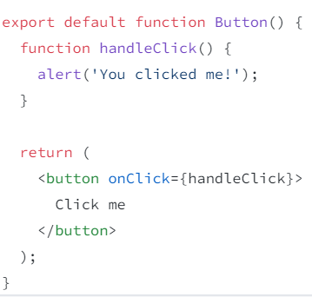
Adding Event Handler
To add an event handler, you will first define a function and then pass it as a prop to the appropriate JSX tag.
You can make it show a message when a user clicks by following these three steps:
Declare a function called handleClick inside your Button component.
Implement the logic inside that function (use alert to show the message).
Add onClick={handleClick} to the <button> JSX.

Slide 43
Managing State
Components often need to change what’s on the screen as a result of an interaction.
In React, this kind of component-specific memory is called state.
Two things prevent that change from being visible using Local variable:
Local variables don’t persist between renders.
Changes to local variables won’t trigger renders.
To update a component with new data, two things need to happen:
Retain the data between renders.
Trigger React to render the component with new data (re-rendering).

Slide 44
Managing State
State represents data that changes over time.
State is local and private to the component.
State changes cause the component to re-render.
For functional components , use the useState hook.
Hooks should only be used inside components
The useState Hook provides those two things:
A state variable to retain the data between renders.
A state setter function to update the variable and trigger React to render the component again.

Slide 45
Props vs State
Props:
Passed into a component from its parent.
Read-only (immutable) within the receiving component.
Allow parent-to-child component communication.
Changes in props can also cause a re-render.
State:
Local and mutable data within a component.
Initialized within the component.
Can change over time.
Causes re-render when updated.
Managed using useState in functional components.

Slide 46
Forms in React
1. State Management: Each input's state is stored in the component's state.
2. Handling Changes: Use onChange to detect input changes.
3. Submission: Utilize onSubmit for form submissions and prevent default with event.preventDefault().
4. Validation: Implement custom validation or use third-party libraries.

Slide 47
Hook: Ref
1. useRef allows access to DOM elements and retains mutable values without re-renders.
2. Used with the ref attribute for direct DOM interactions.
3. Can hold previous state or prop values.
4. Not limited to DOM references; can hold any value.
5. Refs can be passed as props also

Slide 48
Hook: Ref
import { useRef } from "react";
function Example() {
const inputRef = useRef(null);
return (
<div>
<input ref={inputRef} type="text" placeholder="Type here..." />
<button onClick={() => inputRef.current.focus()}>Focus Input</button>
</div>
);
}
export default Example;
Purposes:
Accessing DOM elements directly (e.g., focusing an input field)
Keeping track of values without triggering a re-render (e.g., storing a previous value or counting renders)

Slide 49
Ref vs State
Feature | useState | useRef
Re-renders component? | ✅ Yes | ❌ No
Stores values between renders? | ✅ Yes | ✅ Yes
Used for updating UI? | ✅ Yes | ❌ No
Used for accessing DOM elements? | ❌ No | ✅ Yes

Slide 50
Side Effect
In React, a side effect is anything that happens outside the main component logic.
Here are some examples of side effects:
  Fetching data from an API
  Updating the document title
  Setting up event listeners (like keyboard or mouse events)
  Using setTimeout or setInterval

Slide 51
Hook: useEffect
React provides a special hook called useEffect to handle side effects inside functional components.
import { useState, useEffect } from "react";
function Example() {
const [count, setCount] = useState(0);
useEffect(() => {
document.title = `Clicked ${count} times`;
});
return (
<div>
<p>You clicked {count} times</p>
<button onClick={() => setCount(count + 1)}>Click Me</button>
</div>
);
}
export default Example;

Slide 52

React Context: Context API
1. Prop Drilling: Context API addresses prop drilling; component composition is an alternative.
2. Folder Setup: Use a store folder for context files.
3. Initialization: Use React.createContext with initial state and export it.
4. Provider: Implement with contextName.Provider in components.
5. Access Value: Use the useContext hook.
6. Dynamic Data: Combine context value with state.
7. Export Functions: Context can also export functions for actions
8. Logic Separation: This helps keep the UI and business logic separate from each other.

Slide 53
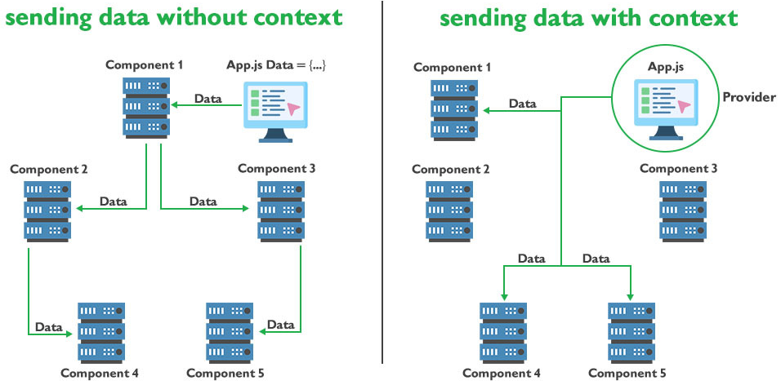
React Context: Context API

Slide 54
Managing Complex State with useReducer
1. useReducer is a hook in React that offers more control over state operations compared to useState, especially for complex state logic.
2. Components: It involves two main components:
  • Reducer: A pure function that takes the current state and an action and returns a new state.
  • Action: An object describing what happened, typically having a type property.
3. Initialization: It's invoked as const [state, dispatch] = useReducer(reducer, initialState).
4. Dispatch: Actions are dispatched using the dispatch function, which invokes the reducer with the current state and the given action.
5. Use Cases: Particularly useful for managing state in large components or when the next state depends on the previous one.
6. Predictable State Management: Due to its strict structure, it leads to more predictable and maintainable state management.

Slide 55

Data fetching
1. fetch: Modern JavaScript API for network requests.
2. Promise-Based: Returns a Promise with a Response object.
3. Usage: Default is GET. For POST use method: 'POST'
4. Response: Use .then() and response.json() for JSON data.
5. Errors: Doesn't reject on HTTP errors. Check response.ok.
6. Headers: Managed using the Headers API.

Slide 56
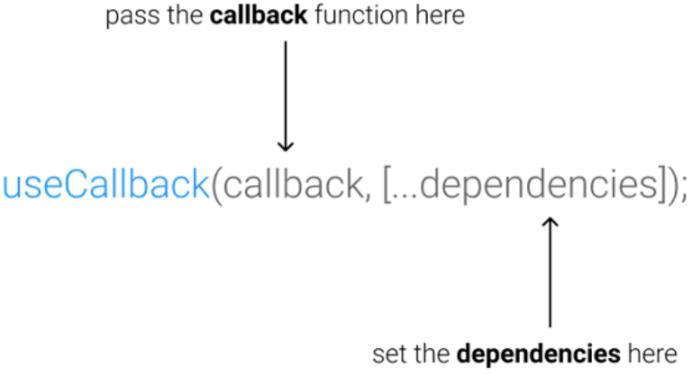
Memoization: useCallback Hook
1. Memoization: Preserves function across renders to prevent unnecessary re-renders.
2. Optimization: Enhances performance in components with frequent updates.
3. Dependency Array: Recreates the function only when specific dependencies change.
4. Event Handlers: Used to keep consistent function references for child components.
5. With useEffect: Prevents infinite loops by maintaining function references.
const memoizedCallback = useCallback(
() => {
functionToBeMemoized(arg);
},
[arg],
);

Slide 57

Memoization: useMemo Hook
1. Memoization: useMemo caches the result of expensive calculations to enhance performance.
2. Re-computation: Only re-computes the memoized value when specific dependencies change.
3. Optimization: Helps prevent unnecessary recalculations, improving component rendering efficiency.
4. Dependency Array: Uses an array of dependencies to determine when to recompute the cached value.
5. Comparison with useCallback: While useCallback memoizes functions, useMemo memoizes values or results of functions.
6. Best Use: Ideal for intensive computations or operations that shouldn't run on every render.

Slide 58
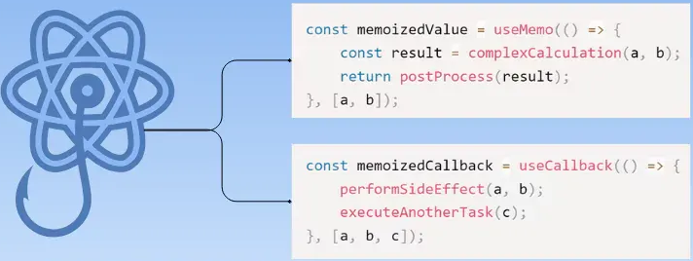
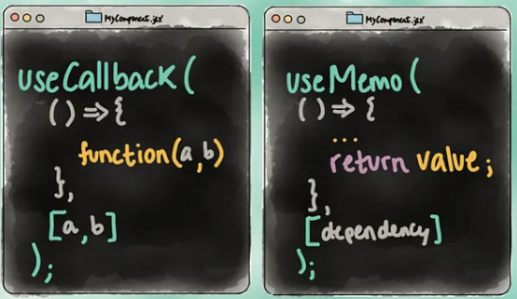
useMemo vs useCallback

Slide 59
Custom Hooks
1. Reusable Logic: Custom hooks allow you to extract and reuse component logic across multiple components.
2. Naming Convention: Typically start with "use" (e.g., useWindowSize, useFetch).
3. Combining Hooks: Custom hooks can combine multiple built-in hooks like useState, useEffect, and others.
4. Sharing State: Enables sharing of stateful logic without changing component hierarchy.
5. Isolation: Helps in isolating complex logic, making components cleaner and easier to maintain.
6. Custom Return Values: Can return any value (arrays, objects, or any other data type) based on requirements.

Slide 60
Custom Hooks: Ex
import { useState } from "react";
export function useCounter(initialValue = 0) {
const [count, setCount] = useState(initialValue);
const increment = () => setCount((c) => c + 1);
const decrement = () => setCount((c) => c - 1);
const reset = () => setCount(initialValue);
return { count, increment, decrement, reset };
}
export default function Counter() {
const { count, increment, decrement, reset } = useCounter(0);
return (
<div className="counter">
<p>Count: {count}</p>
<button onClick={increment}>+</button>
<button onClick={decrement}>-</button>
<button onClick={reset}>Reset</button>
</div>
);
}

Slide 61
Custom Hooks: Ex
import React from "react";
import { useState, useEffect } from "react";
const useWindowWidth = (delay = 200) => {
const [width, setWidth] = useState(window.innerWidth);
useEffect(() => {
let timeoutId = null;
const handleResize = () => {
clearTimeout(timeoutId);
timeoutId = setTimeout(() => setWidth(window.innerWidth), delay);
};
window.addEventListener("resize", handleResize);
return () => {
clearTimeout(timeoutId);
window.removeEventListener("resize", handleResize);
};
}, [delay]);
return width;
};

Slide 62
Custom Hooks: Ex
const ResponsiveComponent = () => {
const width = useWindowWidth();
return (
<div style={{ padding: "20px", textAlign: "center" }}>
<h2>Current Window Width:</h2>
<p style={{ fontSize: "24px", fontWeight: "bold", color: "blue" }}>
{width}px
</p>
</div>
);
};
export default ResponsiveComponent;

Slide 63
Component Spectrum
The Spectrum of Components is a way to think about how components range from small and reusable to large and specific. Unlike strict categories (like "atoms" or "molecules"), this idea says components exist on a fluid scale—meaning they can be anywhere between super reusable and very specific.
Why is this important?
Avoids unnecessary debates – No need to argue whether a component is an "atom" or "molecule."
Easier to organize – Instead of forcing components into strict folders, you can keep them in a simple structure.
More flexible – Real-world components don’t always fit into neat boxes, and that’s okay!

Slide 64
Polymorphic Components
A polymorphic component in React is a highly reusable component that can render different underlying HTML elements or custom components while maintaining consistent styles and logic. This is typically achieved using a special prop, often named as or component, to specify the desired output element.
Simplifying, polymorphic components render as different elements based on props passed to them. A typical example is LinkButton that takes an as prop and can either be a button or a:
<LinkButton
as="a"
href="/" />
<LinkButton
as="button"
onClick={(e) => {
console.log(e);
}} />

