Slide 1
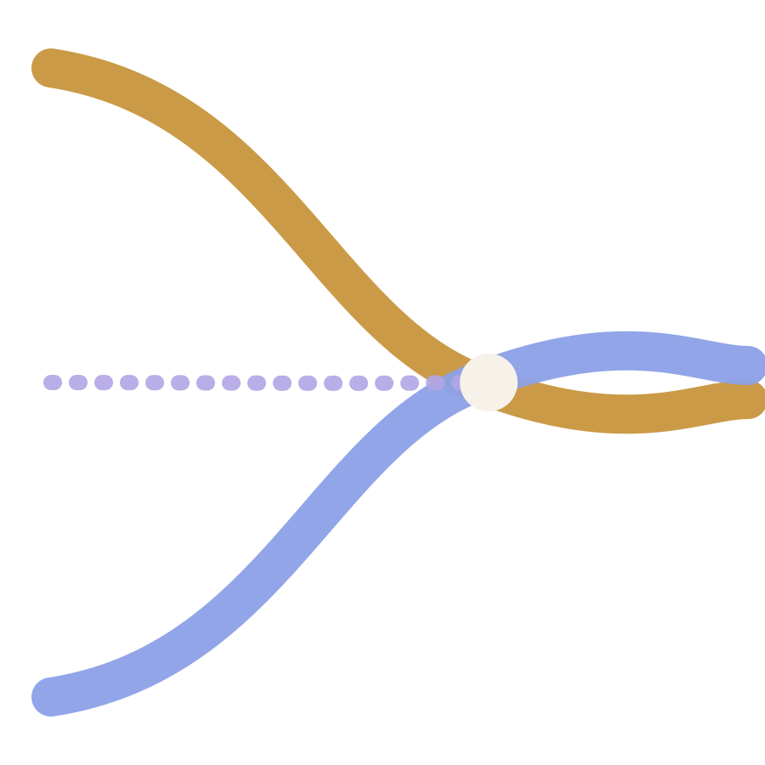
MINOR PROJECT · SECOND DEFENCE · 23 OCT 2026
Sangam
A Blockchain-Coordinated Framework for Privacy-Preserving Federated Learning in Healthcare
Divyanshh Kalra · Shrey Khandal · Tanish Garg
Guide: Dr. Mohit Mittal
Department of CSE-AIML (Section CSE-AIML-1) · Maharaja Agrasen Institute of Technology, Rohini
Notes:
Good morning. Our project is Sangam, which means confluence. Many hospitals contribute to one diagnostic model, and the patient data itself never moves. Today we show what we built since the first defence and our first real results.

Slide 2


Project team
Divyanshh Kalra
Shrey Khandal
Tanish Garg
Dr. Mohit Mittal
Team member
Team member
Team member
Project Guide (Mentor)
Roll No. 00414815623
Section: CSE-AIML-1
Roll No. 00314815623
Section: CSE-AIML-1
Roll No. 02214815623
Section: CSE-AIML-1
Dept. of CSE-AIML, MAIT
Notes:
Mention who owned which part: contracts, FL and privacy, and evaluation plus paper.

Slide 3




Motivation and problem statement
Hospitals cannot pool patient records, so each trains on the few patients it sees.
Data silos
Privacy law keeps records inside each hospital; local models stay weak.
One point of trust
A single aggregator can fail, cheat, or see every update.
Federated learning keeps data local, but it trusts one central server completely.
No defence or audit
Poisoned updates and free riders go unnoticed; no tamper-proof record.
Sangam removes that trusted server
No fair incentive
Hospitals that contribute data and compute get no transparent credit.
Notes:
Four problems. The key one is the central server: it is a single point of failure, it sees every individual update, and nobody can verify it aggregated honestly. Gradients can leak patient data, and one bad hospital can poison the model.

Slide 4
Objectives
01
02
03
Federated pipeline: hospitals train a shared diagnostic model without exchanging raw data
Smart contracts that run training rounds and commit to every update and global model
Secure aggregation and differential privacy so no party sees a raw update
04
05
06
Contribution scoring and reputation that resist poisoning and free riding
On-chain audit trail and model provenance for every round
Evaluate accuracy, robustness and privacy on a public medical dataset
Notes:
These are unchanged from the synopsis. All six now have working code or experiments behind them, which the next slides show.

Slide 5
Literature survey
Work | Decentralised | On-chain audit | Secure agg. | Diff. privacy | Poison defence | Incentive
FedAvg (McMahan 2017) | – | – | – | – | – | –
Secure Agg. (Bonawitz 2017) | – | – | ● | – | – | –
FLTrust (Cao 2021) | – | – | – | – | ● | –
BlockFL (Kim 2020) | ● | ● | – | – | – | ●
Kang et al. 2019 | ○ | ● | – | – | ● | ●
DeepChain (Weng 2021) | ● | ● | ○ | – | ○ | ●
Lu et al. 2020 | ● | ● | – | ● | – | –
BFLC (Li 2021) | ● | ● | – | – | ● | ○
Sangam (ours) | ● | ● | ● | ● | ● | ●
● supported ○ partial – not addressed
Notes:
Each line of work solves part of the problem. Secure aggregation and DP protect data but keep the server. Blockchain FL systems decentralise but mostly skip update privacy or robustness. Full references are in the paper.

Slide 6
Research gap
No single framework combines all four, and few are evaluated together on clinical data.
Decentralised coordination
Layered update privacy
Robust contribution scoring
Transparent incentives
Sangam = all four in one protocol, with on-chain commitments a reviewer can verify.
Notes:
This is the gap we target. The contribution is the integration and its evaluation, not inventing each piece from scratch.

Slide 7
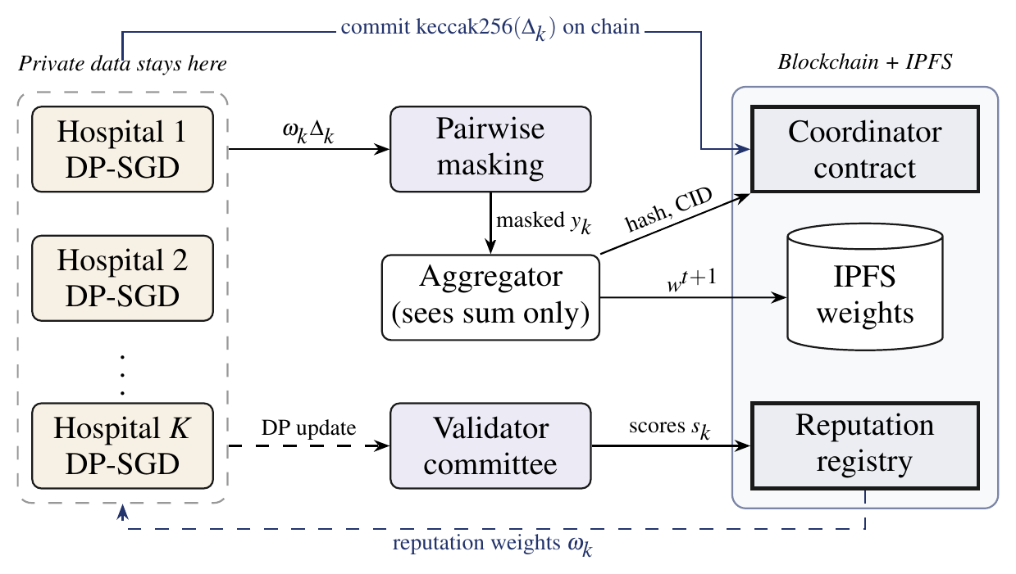
Proposed methodology: architecture
Hospitals
train locally with DP-SGD; data never leaves
Aggregator
sees only the masked sum
Blockchain
stores hashes, scores, reputation; weights live on IPFS
Notes:
Hospitals train with differential privacy, mask their updates so the aggregator only learns the sum, and commit a hash of each update on chain. A validator committee scores updates and the reputation contract turns scores into aggregation weights.

Slide 8
One training round, step by step
1
2
3
4
5
6
Open
Train
Commit
Score
Aggregate
Close
Contract opens round t, publishes global model hash
Each hospital runs DP-SGD on its own data
Hospital posts keccak256(update) on chain
Validators score updates; reputation updated on chain
Weighted updates are masked; masks cancel in the sum
New model pinned to IPFS; hash and CID committed
Reputation rule: one bad round halves a hospital's reputation; recovery takes several good rounds. Quick to distrust, slow to trust.
Notes:
Steps three and four make the process auditable: every update and every score is on chain before aggregation. The asymmetric reputation rule is what pushes an attacker's weight close to zero.

Slide 9
Work completed since the first defence
Study and design
Architecture, threat model, protocol
Done
8 / 8
Federated baseline
FedAvg, local and centralised baselines
Done
contract tests passing
Smart contracts
Coordinator + reputation registry, Solidity 0.8.24
Done (local)
190
Privacy layer
DP-SGD with RDP accounting; pairwise masking
Done (sim.)
experiment runs (19 configs × 10 seeds)
Reputation and scoring
Validation + cosine score, asymmetric rule
Done (sim.)
5 pp
Testnet + dashboard
Polygon Amoy deploy, Flower, React UI
Next
IEEE-style paper draft
Notes:
Everything except testnet deployment and the dashboard is implemented. Contracts are tested on a local Hardhat chain. Privacy and reputation are implemented in our Python simulation; next we port them onto Flower and Opacus.

Slide 10
Results: federation recovers the benefit of pooling
97.63%
Sangam accuracy, within 0.09 points of a trusted-server FedAvg
+1.77 pts
over a hospital training alone, without any trusted server
Notes:
Breast Cancer Wisconsin dataset, 569 cases, split unevenly across four simulated hospitals. Note the y-axis starts at 94 percent. Sangam gives up almost nothing compared with a trusted server, and lowers variance.

Slide 11
Results: one attacker breaks FedAvg, not Sangam
46% → 97%
accuracy under sign flipping: FedAvg vs. Sangam
28.8% → 1.9%
attacker's share of the model. Honest, the same hospital keeps 29.1%.
Notes:
Median is equally robust on accuracy, but it is anonymous: it never says who attacked. Sangam pushes the attacker's weight from 28.8 to under 2 percent, and every score is on chain, so exclusion can be audited. Free riders are only partly caught: 9.8 percent weight, a third of their fair share.

Slide 12
Results: privacy costs little, the chain costs less
96.67%
668,449 gas
accuracy at ε = 4 (δ = 10⁻⁵)
full round, 4 hospitals (measured)
58,246 gas
0.51 ms
per hospital commitment
secure aggregation per round
Notes:
From epsilon 2 upward, a hospital that joins Sangam with privacy is more accurate than training alone with no privacy. Gas is independent of model size because only hashes go on chain.

Slide 13




Discussion and limitations
Validators see updates
Commitment binding
They see DP-noised updates only; leakage bounded by ε. ZK proofs could remove this.
The aggregator cannot check a masked input against its hash. Needs verifiable aggregation.
Self-reported sizes
Scale
Hospitals declare their data size. Reputation limits but does not stop inflation.
4 hospitals, tabular data, 513-parameter model. Imaging and more hospitals next.
Notes:
We list these openly because the panel will ask. Each one maps to a future-work item on the next slide.

Slide 14
Future scope and work plan
Nov–Dec 2026
Jan 2027
Feb–Mar 2027
Mar–Apr 2027
Testnet + Flower
Imaging at scale
Verifiability
Dashboard + paper
Deploy to Polygon Amoy; port to Flower + Opacus with PyTorch
MedMNIST chest X-ray, 8+ hospitals, adaptive attacks
Zero-knowledge proof of correct aggregation
React audit dashboard; DPDP Act and ABDM alignment; submit paper
Beyond hospitals: joint fraud models across banks and insurers, and verifiable on-device learning.
Notes:
Next semester follows the synopsis timeline: integration first, then scale and verifiability, then the dashboard and paper submission.

Slide 15
References
[1] B. McMahan et al., “Communication-efficient learning of deep networks from decentralized data,” AISTATS, 2017.
[2] K. Bonawitz et al., “Practical secure aggregation for privacy-preserving machine learning,” ACM CCS, 2017.
[3] M. Abadi et al., “Deep learning with differential privacy,” ACM CCS, 2016.
[4] I. Mironov, “Rényi differential privacy,” IEEE CSF, 2017.
[5] X. Cao et al., “FLTrust: Byzantine-robust federated learning via trust bootstrapping,” NDSS, 2021.
[6] H. Kim et al., “Blockchained on-device federated learning,” IEEE Commun. Lett., 2020.
[7] J. Weng et al., “DeepChain: auditable and privacy-preserving deep learning with blockchain-based incentive,” IEEE TDSC, 2021.
[8] Y. Li et al., “A blockchain-based decentralized federated learning framework with committee consensus,” IEEE Network, 2021.
[9] D. J. Beutel et al., “Flower: a friendly federated learning research framework,” arXiv:2007.14390, 2020.
[10] W. N. Street, W. H. Wolberg, O. L. Mangasarian, “Nuclear feature extraction for breast tumor diagnosis,” Proc. SPIE, 1993.
Full list of 27 references in the research paper.

Slide 16
Thank you
Many rivers, one model. The data never moves.
Questions welcome

