Slide 1


Slide 2

An introduction
Lately, we've been surrounded by many social media apps, and with that many interesting posts, each app does offer to save these posts under a pinned category to make it possible to find these posts again, but having multiple social media accounts makes it difficult to remember on which platform was each post saved. And that's where 'Savet' comes, an app that saves each of your favorite content into categories and enables you to share them with friends and family.

Slide 3
Key features of the app (which are already implemented)
Signup and login with Google and Facebook.
Visit as a guest.
Change profile photo.
Add new category, give it a name, description and image.
Make a category private or public and associate it with tags.
Add content from gallery & camera into categories and give it a description.
Save images in different sizes (staggered grid view)
Remove a category/items.
Sort categories manually by dragging an item.
Save recently added items into a category.
Follow & unfollow friends and see their public categories.

Slide 4
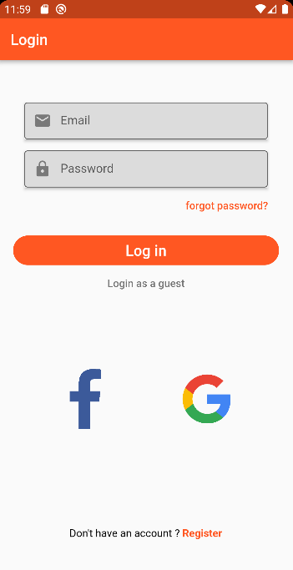
Login page :

Slide 5
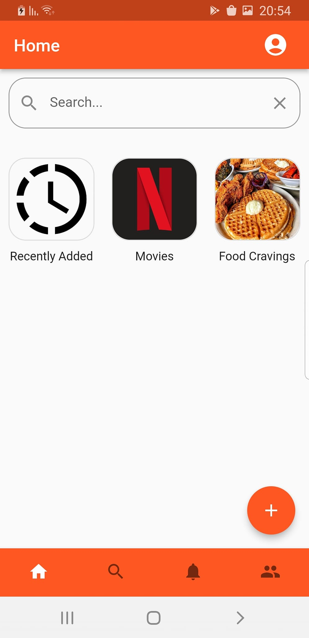
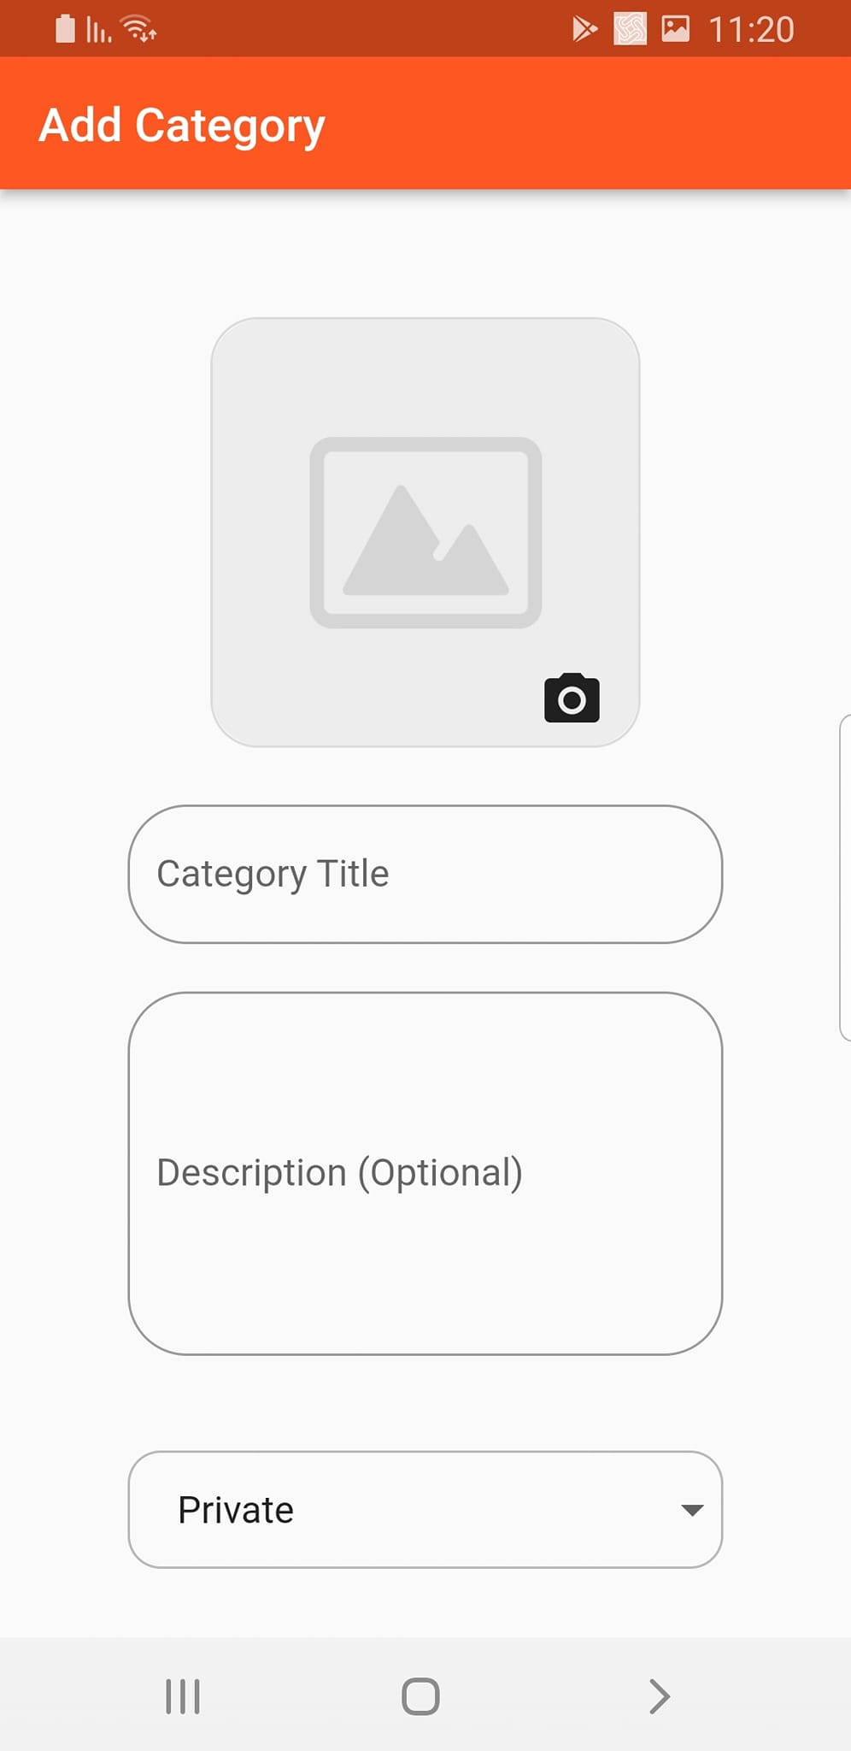
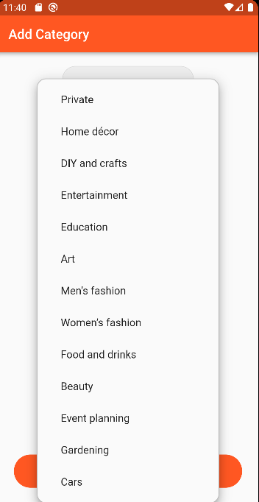
Home page :
Add new category, give it a name, description and image.
Make a category private or public and associate it with tags.
Sort categories manually by dragging an item.
Remove a category
Change category’s name, description, image ot it’s tag.

Slide 6
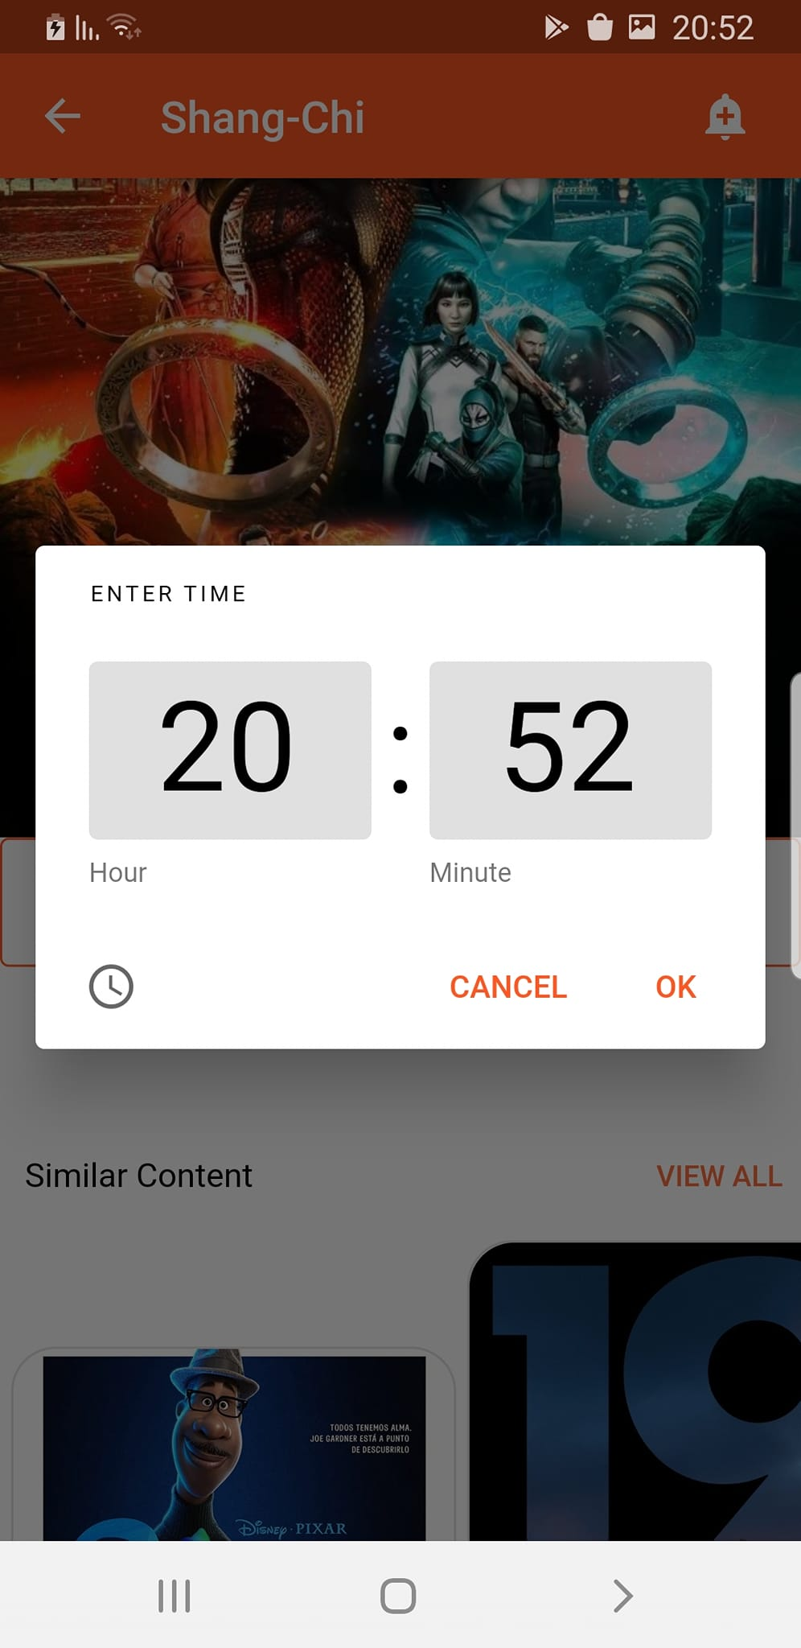
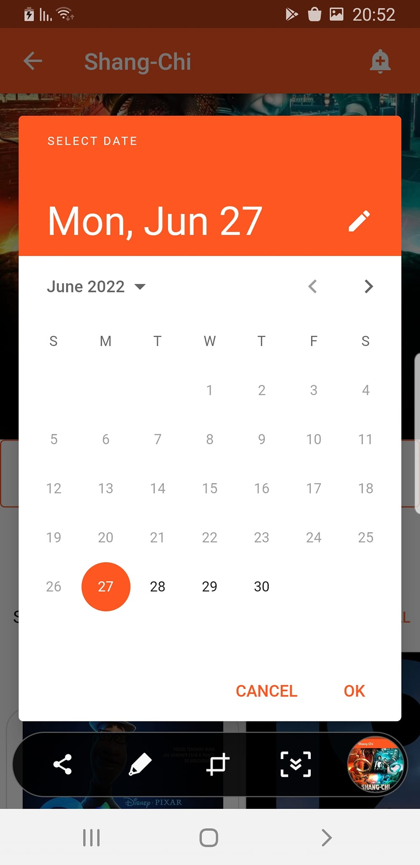
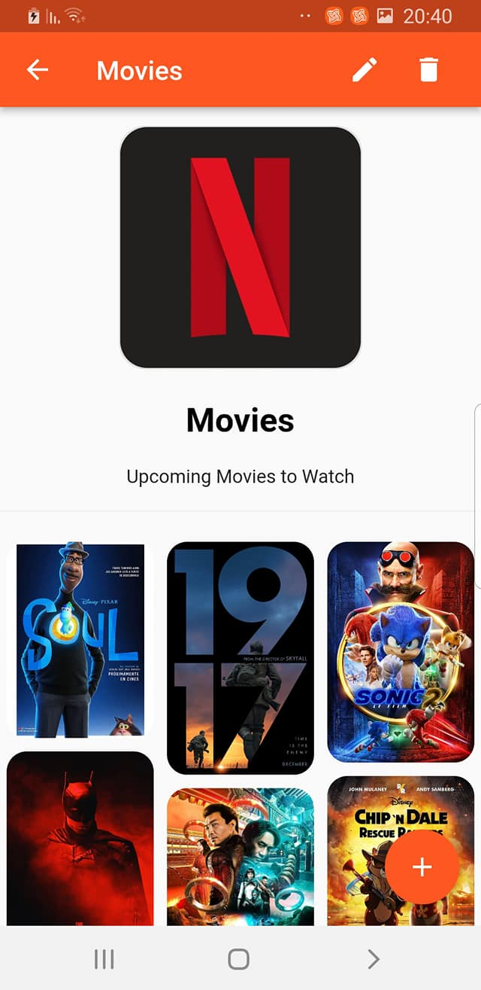
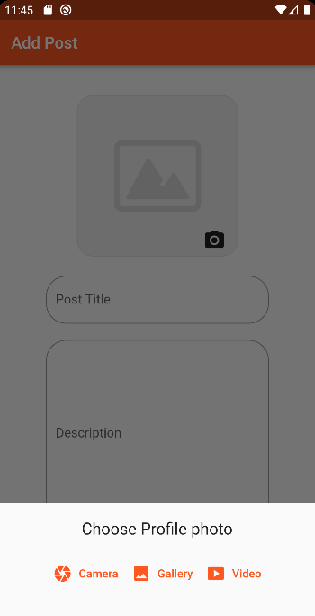
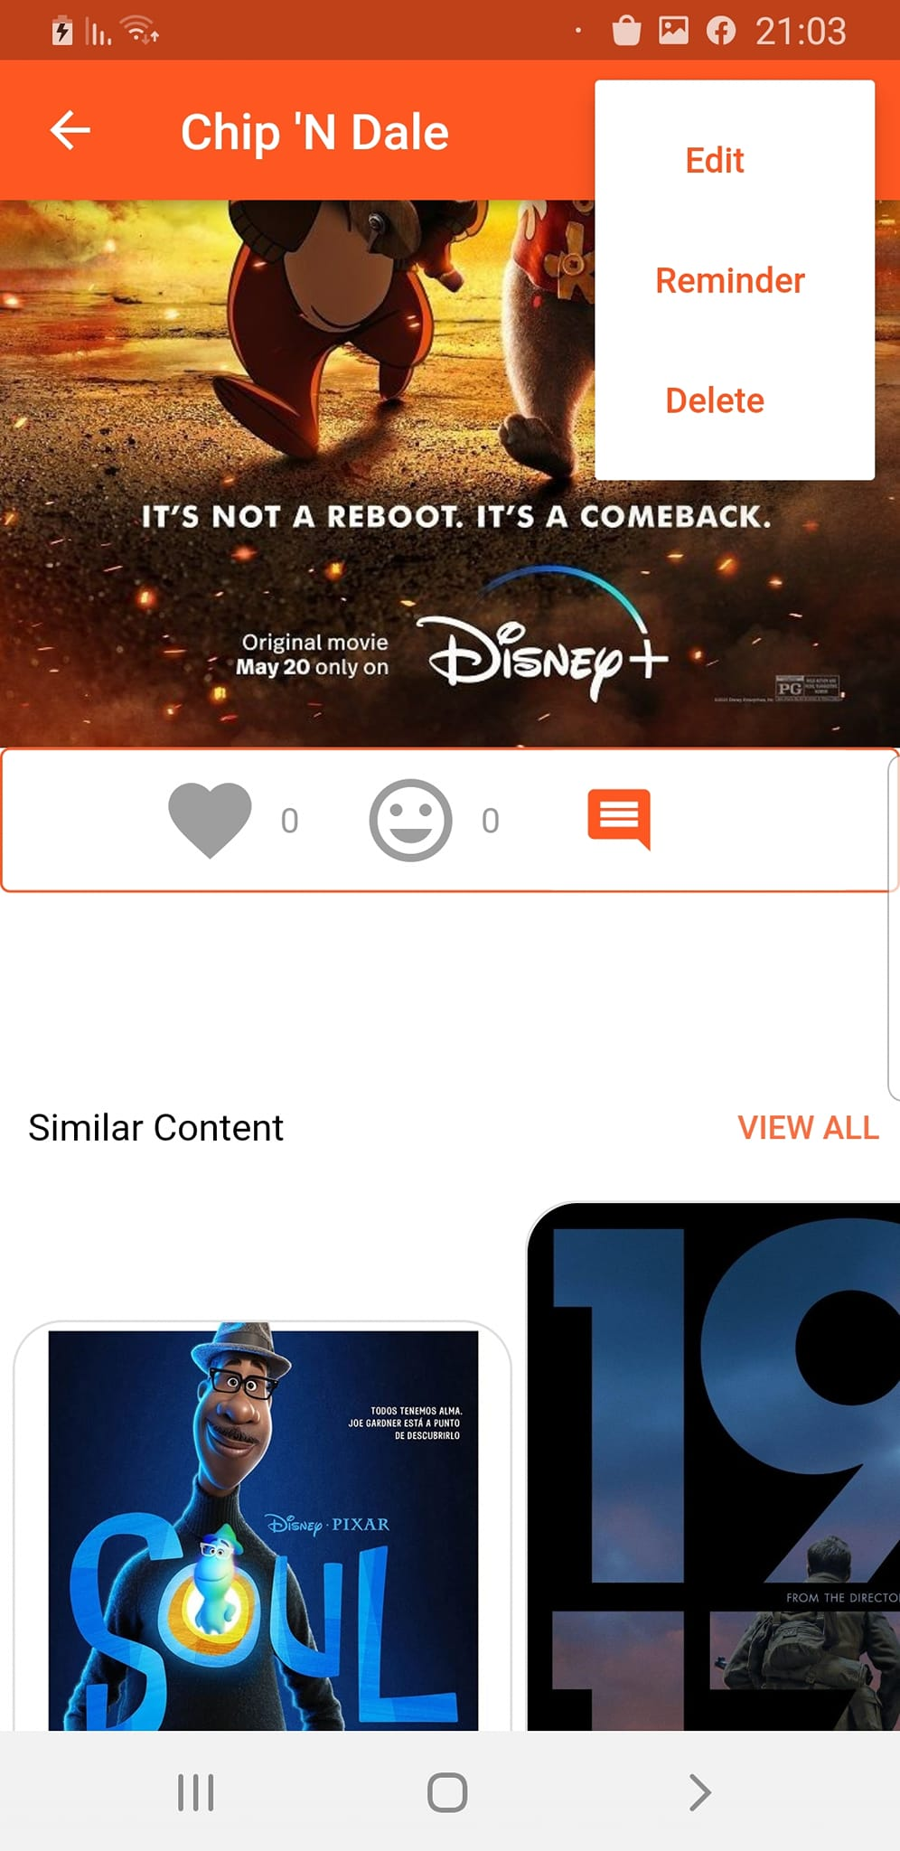
Posts page :

Slide 7
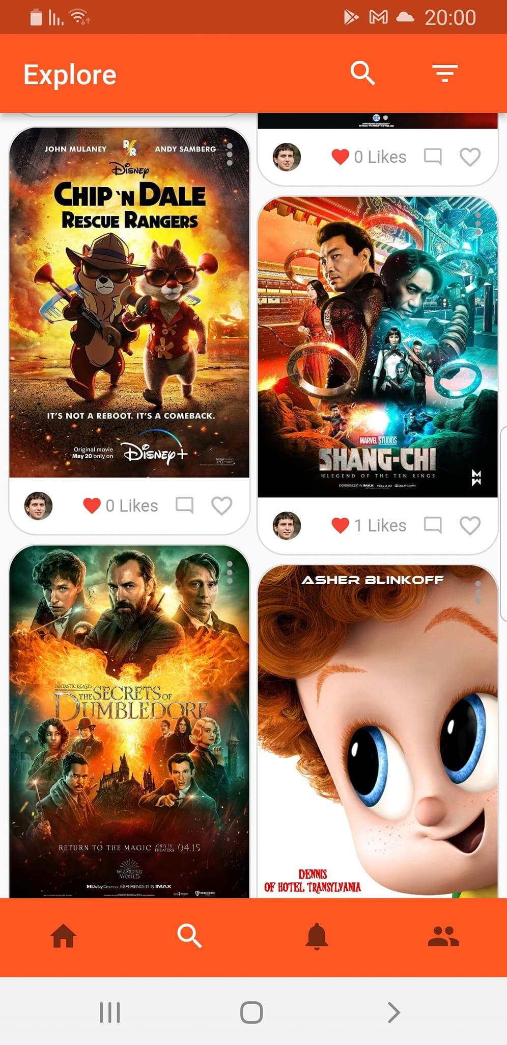
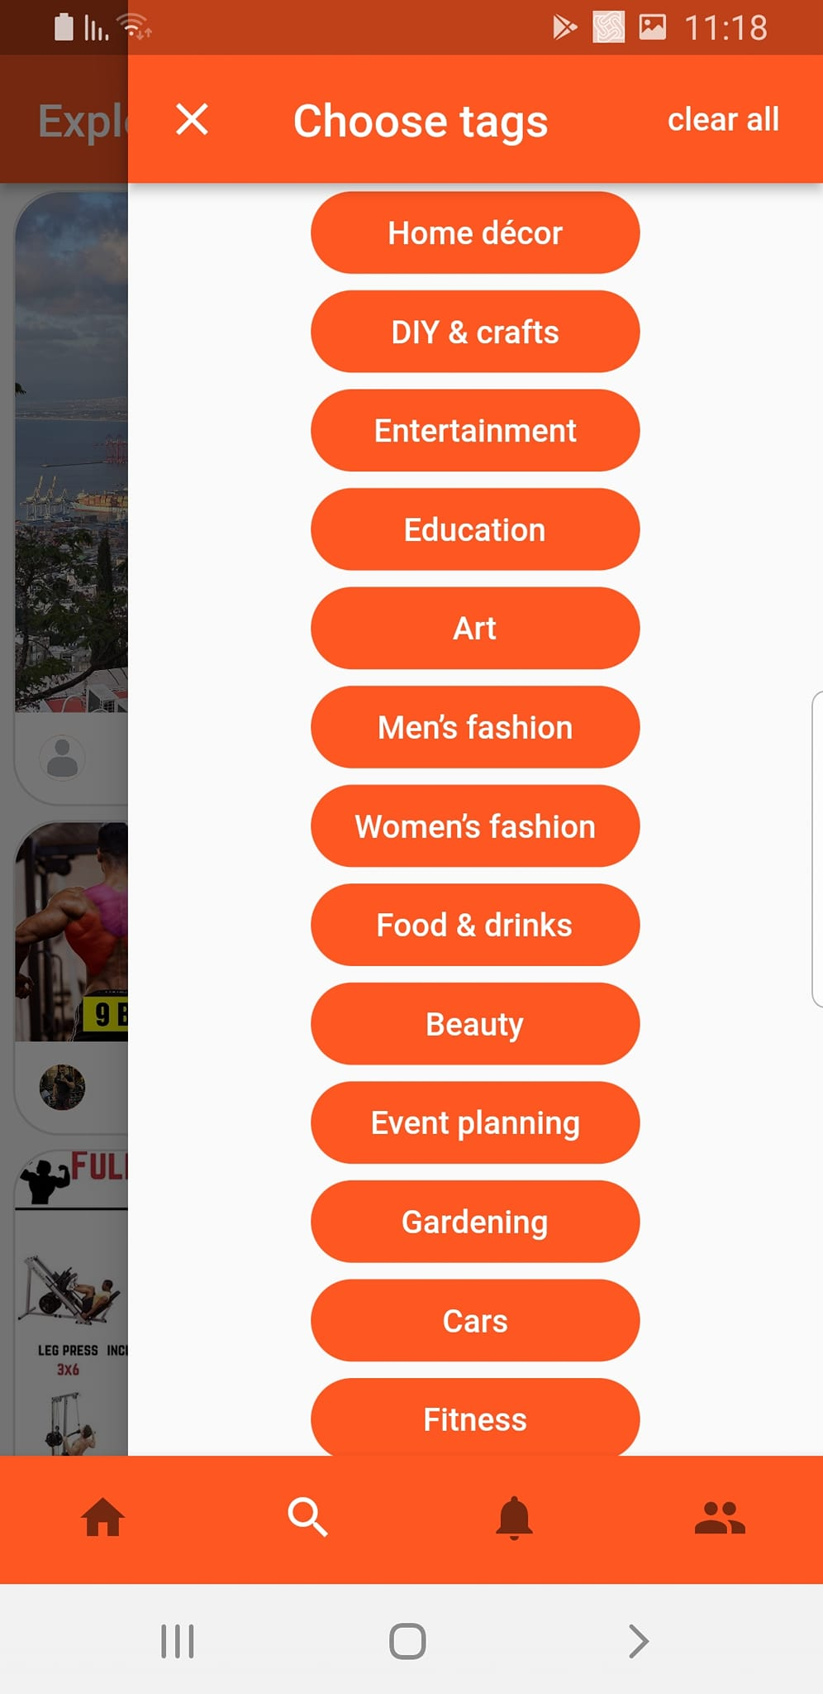
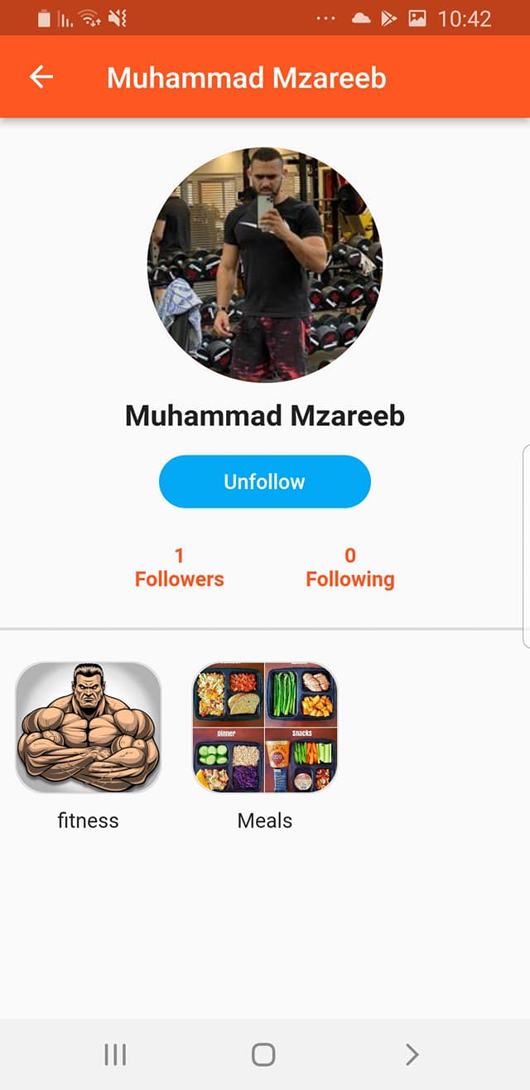
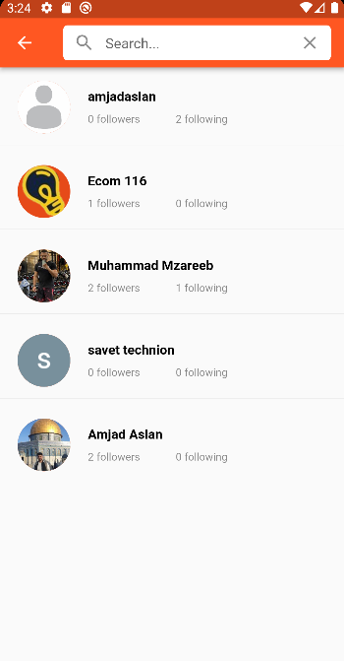
Explore page :

Slide 8
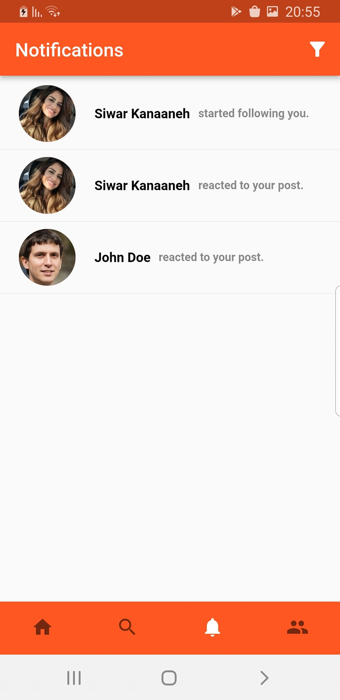
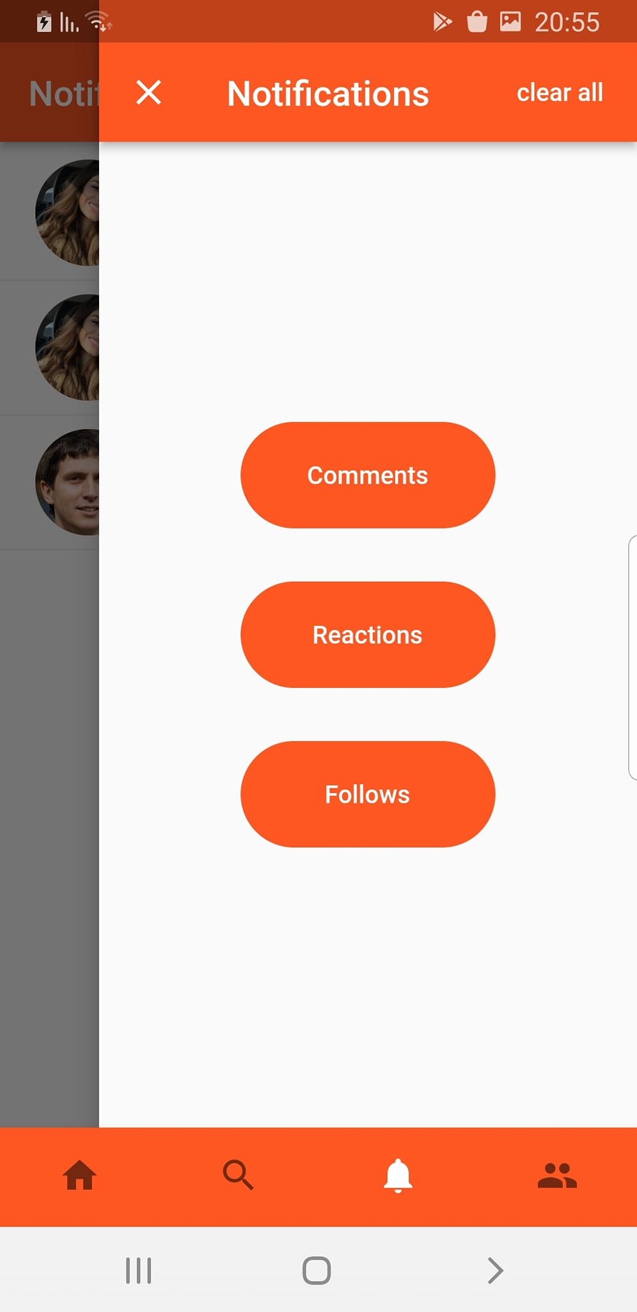
Notifications page :

Slide 9
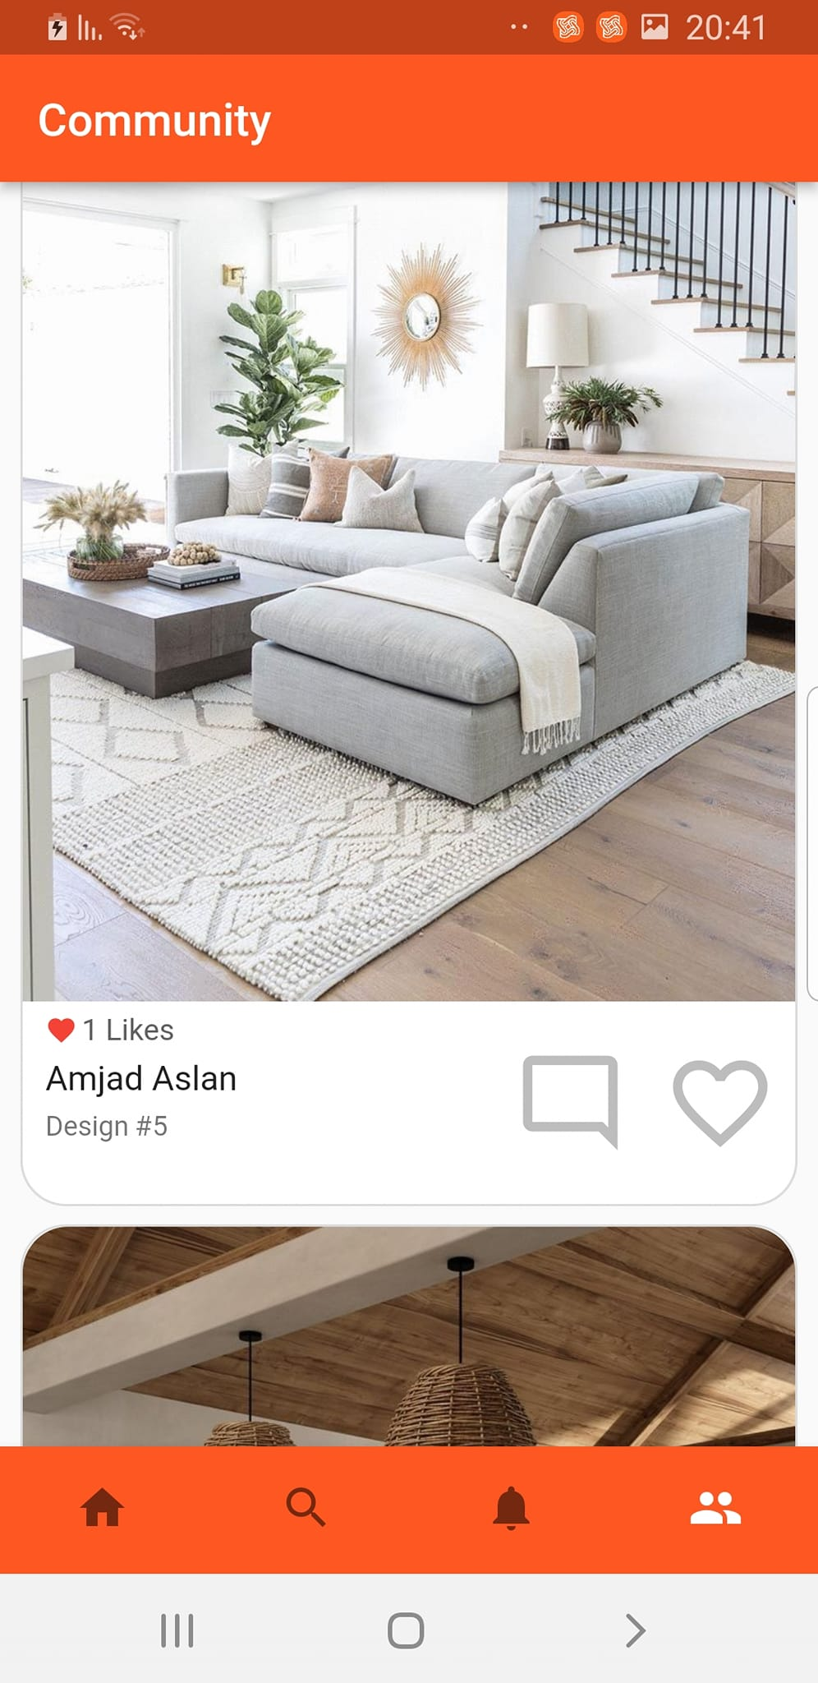
Community page :

Slide 10
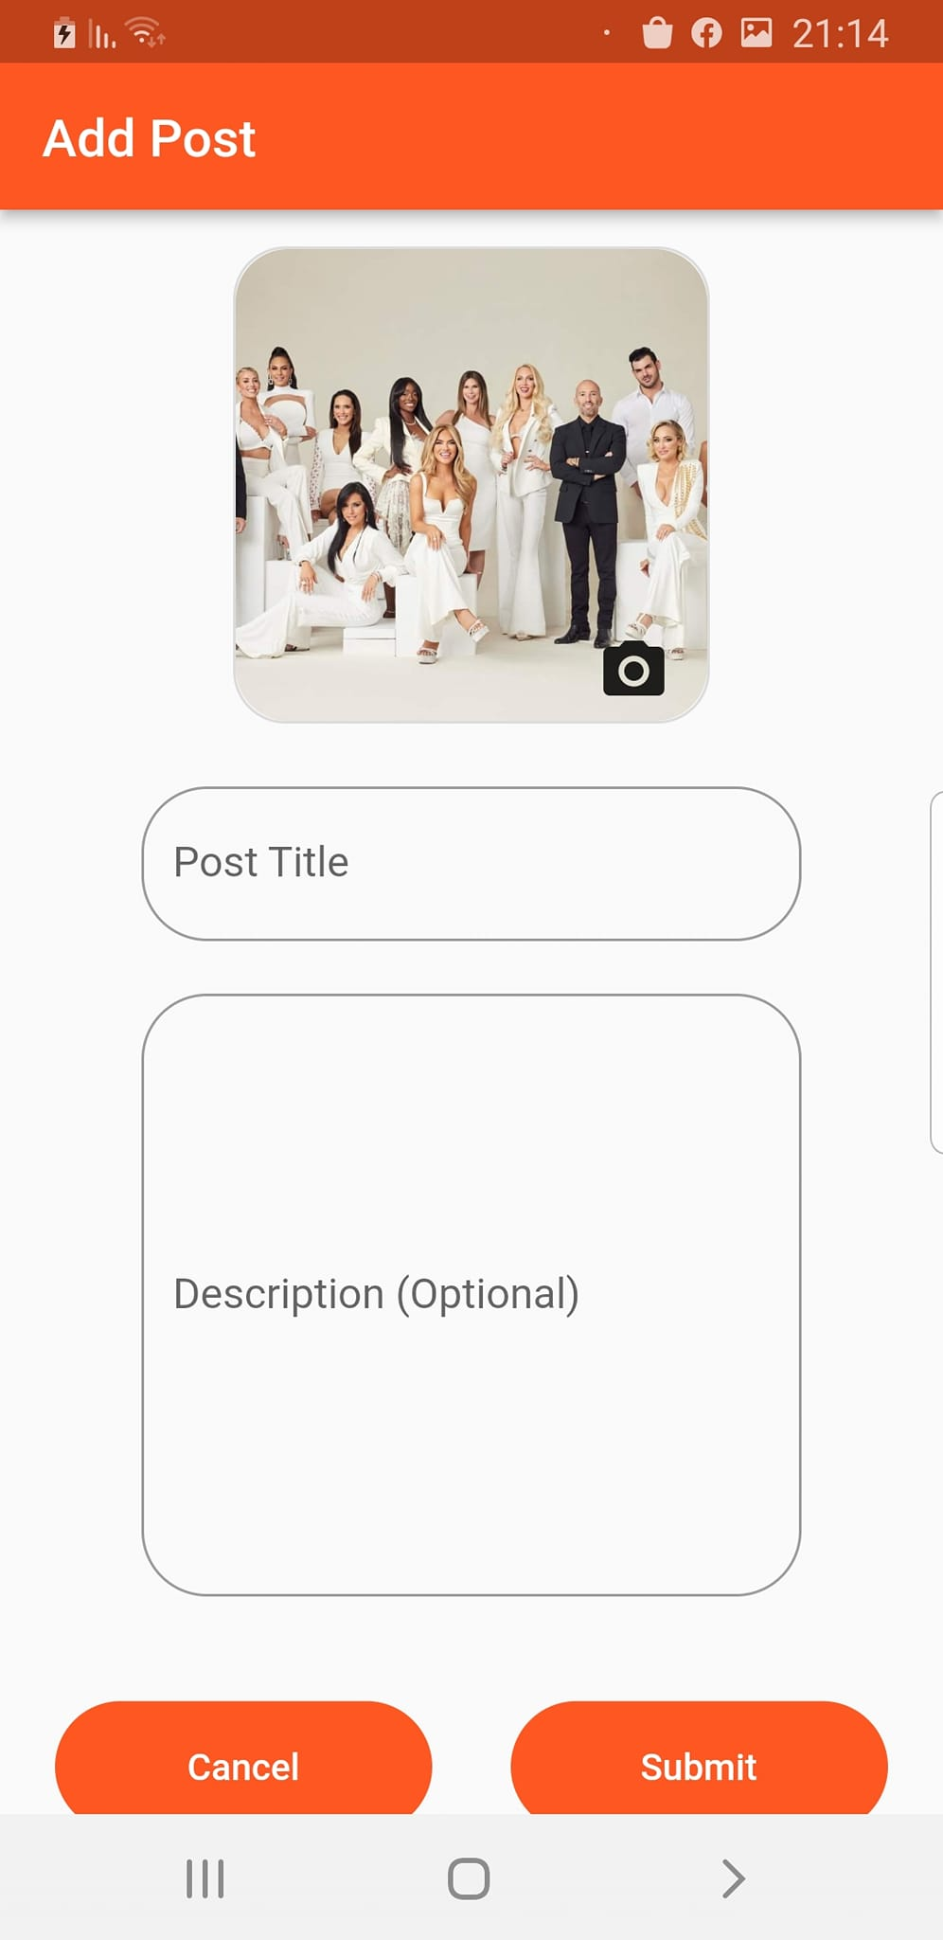

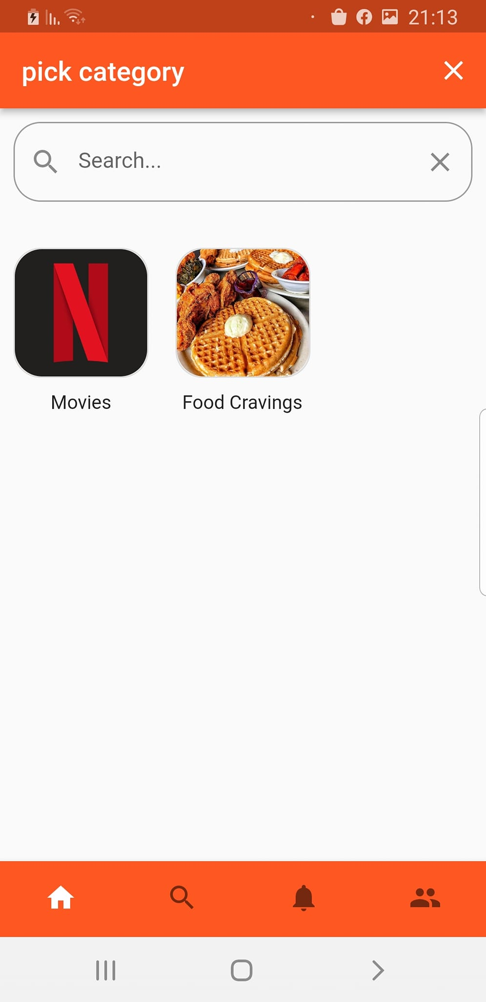


Share Button :
Here is an example for saving directly an image from Facebook app to Savet app by the share button.

Slide 11
Recorded demo

Slide 12

Thank you !

