Slide 1


Slide 2
An introduction Savet is an app that combines saved collections from multiple social media platforms into one place and enables you to share them with friends and family.

Slide 3
Key features of the app (which are already implemented)
Signup and login with Google and Facebook.
Visit as a guest.
Change profile photo.
Add new category, give it a name, description and image.
Make a category private or public and associate it with tags.
Add content from gallery & camera into categories and give it a description.
Save images in different sizes (staggered grid view)
Remove a category/items.
Sort categories manually by dragging an item.
Save recently added items into a category.
Follow & unfollow friends and see their public categories.

Slide 4
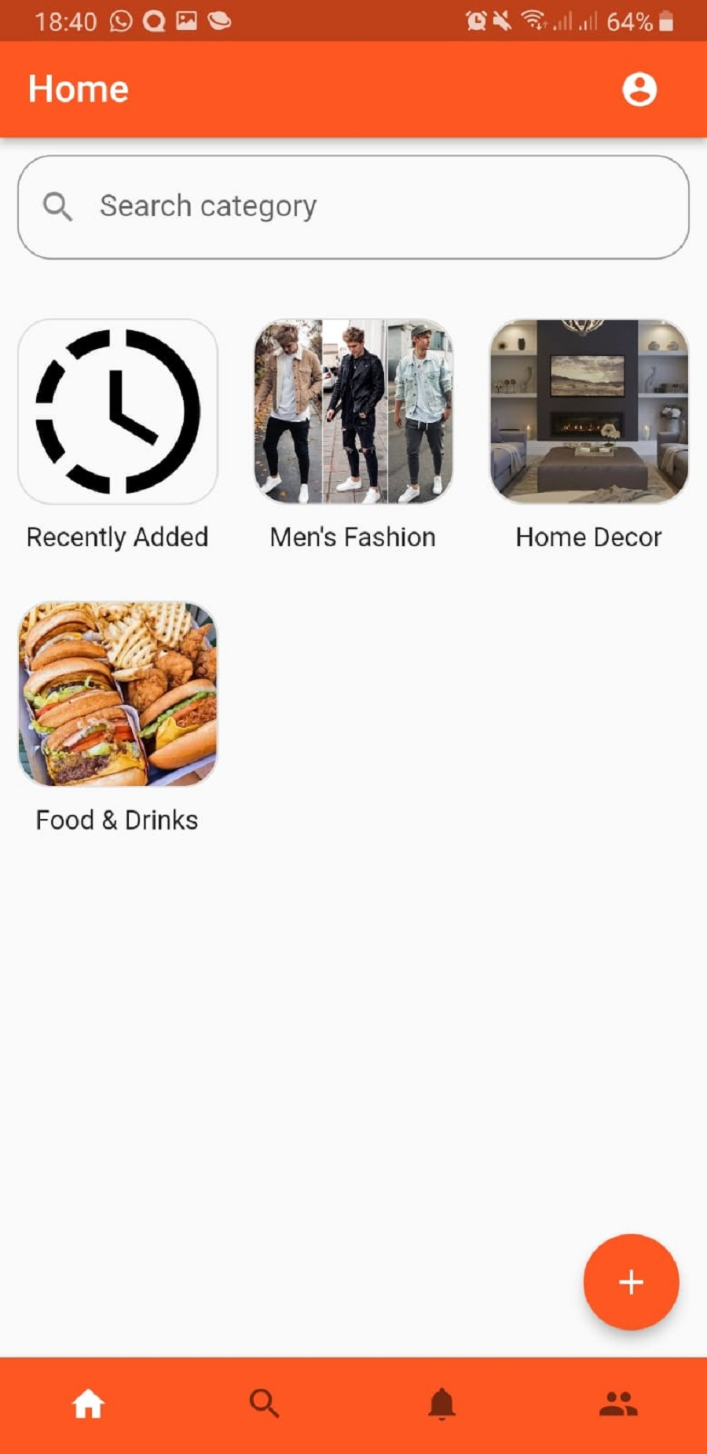
Home page :
Add new category, give it a name, description and image.
Make a category private or public and associate it with tags.
Remove a category.
Sort categories manually by dragging an item.

Slide 5
Features which you did not yet implement for the first sprint (but you plan on doing for the next one)

Slide 6
A recorded/live demo of your application

Slide 7
Technical explanation: Frameworks, libraries, technologies, and algorithms you used to implement your application

Slide 8

Thank you !

