Slide 1
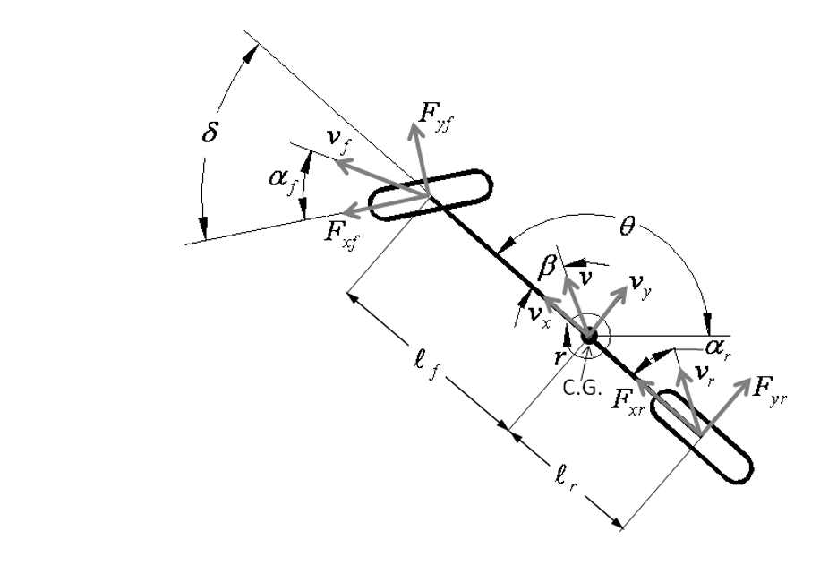

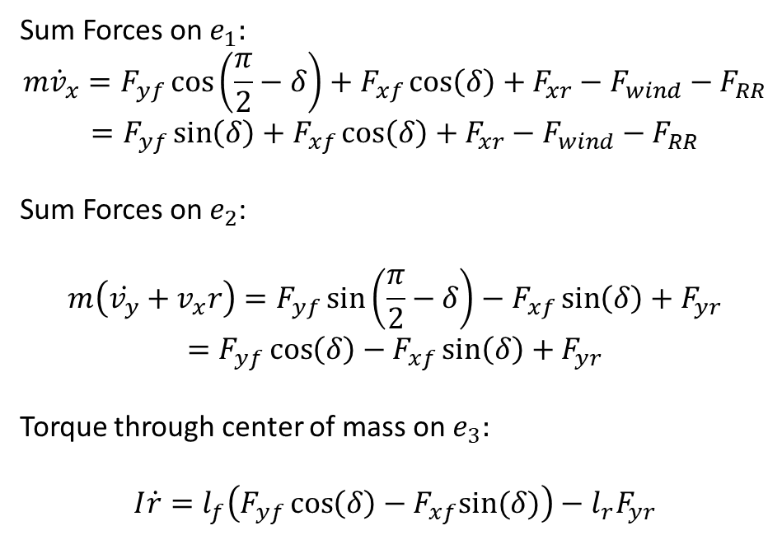


Equations of Motion
$$F_{wind}+F_{RollingResistence}$$
$$e_{1}$$
$$e_{2}$$
Sum Forces on $e_{1}:$
$$m{\dot{v}}_{x}=F_{yf}\cos\left(\frac{π}{2}−δ\right)+F_{xf}\cos\left(δ\right)+F_{xr}−F_{wind}−F_{RR}$$
$$=F_{yf}\sin\left(δ\right)+F_{xf}\cos\left(δ\right)+F_{xr}−F_{wind}−F_{RR}$$
Sum Forces on $e_{2}$:
$$m\left(\dot{v_{y}}+v_{x}r\right)=F_{yf}\sin\left(\frac{π}{2}−δ\right)−F_{xf}\sin\left(δ\right)+F_{yr}$$
$$=F_{yf}\cos\left(δ\right)−F_{xf}\sin\left(δ\right)+F_{yr}$$
Torque through center of mass on $e_{3}:$
$$I\dot{r}=l_{f}\left(F_{yf}\cos\left(δ\right)−F_{xf}sin⁡(δ)\right)−{l_{r}F}_{yr}$$

Slide 2


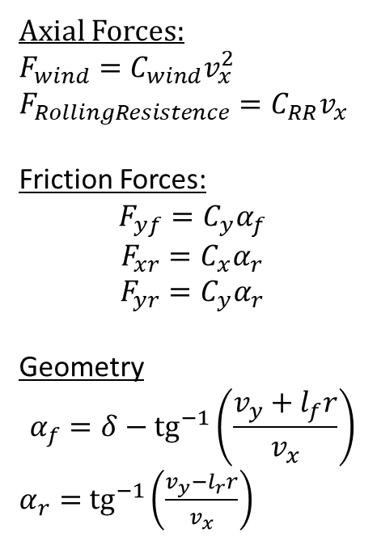
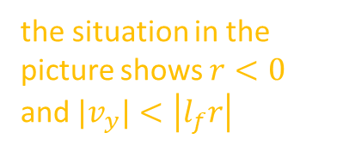

Modeling Forces
$$F_{wind}+F_{RollingResistence}$$
$$e_{1}$$
Axial Forces:
$$F_{wind}={C_{wind}v}_{x}^{2}$$
$$F_{RollingResistence}=C_{RR}v_{x}$$
Friction Forces:
$$F_{yf}=C_{y}α_{f}$$
$$F_{xr}=C_{x}α_{r}$$
$$F_{yr}=C_{y}α_{r}$$
Geometry
$$α_{f}=δ−{tg}^{−1}\left(\frac{v_{y}+l_{f}r}{v_{x}}\right)$$
$α_{r}=$ ${tg}^{−1}\left(\frac{v_{y}−l_{r}r}{v_{x}}\right)$
$$e_{2}$$
$$v_{y}+l_{f}r$$
$$v_{f}$$
$$v_{x}$$
the situation in the picture shows $r<0$
and ${|v}_{y}|<\left|l_{f}r\right|$

Slide 3
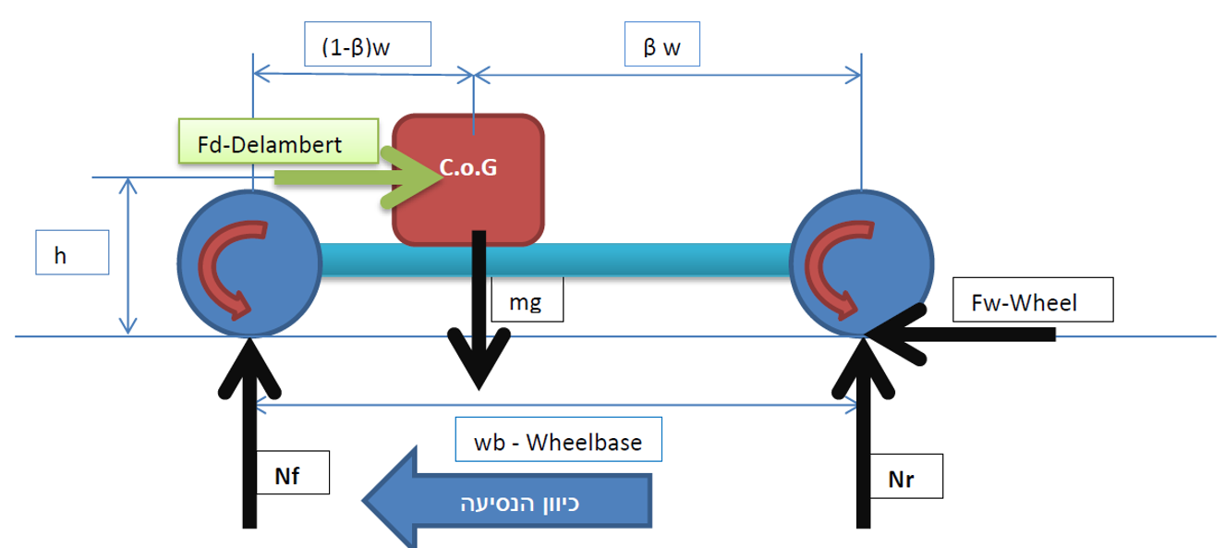
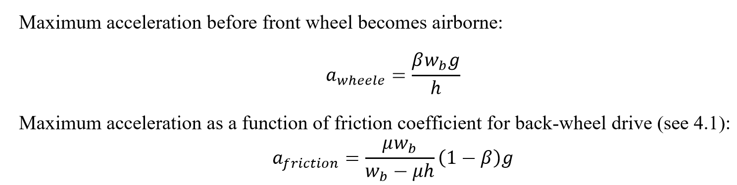
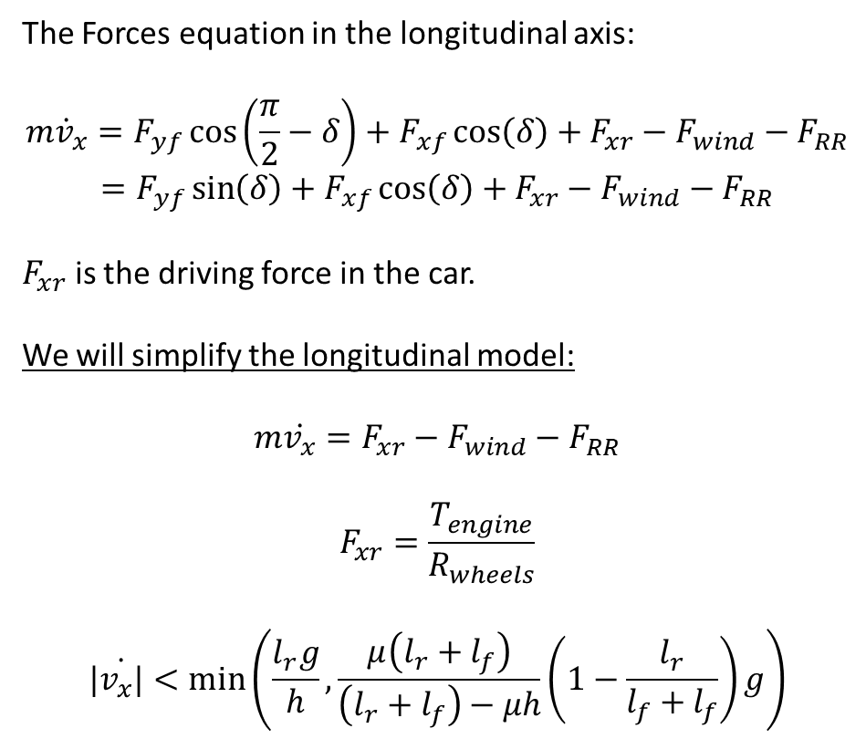
Modeling Forces – Cont.
The Forces equation in the longitudinal axis:
$$m{\dot{v}}_{x}=F_{yf}\cos\left(\frac{π}{2}−δ\right)+F_{xf}\cos\left(δ\right)+F_{xr}−F_{wind}−F_{RR}$$
$$=F_{yf}\sin\left(δ\right)+F_{xf}\cos\left(δ\right)+F_{xr}−F_{wind}−F_{RR}$$
$F_{xr}$ is the driving force in the car.
We will simplify the longitudinal model:
$$m\dot{v_{x}}=F_{xr}−F_{wind}−F_{RR}$$
$$F_{xr}=\frac{T_{engine}}{R_{wheels}}$$
$$|\dot{v_{x}|}<\min\left(\frac{l_{r}g}{h},\frac{μ\left(l_{r}+l_{f}\right)}{\left(l_{r}+l_{f}\right)−μh}\left(1−\frac{l_{r}}{l_{f}+l_{f}}\right)g\right)$$

Slide 4
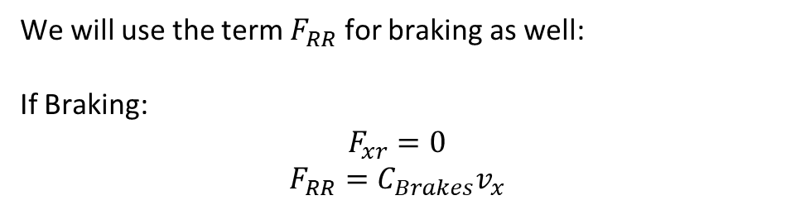
Modeling Forces – Cont.
We will use the term $F_{RR}$ for braking as well:
If Braking:
$$F_{xr}=0$$
$$F_{RR}=C_{Brakes}v_{x}$$

