Slide 1
Text2Json
Project presentation
Presenting: Noa Shilo and Igal Brenner
Under supervision of: Dr. Oren Mishali

Slide 2
OVERVIEW
Text2Json is a general parsing tool for developers
Using Text2Json a programmer can almost effortlessly convert any text file to an easy-to-work-with json format file
The library was developed as part of the JBS project in the Technions TDK lab
With the help of this tool dozens of jewish books were “translated” to json format and used in the project to create a semantic web database of the jewish books

Slide 3


Motivation
Extracting information from a raw text file is very hard, especially when doing so repeatedly with big text files.
This is exactly the case in the JBS project.
Rearranging the text in a structural form with metadata combined is necessary for every phase of the project.
For that reason we developed the Text2Json tool. With it every text file can easily be converted to a json file.

Slide 4
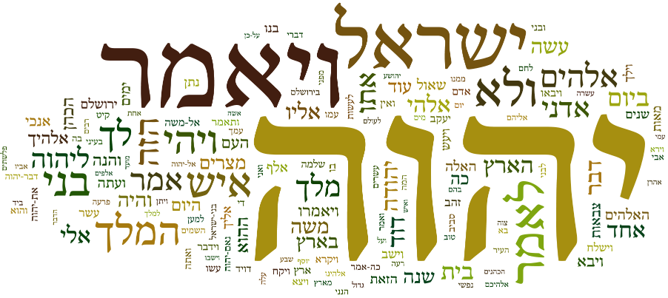
Some results

Slide 5
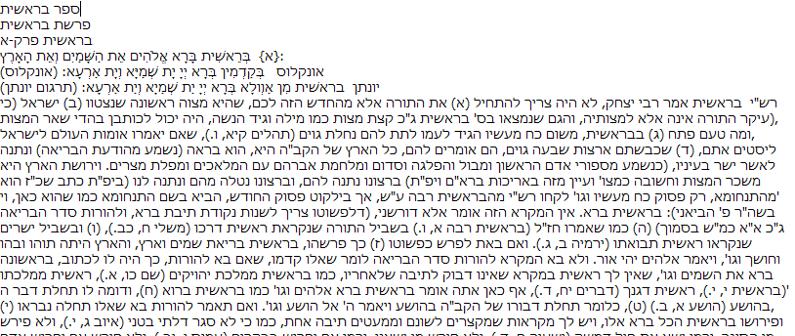
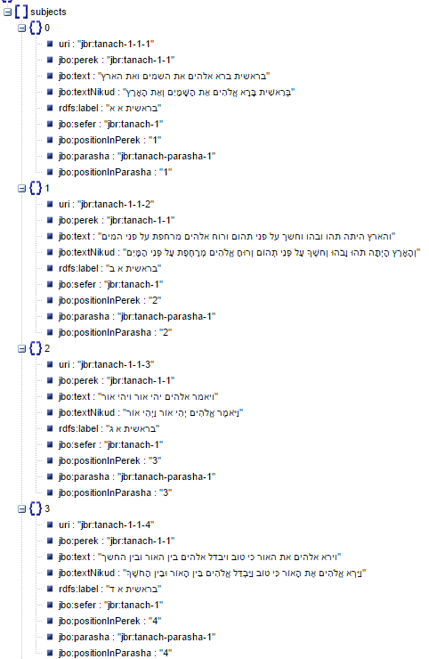

תנ"ך

Slide 6
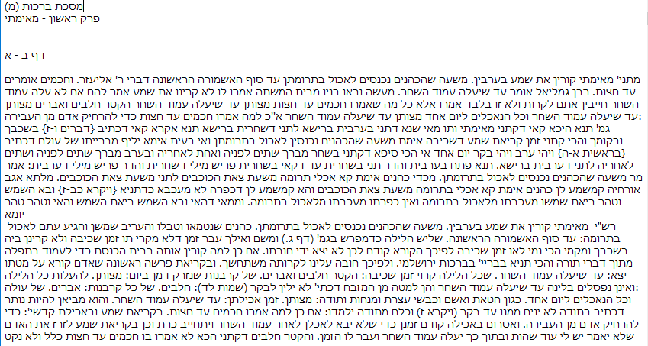
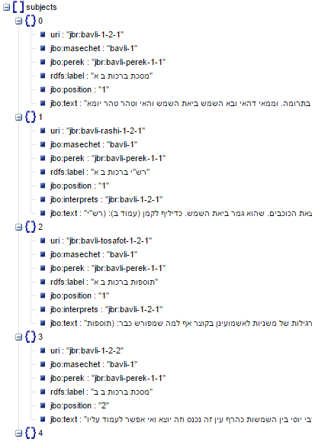

תלמוד בבלי

Slide 7
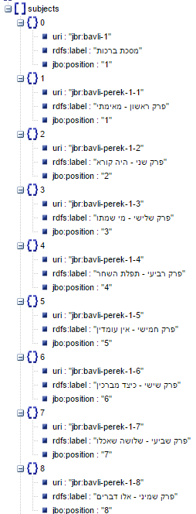
Json file for package data
תלמוד בבלי

Slide 8
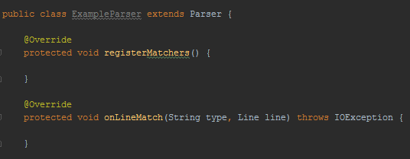
USING Text2Json
Create a new parser inheriting from the parser class
Define pattern matchers
Define actions to be taken upon match

Slide 9

Register Matchers
LineMatcher - interface for pattern matching.
Define as many matchers as you would like.
Give each one a “type” i.e. PEREK, PASUK
Define a matching expression for each matcher

Slide 10
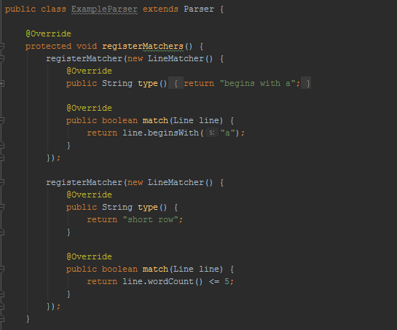
Register Matchers
Line - A class with a set of functions for examining the text. Use it to write the matching rule i.e. line.contains(“hello”)

Slide 11

Some of the functions provided by the Line class
Get line
Begins with
Ends with
Contains
Word count
Extract
Get first word

Slide 12
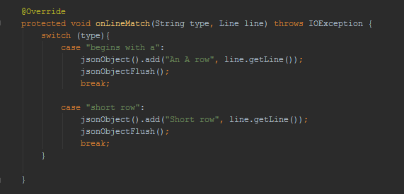
On Line Match
A call back function called by the program upon matching a matcher as defined in the Register Matchers phase
JsonObject – A class for easily writing to a json file

Slide 13

Some of the functions provided by the json object class
Add – write a new json key and value pair to the current json object
Append – append string to a value of a pair with a given key
Flush – write the json object to the file and open a new one

Slide 14
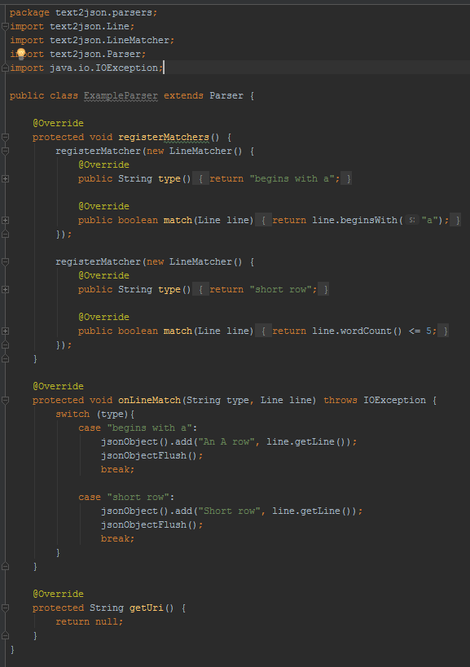


Slide 15

Testing and Debugging
Test with Junit
“Spill” all json objects into an array
Assert test the number of expected objects – Used to identify abnormalities
Add prints to the program to locate the missing/added object/s
Sample some objects in the array and assert their attributes are as expected
Examples can be found in the project git

Slide 16

Working process
“Feel the ground”: created a specific parser before creating the tool
Insights: encoding, Hebrew nikud, Gson library and more…
Created a general parser – the Parser class
Started parsing jewish books
Simultaneously created helping tools for the general parser and utilities specifically for the jewish bookshelf parsing.
Dealt with changes along the way

Slide 17

Challenges and Difficulties
Data quality – the raw text was mostly consistent but abnormalities were present and hard to locate
Used Software engineering technics that were unfamiliar to us at first
Dynamic requirements – the other groups in the project used the results produced by the Text2Json. As the project evolved the requirements from the other tools’ input changed and the Text2Json had to be adapted

Slide 18

THANK YOU! For more information: https://github.com/TechnionTDK/jbs-text2json

