Slide 1
Text2Json
Project presentation
Presenting: Noa Shilo and Igal Brenner
Under supervision of: Dr. Oren Mishali

Slide 2
OVERVIEW
Text2Json is a general parsing tool for developers
Using Text2Json a programmer can almost effortlessly convert any text file to an easy-to-work-with json format file
The library was developed as part of the JBS project in the Technions TDK lab
With the help of this tool dozens of jewish books were “translated” to json format and used in the project to create a semantic web database of the jewish books

Slide 3
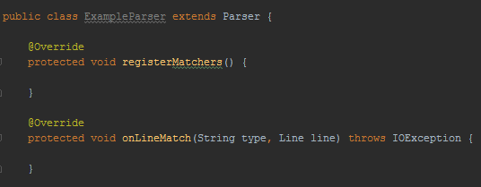
USING Text2Json
Create a new parser inheriting from the parser class
Define pattern matchers
Define actions to be taken upon match

Slide 4
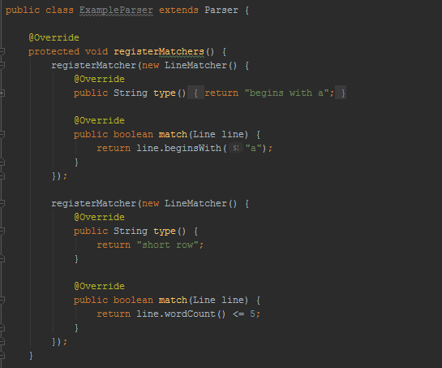
Register Matchers
LineMatche - interface for pattern matching.
Line - A class with a set of functions for examining the text.

Slide 5
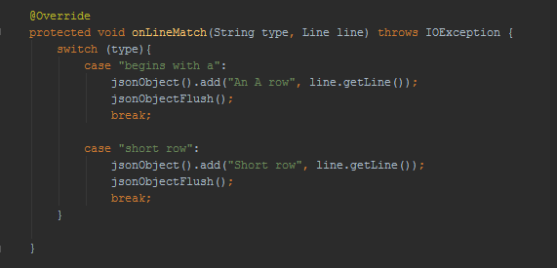
On Line Match
JsonObject – A class for easily writing a json object
Line - A set of functions to manipulate the text.

Slide 6
Some results

Slide 7
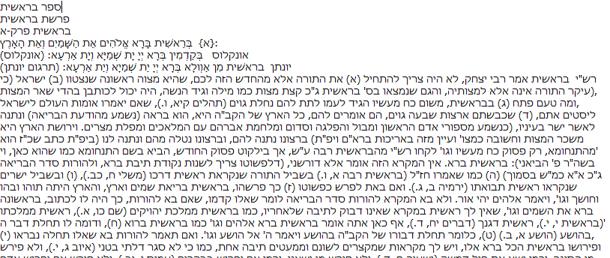
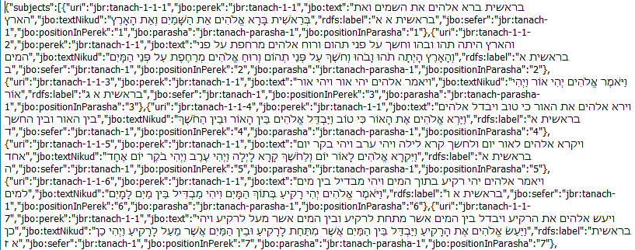
תנ"ך

Slide 8
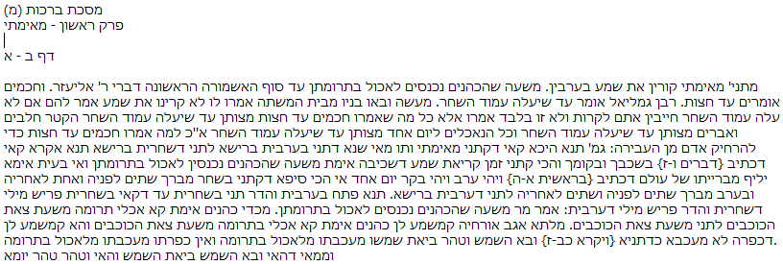
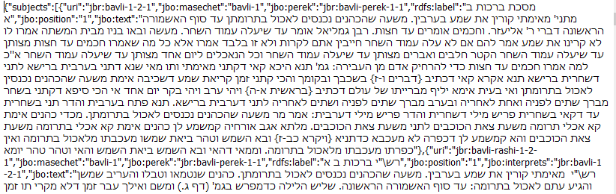
תלמוד בבלי

Slide 9
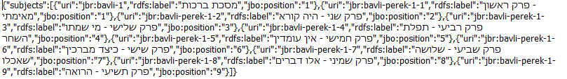
Json file for package data
תלמוד בבלי

Slide 10
For more information: https://github.com/TechnionTDK/jbs-text2json

