Slide 1
Text2Json
Project presentation
Presenting: Noa Shilo and Igal Brenner
Under supervision of: Dr. Oren Mishali

Slide 2
OVERVIEW
Text2Json is a general parsing tool for developers
Using Text2Json a programmer can almost effortlessly convert any text file to an easy-to-work-with json format file
The library was developed as part of the JBS project in the Technions TDK lab
With the help of this tool dozens of jewish books were “translated” to json format and used in the project to create a semantic web database of the jewish books

Slide 3
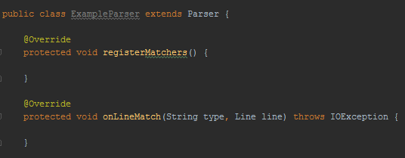


USING Text2Json
Create a new parser inheriting from the parser class
Define pattern matchers
Define actions to be taken upon match

Slide 4
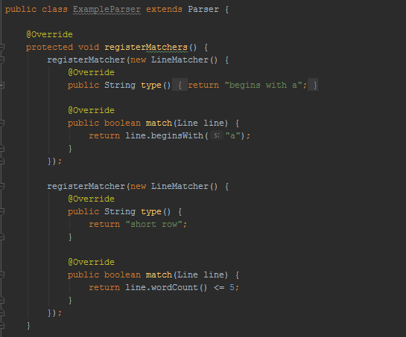

Register Matchers
LineMatcher - interface for pattern matching.
Line - A class with a set of functions for examining the text.

Slide 5

Some of the functions provided by the Line class
Get line
Begins with
Ends with
Contains
Word count
Extract
Get first word

Slide 6
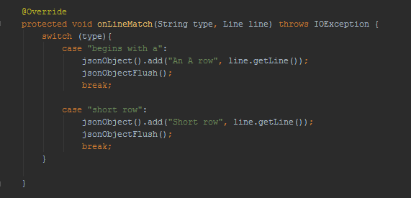
On Line Match
JsonObject – A class for easily writing to a json file

Slide 7

Some of the functions provided by the json object class
Add
Append
Has key
Write

Slide 8
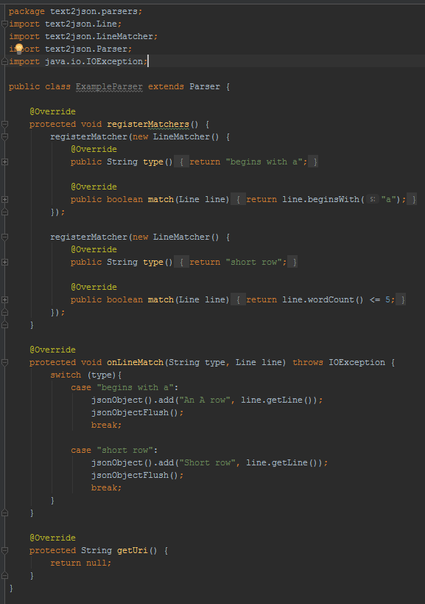

Slide 9
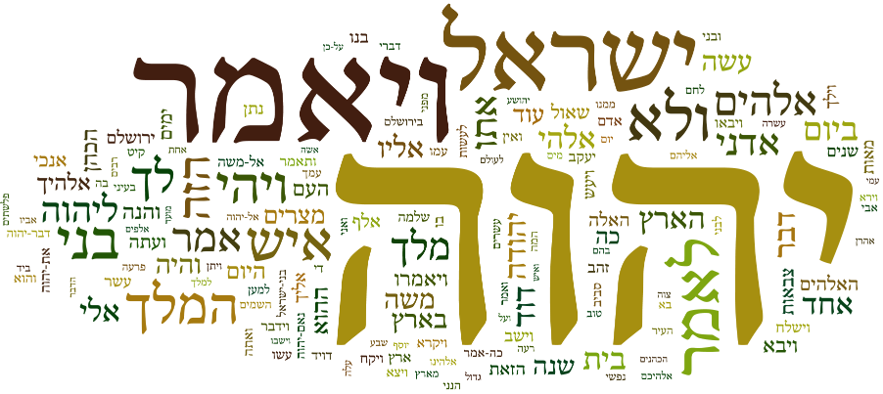
Some results

Slide 10
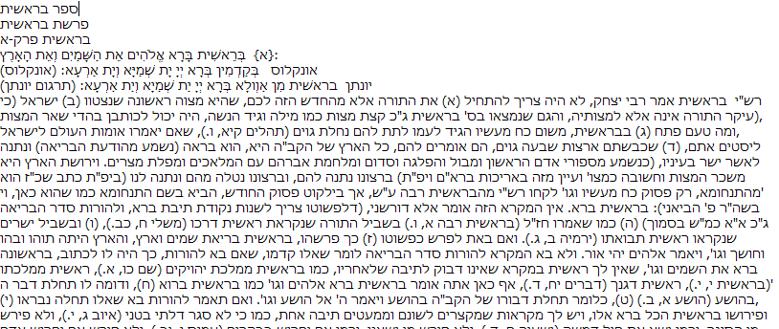
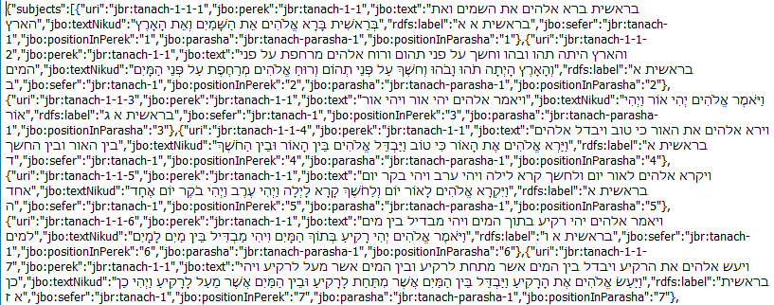

תנ"ך

Slide 11
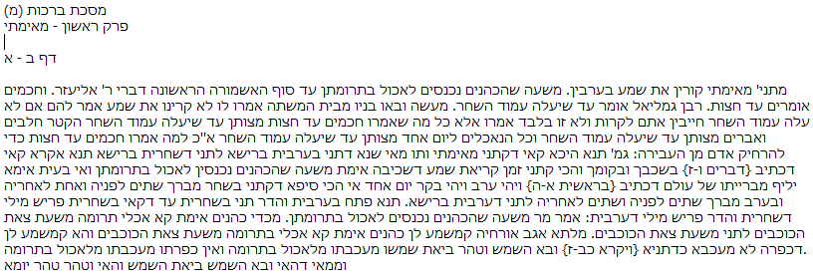
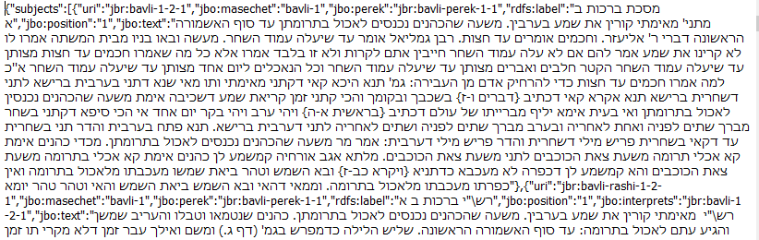

תלמוד בבלי

Slide 12
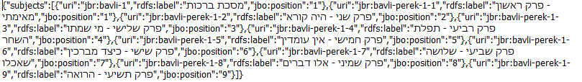
Json file for package data
תלמוד בבלי

Slide 13
Working process
“Feel the ground”: created a specific parser before creating the tool
Insights: encoding, Hebrew nikud, Gson library and more…
Created a general parser – the Parser class
Started parsing jewish books
Simultaneously created helping tools for the general parser and utilities specifically for the jewish bookshelf parsing.
Dealt with changes along the way

Slide 14

THANK YOU! For more information: https://github.com/TechnionTDK/jbs-text2json

