Slide 1



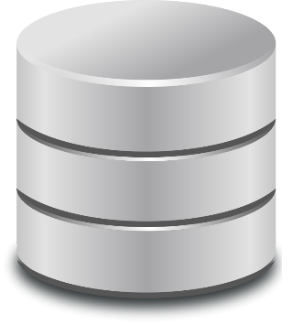




extract-
edb-
schema
EDB
edb.schema.
json
app.spl
compile-to-ddlog
app.
ddlog
articles.csv
spannerlog-
compiler
compiled.
spl.json
compile-rgx-to-sql
rgx.sql
aliases.csv
db.url
compile-exec-plan-to-bash
run.sh
extract-ief-schema
ief.
schema. json
IEF
my_func1
my_func2

