Slide 1

The Doors

Slide 2
Participants
Stav Namir
Ilana Levitan
Koby Brandes
Advisor: Tom Palny
Yarin Ozery
Aviad Rozenknof
Elyasaf Boim

Slide 3






How would you schedule the employees in the factory in order to avoid loads?

Slide 4
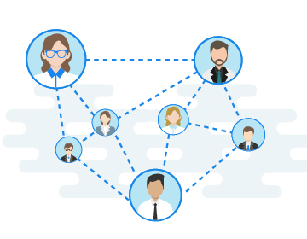
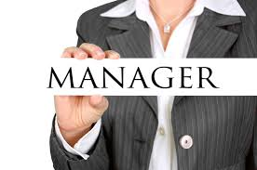

Add / Edit Rooms and Employees
Employees can communicate
Can schedule meetings
Help Manager avoid loads

Slide 5





The tools

Slide 6

Error handling
Our program knows how to deal with errors.
Will be showed in the Live Demo.

Slide 7
Be ready for Live Demo

Slide 8

Testing
Manually tests on GUI
Pytest
CodeCav
Logger

Slide 9




Next steps
Expand simulation & add to GUI
NFC
Ability to log in via Facebook
Integration with google calendar

Slide 10

Thanks for listening!

