Slide 1


Session #1
Introduction
Winter 2024/25

Slide 2
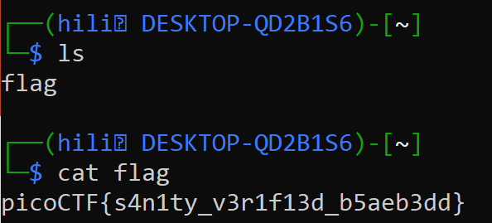
What is CTF?
“Capture The Flag” - Cybersecurity competition
Objective – find "flags" (strings of text) that are hidden in different and creative ways.
Highly technical
01 Introduction

Slide 3
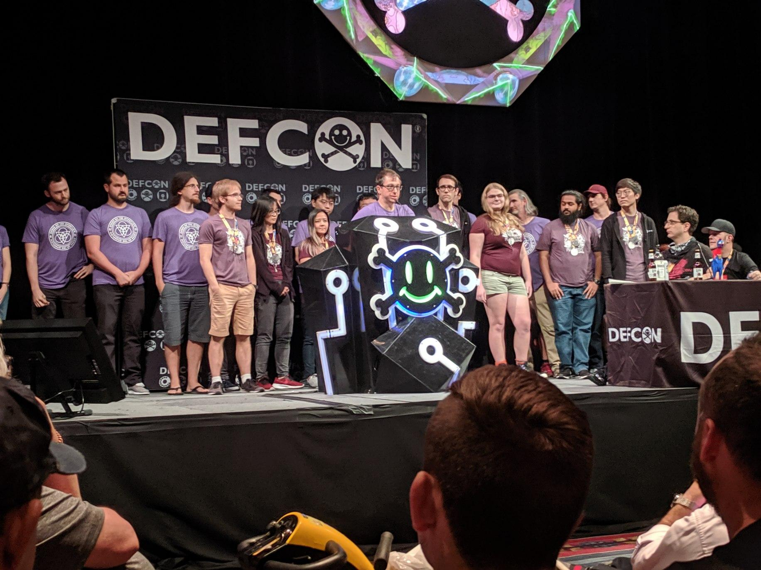
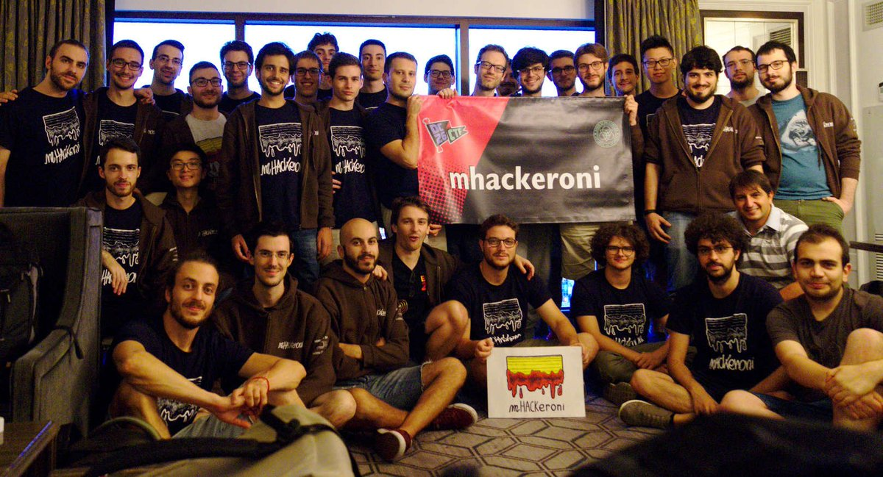
Basics – Why CTF?
Practical skills
Meet new people
Fun!
07 Basics

Slide 4
Schedule
Meeting | Date | #
Introduction | 13/5/2026 | 1
Web | 10/6/2026 | 2
Cryptography | 23/6/2026 | 3
Forensics | 7/7/2026 | 4
Additional Lectures By:
Prof. Avi Mendelson
Mystery Guest lecturer
08 Introduction

Slide 5
Keynote – Prof. Avi Mendelson
03 Introduction

Slide 6

Example: repetition

Slide 7
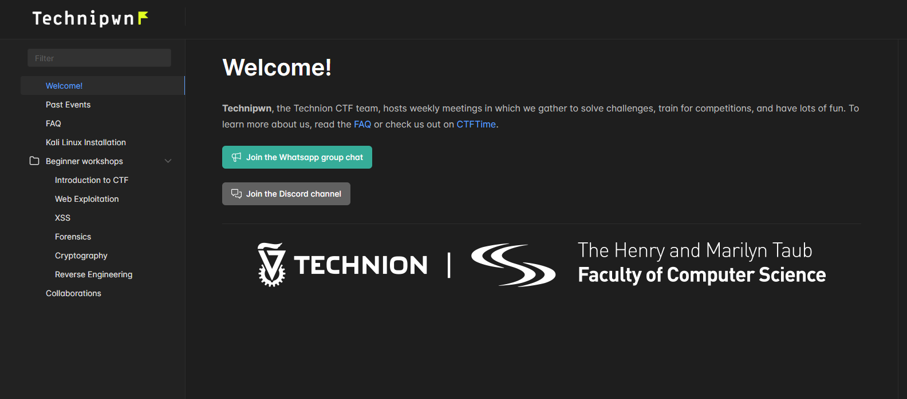
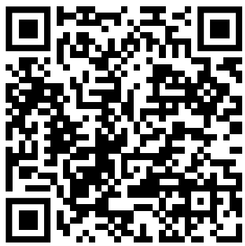
Website
https://natitati4.github.io/technion-ctf/
01 Introduction

Slide 8
Practice Time
Beginners
https://learn.cylabacademy.org/classrooms
CbyOpQlZJ | picoCTF{♥♦♣♠}

Slide 9
Thank You

