Slide 1


Session #5
Cryptography
Winter 2025/26

Slide 2
What is cryptography?
Alice
Bob
My credit card number is …
My credit card number is…
Alice’s credit card number is…
05 Crypto
Notes:
Alice and Bob want to talk between them. Sometimes it’s in chat, or on the phone, etc. Sometimes they send nonsense information and sometimes they send secrets.

Slide 3
What is cryptography?
Alice
Bob
My card number is …
My credit card number is…
Eve
Alice’s credit card number is…
05 Crypto
Notes:
What’s the problem? When the message is out in the open like this, anyone can listen and abuse the information.

Slide 4


What is cryptography?
Alice
Bob
##$@$##$@#@##@
My credit card number is…
Alice’s credit card number is…
Eve
05 Crypto
Notes:
This is our end goal

Slide 5
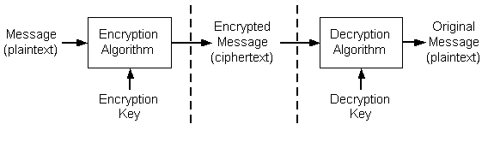
What is cryptography?
05 Crypto
Notes:
https://learn.microsoft.com/en-us/windows/win32/seccrypto/cryptography-concepts
Base concepts – plaintext, ciphertext; encryption and decryption algorithms; encryption and decryption keys

Slide 6
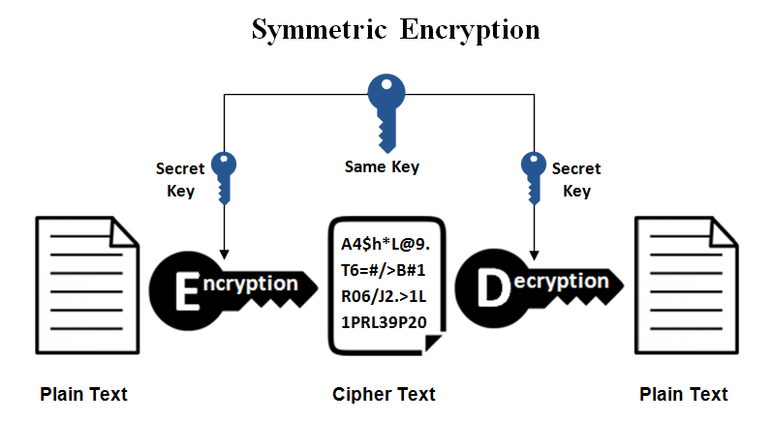
Symmetric encryption
05 Crypto
Notes:
https://www.ssl2buy.com/wiki/symmetric-vs-asymmetric-encryption-what-are-differences

Slide 7
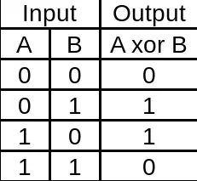
XOR
We XOR longer binary numbers bit by bit: 0110^1010 = 1100
We can XOR integers by converting them from decimal to binary
We can XOR strings by converting each character to its ASCII value
05 Crypto
Notes:
https://en.wikipedia.org/wiki/Symmetric-key_algorithm

Slide 8
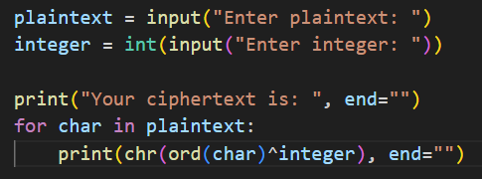
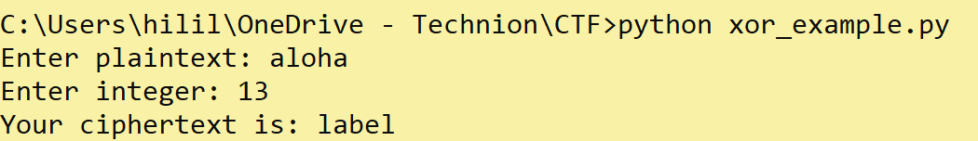
XOR
05 Crypto
Notes:
https://onecompiler.com/python/424mjnw8j
https://adityatelange.in/writeups/cryptohack/general/xor-starter/

Slide 9
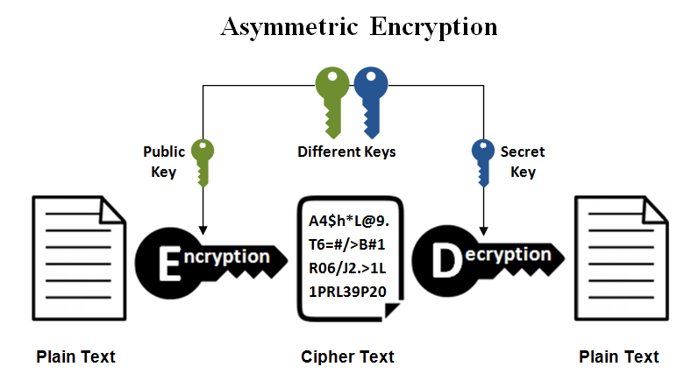
Asymmetric Encryption
05 Crypto
Notes:
https://www.ssl2buy.com/wiki/symmetric-vs-asymmetric-encryption-what-are-differences

Slide 10
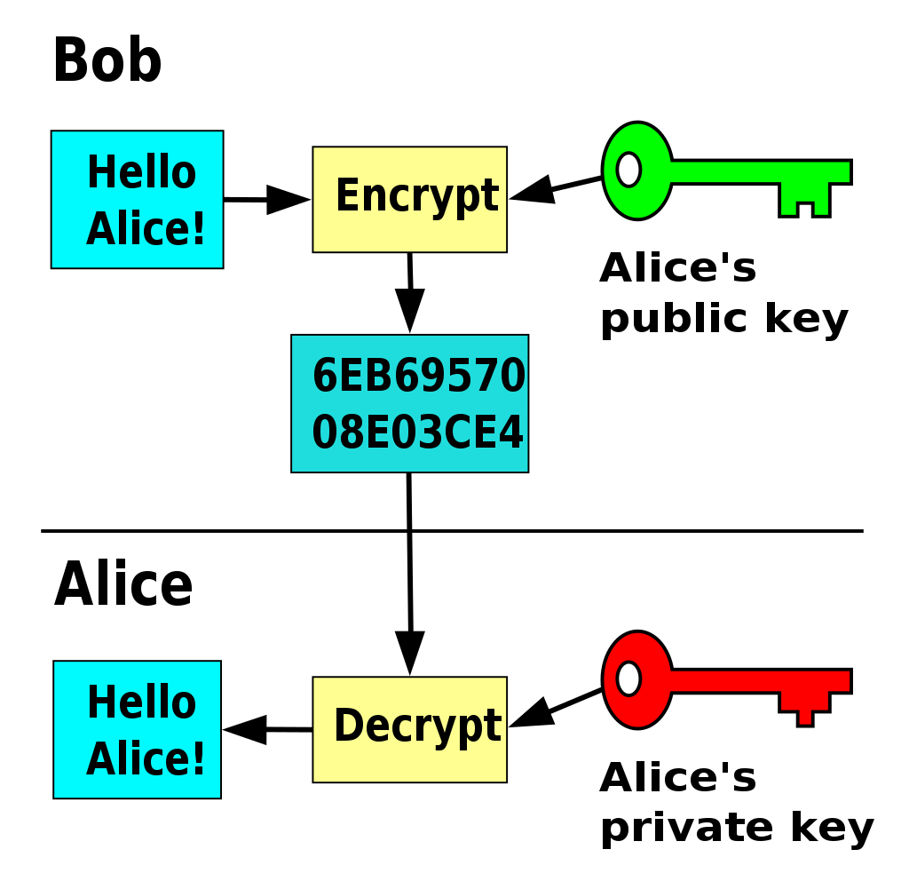
Asymmetric Encryption
05 Crypto
Notes:
https://en.wikipedia.org/wiki/Public-key_cryptography

Slide 11
What is cryptography?
02 Crypto
Notes:
https://learn.microsoft.com/en-us/windows/win32/seccrypto/cryptography-concepts
Going back before next slide

Slide 12
Cryptography in CTFs
Flag
Given an encrypted message and the algorithm,
We need to find the keys to get the flag.
Flag
05 Crypto
Notes:
https://learn.microsoft.com/en-us/windows/win32/seccrypto/cryptography-concepts

Slide 13

Practice time!
05 Crypto
Notes:
https://cryptohack.org/challenges/

Slide 14
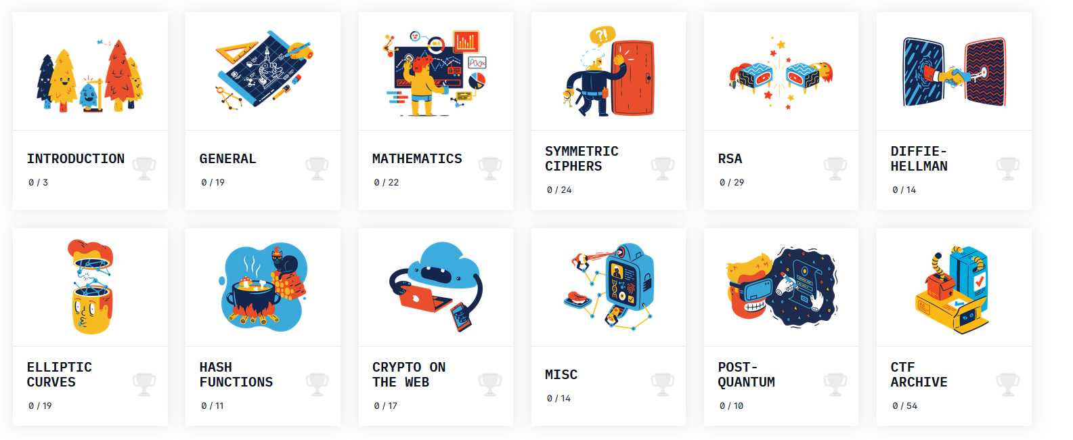
Practice time!
05 Crypto
Notes:
You can choose what you do with your time – we recommend for beginners to go over the general challenge, and for more-advanced to try out the challenges on “crypto on the web”.

Slide 15

Thank You

