Slide 1

Zepto Sales Analysis
By Shubham

Slide 2

Objective
Identifying growth opportunities.
Evaluating the performance of different product categories.
Gaining insights into customer behavior and regional sales trends.

Slide 3
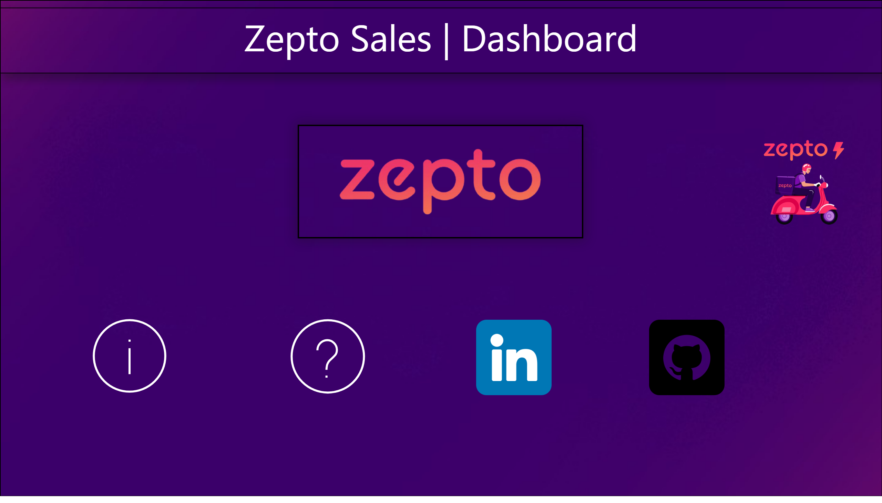
Home
Notes:
image
No alt text provided
actionButton
No alt text provided
actionButton
No alt text provided
image
No alt text provided
image
No alt text provided
image
No alt text provided
image
No alt text provided
textbox
No alt text provided

Slide 4
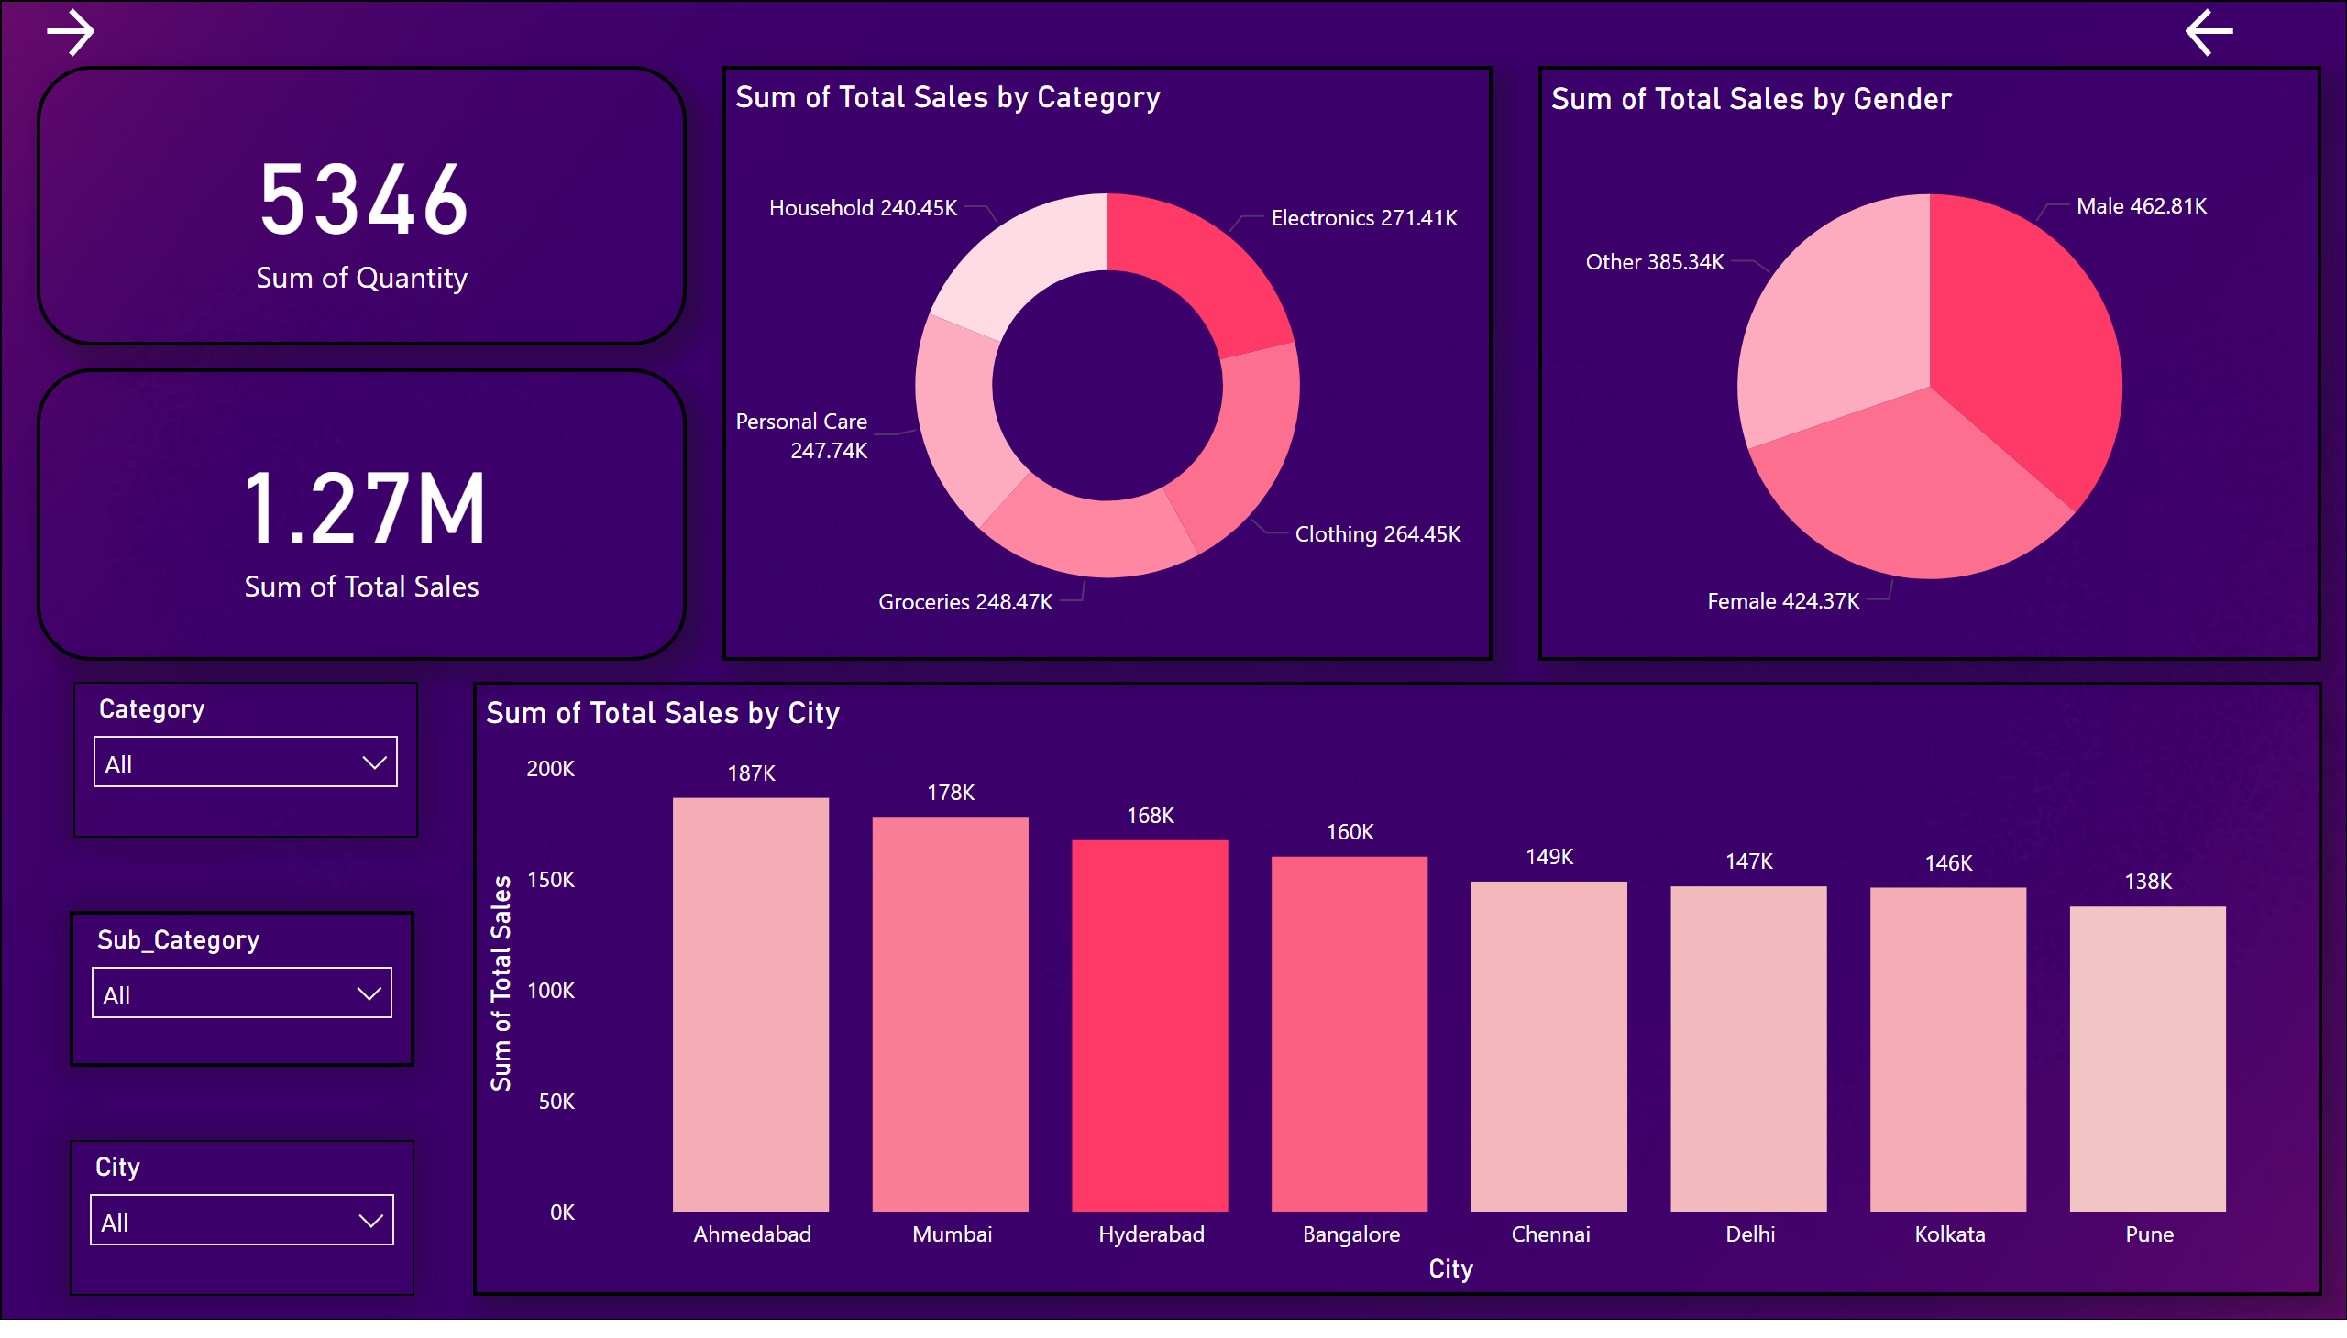
Sales - 1
Notes:
image
No alt text provided
pieChart
No alt text provided
donutChart
No alt text provided
card
No alt text provided
card
No alt text provided
slicer
No alt text provided
slicer
No alt text provided
slicer
No alt text provided
columnChart
No alt text provided
actionButton
No alt text provided
actionButton
No alt text provided

Slide 5
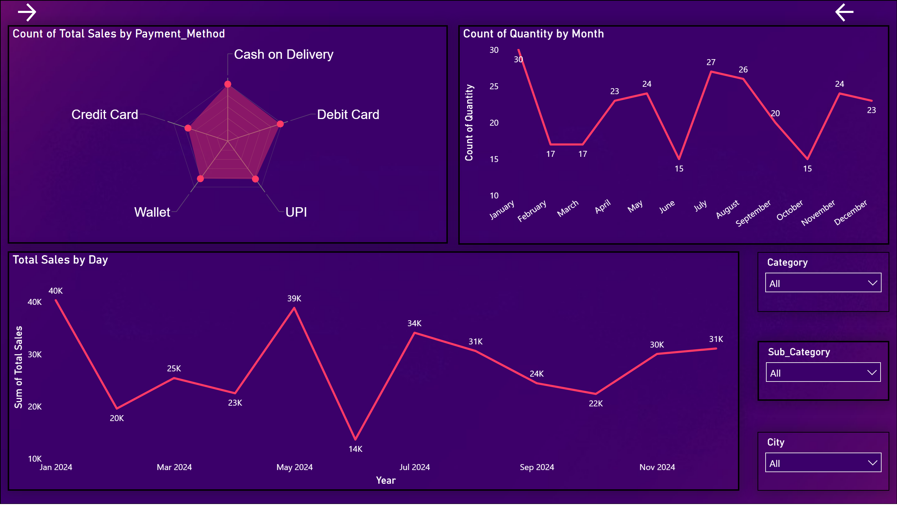
Sales - 2
Notes:
image
No alt text provided
RadarChart1446119667547
No alt text provided
lineChart
No alt text provided
Total Sales by Day
No alt text provided
slicer
No alt text provided
slicer
No alt text provided
slicer
No alt text provided
actionButton
No alt text provided
actionButton
No alt text provided

Slide 6
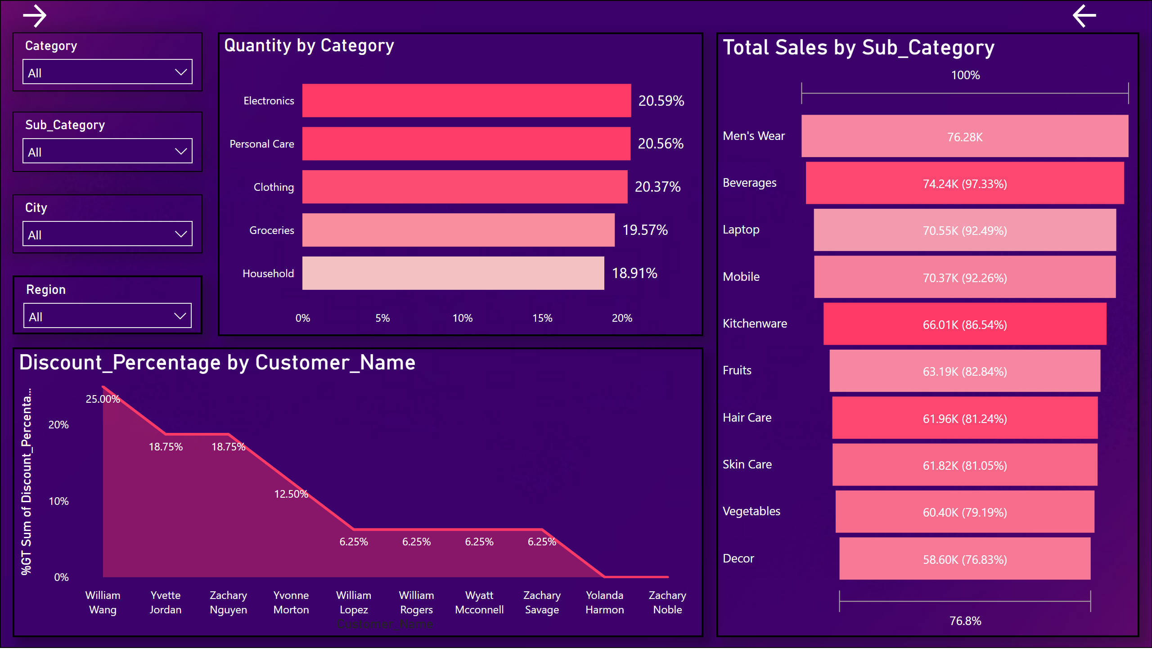
Sales - 3
Notes:
image
No alt text provided
Discount_Percentage by Customer_Name
No alt text provided
slicer
No alt text provided
Total Sales by Sub_Category
No alt text provided
slicer
No alt text provided
slicer
No alt text provided
Quantity by Category
No alt text provided
slicer
No alt text provided
actionButton
No alt text provided
actionButton
No alt text provided

Slide 7
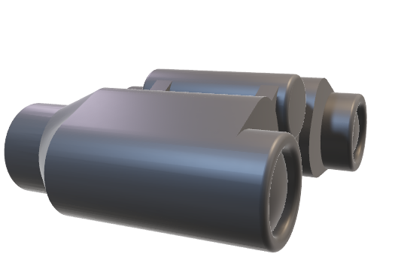
Insights / Conclusion
Sales Trends: Understand revenue growth, sales volume, and average order value (AOV) trends.
Category Performance: Identify top-performing and underperforming product categories.
Regional Insights: Analyze regional sales contributions and growth opportunities.
Customer Behavior: Gain insights into customer preferences, retention, and demographics.
Operational and Marketing Efficiency: Assess supply chain performance and the impact of marketing
campaigns on sales.

Slide 8
Thank You

