Slide 1
Biodiversity in National Parks
Cyn Armistead

Slide 2
Purpose
We were tasked to examine observational data on various species collected from four national parks in order to assess the biodiversity present in those parks. We chose to focus on five questions while studying that data.

Slide 3
Research Questions
Which species have been observed in which parks?
What is the distribution of conservation statuses for those species?
Are certain categories of species more likely to be endangered?
Are the differences between species and their statuses significant?
What species are most prevalent and what is their distribution amongst these parks?

Slide 4
Data
We were presented with two files of data. The first, species_info.csv, contained category, scientific names, common names, and conservation statuses for various species. The second, observatons.csv, contained counts of various species as observed at four national parks. There were 5,541 distinct species noted from seven categories. These were assigned one of five conservation statuses.
The data was cleaned by removing duplicate species entries.

Slide 5
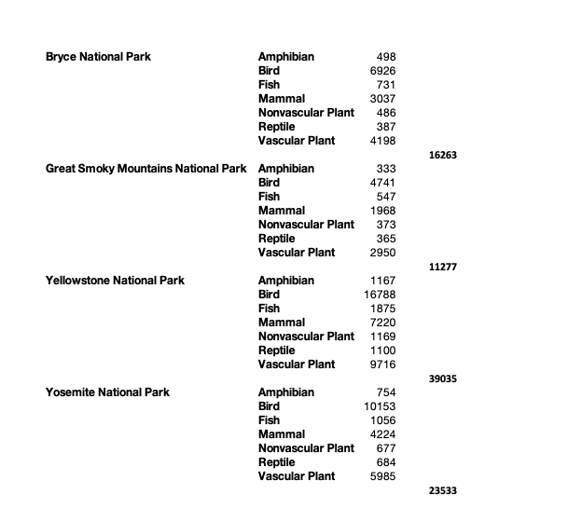
Distribution of Species by Park
There were far more observations in Yellowstone National Park than in the other parks (43%). We don’t know if that reflects greater biodiversity there or if there is some other factor in play.

Slide 6
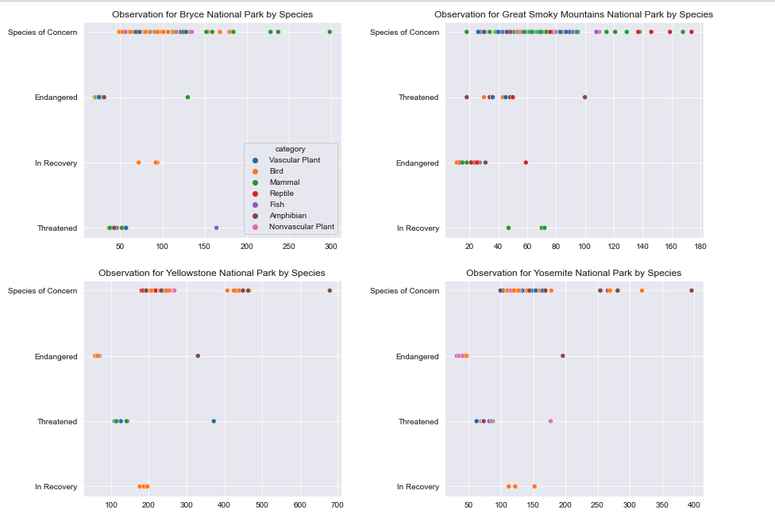
Conservation Statuses by Species and Park
The vast majority of species (97%) are considered to be in Least Concern conservation status.

Slide 7
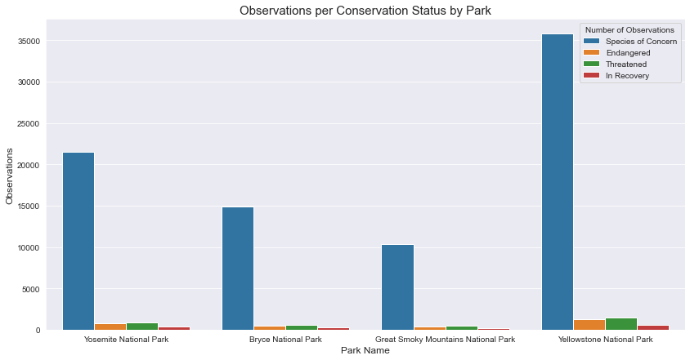
Species in Each Park
The vast majority of species (97%) are considered to be in Least Concern conservation status. Removing those from the graph makes it a little easier to see the other 3%.

Slide 8
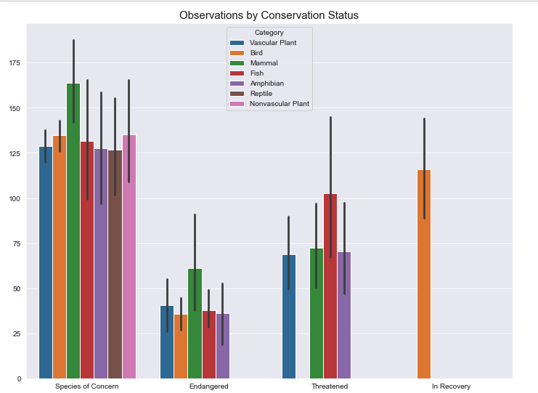
Observations by Conservation Status
Vascular plants, followed by nonvascular plants, then birds, are those most likely to be Species of Concern. Fish lead the Threatened category. The In Recovery status has only one category, birds. Endangered is led by fish.

Slide 9
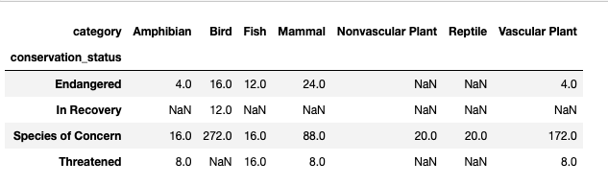
Conservation Status by Species
There are more mammals considered Endangered than any other category, but does that mean they’re more likely to be threatened or they’re easier to count?

Slide 10
Significance of Differences
We used a Chi-Square contingency test to determine whether the differences in the animals’ conservation statuses were significant. For both the full set of data and the subset without the Least Concern items, there was a strong suggestion of significance.

Slide 11
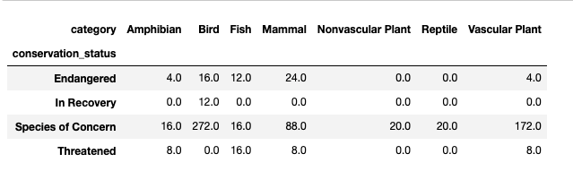
Conservation Status by Species Category
There are more birds considered Species of Concern than any other category.

Slide 12
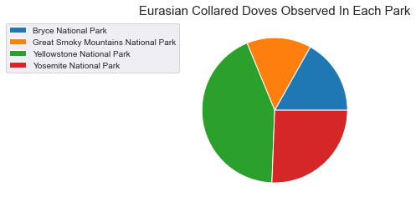
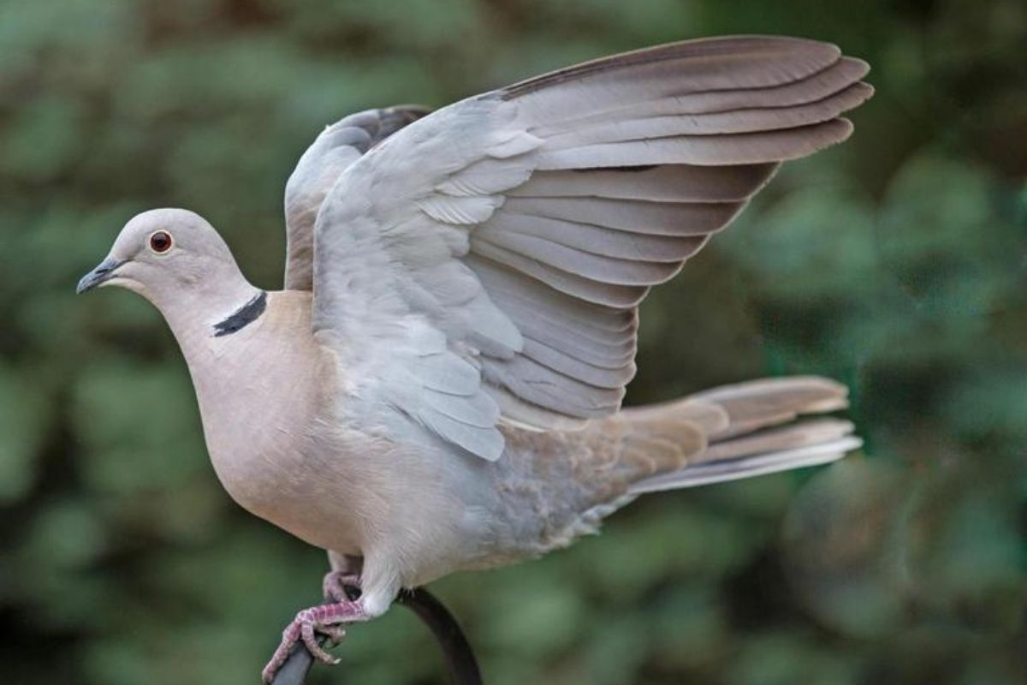
Most Common Species
The most commonly-observed species was the Streptopelia decaocto, or Eurasian collared dove. The majority of them (43%) were in Yellowstone. As it is an invasive species, one wonders what it has displaced.

Slide 13
Conclusions
Endangered species were least likely to be observed, which makes sense.
Birds, vascular plants, and mammals were most likely to be Endangered or Threatened.
Yellowstone National Park showed the greatest biodiversity and Great Smokey Mountain National Park the least. That should be considered when allocating funding.
Special attention should be given to methodology when gathering information in the future, as the lack of detail prevented the researchers drawing firmer conclusions.

