Slide 1


UI Superhero Roadshow
WinForms Outlook-Inspired UI
Seth Juarez
Program Manager, Reporting & Analytics, DevExpress
sethj@devexpress.com
@sethjuarez

Slide 2
hi
Seth

Slide 3
most interesting?

Slide 4
WinForms DevAV

Slide 5
UI Pattern
be consistent about being consistent

Slide 6
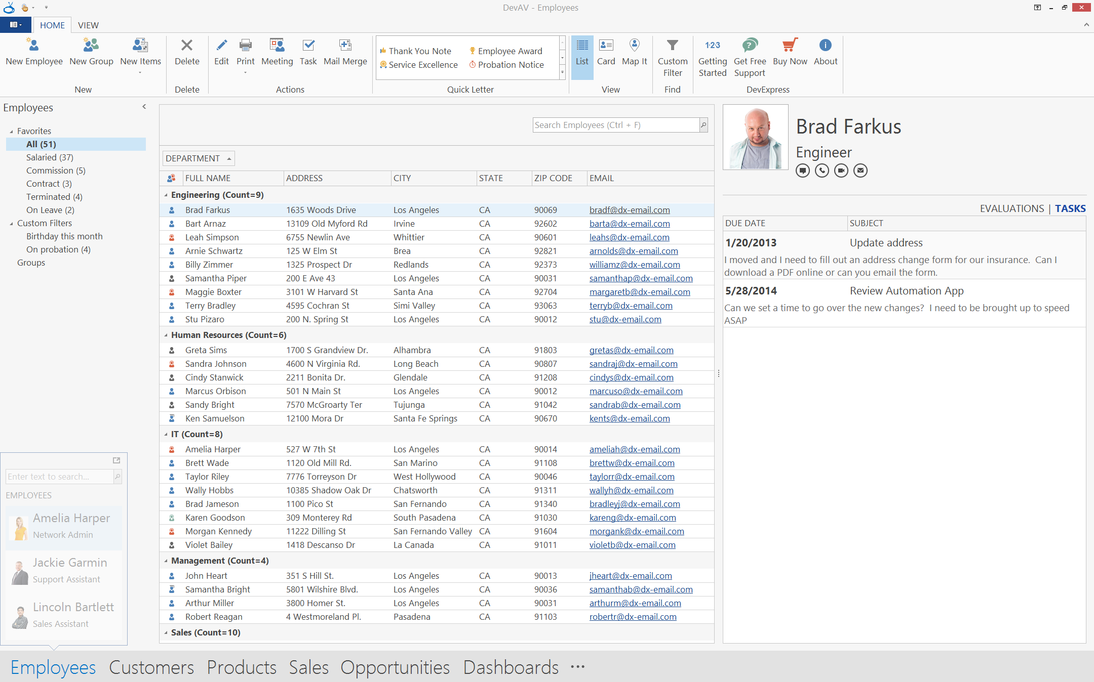
Actions
List
Filters
Detail
Peek
Modules

Slide 7
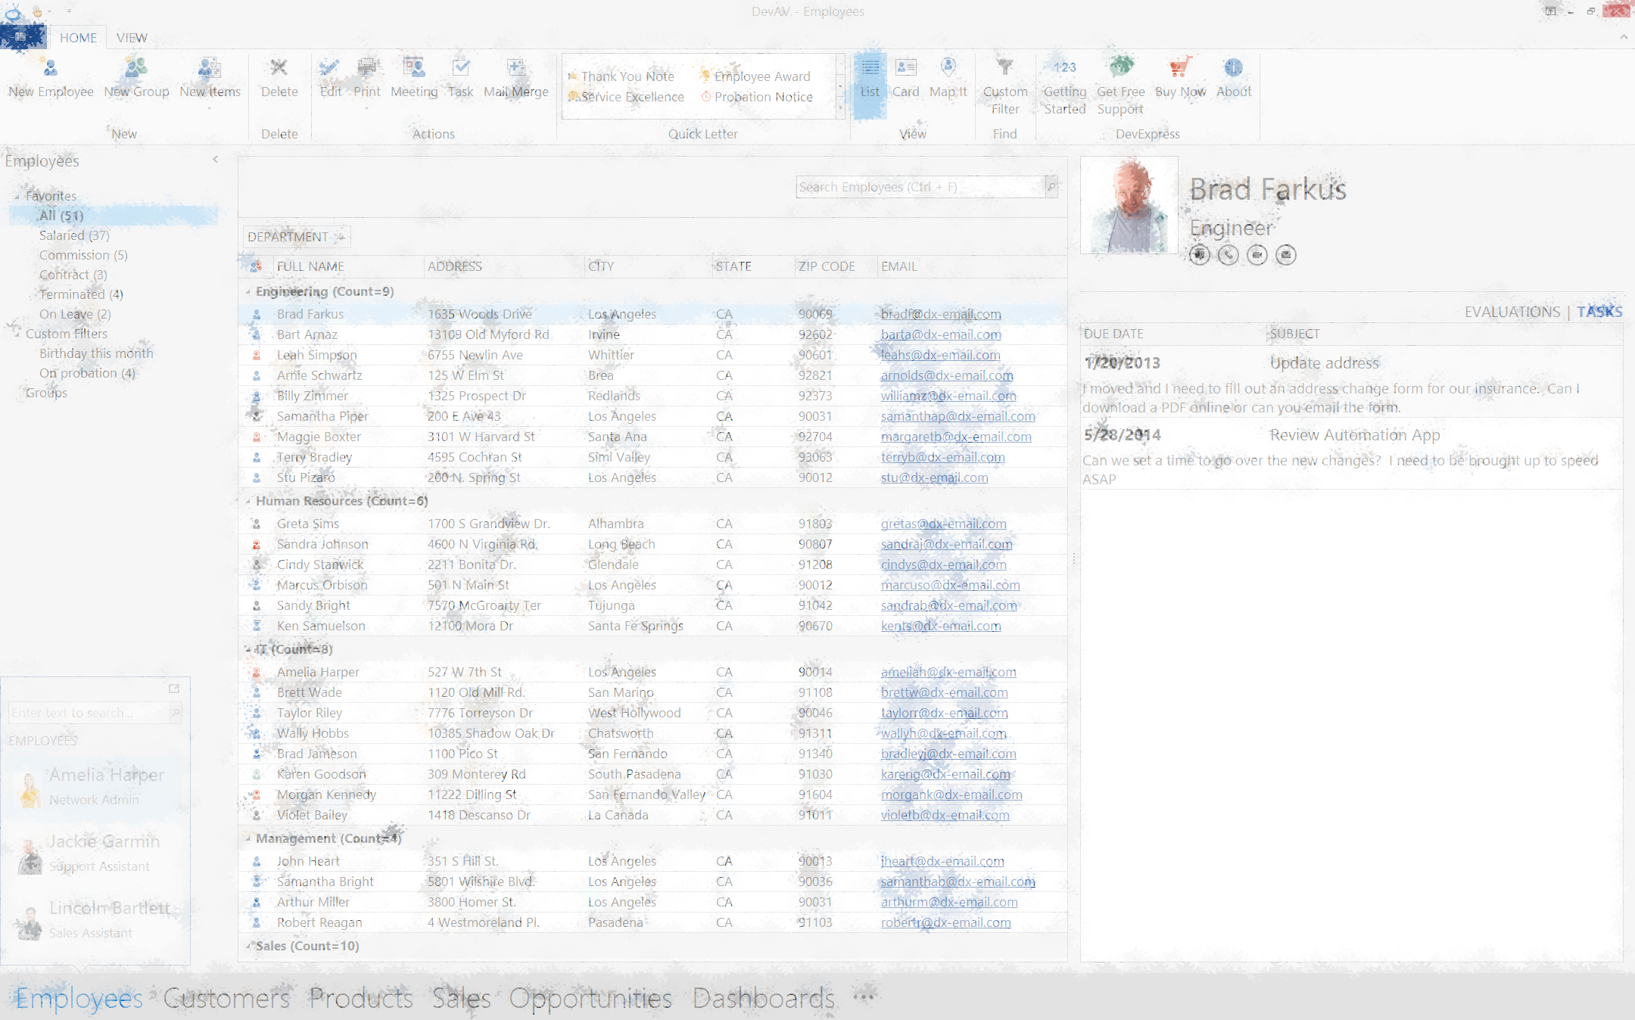
5 modules
4/5 dependent modules
?!?

Slide 8
consistency through architectural patterns
MVVM
MVPVM

Slide 9
Model
ViewModel
View
WPF
Bindings
Commands
Notifications

Slide 10
Model
ViewModel
View
Presenter
WinForms
Bindings
Notifications
Commands

Slide 11
ViewModel
View
Presenter
Commands
Events
Data

Slide 12
let’s make something

Slide 13


DevAV Dashboards
File
Home
My Dashboard
Other Dashboard
Sales
1

Slide 14
code

Slide 15
why?

Slide 16
some links
Tooling – https://github.com/sethjuarez/WinFrameworkTools
DevAV – https://github.com/sethjuarez/DevAV

Slide 17
Questions?
Seth Juarez
Program Manager, Reporting & Analytics, DevExpress
sethj@devexpress.com
@sethjuarez

