Slide 1
Jstorm

Slide 2
简介
JStorm 是一个类似Hadoop MapReduce的系统， 用户按照指定的接口实现一个任务，然后将这个任务递交给JStorm系统，JStorm将这个任务跑起来，并且按7 * 24小时运行起来，一旦中间一个Worker 发生意外故障， 调度器立即分配一个新的Worker替换这个失效的Worker。
从应用的角度，JStorm应用是一种遵守某种编程规范的分布式应用。从系统角度， JStorm是一套类似MapReduce的调度系统。 从数据的角度，JStorm是一套基于流水线的消息处理机制。

Slide 3
应用场景
日志分析，从日志中分析出特定的数据，并将分析的结果存入外部存储器如数据库。目前，主流日志分析技术就使用JStorm或Storm
管道系统， 将一个数据从一个系统传输到另外一个系统， 比如将数据库同步到Hadoop
消息转化器， 将接受到的消息按照某种格式进行转化，存储到另外一个系统如消息中间件
统计分析器， 从日志或消息中，提炼出某个字段，然后做count或sum计算，最后将统计值存入外部存储器。中间处理过程可能更复杂。
实时推荐系统， 将推荐算法运行在jstorm中，达到秒级的推荐效果

Slide 4
启动
storm.yaml参数修改
nohup jstorm nimbus &
nohup jstorm supervisor &
jstorm jar jstorm_test-0.0.1.jar com.test.TestTopology
Web UI
#mkdir ~/.jstorm
#cp -f $JSTORM_HOME/conf/storm.yaml ~/.jstorm

Slide 5
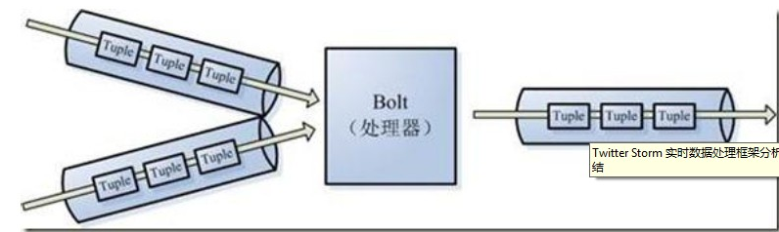
Jstorm组件
Stream
JStorm contain the abstraction of stream, which is an ongoing continuous unbounded tuple sequence。

Slide 6
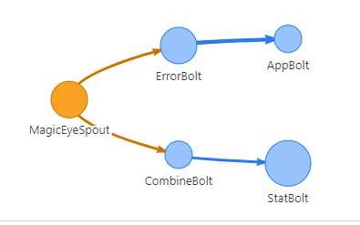
Jstorm组件
Topology
Topology is the highest abstraction in JStorm， it can be submitted to JStorm cluster to be run there. A topology is a data stream conversion chart, each node in graph above represents a spout or bolt, and each edge in the graph represents one data stream. After spout or bolt sends tuple to a stream, it will send tuple to each bolt subscribed from this stream

Slide 7
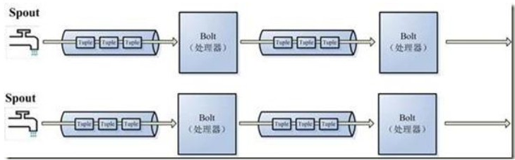
Spout/Bolt
Spout： JStorm considers that every stream has a source, so sources are abstracted as spout。
Bolt ： A bolt consumes any number of input streams, does some processing, and possibly emits new streams。

Slide 8
Tuple& Worker/Task & Resource Slot
Tuple： The data in stream is abstracted as tuple in JStorm. A tuple is a list of values, each value in the list has a name, and the value can be a basic type, character type, byte array, of course, also can be any other serializable type。
Worker/Task： Worker and Task are the execution units in JStorm, a worker represents a process, a task represents a thread, and tasks run in worker, one worker can run more than one task.
Resource Slot：

Slide 9
Resource Slot
In JStorm, the resource types are divided into three dimensions, CPU, Memory, and Port, no longer confined to port like Storm. That is, how many CPU Slot, how many Memory Slot, how many Port Slot a supervisor can provide。
A worker consumes a Port Slot.
Topology can set how many CPU slot will one worker cost. If there are some tasks cost too much cpu, please allocate more CPU slot to them.
Topology can set how many Memory will be assigned to one worker task. The default size is 2GB. Please enlarge it when not enough.

Slide 10
Nimbus & Supervisors & Worker & Task
Nimbus:
Supervisors:

Slide 11
快速开发
1. 继承BaseRichSpout
2. 继承BaseRichBolt
3. 本地测试LocalCluster
4. 集群运行StormSubmitter
5. example（分布式追踪系统的Jstorm模块）
6. Web UI（日常Jstorm集群控制台）

Slide 12
SubmitTopology

Slide 13
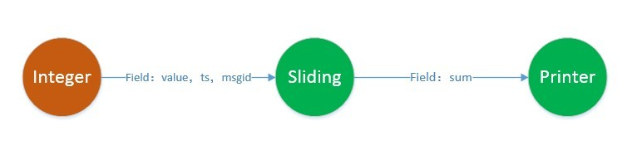
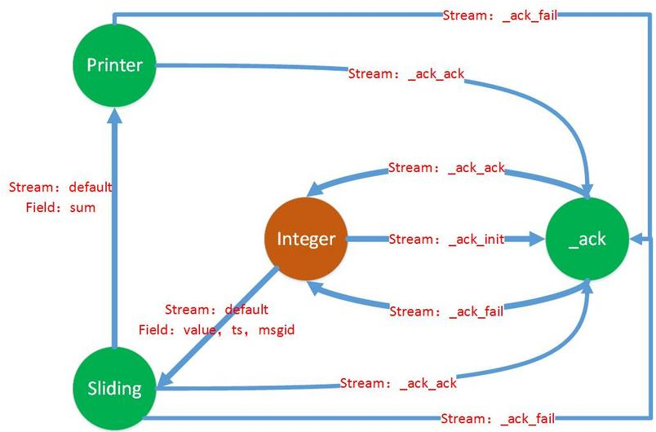
Acker

Slide 14
Zookeeper Nodes
nimbus_master, assignments, blobstoremaxkeysequencenumber,
topology
blobstore, taskbeats, nimbus_slave
assignments_bak, metrics
taskerrors, nimbus_slave_detail, tasks, supervisors

Slide 15
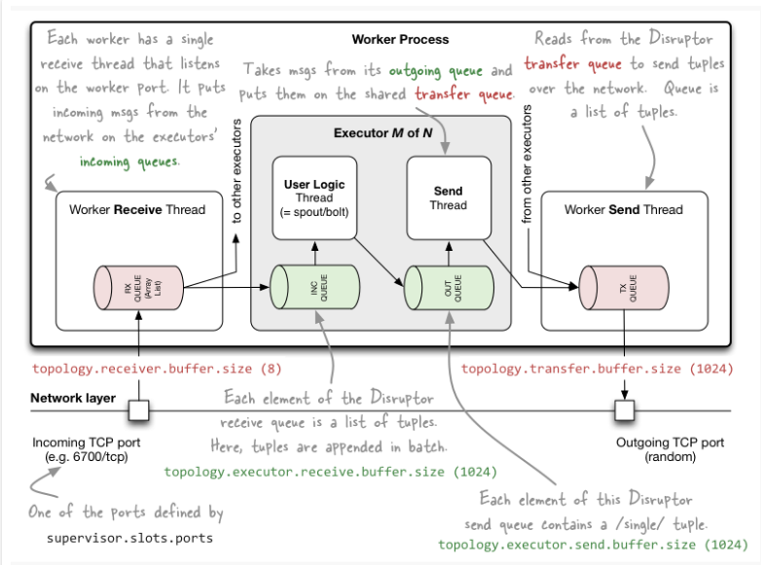
Internal Message Buffers

Slide 16
Jstorm命令
jstorm nimbus &
jstorm supervisor &
jstorm jar topology-jar-path classPath param
update_topology，动态修改topology的配置文件
jstorm update_topology topology-name -jar [jarpath] -conf [confpath]
kill命令，kill 指定的 topology, jstorm集群会先禁用相关的spouts，并待所有处理中的进程执行完毕后关闭works并清理他们的状态，可以指定等待的超时时间
jstorm kill topology-name [wait-time-secs]
activate，激活指定topology的spouts
jstorm activate topology-name
deactivate，禁用指定topology的spouts
jstorm deactivate topology-name

Slide 17
Jstorm命令
blacklist, 将某个hostname加入或移除黑名单，黑名单中的hostname将不会被Nimbus调度
jstorm blacklist add|remove hostname
list, 列出JStorm集群的信息
jstorm list
rebalance, 对集群任务重新进行负载均衡，一般在新增服务器后执行，该命令会先禁用所有正在执行的topology，等再分配完成后恢复，可以指定超时时间
jstorm rebalance topology-name [-w wait-time-secs]
metricsMonitor, 开启或关闭topology的指标监控
jstorm metricsMonitor topologyname bool

Slide 18
References
http://www.michael-noll.com/blog/2012/10/16/understanding-the-parallelism-of-a-storm-topology/
http://www.michael-noll.com/blog/2013/06/21/understanding-storm-internal-message-buffers/
https://www.tutorialspoint.com/apache_storm/apache_storm_tutorial.pdf
http://ifeve.com/wp-content/uploads/2014/03/Getting-Started-With-Storm-Jonathan-Leibiusky-Gabriel-E_1276.pdf

