Slide 1
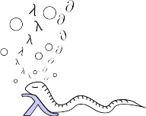

Programming matters
Experiences of Python in scientific computing
Juha Jeronen
juha.jeronen@jyu.fi ⇥ 05/2019
juha.m.jeronen@gmail.com → ∞
⚠ This presentation contains many weblinks
to further reading. Get the slides at:
https://github.com/Technologicat/python-3-scicomp-intro
⊳ physsem2019 ⊳ physsem2019.pdf
4.4.2019, Tampere University
FYS-1556 Physics Seminar 2018–19

Slide 2
My background
where
IT = information technology, CS = computer science
...with some software engineering, too
M = mathematics
P = physics, ES = engineering sciences
Software engineer 1999–2007, Jutel Oy
MSc 2008, University of Oulu, mathematics
PhD 2011, University of Jyväskylä, information technology [thesis]
Postdoc researcher 2012–, mostly at JYU; at TUT 2017–2018
  Gave a Python course at TUT in 2018 [5 ECTS; material]
Research topic: axially moving materials (+ some energy harvesting)
Programming background before Python: C, C++, Perl, Java, MATLAB
Python as primary programming language since 2012
  ...with some experiments ( [1] [2] ) in Racket
My GitHub.

Slide 3
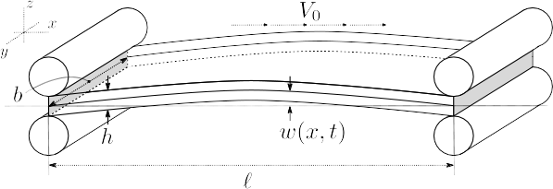
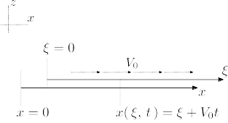
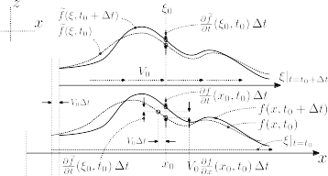
Axially moving materials, in 3 minutes
A solid, flowing through domain of interest
Applications e.g. in:
  Process industry: paper, steel, textiles
  Rotating storage media: hard disks, optical disc drives
  Newspaper printing, band saw blades, tape drives, …
My research topic: runnability of paper machines (stability analysis)
Our books: Mechanics of moving materials (2014, SMIA vol. 207),
Stability of axially moving materials (to appear 2019, SMIA)

Slide 4
“Programming matters”?
Programming is codification of imperative knowledge (SICP 2e, Abelson & Sussman, 1996).
  Algorithms: how to solve (particular) problems
  Data structures: how to store data efficiently for different use cases
Usually machine-readable (executable), but not central to the idea.
Contrast pure mathematics, which is declarative knowledge – e.g. that something exists,
but (often) no constructive proof to actually compute it.
Paradigms (e.g. imperative, functional): ways to structure that knowledge.
Languages: tools to think in.
Programming languages are not equal; variation in paradigms supported, focus/target audience, level of abstraction, type system, verbosity, feature set, …
  A language that doesn't affect the way you think about programming,
  is not worth knowing. –Alan Perlis, Epigrams on Programming (1982)
  Haskell: pure functional, focus on category theory, high level, concise, statically typed with parametric types (e.g. any “a” instead of int, double, …) and automatic type inference.
  Lisp (family; see Racket for a modern Lisp): impure functional, language-oriented (extensible language defined partly by the programmer), high level, concise, dynamically typed. Has closures. The Scheme subfamily (including Racket) has continuations.
  Python: object-oriented, imperative, impure functional, focus on readability, high level, concise, dynamically typed, duck-typed. Has closures.
  C, Fortran: imperative, procedural, respectively for systems programming and raw number crunching, low level, verbose, statically typed (in a very rudimentary, hardware-oriented way)
  C++: imperative, object-oriented, low level, verbose, statically typed
  Prolog: declarative, logic-oriented, high level (embedded into Racket as Racklog)
Practical implications: human efficiency, maintainability, potential for automated analysis, …

Slide 5
“Programming matters”?
Implementing numerical solvers is software engineering
  Computational research is at least 1/3 software engineering
  ...the other 2/3 divided between mathematics and writing papers
  To be effective and efficient in such research, tools and practices developed in the software industry are extremely valuable
Problem: software is complex
  But humans can only work with a limited amount of complexity
  Solution: reduce visible complexity, building a tower of abstractions
    Efficiency? 80/20; also clock cycles cheap, human time expensive
    So, push bits in Fortran, C, C++, Cython…, but write the 80% in an appropriate high-level language → wide-spectrum programming
A good language (for a given task) minimizes the impedance mismatch between the language and the problem domain ⇒ shorter programs
  Less work to write, easier to maintain, easier to spot errors
  ...and much easier to read and understand 6 months later
  Similarly to how notation matters in mathematics (see also Leibniz)

Slide 6
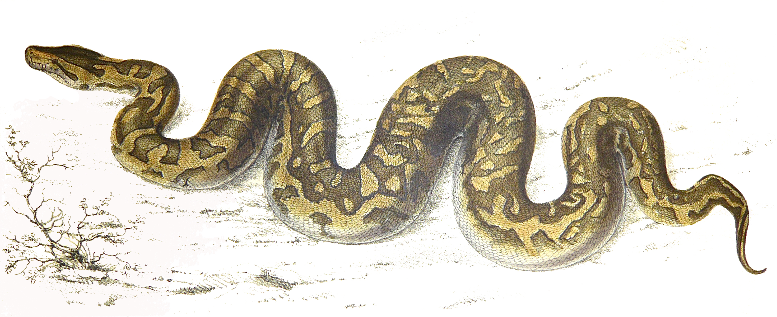
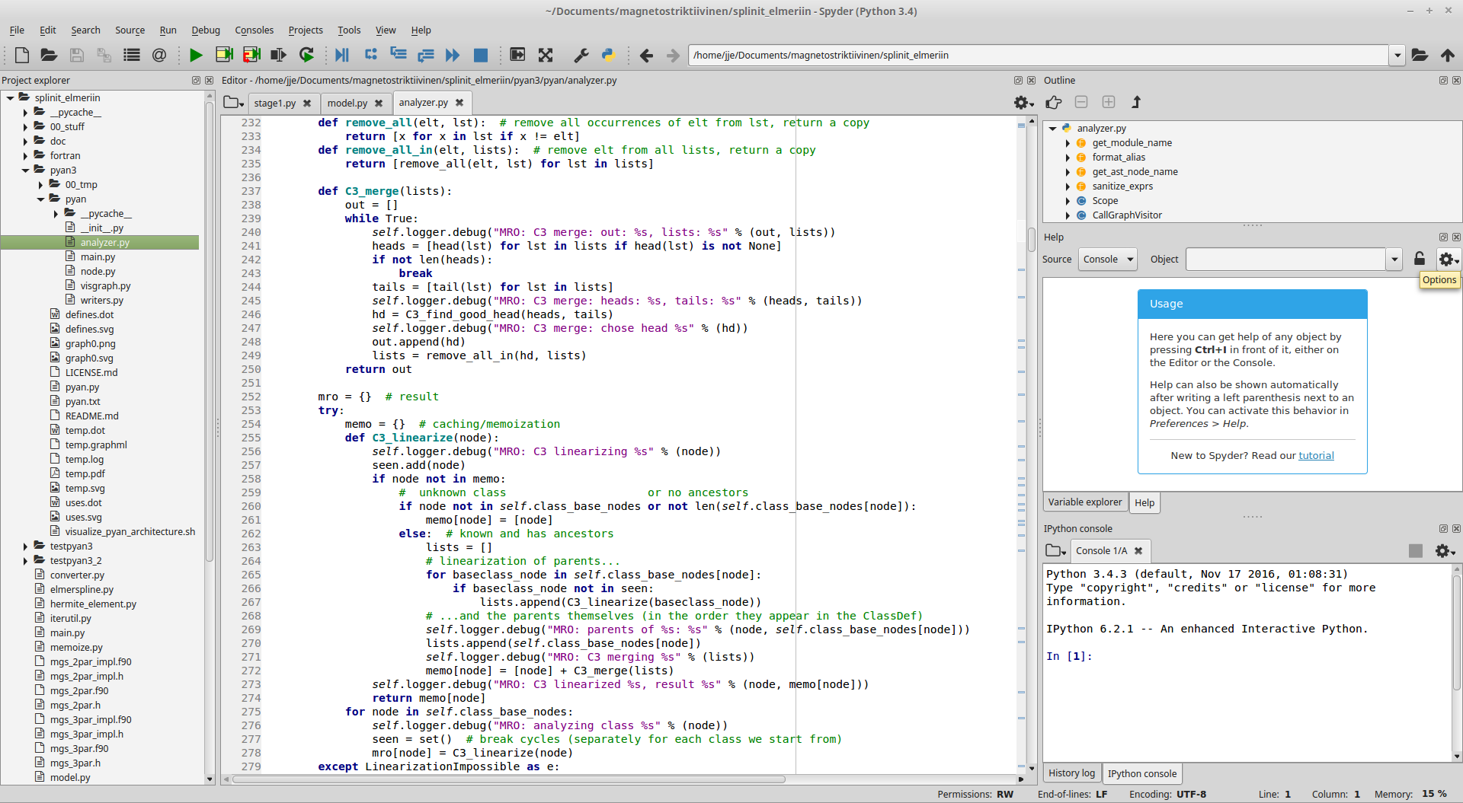
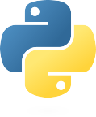
Python?
Python natalensis, Sir Andrew Smith, 1840. [Wikimedia commons]
A fairly long history:
  Python 1.0: 1991
  Python 2.0: 2000
  Python 3.0: 2008
See a family tree of languages.
Python 3:
https://www.python.org/

Slide 7
What & why for numerics
Clear, general-purpose, high-level, well-designed complete programming solution
Easy to learn
Focus on clarity: often Python programs look clear, making it easier to return to old code later
Open source; repeatability and transparency of science
Free of cost; no need for licenses
“Complete” includes numerics; a viable competitor for MATLAB
Suitable for wide-spectrum programming, especially numerics
#!/usr/bin/env python3
# -*- coding: utf-8 -*-
print(“Hello, world!”)
https://www.python.org/

Slide 8
Why now?
Python 3 is a sufficiently stable platform to build science on
Rise and popularization of Python during the last 15 years
Python now part of the mainstream of programming: many libraries,
extensive help available on the internet (especially Stack Overflow)
IEEE Spectrum 2017: Python the most popular language worldwide
#!/usr/bin/env python3
# -*- coding: utf-8 -*-
f = lambda x: x**2
p = lambda x: x % 2 == 0
A = range(10)
B = [f(x) for x in A if not p(x)]
print(B)
https://www.python.org/

Slide 9
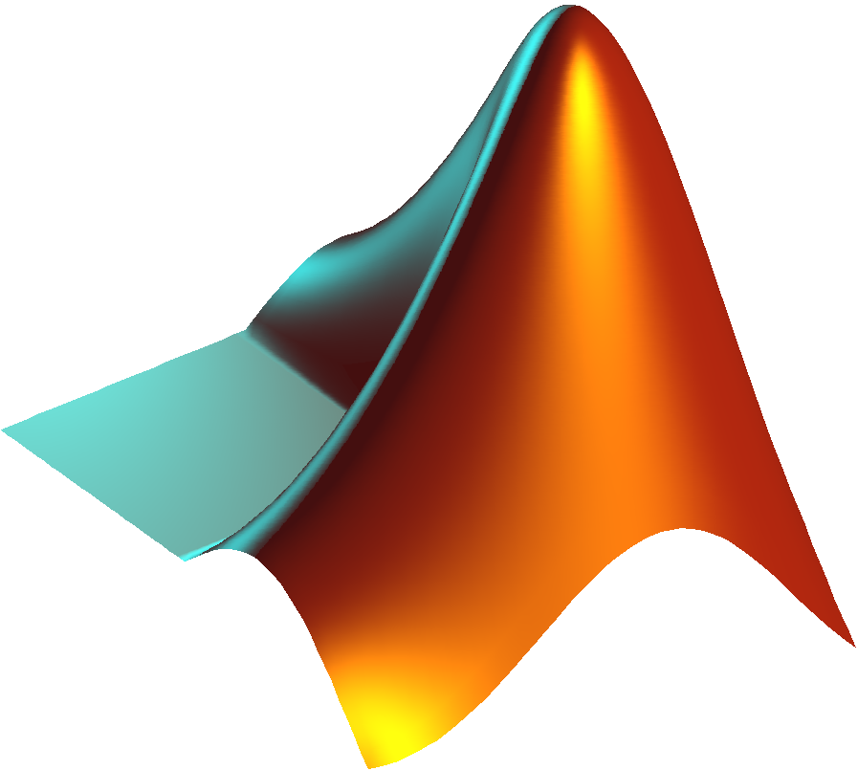
Where MATLAB is good
Quality-of-life features of a commercial product
    All-in-one
    Attempts to do some things automatically for the user,
    e.g. just-in-time (JIT) compilation
    Community focused solely on numerics
    If an algorithm is not in MATLAB, it can likely be found in
    MATLAB File Exchange
Polished integrated development environment (IDE) for scientists
Interactive plot editor
Some things easier to do than in Python (e.g. 3D plotting)
SimuLink: graphical block model simulator
vs.

Slide 10
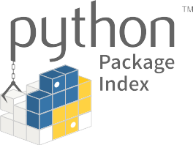
Where Python is good
Elegant language, in which it is easy to write clear code
Control: does only what you explicitly tell it to
Software ecosystem with dependency management (PyPI, pip)
    A huge number of libraries for anything a computer can do
    A sensibly sized numerics community, too
Free of cost; no need for licenses
Open; repeatability and transparency of science
    In practice, also the libraries are open source.
    Sometimes a library already does 99% of what
    you need...
vs.

Slide 11
“Python”
Technically speaking, “Python” is a specification, like “C” or “Fortran”
    Several implementations: CPython, Jython, IronPython, PyPy
    CPython however de facto standard; for most == Python
Python 3 vs. Python 2
    Python 3: current version (2019, v3.7.3)
        Also unofficially known as py3k, Python 3000
    Python 2: legacy (2010, v2.7, support ends by 2020)
        Python 2.x ends at 2.7: Python 2.8 Un-release Schedule
    Backwards incompatibilities; but devs promised not to do it again
    Practically all projects have migrated to Python 3
    This presentation: Python 3
#!/usr/bin/env python3
# -*- coding: utf-8 -*-
import re
print(re.sub(r'^monty\s*', r'', 'monty python') + " 3")
https://www.python.org/

Slide 12
Zen of Python, The
import this
A guiding philosophy for the design of the Python language, as well as many Python programs.
Consists of 20 aphorisms, 19 of which have been written down:
Beautiful is better than ugly.
Explicit is better than implicit.
Simple is better than complex.
Complex is better than complicated.
Flat is better than nested.
Sparse is better than dense.
Readability counts.
Special cases aren't special enough to break the rules.
Although practicality beats purity.
Errors should never pass silently.
Unless explicitly silenced.
In the face of ambiguity, refuse the temptation to guess.
There should be one– and preferably only one –obvious way to do it.
Although that way may not be obvious at first unless you're Dutch.
Now is better than never.
Although never is often better than right now.
If the implementation is hard to explain, it's a bad idea.
If the implementation is easy to explain, it may be a good idea.
Namespaces are one honking great idea – let's do more of those!
–Tim Peters
https://www.python.org/

Slide 13

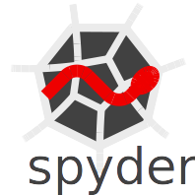
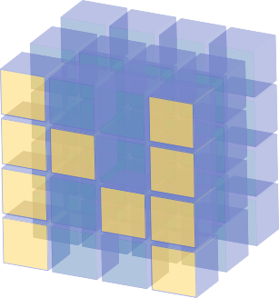
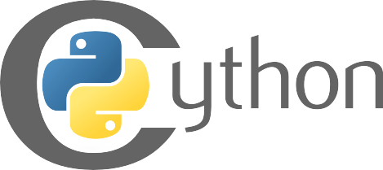
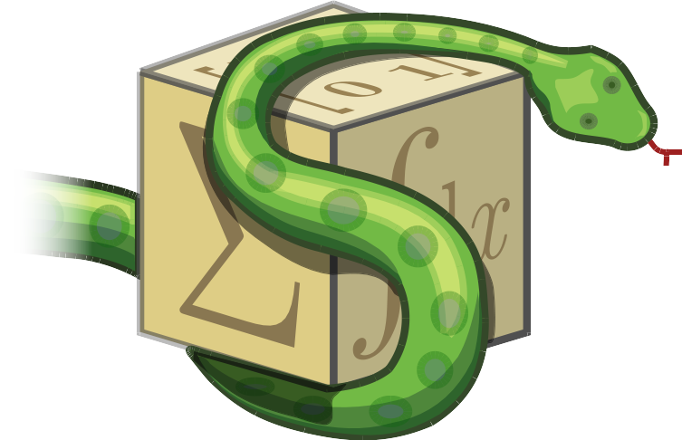
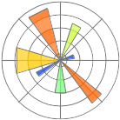

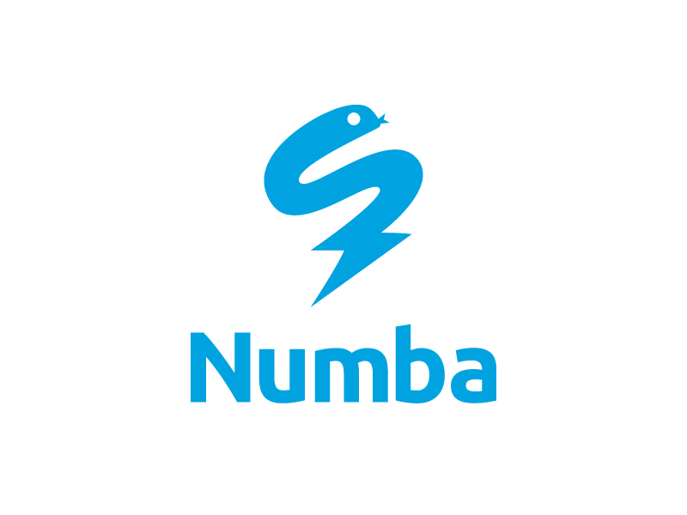


Scientific Python
Welcome to the bazaar

Slide 14
Tools
http://ipython.org/
https://www.anaconda.com/
IPython: advanced command line
Jupyter: IPython's graphical cousin, based on a Mathematica-style notebook approach
Spyder: integrated development environment (IDE)
Anaconda: scientific Python distribution
    Perhaps the easiest way to install Python and its scientific libraries.
https://github.com/spyder-ide

Slide 15
Spyder IDE
The Scientific PYthon Development EnviRonment
Preinstalled in Anaconda
Designed for scientists
MATLAB style IDE
Matplotlib integration
Debugger
Profiler
Static code analyzer
REPL (IPython/Jupyter)
read-eval-print-loop
https://github.com/spyder-ide
Mostly well balanced between scientific use oriented,
interactive, and software development oriented features.
Cons: no automatic refactoring or version control GUI.

Slide 16


Libraries, accelerators
Scientific Python consists of
a number of separate libraries
as usual with general-purpose programming languages
NumPy, SciPy, Matplotlib
the primary scientific libraries
SymPy for symbolic computing
Numba and Cython the most important accelerators
Other, more specific libraries also available
  See my Python course
  (lecture notes sec. 2;
  slide sets 5–8)

Slide 17

NumPy
http://www.numpy.org/
n-dimensional arrays
MATLAB style API, but instead of matrices, based on cartesian tensors:
    A vector is a rank-1 tensor
    A matrix is a rank-2 tensor
#!/usr/bin/env python3
# -*- coding: utf-8 -*-
import numpy as np
A = np.array( [[1, 2],
[4, 9]], dtype=np.float64 )
b = np.array( [3, 7], dtype=np.float64 )
x = np.linalg.solve(A, b)

Slide 18
SciPy
https://scipy.org/
Advanced-user versions
of linear algebra routines
Sparse matrices
I/O for MATLAB .mat files
Numerical integration (quad), initial value problems (ODE), special functions
Signal processing
Some optimization solvers
Cython interface to LAPACK,
for advanced users

Slide 19
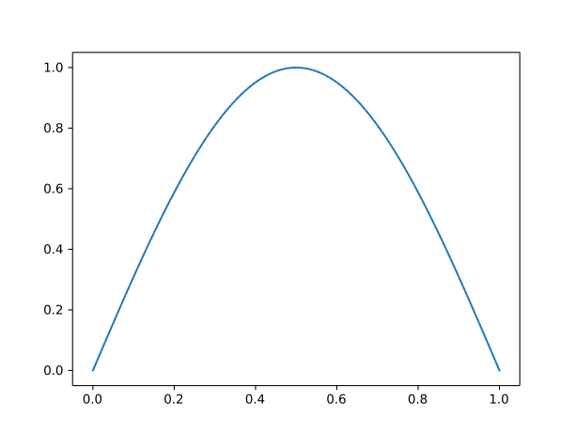
Matplotlib
http://matplotlib.org/
MATLAB-style plotting API
Standard tool for publication-quality numerical graphics
in Python
Also made with Matplotlib
#!/usr/bin/env python3
# -*- coding: utf-8 -*-
import numpy as np
import matplotlib.pyplot as plt
xx = np.linspace(0, 1, 101)
yy = np.sin(xx * np.pi)
plt.plot(xx, yy)
plt.savefig('sin_x.svg')

Slide 20

SymPy
http://www.sympy.org/
Symbolic algebra, differentiation, integration
#!/usr/bin/env python3
# -*- coding: utf-8 -*-
import sympy as sy
x = sy.symbols('x')
λf,λg = sy.symbols('f,g', cls=sy.Function)
g = λg(x)
f = λf(g)
D = sy.diff(f, x).doit()
sy.pprint(D)
d d
─────(f(g(x)))⋅──(g(x))
dg(x) dx
Python 3 allows Unicode variable names
(with certain limitations).
Input e.g. with a LaTeX input method

Slide 21
Numba
http://numba.pydata.org/
Just-in-time (JIT) compiler for Python
Accelerate functions by compiling them at runtime, when called for the first time.
Supports a subset of Python; meant for accelerating data-crunching loops.
#!/usr/bin/env python3
# -*- coding: utf-8 -*-
from numba import jit
from random import random
@jit(nopython=True)
def monte_carlo_pi(nsamples):
acc = 0
for i in range(nsamples):
x = random()
y = random()
if (x**2 + y**2) < 1.0:
acc += 1
return 4.0 * acc / nsamples
Easy to use.

Slide 22
Cython
https://cython.org/
Combine the power of Python and C
  For implementing accelerated code, extends Python with a dialect of C that looks almost like Python
  A superset of Python; allows mixing in Python wherever speed is not the primary concern
  Easy to call to/from Python; compiles into Python extension modules that transparently interface with
  regular Python programs
A language; detailed usage requires at least a full lecture.
The other common use case of Cython is to create Python bindings for existing C libraries. For that use, see also CFFI and ctypes. For interfacing to Fortran instead of C, see F2PY.
def ddot(double [::1] a, double [::1] b):
cdef unsigned int k
cdef unsigned int n = a.shape[0]
cdef double out = 0.0
for k in range(n):
out += a[k] * b[k]
return out
Compiles into
a C for loop,
since static types
are declared and
no Python objects
are accessed.
(The memoryview is treated specially.)

Slide 23
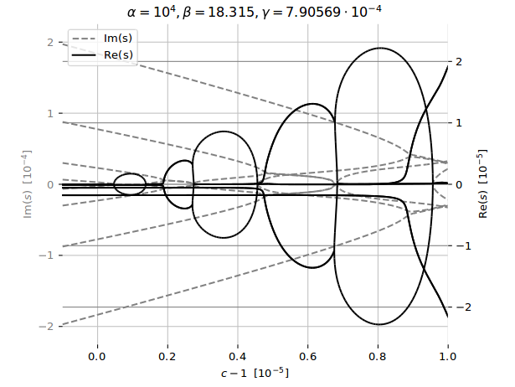
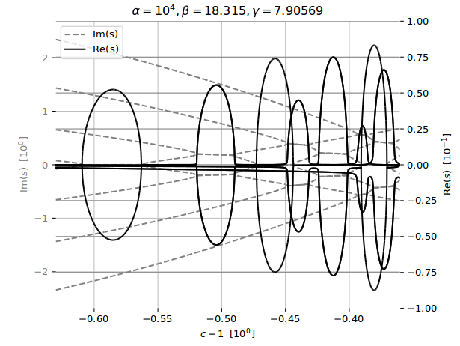
What can we do with Python?
MATLAB-style numerics:
Stability exponents of an axially travelling viscoelastic Kelvin–Voigt panel subjected to a potential flow
After discretization of the PDE, this is a quadratic eigenvalue problem
After reduction to a generalized linear eigenvalue problem (via the companion form technique), solved using scipy.linalg.eig
Stability of axially moving materials (to appear 2019, SMIA)

Slide 24
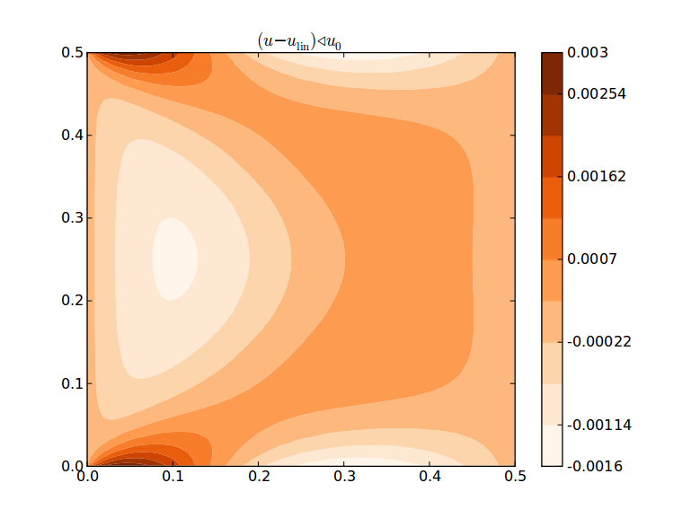
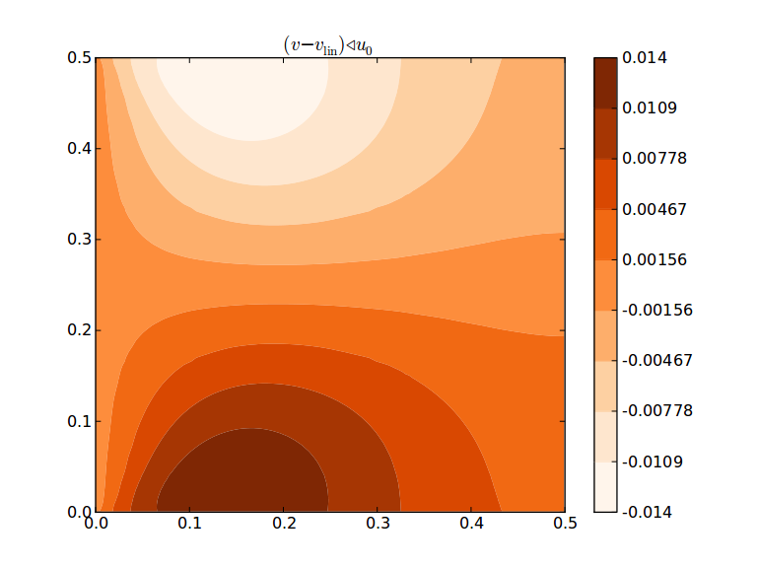
What can we do with Python?
MATLAB-style numerics:
In-plane deformation of an axially moving viscoelastic Kelvin–Voigt sheet
Computed using a custom 2D C1 FEM code implemented in Python
  Actually recommended FEM codes for Python: FEniCS Project, SfePy
10.1016/j.ijsolstr.2015.10.027

Slide 25
What can we do with Python?
Symbolic mathematics:
import sympy as sy
def hermite(k):
"""Derive C**k continuous Hermite interpolation polynomials for the interval [0, 1]."""
order = 2*k + 1
*A,x = sy.symbols('a0:{},x'.format(order + 1))
w = sum(a*x**i for i,a in enumerate(A)) # as a symbolic expression
λw = lambda x0: w.subs({x: x0}) # as a Python function; subs: symbolic substitution
wp = [sy.diff(w, x, i) for i in range(1, 1 + k)] # diff: symbolic differentiation
λwp = [(lambda expr: lambda x0: expr.subs({x: x0}))(expr) for expr in wp] # why two lambdas: lecture notes sec. 5.8
zero, one = sy.S.Zero, sy.S.One
w0, w1 = sy.symbols('w0, w1')
eqs = [λw(zero) - w0, λw(one) - w1] # eqs. in form LHS = 0; see sympy.solve
dofs = [w0, w1]
for i, f in enumerate(λwp, start=1):
d0_name = 'w{}0'.format(i * 'p') # p = 'prime', to denote differentiation
d1_name = 'w{}1'.format(i * 'p')
d0, d1 = sy.symbols('{}, {}'.format(d0_name, d1_name))
eqs.extend([f(zero) - d0, f(one) - d1])
dofs.extend([d0, d1])
coeffs = sy.solve(eqs, A)
solution = sy.collect(sy.expand(w.subs(coeffs)), dofs)
N = [solution.coeff(dof) for dof in dofs] # result: shape functions
return tuple(zip(dofs, N)) # pairs (dof, shape function)
hermite(0) # linear interpolation
((w0, -x + 1), (w1, x))
hermite(1) # beam element
((w0, 2*x**3 - 3*x**2 + 1),
(w1, -2*x**3 + 3*x**2),
(wp0, x**3 - 2*x**2 + x),
(wp1, x**3 - x**2))
hermite(2) # 2nd derivative also continuous
((w0, -6*x**5 + 15*x**4 - 10*x**3 + 1),
(w1, 6*x**5 - 15*x**4 + 10*x**3),
(wp0, -3*x**5 + 8*x**4 - 6*x**3 + x),
(wp1, -3*x**5 + 7*x**4 - 4*x**3),
(wpp0, -x**5/2 + 3*x**4/2 - 3*x**3/2 + x**2/2),
(wpp1, x**5/2 - x**4 + x**3/2))

Slide 26
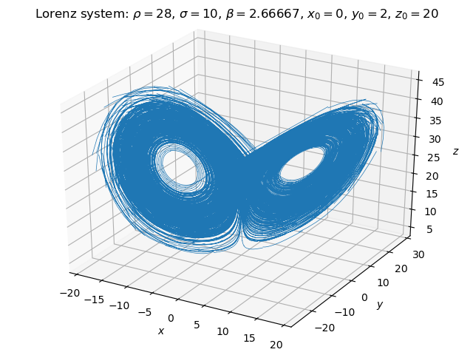
What can we do with Python?
Implement and package algorithms:
pydgq: ODE system solver using dG(q), time-discontinuous Galerkin
with a Lobatto (a.k.a. hierarchical) basis.
import numpy as np
from pydgq.solver.kernel_interface import PythonKernel
from pydgq.solver.galerkin import init
from pydgq.solver.types import DTYPE
from pydgq.solver.odesolve import ivp
class LorenzKernel(PythonKernel):
def __init__(self, ρ, σ, β):
super().__init__(n=3)
self.p = [float(x) for x in ρ, σ, β]
def callback(self, t):
(ρ, σ, β), (x, y, z) = self.p, self.w
self.out[:] = (σ*(y - x), x*(ρ - z) - y, x*y - β*z)
w0 = np.array([0, 2, 20], dtype=DTYPE)
rhs = LorenzKernel(ρ=28, σ=10, β=8/3)
init(q=2, method='dG', nt_vis=11, rule=None)
ww, tt = ivp(integrator='dG', interp=11, w0=w0, dt=0.1, nt=3500, rhs=rhs, maxit=10)
Full example on GitHub.

Slide 27
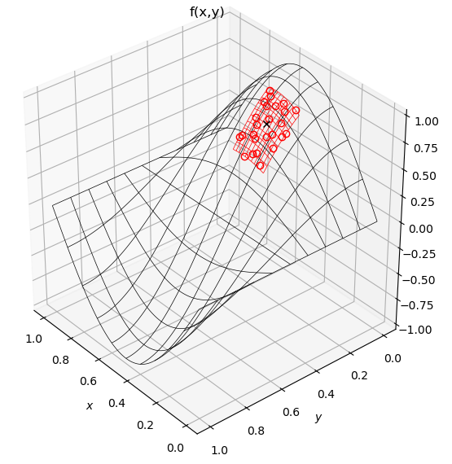
What can we do with Python?
Implement and package algorithms:
wlsqm: weighted least squares meshless interpolator and differentiator
import numpy as np
from scipy.spatial import cKDTree as KDTree
import wlsqm
n, k, fit_order = 1000, 6, 2
f = lambda x: np.sin(np.pi*x[:, 0]) * np.cos(np.pi*x[:, 1]) # silly test data
x = np.random.random((n, 2)) # no mesh topology!
F = f(x)
tree = KDTree(data=x) # Wikipedia: k-d tree
_, ii = tree.query(x, 1 + nk)
hoods = np.array(ii[:, 1:], dtype=np.int32)
kk = k * np.ones((npoints,), dtype=np.int32)
fit_orders = fit_order * np.ones((npoints,), dtype=np.int32)
knowns_bitmask = wlsqm.b2_F * np.ones((npoints,), dtype=np.int64)
wms = wlsqm.WEIGHT_UNIFORM * np.ones((npoints,), dtype=np.int32)
solver = wlsqm.ExpertSolver(dimension=2, nk=kk,
order=fit_orders, knowns=knowns_bitmask,
weighting_method=wms, algorithm=wlsqm.ALGO_BASIC,
do_sens=False, max_iter=10, ntasks=8, debug=False)
ndofs = wlsqm.number_of_dofs(dimension=2, order=fit_order)
fi = np.empty((npoints, ndofs), dtype=np.float64)
fi[:, 0] = F # fi[i, 0] = function value at x[i, :]
solver.prepare(xi=x, xk=x[hoods])
solver.solve(fk=fi[hoods, 0], fi=fi, sens=None)
Full example on GitHub.

Slide 28
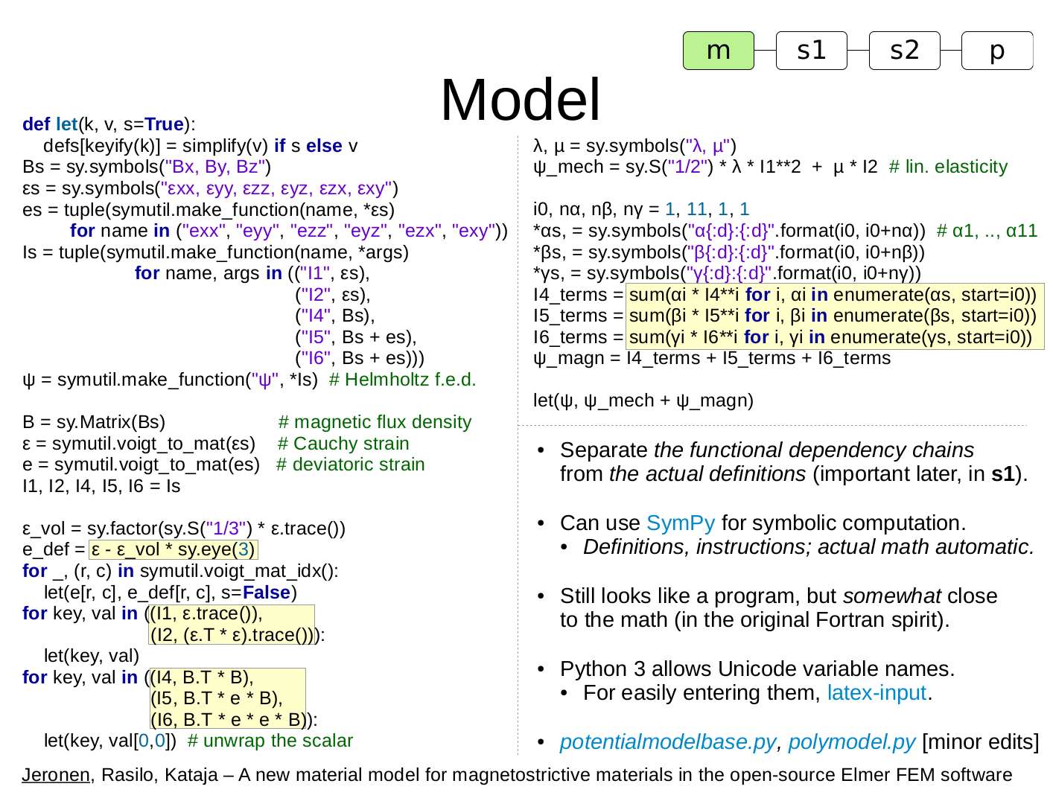
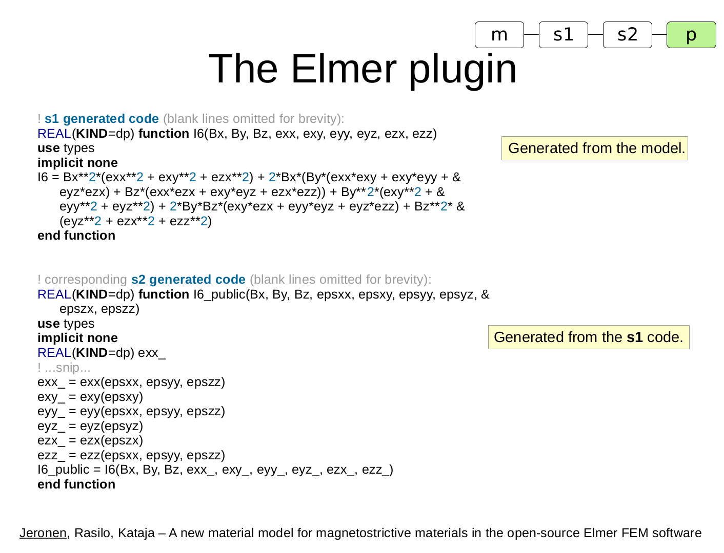
What can we do with Python?
Create a SymPy to Fortran compiler:
mm-codegen: Create material models for Elmer in SymPy
  The compiler is < 2000 SLOC – including comments and docstrings!
See original presentation slides, Jeronen, XIII Finnish Mechanics Days, 2018.

Slide 29
Feature highlight: Lexical closures
A feature of many high-level languages, with numerous applications. Has a long tradition in the Lisp family.
Requires first-class functions. Not supported by Fortran or C. Supported by e.g. C++ 11, Java 8, Python, Racket and Clojure.
Python example:
def make_adder(inc):
def adder(x):
return x + inc
return adder
f = make_adder(inc=3)
g = make_adder(inc=17)
print(f(2)) # 5
print(g(25)) # 42
Eliminate boilerplate. Define local helper functions locally, in a nested def.
In the inner definition, list as parameters only those that actually vary.
Separate public interface from implementation compactly, without exposing internal details (example later).
Change how existing functions behave; see Python's decorators [1] [2]
Create an object system (in Python, don't do that – it already has one!).
Create a continuation system. (See a simple explanation of continuations.)
Calling make_adder causes the nested function
definition of adder to run, creating a new closure
instance.
Here inc is a free variable (no local definition; not global).
We can then return the closure instance to the caller.
The closure property is that an instance permanently
retains access to the inc that was passed in by the caller
of make_adder when that closure instance was created.
(The name closure means that a surrounding, non-global
scope closes over the free variables of the inner scope.)

Slide 30
Advanced: Syntactic macros
Scheme code is not meant to be written by humans, [but] … automatically by macros.
  –Michele Simionato
Syntactic macros are an advanced feature almost unique to the Lisp family. Exceptions: Julia, R.
What: Syntactic macros transform the AST, by running arbitrary code on it, at compile time.
  Contrast C preprocessor macros, which perform only text substitution.
  Contrast C++ generics: Lisp itself as metalanguage (no separate templating mini-language).
  StackOverflow. Understanding macros. Perl perspective. Macros and washing machines.
  Paul Graham (1993): Programming bottom-up; Metaprogramming; Extensible programming.
  Lisp isn't a language, it's a building material. –Alan Kay (of Smalltalk fame; on Lisp, [1] [2])
Why: Design patterns: a symptom of being unable to extract an abstraction (Paul Graham).
  E.g. with [1] or assert [2] in Python, which encode particular design patterns.
  Syntactic macros allow the programmer to create such constructs:
    with in Clojure.
    Delayed evaluation in Racket.
  Just like in mathematics [1] [2]: code is for humans, so notation matters.
  Macros are an important feature that make Lisp feel more like a fluid than a solid.
  Democratization of language design? On the other hand, herd of cats (according to some,with machine guns), no BDFL. No process to pick, polish and promote the best abstractions; thus, “lowest common denominator” often used. The Lisp Curse [1] [2].
abstract syntax tree

Slide 31
Advanced: Syntactic macros
The nuclear option: only create a macro if the job is not suitable for a run-of-the-mill function!
  Extract design patterns that cannot be extracted as functions.
    Although Racket is eager, macro arguments avoid immediate evaluation; highly useful [1][2].
    Macros replacing design patterns is what “programs writing programs” means in Lisp;
    it's not about “source code generation” à la Cython (which takes Cython and writes C).
      It's also robust, unlike source filters in many languages.
  Add syntactic forms the original designer of the language might not approve. [1]
  Create a DSL (domain-specific language) to fit the language to your domain; shorter code.
  DRY out repetition in a set of similar macros, by macro-writing macros. (Example.)
  Programmatically create lookup tables at compile time. [1]
Limitations:
  Second-class; cannot pass a macro as an argument: expanded away at compile time!
  Local: a macro call cannot rewrite any forms surrounding it (due to Lisp's prefix notation)
  Macros cannot change the lexical conventions (use of parentheses, prefix notation, …)
    If you want to do that, you could modify or extend the reader [1] [2].
  Macros don't compose. In a multi-layered macro library, each layer needs to know about
  all of the previous layers. This build-up of complexity limits what can be achieved in practice.
  Still, Racket itself is built mostly from macros; very few primitives in a fully expanded program!
Examples in Racket: Non-deterministic evaluation, automatic currying, Python-inspired syntactic forms, simple infix math, User-programmable infix operators, Algebraic Data Types (ADTs) in Typed Racket.
MacroPy: Syntactic macros for Python.

Slide 32
What can we build with MacroPy?
Let constructs like those in the Lisp family and Haskell.
Bind names for the duration of one expression. Use cases:
Break an expression into easily readable chunks, without
polluting the surrounding scope with temporaries.
Explicitly indicate which definitions are needed only locally.
from unpythonic.syntax import macros, let, letseq, letrec
let[((x, 17), # parallel binding, i.e. bindings don't see each other
(y, 23)) in
print(x, y)]
letseq[((x, 1), # sequential binding, i.e. Scheme/Racket let*
(y, x+1)) in
print(x, y)]
# mutually recursive binding, sequentially evaluated
t = letrec[((is_even, lambda x: (x == 0) or is_odd(x - 1)),
(is_odd, lambda x: (x != 0) and is_even(x - 1))) in
is_even(42)]
Automatic tail call optimization (TCO):
from unpythonic.syntax import macros, tco
with tco:
is_even = lambda x: (x == 0) or is_odd(x - 1)
is_odd = lambda x: (x != 0) and is_even(x - 1)
assert is_even(10000) is True
with tco:
def is_even(x):
if x == 0:
return True
return is_odd(x - 1)
def is_odd(x):
if x != 0:
return is_even(x - 1)
return False
assert is_even(10000) is True
Macros on this and the next slide are available in unpythonic,
and they mostly work together. See documentation.

Slide 33
What can we build with MacroPy?
Continuations (call-with-current-continuation a.k.a. call/cc):
from unpythonic.syntax import macros, continuations, call_cc
with continuations:
stack = []
def amb(lst, cc): # McCarthy's amb operator
if not lst:
return fail()
first, *rest = tuple(lst)
if rest:
ourcc = cc
stack.append(lambda: amb(rest, cc=ourcc))
return first
def fail():
if stack:
f = stack.pop()
return f()
def pt(): # Pythagorean triples
z = call_cc[amb(range(1, 21))]
y = call_cc[amb(range(1, z+1)))]
x = call_cc[amb(range(1, y+1))]
if x*x + y*y != z*z:
return fail()
return x, y, z
t = pt()
while t:
print(t)
t = fail() # ...outside the dynamic extent of pt()!
Automatic currying:
from unpythonic.syntax import macros, curry
from unpythonic import foldr, composerc, cons, nil
with curry:
def add3(a, b, c):
return a + b + c
assert add3(1)(2)(3) == 6
# see John Hughes: Why FP Matters
my_map = lambda f: foldr(composerc(cons, f), nil)
double = lambda x: 2 * x
print(my_map(double, (1, 2, 3)))
Call-by-need functions:
from unpythonic.syntax import macros, lazify
with lazify:
def g(a, b):
return a # b is never used
def f(a, b):
return g(2*a, 3*b)
assert f(21, 1/0) == 42
…this is starting to look like a custom language?

Slide 34
Packaging a language: Dialects
Pydialect implements a dialect system, in pure Python, based on import hooks [1] [2].
  Motivation: Language semantics and surface syntax encode patterns at a very high level.
Disclaimer: Very much outside the vision for the official Python language.
  PEP 511 was rejected for the specific reason it could be seen as officially blessing
  the creation of dialects.
  The native habitat of this idea is Racket (Solve problems. Make languages.).
from __lang__ import lispython
def fact(n):
def f(k, acc):
if k == 1:
return acc
f(k - 1, k*acc)
f(n, acc=1)
assert fact(4) == 24
fact(5000)
t = letrec[((is_even, lambda x: (x == 0) or is_odd(x - 1)),
(is_odd, lambda x: (x != 0) and is_even(x - 1))) in
is_even(10000)]
assert t is True
g = lambda x: [local[y << 2*x],
y + 1]
assert g(10) == 21
__lang__ is a magic module that doesn't actually exist.
Importing a dialect from it triggers the dialect processor
when the program is run with pydialect instead of
bare Python. Dialects may define new surface syntax
and/or change semantics.
Public interface
Implementation
Implicit return in tail position
Tail call optimization; O(1) call stack depth with tail calls,
so tail calls can be used for
recursion-based looping,
like in Scheme
and in Racket.
⚠ This code is not Python; it's Lispython.

Slide 35
Literature
Mark Lutz: Learning Python, 5th ed., O'Reilly, 2013.
    Standard “bible” of the trade, very comprehensive.
    A couple of minor versions behind the latest Python.
Luciano Ramalho: Fluent Python: Clear, Concise and Effective Programming, O'Reilly, 2015.
    Python 3 for programmers coming from other languages.
    Focuses on features that are easily missed, if the reader
    is used to thinking in another programming language.
Zed A. Shaw: Learn Python 3 the Hard Way, Addison–Wesley, 2017.
    For newcomers to programming.
    Hard way because There is no royal road to geometry. –Euclid
Internet!
    Especially Stack Overflow.
    For a self-contained introduction to Python in scientific computing:
      Python 3 for scientific computing, my course held at TUT, 2018;
      covers also background in CS/IT; see esp. slides and exercises.
      Scipy Lecture Notes, a community-maintained course with
      a tight focus on the scientific computing parts only.

Slide 36


The finish line
Thank you for your attention!

