Slide 1

Python 3 for scientific computing
Lecture 1, 24.1.2018
Introduction and 30,000 ft overview
Juha Jeronen
juha.jeronen@tut.fi
9,144 m
Spring 2018, TUT, Tampere
RAK-19006 Various Topics of Civil Engineering

Slide 2
Meta
Seminar on Python 3 from the viewpoint of scientific computing
Timeslot: Wednesday, 12–14, in RO105
5 credits; O(10) meetings
Formal requirements to pass the course:
    Final assignment: write a small, possibly useful project in Python
    (details will be announced later)
    No exam; exercises almost surely useful, but not compulsory
Lecture material:
https://github.com/Technologicat/python-3-scicomp-intro/
Also these slides will be available
Don't worry, I will try to fix the course signup and any other
practical issues.

Slide 3

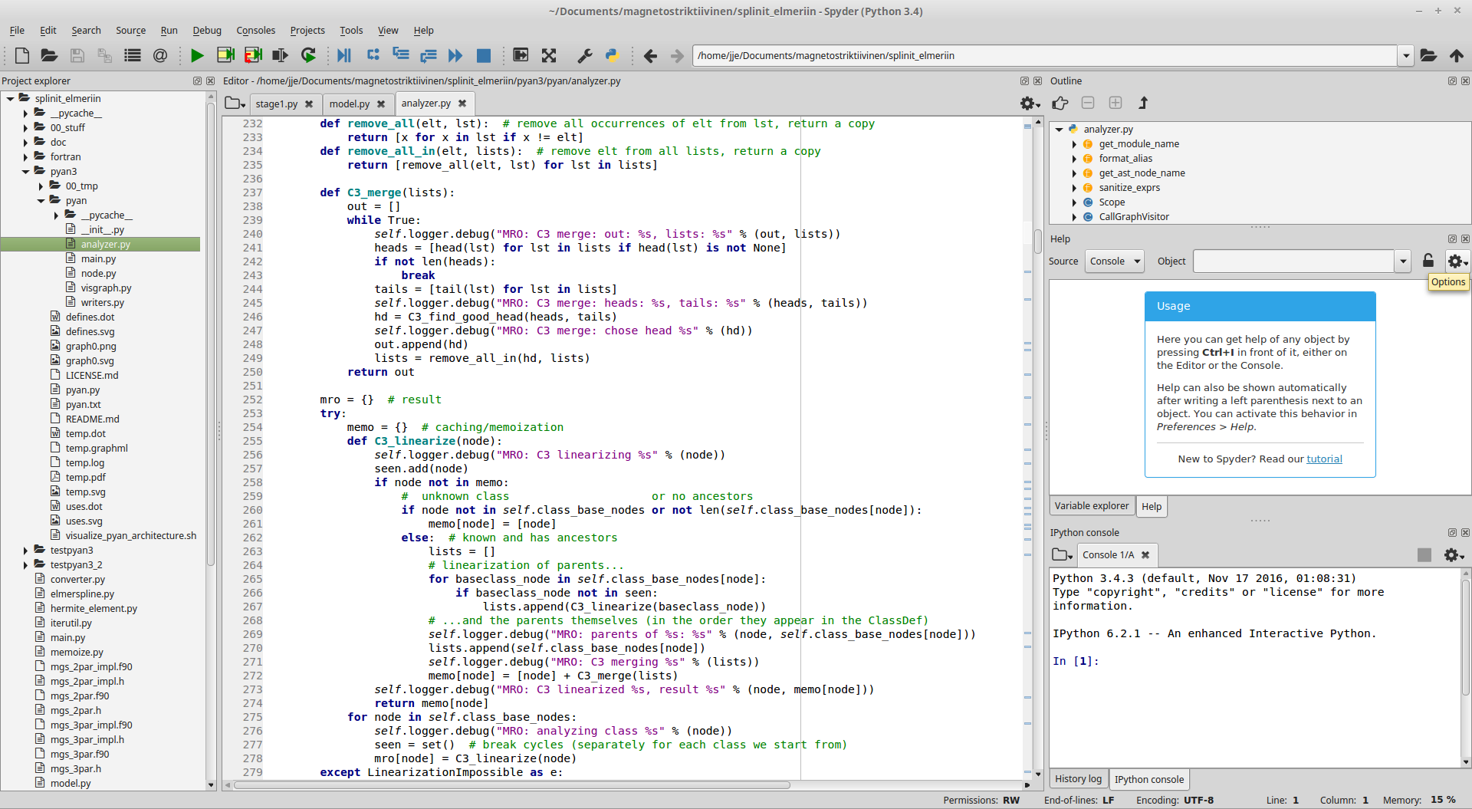

Python?
Python natalensis, Sir Andrew Smith, 1840.
https://commons.wikimedia.org/wiki/File:Python_natalensis_Smith_1840.jpg
A fairly long history:
Python 1.0: 1991
Python 2.0: 2000
Python 3.0: 2008
Family tree of languages:
https://www.levenez.com/lang/
Python 3:
https://www.python.org/

Slide 4
What & why for numerics
Clear, general-purpose, high-level, well-designed complete programming solution
Easy to learn
Focus on clarity: often Python programs look clear, making it easier to return to old code later
Open source; repeatability and transparency of science
Free of cost; no need for licenses
“Complete” includes numerics; a viable competitor for MATLAB
#!/usr/bin/env python3
# -*- coding: utf-8 -*-
print(“Hello, world!”)
https://www.python.org/

Slide 5
Why now?
Python 3 is a sufficiently stable platform to build science on
Rise and popularization of Python during the last 15 years
Python now part of the mainstream of programming: many libraries,
extensive help available on the internet (especially StackOverflow)
IEEE Spectrum 2017: Python the most popular language worldwide
https://spectrum.ieee.org/computing/software/the-2017-top-programming-languages
#!/usr/bin/env python3
# -*- coding: utf-8 -*-
f = lambda x: x**2
g = lambda x: x % 2 == 0
A = range(10)
B = [f(x) for x in A if not g(x)]
print(B)
https://www.python.org/

Slide 6

Where MATLAB is good
Quality-of-life features of a commercial product
    All-in-one
    Attempts to do some things automatically for the user, e.g. JIT:
    https://hips.seas.harvard.edu/blog/2013/05/13/jit-compilation-in-matlab/
Community focused solely on numerics
    If an algorithm is not in MATLAB, it can likely be found in
    MATLAB File Exchange
Polished integrated development environment (IDE) for scientists
Interactive plot editor
Some things easier to do than in Python (e.g. 3D plotting)
SimuLink
vs.

Slide 7
Where Python is good
Elegant language, in which it is easy to write clear code
Control: does only what you explicitly tell it to
Software ecosystem with dependency management (PyPI/pip)
    A huge number of libraries for anything a computer can do
    A sensibly sized numerics community, too
Free of cost; no need for licenses
Open; repeatability and transparency of science
    In practice, also the libraries are open source. Sometimes a library already does 99% of what you need...
vs.

Slide 8
“Python”
Technically speaking, “Python” is a specification, like “C” or “Fortran”
    Several implementations: CPython, Jython, IronPython, PyPy
    CPython however de facto standard; for most == Python
Python 3 vs. Python 2
    Python 3: current version (2017, v3.6.3)
        Also unofficially known as py3k, Python 3000
    Python 2: legacy (2010, v2.7, support ends by 2020)
        Python 2.x ends at 2.7: Python 2.8 Un-release Schedule
        https://www.python.org/dev/peps/pep-0404/
    Practically all projects have already migrated to Python 3
    This seminar: Python 3
#!/usr/bin/env python3
# -*- coding: utf-8 -*-
import re
print(re.sub(r'^monty\s*', r'', 'monty python') + " 3")
https://www.python.org/

Slide 9
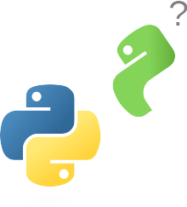
Python 2 vs. Python 3
Almost the same language, but not quite
Most significant change: Unicode support
    Python was designed before Unicode,
    Unicode support was added on
    Cleaned up in Python 3, but broke backward compatibility
In some things Python 3 is a more elegant language, because it was cleaned up also in other respects in the major update
    print() is a function; division / always outputs a float; integer division //; list comprehension has an internal scope
Python core developer Nick Coghlan: we won't break backward compatibility again when the time for Python 4.0 comes
http://www.curiousefficiency.org/posts/2014/08/python-4000.html
Nick Coghlan: Python 3 Q&A:
http://python-notes.curiousefficiency.org/en/latest/python3/questions_and_answers.html
Python 3?

Slide 10
Python 3.x and PEP
PEP = Python Enhancement Proposal
The main mechanism for suggesting extensions to the language
An evolving language; some picks from recent accepted PEPs:
    Literal string interpolation (f-strings) (3.6+), a new clear syntax for formatting strings
    https://www.python.org/dev/peps/pep-0498/
    A dedicated infix operator for matrix multiplication (3.5+), A @ B
    https://www.python.org/dev/peps/pep-0465/
    Additional unpacking generalizations (3.5+), an extension for the tuple unpacking syntax
    https://www.python.org/dev/peps/pep-0448/
    Coroutines with async and await syntax (3.5+), decoupling of coroutines from generators (to avoid misleading programmer intuition)
    https://www.python.org/dev/peps/pep-0492/

Slide 11



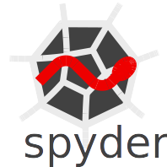
Tools
http://ipython.org/
https://www.anaconda.com/
IPython: advanced command line
Jupyter: IPython's graphical cousin, based on a Mathematica-style notebook approach
Spyder: integrated development environment (IDE)
Anaconda: scientific Python distribution
    Maybe the easiest way to install Python and its scientific libraries on a Windows computer.
https://github.com/spyder-ide

Slide 12
Spyder IDE
The Scientific PYthon Development EnviRonment
Designed for scientists
MATLAB style IDE
Matplotlib integration
Debugger
Profiler
Static code analyzer
REPL (IPython/Jupyter)
read-eval-print-loop
https://github.com/spyder-ide
Mostly well balanced between scientific use oriented,
interactive, and software development oriented features.
Cons: no automatic refactoring or version control GUI.
Tools exist; a matter of implementing a frontend.

Slide 13
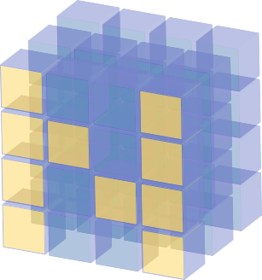


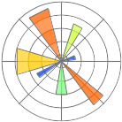
Scientific Python
Welcome to the bazaar
SciPy
https://scipy.org/
SymPy
http://www.sympy.org/
NumPy
http://www.numpy.org/
Matplotlib
http://matplotlib.org/

Slide 14

Scientific Python
Consists of separate libraries
(as usual with general-purpose programming languages)
NumPy, SciPy, Matplotlib
the most important
    These already do a lot
SymPy for symbolic computing
    We will look at this, too
Some other, more specific libraries and their use cases are gathered in the lecture material
(sec. 2)
    We will also look at some of them later on the course

Slide 15

NumPy
http://www.numpy.org/
n-dimensional arrays
MATLAB style API, but instead of matrices, based on cartesian tensors:
    A vector is a rank 1 tensor
    A matrix is a rank 2 tensor
#!/usr/bin/env python3
# -*- coding: utf-8 -*-
import numpy as np
A = np.array( [[1, 2],
[4, 9]], dtype=np.float64 )
b = np.array( [3, 7], dtype=np.float64 )
x = np.linalg.solve(A, b)

Slide 16
SciPy
https://scipy.org/
Advanced-user versions of linear algebra routines
Sparse matrices
I/O for MATLAB .mat files
Numerical integration (quad), initial value problems (ODE), special functions
Signal processing
Some optimization routines
Cython interface to LAPACK,
for advanced users

Slide 17
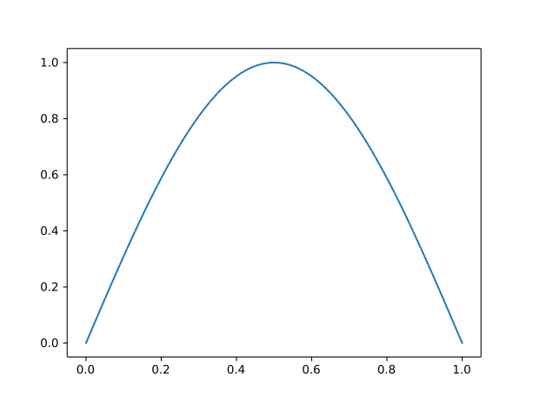
Matplotlib
http://matplotlib.org/
MATLAB-style plotting API
Standard tool for publication-quality numerical graphics
in Python
Also made with Matplotlib
#!/usr/bin/env python3
# -*- coding: utf-8 -*-
import numpy as np
import matplotlib.pyplot as plt
xx = np.linspace(0, 1, 101)
yy = np.sin(xx * np.pi)
plt.plot(xx, yy)
plt.savefig(“sin_x.svg”)

Slide 18

SymPy
http://www.sympy.org/
Symbolic algebra, differentiation, integration
#!/usr/bin/env python3
# -*- coding: utf-8 -*-
import sympy as sy
x = sy.symbols('x')
λf,λg = sy.symbols('f,g', cls=sy.Function)
g = λg(x)
f = λf(g)
D = sy.diff(f, x).doit()
sy.pprint(D)
d d
─────(f(g(x)))⋅──(g(x))
dg(x) dx
Python 3 allows Unicode variable names
(with certain limitations).
Input e.g. using this: https://github.com/clarkgrubb/latex-input

Slide 19
Zen of Python, The
import this
https://www.python.org/dev/peps/pep-0020/
A guiding philosophy for the design of the Python language, as well as many Python programs.
Consists of 20 aphorisms, 19 of which have been written down:
Beautiful is better than ugly.
Explicit is better than implicit.
Simple is better than complex.
Complex is better than complicated.
Flat is better than nested.
Sparse is better than dense.
Readability counts.
Special cases aren't special enough to break the rules.
Although practicality beats purity.
Errors should never pass silently.
Unless explicitly silenced.
In the face of ambiguity, refuse the temptation to guess.
There should be one– and preferably only one –obvious way to do it.
Although that way may not be obvious at first unless you're Dutch.
Now is better than never.
Although never is often better than right now.
If the implementation is hard to explain, it's a bad idea.
If the implementation is easy to explain, it may be a good idea.
Namespaces are one honking great idea – let's do more of those!
–Tim Peters
https://www.python.org/

Slide 20

Python as a programming language
Imperative (but also some FP features)
Interpreted
Object-oriented
Lexically scoped
Duck typed
Call-by-sharing (call-by-object)
Reflective
functional programming
#!/usr/bin/env python3
# -*- coding: utf-8 -*-
class Duck:
def __init__(self):
pass
def quack(self):
print('quack quack')
d = Duck()
d.quack()
quack quack

Slide 21
Python as a programming language
1) Imperative, but also some FP features
Imperative, like C, C++, Fortran, Java, MATLAB.
    I.e. a program is a sequence of simple steps.
    On the other hand, imperative programming has another connotation, especially in FP circles (e.g. Haskell, Racket):
    Imperative programs contain mutable state, which is changed (mutated) as the computation proceeds; functional ones attempt to avoid this.
    Cf. the thought of executable mathematics (L. Peter Deutsch) http://www.paulgraham.com/quotes.html
Python can also be used for functional programming (FP):
    Functions are first-class objects (can be passed as arguments,
    returned from functions, saved in a variable, and so on)
    Anonymous functions, lambda x: ..., like MATLAB's @(x) …
    Module functools in the standard library
    High-level language; often, in the parts of the program that are not performance-critical, a functional approach is natural (no side effects ⇒ easier to test, fewer bugs).

Slide 22
Python as a programming language
2) Interpreted
Typical modern interpreted language. Compiled to bytecode, like Java and MATLAB.
Bytecode runs on the Python virtual machine, contained in the Python interpreter.
Bytecode can be disassembled. Possibly useful, if curious about how Python works:
def f(x):
return x**2
import dis
print(dis.dis(f))

Slide 23
Python as a programming language
3) Object-oriented
Everything is an object (also functions)
Even the types of objects are objects
At the top of the class hierarchy, everything inherits from object
Multiple inheritance allowed
    Method resolution order (MRO) determined by C3 linearization: https://en.wikipedia.org/wiki/C3_linearization
No separate struct; a data structure with named fields ⇒ class
Classes can be defined anywhere, also inside a function.
Python is not as strict about object-orientedness as e.g. Java, where even the main() function must be a static method of a class. Python allows also classical functions (not part of any class).
Python is not as strict about the procedural model either (cf. C). Even main() does not need to be defined, unless one specifically wants to.
Like in MATLAB, any sequence of statements (and/or expressions)
is a valid Python program.

Slide 24
Python as a programming language
4) Lexically scoped
Like in most modern languages.
Lexical scope = a piece of the program's source code as text.
A name declared in a certain lexical scope exists within the piece of text spanned by that scope, and nowhere else.
(Confused? We will have examples/exercises about this.)
In Python, the smallest unit of scope is the function.
    A for loop, or most other blocks for that matter (e.g. while, try, with),
    do not introduce a local scope (contrast C++, Java).
    List comprehension however does; it is processed like a function.
        This was one of the things that was changed in Python 3.0.
Name lookup follows the LEGB rule: Local, Enclosing, Global, Built-in.
https://en.wikipedia.org/wiki/Scope_(computer_science)#Lexical_scoping_vs._dynamic_scoping

Slide 25
Python as a programming language
5) Duck typed
“If it quacks...”
Any object may be used in any context, up until it is used in a way that it does not support.
https://en.wikipedia.org/wiki/Duck_typing
No (typed) variables!
  In Python, types are attached to values (object instances),
  which are referred to using untyped names.
  Assignment re-assigns the name to point to the new value;
  it does not modify the original value.
  Ned Batchelder: Facts and myths about Python names and values
  https://nedbatchelder.com/text/names.html
Python is, however, both dynamically typed and strongly typed.
  Dynamically: types are checked only at runtime (no compile-time checks).
  Strongly: Types of values are never implicitly converted. Unlike in Perl,
  a string will not become a number even if it contains only digits.

Slide 26
Python as a programming language
6) Call-by-sharing (call-by-object)
Cf. the traditional approaches of call-by-value and call-by-reference.
Call-by-sharing is neither of these!
In Python, the caller and callee share the same object instance.
Combined with how assignment works, this implies that mutable instances and immutable instances behave differently as function arguments.
(We will have an exercise about this.)
https://en.wikipedia.org/wiki/Evaluation_strategy#Call_by_sharing

Slide 27
Python as a programming language
7) Reflective
A running program may modify almost anything (including its own code),
at any time.
https://en.wikipedia.org/wiki/Reflection_(computer_programming)
compile(), eval(), exec() – also possible to run code given or generated at run time.
    Note! eval() for user-given input is a serious information security risk.
    Only use eval(), if it can be guaranteed that the input is harmless.
Generally speaking, it is difficult or impossible to deduce anything about the behaviour of Python programs by static analysis approaches.
    However, in practice, reflective features are used sparingly. Static code analyzers exist, and usually the results are good. (pyan, pyflakes, pylint)

Slide 28
Python as a programming language
+1) Other features
0-based indexing (contrast MATLAB and Fortran)
Automatic memory management (garbage collection, GC)
No need to declare names; assignment creates the name if nonexistent.
Expressions vs. statements
    Like in many imperative programming languages, starting with
    Fortran 1 (1957).
    An expression returns a value, a statement does not.
    Explicit return statement required to return a value from a function.
    The default return value (if no return) is always the special value None.
Named arguments.
    Function arguments can be passed also by name, not only by position in the argument list. (More on this in the exercises.)
Aggressive use of namespaces.
    Usually, a quick look at the source code of a Python program is sufficient to tell which library and module each function comes from.
Indentation is part of the language syntax.
    Improves readability, and no need to explicitly terminate blocks.

Slide 29
Meta: the next few weeks
Weeks 2-3:
    Putting the theory in practice: examples and exercises.
    Exercises not compulsory, but almost surely useful.
Week 4: Overview of the most important scientific libraries:
NumPy, SciPy, Matplotlib, SymPy.
Week 5: hands-on for NumPy, SciPy, Matplotlib, SymPy.

Slide 30
Literature
Mark Lutz: Learning Python, 5th ed., O'Reilly, 2013.
    Standard “bible” of the trade, very comprehensive.
    A couple of minor versions behind the latest Python.
Luciano Ramalho: Fluent Python: Clear, Concise and Effective Programming, O'Reilly, 2015.
    Python 3 for programmers coming from other languages.
    Focuses on features that are easily missed, if the reader
    is used to thinking in another programming language.
Zed A. Shaw: Learn Python 3 the Hard Way, Addison–Wesley, 2017.
    For newcomers to programming.
Internet!
    The lecture material lists some web links with each topic.
Questions? ⊳ juha.jeronen@tut.fi

