Slide 1

Python 3 for scientific computing
Lecture 2, 31.1.2018
A first practical look at Python 3
Juha Jeronen
juha.jeronen@tut.fi
Spring 2018, TUT, Tampere
RAK-19006 Various Topics of Civil Engineering

Slide 2
Meta
Last week
Overview
  What Python is: a general high-level programming solution, open source, ...
  Why for numerics, why now; how Python compares to MATLAB
  Language versions: current Python 3 vs. legacy Python 2
Scientific Python is the bazaar to MATLAB's one-stop shop
Python in the context of programming languages in general
  Imperative, somewhat functional, interpreted, object-oriented, duck-typed, ...

Slide 3
Meta
Course schedule
Week 1: Introduction and overview.
Week 2: A first practical look into Python 3. Basics by example.
Week 3: A second practical look into Python 3. Language features by example.
        Structuring programs in Python.
Week 4: Overview of scientific Python: NumPy, SciPy, Matplotlib, SymPy.
Week 5: Basics of NumPy, SciPy, Matplotlib, SymPy, by example.
Week 6: More NumPy, SciPy, Matplotlib, SymPy. An overview of smaller scientific
libraries for specific tasks. Behaviour of floating point numbers.
Week 7: Parallel computing, in general and in Python. MPI, OpenMPI, mpi4py.
Week 8: Fundamentals of software engineering: version control (local and social),
        effective use of comments, testing, static code analysis.
Week 9: High-performance computing in Python via Cython and OpenMP.
Week 10: The new paradigm: a gentle introduction to functional programming (FP).
Week 11: Beyond Python: expressive power, lambda calculus, the Lisp family, and
        Racket (a modern Lisp).
Exercises will be posted after most lectures, starting week 3.
  The topics of weeks 1 and 2 are included in the exercises of week 3.
  One week to solve. Each week starting from week 4, solutions to the
  previous week's exercises will be discussed.
(confidence = 0.949999999999999956)

Slide 4
Meta
General information
Lecture slides (PDF), uploaded after each lecture:
https://github.com/Technologicat/python-3-scicomp-intro/tree/master/lecture_slides
Information on the final assignment:
  A small software project in Python. A simple numerical solver is fine.
  Individual work. Can be started after week ≈6. Deadline 31.5.
  Topic can be freely chosen.
    Everyone can suggest their own topic. Is there something
    that would be useful in your own studies or research?
    Default topic, if none suggested:
      Linear (or bilinear) finite element solver, heat equation,
      unit square, zero Dirichlet boundary conditions.
      Use only NumPy, SciPy, Matplotlib et al.; ready-made FEM packages (e.g. SfePy or FeniCS) not allowed.
      Keep it as simple as possible, this is intended as a small project (and the focus is not on how to make a generic FEM framework).
      A summary of the required mathematics will be provided.

Slide 5
Getting to know Python (1 of 2)
(This set of slides)
Python's documentation
Basic flow control (loops, conditionals)
Containers
  Basic operations on lists and strings
  String formatting
  Slicing (indexing operation)
  tuple (immutable list)
  zip (interleaving iterables)
  Tuple unpacking (destructuring bind and its friends)
  set, dict
  List comprehension
Functions
  Defining; returning values
  Argument passing (by position, by name)
  Argument default values
  Docstrings (where all the help comes from)
  Functions as first-class objects; lambda (anonymous func.)
Getting started with Spyder IDE (for exercises)
From this point on we
will have actual code
( )
[ ]
{ }
”a”
'a'
%0.3g
”””a”””
B = [f(x) for x in A if g(x)]

Slide 6
Getting to know Python (2 of 2)
(The next set of slides)
Modules: defining, loading (import)
The with statement (ensuring open files are eventually closed)
Advanced flow control: exceptions (try, except, finally)
Python and Unicode
Language features, a closer look by example
  Names and values (Python's “variables”)
    Special value None, keyword is; global and nonlocal
  Paradigms: imperative vs. functional programming
  Lexical scoping (contrast dynamic scoping)
  Type system: strong typing, duck typing
  Call-by-sharing (argument passing model)
How to structure Python programs
  Script (just a sequence of statements or expressions)
  Procedural program
    Conditional execution of the main program
    (allows dual use as main program and library)
  Object-oriented program
    Basics of object-oriented programming (OOP)
    (or, how to get rid of global variables in your solvers!)
    Inheritance (single and multiple)

Slide 7
Python's documentation
In Python, almost everything is documented
help(foo) to access documentation of object foo – such as a function,
object instance, or object type.
  Often contains technical details not easily found by searching the internet
  ...because if it's in help, no need to ask.
Introspection tools useful to find candidates for help:
  dir, vars (built-in functions)
  Standard library module inspect, esp. its function getmembers
IPython (incl. Spyder IDE, Jupyter Notebook):
  foo? – description
  foo?? – source code (if applicable)
…

Slide 8
Python's documentation
…
Spyder IDE – help, with rich text rendering (NumpyDoc format)
  Click the object to get help on (to place the text cursor), press Ctrl+I
  If the Help pane is not visible, View ⊳ Panes ⊳ Help
  Depends on static code analysis to determine the type of the
  object instance under the text cursor – often works, but not always
Internet!
  For example, the Python 3 standard library reference:
  https://docs.python.org/3/library/index.html
  Project websites (for libraries), e.g. in case of NumPy:
  https://docs.scipy.org/doc/numpy/
  Search engines
    E.g. googling for “python 3 inspect” is likely the fastest way to find this:
    https://docs.python.org/3/library/inspect.html
    A useful complement for help. Other search results useful when the official documentation is unnecessarily cryptic.
    See esp. any helpful questions/answers at StackOverflow.
    Sometimes “python 3” better as a search term than just “python”,
    because of the still ongoing Python 2 to Python 3 transition.

Slide 9
Basic flow control
Loops, for
Python supports for and while loops. Some examples of for loops:
for k in range(10): # integers 0, 1, …, 9
print(k**2) # ** denotes exponentiation (like in Fortran)
A = [5, 17, 23, 42] # list, we will discuss them below
for x in A: # loop directly over a container (here a list)
print(x)
Note the consistent indentation. The loop body must be indented.
  This is how Python knows where the loop body ends in your source code.
As usual, continue skips the rest of one iteration; break exits the loop.
Recall Python's lexical scoping rules from lecture 1: the loop counter lives
in the scope containing the loop (the loop does not introduce a new scope).
  In other words: the loop counter remains visible after the loop finishes,
  and has the value it had when the loop finished.
  Language feature, can be useful.
  https://eli.thegreenplace.net/2015/the-scope-of-index-variables-in-pythons-for-loops/

Slide 10
Basic flow control
Loops, for
Python's for loop always runs over an iterable (contrast C, Java).
To iterate over integers, first consider if you really need to.
  If you only need an index, iterate over the container itself instead.
  If need to get corresponding elements from two or more sequences,
  zip them (will be discussed later in this lecture).
If you really do need an integer, use the range built-in function, which – roughly speaking – gives an iterable view into the natural numbers.
  See help(range) for more options (start, step).
  Range is lazy. No array; each number is produced on-demand.
    This was changed in Python 3.0. In legacy codes (Python 2.x), one may see xrange(), which is essentially equivalent to the Python 3 range().
  Technically speaking... range() creates a range object, which is Python's built-in way to represent ranges. It behaves mostly like a generator, except that one can iterate over it multiple times (each time starting from the beginning).

Slide 11
Basic flow control
Loops, for/else
In Python, a for loop may have an else block:
for k in range(10):
m = k**2
if m > 100:
break
print(m) # here m ≤ 100; no need for an else block (for the if)
else: # this else belongs to the for (indentation!)
print(”All squares were ≤ 100.”)
The else in a for/else means “if no break occurred”.
Although the feature is known as for/else, mnemonic: (for/)break/else
Keep in mind you can access the final value of the loop counter
also in the else block (this makes for/else actually useful).
(But for searching a collection for an item, there is a more pythonic way,
see below.)

Slide 12
Basic flow control
Loops, while
Example of a while loop:
x = 0
while x**2 < 100:
print(x)
x = x + 1
As usual, continue skips the rest of one iteration; break exits the loop.
Be careful: when writing a while, all too easy to forget to update the counter.
  The for loop does that for you, whereas the while loop expects you to
  do that yourself.
The scope for the loop counter is the same as for the for loop, but here it is more explicit (since the counter is initialized manually).
A while loop is not really meant to iterate over a collection; use for instead.
It is appropriate when the decision on whether to keep looping must be made dynamically, i.e. while the loop is running: while do_something(…):

Slide 13
Basic flow control
Conditionals, if statement
Python has two forms of if. First, the statement form:
if 0 < x < 1: # this works, and evaluates each term (at most) once
print(”hello, ε!”)
elif x < 0: # in Python, “else if” is spelled “elif”
print(”now that's too negative”)
else:
print(”...”)
As usual, the conditions are tested in sequence until one is true,
or the else block is reached. The corresponding body runs.
In Python, most things that are not None or False are “truthy”. Details:
https://docs.python.org/3/library/stdtypes.html#truth-value-testing
elif and else parts are optional. There may be several elifs.
Chained comparisons in Python:
https://docs.python.org/3/reference/expressions.html#comparisons

Slide 14
Basic flow control
Conditionals, logical operators
To create more complex conditions, use the logical operators and, or, not
(and parenthesize where needed).
The and and or operators evaluate one term at a time, from left to right.
They short-circuit, i.e. stop as soon as the result becomes known. Hence:
  and stops evaluation after the first falsey value.
  or stops evaluation after the first truthy value.
The return value from an expression involving and and/or or is the
actual value of the last term tested, not a bool! (No implicit conversions.)
For decision purposes (also in if, while), only truthiness matters.
Examples:
a or b # if a is truthy, return a; else return b
a and b # if a is truthy, test and return b; else return a
a or b or c # from the left, return the first one that is truthy, or finally c
a and b and c # from the left, return the first one that is falsey, or finally c

Slide 15
Basic flow control
Conditionals, if expression
Python also has an expression form of if, sometimes used in assignments:
x = some_expr if condition else other_expr
In this variant, other_expr is mandatory, because an expression
must always return a value, and the elif part is not supported.
Similar to C's ternary operator a?b:c, but different ordering: b if a else c
History for the curious:
https://docs.python.org/2.5/whatsnew/pep-308.html
https://www.python.org/dev/peps/pep-0308/ Conditional expressions (2.5+)
Also sometimes seen: a conditional assignment using only logical operators:
x = some_expr or other_expr
This is useful if some_expr may be falsey, and in that case one wants to use other_expr (e.g. default value for an optional argument initialized to None).
Equivalent to:
x = some_expr if some_expr else other_expr

Slide 16
Containers
Basic operations on lists and strings
Indexing uses square brackets: [ ]
Indices always start from 0, also in NumPy (contrast Fortran, MATLAB)
Negative indices allowed: -1 is the last element, -2 second to last, …
Accesses are bounds-checked (like in MATLAB; contrast C); any access
past the end raises IndexError; silent memory corruption cannot occur
A list is a sequence of arbitrary elements
Lists are represented using square brackets, e.g. ['foo', 'bar', 'baz']
A string is a sequence of characters (a character is a length-1 string)
Python 3 strings support Unicode transparently, e.g. '∂²u/∂x²', '∃x', 'λ', 'あ'
  i.e. requiring no additional effort from the programmer
The type name is str; e.g. str(1) → ”1”
String literals are quoted, as usual. Supported styles:
  Single quote (apostrophe): 'a'
  Double quote: ”a”
  Three double quotes: ”””a”””
    This variant allows embedded newlines. Especially useful for docstrings.
  Same meaning for 'a', ”a” and ”””a””” (contrast *nix shells, e.g. bash)

Slide 17
Containers
Basic operations on lists and strings
Examples:
empty_list = [] # just square brackets [ ]
letters = ['a', 'b', 'c']
numbers = [1, 2, 3]
all = letters + numbers # for lists, + concatenates
numbers_thrice = 3 * numbers # for lists, * repeats
Python lists are heterogeneous, i.e. elements can have different types:
stuff = ['cat', 42, True]
Useful methods: append, extend, insert, pop, remove, sort, reverse
Strings also support joining via str.join. This is invoked as a method on a str instance that represents the separator:
s = ', '.join(letters) # ⇒ 'a, b, c'
Inverse operation: str.split

Slide 18
Containers
Basic operations on lists and strings
Escape sequences:
”This string contains a quote \” and\na newline.” # \” ⇒ ”, \n ⇒ newline
Full list:
https://docs.python.org/3/reference/lexical_analysis.html#string-and-bytes-literals
General explanation:
https://en.wikipedia.org/wiki/Escape_sequence#Programming_languages
Specifically for quotes, can also use alternate styles (also ”””...”””):
”I'm a string containing an apostrophe.”
'The cat said ”meow”, so this string contains two double-quotes.'
Raw strings disable escape sequences (Python-specific feature):
r”Here \n is just backslash and n.” # prefix r denotes a raw string
(Very convenient with LaTeX math in Matplotlib labels, and with regexes.)

Slide 19
Containers
String formatting
A.k.a. string literal interpolation. Or in plain English, insertion of values into a string at runtime, based on a template with placeholders. Critically important for (human-language) localization; also makes code look clearer than concatenating pieces via +. Currently, three ways to do it:
Traditional, also known as C sprintf style. In Python, % interpolates strings:
msg = ”Hello %s, the result is %0.6g.” % (”Fred”, 17/23)
https://docs.python.org/3/library/stdtypes.html#printf-style-string-formatting
Python 3.0 and later, str.format, invoked as a method of a str instance that is the template:
msg = "Hello {name:s}, the result is {result:0.6g}.".format(name='Fred', result=17/23)
https://docs.python.org/3/library/string.html#formatspec
Python 3.6 and later, f-strings, i.e. formatted string literals. Can use Python expressions inline.
name = "Fred"
result = 17/23
msg = f"Hello {name:s}, the result is {result:0.6g}." # prefix f denotes a formatted string
https://docs.python.org/3/reference/lexical_analysis.html#formatted-string-literals
Examples in plain English: https://pyformat.info/

Slide 20
Containers
Slicing (indexing operation)
Like MATLAB, Python supports slicing:
s = 'category'
s[:3] # ⇒ 'cat'
Full syntax: start:stop:step
  CAUTION: First stop, then step, unlike MATLAB!
  Slicing only allowed in indexing expressions
    See np.r_ if you absolutely must 0:101:10 in MATLAB style,
    but prefer np.linspace(0,100,11) for that.
  All parts optional; start is inclusive; stop is one-past-end; default step is +1
  For step > 0, default start is 0, default end end-of-string
  For step < 0, default start is -1, default end start-of-string
Examples:
s[4:6] # elements 4, 5 (counting from 0!)
s[1:] # all elements, starting from element 1 (the second one)
s[:-1] # all elements except the last one
s[1::2] # starting from element 1, every other element

Slide 21
Containers
Tuple (immutable list) vs. list
Lists are mutable, i.e. elements may be added or removed:
letters = ['a', 'b', 'c']
letters.append('d') # add a new single element to the end
letters.extend(['e', 'f']) # concatenate another list to this one, modify in-place
print(len(letters)) # how many letters now?
Tuples are immutable, i.e. once the tuple is created, elements cannot be added or removed. Useful because:
  Immutable objects are often hashable, i.e. can be used as dictionary keys and be included into (mathematical) sets.
  Language-enforced guarantee that there will be no modifications.
letters = ('a', 'b', 'c') # parentheses denote a tuple
just_one = ('a',) # one-element tuple (must use a trailing comma
# to distinguish from parenthesized expression)
the_empty_tuple = () # the empty tuple is a singleton (i.e. there is only one)
However, keep in mind that the container type says nothing of whether
each element itself is mutable or immutable.

Slide 22
Containers zip (interleaving iterables)
Useful for obtaining the corresponding elements from two iterables (e.g. lists or tuples) of the same length. Example:
T1 = (1, 2, 3)
T2 = ('a', 'b', 'c')
print(tuple(zip(T1,T2))) # ⇒ ((1, 'a'), (2, 'b'), (3, 'c'))
Technical detail: we need the final tuple() because Python 3 treats some sequences lazily; often that is very useful. (The zipped sequence is generated on-demand rather than all-at-once; tuple() forces the generator.)
Zipping is often used in loops:
for a,b in zip(T1,T2):
print(”Our values are %s and %s” % (a, b))
Note the use of two counter variables, which step in sync; Python unpacks each element of the sequence given on the right-hand side of in.
Mnemonic: think of a zipper, the physical object.

Slide 23
Containers
Tuple unpacking
Regarding the loop with zip(), we mentioned tuple unpacking. Examples:
a,b,c = (0,1,2) # ⇒ a = 0, b = 1, c = 2
a,b,*others = range(5) # ⇒ a = 0, b = 1, others = [2, 3, 4]
*rest,last = range(5) # ⇒ rest = [0, 1, 2, 3], last = 4
The operation de-structures the tuple (or any sequence) on the right-hand side,
and binds parts of it to names on the left-hand side. Hence destructuring bind.
The star means “the rest”. In an assignment, there can be only one star, and up to Python 3.4, only on the LHS. Python 3.5+ allows some uses of a star on the RHS:
T1 = range(5)
T2 = [100, *T1, 200] # ⇒ T2 = [100, 0, 1, 2, 3, 4, 200]
https://www.python.org/dev/peps/pep-0448/ (Additional unpacking generalizations)
https://stackoverflow.com/questions/2238355/what-is-the-pythonic-way-to-unpack-tuples
https://stackoverflow.com/questions/2921847/what-does-the-star-operator-mean
https://www.python.org/dev/peps/pep-3132/ (tuple unpacking in Python 3.0+)
See also lecture material, p. 36.

Slide 24
Containers
Unordered containers, set
A Python set represents a mathematical set: an unordered collection
of unique elements. Elements must be hashable, which implies immutable.
Elements can have any type, and can be heterogeneous.
S = {'a', 'b', 'c', 'd'}
S.add('e') # add an element to the set; if duplicate, discarded automatically
S.remove('a')
empty_set = set() # no “the”, mutable. Syntax {} means empty dict instead (historical reasons).
Other interesting methods: intersection, union, difference
Searching a collection for an item, pythonic way. Use the in operator:
if 'b' in S: # for the opposite, use “not in”: if 'b' not in S:
print(”Yes, 'b' is in S”)
else:
print(”No, 'b' is not in S”)
Sets themselves are mutable, frozensets immutable (useful as dict keys).
F1 = frozenset(('a', 'b', 'c', 'd')) # make tuple, convert to frozenset
F2 = frozenset(S) # convert a set to frozenset
Note double parentheses for F1; the frozenset constructor wants just one iterable.

Slide 25
Containers
Unordered containers, dict
A dict (dictionary, a.k.a. associative array, map (data structure)) is an
unordered collection of key-value pairs. Keys must be hashable, which implies immutable. No restrictions on values. Keys and values can have
any type, and can be heterogeneous.
Dictionaries are a highly useful as small ad hoc data structures,
since the keys can be human-readable strings.
To read or write a dict, index it with the desired key.
D = {'a': 1, 'b': 2, 'c': 3}
D['a'] # ⇒ 1
D['d'] = 4
if 'b' in D: # search the keys for 'b'
print(”Yes, 'b' is in D, the corresponding value is %s” % (D['b']))
else:
print(”No, 'b' is not in D”)
empty_dict = {} # no “the”, because dict (just like set) is mutable.

Slide 26
Containers
Unordered containers, dict
How to iterate over a dict:
for k in D: # iterating over the dict itself iterates over the keys
print(k, D[k])
for k in D.keys(): # same; old way, still sometimes seen in the wild
print(k, D[k])
for v in D.values(): # values only, no access to corresponding keys
print(v) # because dict is one-way
for k,v in D.items(): # useful when you need both keys and values
print(k, v)
Read from a dict, with a default value if the key is not there:
D.get('some_nonexistent_key', 42)
(Indexing the dict with a nonexistent key instead raises KeyError.)

Slide 27
Containers
Unordered containers, dict
Some final points on dict:
  Keys are (operationally) a set, i.e. an unordered collection.
  To display a sorted list of keys (e.g. for debugging), use
  print(sorted(D.keys()))
  Sorted is a built-in function in Python, which takes an iterable
  and returns a sorted copy. See also reversed.
  To update a dict using the contents of another, use .update:
  D = {'a': 1, 'b': 2, 'c': 3}
  E = {'d': 4, 'e': 5, 'f': 6, 'a': 100}
  D.update(E) # insert/overwrite into D, using data from E
  Any new keys will be added, and existing keys will overwrite.
  If, at some point, you happen to need a dictionary that remembers the order the items were inserted into it, see the standard library module collections, and there OrderedDict.

Slide 28
Containers
List comprehension
List comprehension is a syntax for building new sequences from existing sequences by filtering and mapping. In Python:
B = [f(x) for x in A if g(x)]
says that:
  for x in A: Consider the elements x of the sequence A, in order.
  [filter step] Accept those elements for which g(x) is truthy.
  [map step] Pass each accepted x to the function f, and record its result.
  Build the output sequence from these results.
  Bind the output sequence to the name B.
The notation used in Python borrows ideas from set-builder notation and
the axiom schema of comprehension, from set theory in mathematics.
https://en.wikipedia.org/wiki/Set-builder_notation
https://en.wikipedia.org/wiki/Axiom_schema_of_specification#Unrestricted_comprehension

Slide 29
Containers
List comprehension
The filter step (if …) is optional. Similarly, the map step may also just pass through its input, as in [x for x in range(10) if g(x)].
Using round parentheses in place of square brackets makes instead a generator expression, which evaluates its output lazily (on-demand).
Python has also set comprehension and dict comprehension.
The syntax is similar to list comprehension, but with curly braces.
Set comprehension:
evens = {x for x in range(10) if x % 2 == 0} # for numbers, % is “modulo”
Dict comprehension:
D = {x: x**2 for x in range(100)} # map x ↦ x² for x ∈ [0, 100)
Note the colon in the expression part, separating the key and value.
This is the only syntactic difference between a set comprehension
and a dict comprehension in Python.

Slide 30
Functions defining; return values
To define a function, use the keyword def:
def my_function(x):
return x**2
Preferred naming convention is all_lowercase_with_underscores.
For mathematical functions just f or similar is fine.
No distinction between functions and procedures (contrast Fortran).
  Any function may (but does not have to) return a value.
  If no return statement, the return value is the special value None.
  The return value is not declared, and is not part of the function signature.
  Just “return some_expr” if you want to return a value.
    But if you really like statically typed languages, see:
    https://www.python.org/dev/peps/pep-0484/ Type hints (3.5+)
    http://mypy-lang.org/ Mypy, optional static type checker for Python
The return value can be any Python object, including containers.
  Output arguments needed very rarely (contrast Fortran).
  But if needed, can use mutable objects as arguments, for in-place output of e.g. large arrays.
To return several objects at once, pack them into a container such as tuple:
def my_other_function(a, b):
return (2*a, 3*b**2)

Slide 31
Functions
Defining, anywhere
Functions can be defined anywhere, also inside other functions. Arbitrarily deep nesting is allowed. In this example, we have just two levels for clarity:
def f(x):
def g(y):
return (2*y, 3*y)
return g(x)
An inner function is inside the outer function's lexical scope, hence it can access also any names visible in the outer function:
def f(x):
def g(y):
print('a is {0:d}, x is {1:d}, y is {2:d}'.format(a, x, y))
a = 23
g(y=42) # the argument of g is always y; we're just being explicit
Note! “a” does not yet have a value when Python reads the definition of g(y).
  That's fine, because we are just defining “g” (not running it yet), and the name “a”
  is visible in the whole body of “f” (the lexical scope in which “a” is created).
Only attempting to actually use “a” before setting a value will raise NameError.

Slide 32
Functions
Argument passing: named args
  Function arguments can be passed by name as well as by position.
  (This is one of Python's great strengths for improving readability.)
  def f(a, b):
  print('a = {}'.format(a))
  print('b = {}'.format(b))
  f(a=2, b=3) # pass both “a” and “b” by name
  f(b=3, a=2) # when using names, ordering does not matter
  f(2, b=3) # pass first argument by position, “b” by name
  f(2, 3) # pass both by position
  Tuple unpacking, *, is allowed in function calls. It passes by position:
  lst = (2, 3)
  f(*lst) # unpack lst into positional arguments of “f”
  ...as well as is dictionary unpacking, **. It passes by name:
  dic = {'a': 2, 'b': 3}
  f(**dic) # keys must be arguments accepted by “f”, by name
Here “a” and “b” are named.

Slide 33
Functions
Terminology: formal parameters, arguments
  def f(a, b):
  ...
  f(2, 3)
  x = 5
  f(a=x, b=10)
  This call to “f” sets the formal parameter “a” to the current value of “x” (passes in the object “x” currently points to in the caller's scope), and sets the formal parameter “b” to 10 (by internally creating a temporary object).
  a = 3
  f(a=a, b=10)
  This call sets f's “a” to the current value of the caller's “a” (and “b” to 10).
Formal parameters: placeholder names, to be filled at call time with...
Arguments: ...actual values (object instances)

Slide 34
Functions
Terminology: shadowing/masking
  # names defined at the module's top-level scope
  a = 1
  x = 2
  def f(a, b):
  print(a) # 3
  print(b) # 5
  print(x) # 2
  f(3, 5)
  In computer programming, variable shadowing occurs when a variable declared within a certain scope (decision block, method, or inner class) has the same name as a variable declared in an outer scope. At the level of identifiers (names, rather than variables), this is known as name masking. This outer variable is said to be shadowed by the inner variable, while the inner identifier is said to mask the outer identifier. https://en.wikipedia.org/wiki/Variable_shadowing
  Recall Python's LEGB rule for name lookup (lecture 1, slide 24).
The formal parameter “a” shadows (hides)
the “a” defined in the top-level scope.

Slide 35
Functions
Argument passing: collecting by *, **
  In the list of formal parameters, * makes the function accept any number of positional arguments, collecting any extra ones into a list. In the function body, this list is bound
  to the name immediately following the *:
  def f(*args):
  for x in args:
  print(x)
  f(2, 3, 5)
  Here “extra” means leftovers after positionally passed values have been assigned to all named parameters in the function definition. (Example on next slide.)
    To keep this short, we will omit discussion of corner cases.
  Similarly, ** makes the function accept any named arguments, and collects into a dictionary any that do not match the name of any named parameter in the function definition. In the function body, this dictionary is bound to the name immediately following the **:
  def f(**kwargs): # kwargs is a common abbreviation for “keyword arguments”
  for k,v in kwargs:
  print('{} → {}'.format(k, v))
  f(a=2, b=3, c=5)

Slide 36
Functions
Argument passing: example
  The different argument passing styles may be mixed freely:
  def f(a, b, *args, **kwargs):
  print('a = {}'.format(a))
  print('b = {}'.format(b))
  for x in args:
  print(x)
  for k,v in kwargs:
  print('{} → {}'.format(k, v))
  if 'foo' in kwargs: # check for given dictionary key
    print('foo given, its value is {}'.format(kwargs['foo']))
  f(a=2, b=3, c=5) # a and b by name; no formal param c, so c into kwargs
  f(2, 3, c=5) # first two by position, c into kwargs
  f(2, 3, 5) # all by position; since f has just two named formal
  # parameters, the third positional arg goes into args
  The names “args” and “kwargs” are conventional; any name can be used.
    Sometimes seen instead of “kwargs”: “kwds”, “kws”, “kw”

Slide 37
Functions
Argument passing: optional args
  Pythonic way to implement optional arguments:
  def f(a, b, c=42): # here c is optional; if not given, default to 42
  print('a = {}'.format(a))
  print('b = {}'.format(b))
  print('c = {}'.format(c))
  f(2, 3) # use default value for c
  f(2, 3, 5) # pass in a value also for c, overriding the default
  f(2, 3, c=5) # clearer style, especially if “f” supports more than one optional arg
  Another way, for rarely used optional arguments:
  def f(a, b, **kwargs):
  c = kwargs['c'] if 'c' in kwargs else 42
  print('a = {}'.format(a))
  print('b = {}'.format(b))
  print('c = {}'.format(c))
  This way, rarely used optional args won't clutter the function signature in help
  On the other hand, must document manually so that users know what
  optional arguments exist. (No guarantees on which keys “f” reads from kwargs!)

Slide 38
Functions
Argument passing: keyword-only args
  Finally, Python 3 allows defining also keyword-only arguments:
  def f(*, a, b):
  print('a = {}'.format(a))
  print('b = {}'.format(b))
  A lone star in the formal parameter list means that all the parameters that follow it can be passed by name only:
  f(a=2, b=3) # pass both “a” and “b” by name
  f(2, 3) # TypeError, “f” takes no positional arguments
  Useful to improve readability, to protect against passing arguments
  by position for functions for which it could be confusing (e.g. if the arguments naturally form a set, instead of an ordered sequence).
  https://www.python.org/dev/peps/pep-3102/ Keyword-only arguments (3.0+)

Slide 39
Functions
Argument default values
  To set default values for optional arguments, use the assignment notation
  (like in C++):
  def f(a=42):
  …
  If the exact value of the default is an implementation detail, use None
  to signify “not given”, and set the actual value inside the function body:
  def f(a=None):
  a = a or 42
  …
  (Otherwise someone will eventually pass in 42 just to explicitly signify “yes, I thought about it, and I want to use the default here”.)
    This follows the programming principle of information hiding:
      Protects the user from unimportant internal details.
      Call sites do not need changes even if those details change later.

Slide 40
Functions
Documenting
  Docstrings (documentation strings) are where all the help comes from.
  In Python, it is just the first expression in a function body, if that first expression is a string:
  def rectangle_area(a, b):
  ”””Compute the area of a rectangle.
  Parameters:
  a: number
  The width.
  b: number
  The height.
  Returns:
  Number:
  The area.”””
  return a*b
  Note indentation. The start-quote is indented, but the following lines (inside the docstring)
  do not have to be. The three-double-quotes syntax is very useful here.
  Spyder's Help window supports pretty-rendering the format used here.
  Docstrings are easy to make. Highly useful when you return to your old code later.

Slide 41
Functions as first-class objects – as arguments
  In Python, functions are first-class objects. They can be:
    passed in as arguments to other functions
      ⇒ higher-order functions
    returned from functions
    saved to variables (names), stored in containers, …
  def f(a):
  return a**2
  def do_stuff(op, lst): # “op” short for “operation”
  result = []
  for x in lst:
  result.append(op(x))
  return result
  L = range(10)
  K = do_stuff(op=f, lst=L)
This is an executable
pseudocode sketch of the
higher-order function
commonly known as map.
It has nothing to do
with the data structure
also called map
(dict, associative array).
(Try it, it works.)
(Except that both are instances of
the mathematical idea of mapping.)

Slide 42
Functions as first-class objects – as return values
  The function factory is a design pattern where we return a function instance.
  It can be used to parameterize operations that have a common template, such as:
  def make_adder(inc):
  def adder(x):
  return x + inc
  return adder
  f = make_adder(inc=3) # create function from template, bind to name “f”
  print(f(2)) # 5
  This particular use of a function factory utilizes lexical closures.
    Roughly, a closure is a function together with an environment that contains
    the values for its free variables. Lexical due to lexical scoping.
    We will return to this in week 9, on functional programming.
    https://en.wikipedia.org/wiki/Closure_(computer_programming)
  In short, in each adder instance created here, “inc” is bound to the object the caller gave when calling make_adder to create that particular instance – the created function instance “remembers” the value (object reference, to be exact).

Slide 43
Functions as first-class objects – lambda
  Python supports creating short anonymous functions, using the keyword lambda. These are useful as throwaways for one-off tasks, saving the verbosity of a def:
  lst = range(10)
  result = tuple(map(lambda x: x**2, lst))
  print(result)
  ...but for this particular application, prefer a list comprehension (more readable).
  The body must consist of a single expression only. No statements allowed.
    Ways around: use a tuple as a container, and index to select the return value. Abuse the short-circuiting logical operators to conditionally sequence tasks.
      But this is seriously frowned upon, for good reason: such approaches significantly harm readability.
    Generally, the Python community prefers using def almost everywhere.
  Beware: since lambda is a keyword, “lambda” is not available as a variable name.
    Many numerical Python programmers use “lamda” or “lam”. Can also use “λ” (U+3bb, GREEK SMALL LETTER LAMDA), but perhaps not recommended.
    ftp://ftp.unicode.org/Public/UNIDATA/UnicodeData.txt
  Python's map returns a lazy sequence, hence we call tuple() to force the result.
  Python's lambda x: … is like MATLAB's @(x) ...
Python provides map
(the higher-order
function) as a built-in.

Slide 44

Spyder IDE
Getting started
To start: All programs ⊳ Anaconda ⊳ Spyder
May be named “Spyder3” for the Python 3 version
(If this appears, things are going well.)

Slide 45
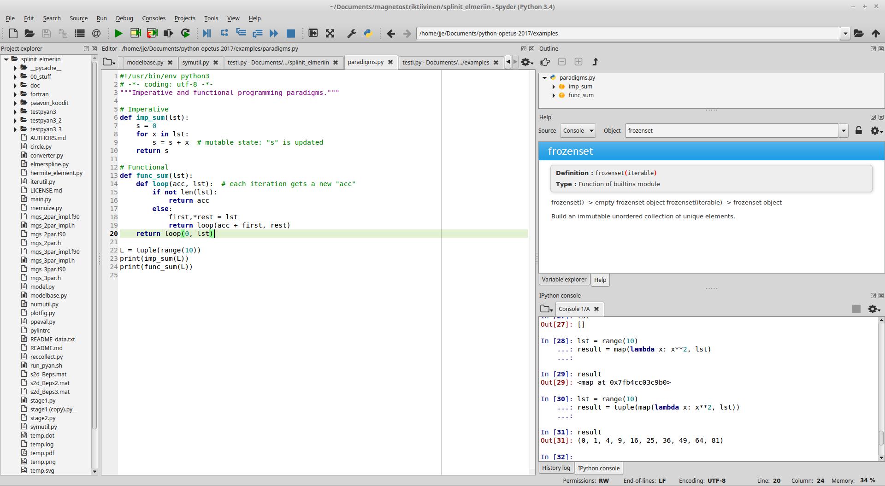
Spyder IDE
GUI layout
Once loading completes, Spyder looks approximately like this:

Slide 46
Spyder IDE
GUI layout
Run menu and button “⊳”
Can also run by pressing F5.
Outline of the currently active file,
for quick code navigation
Files
in your
project
folder
Help, Variable explorer, et al.
Code editor
The file currently active in
the editor runs when you Run
For autocompletion, start typing
and press Ctrl+Space
See the
Projects
menu
REPL (IPython)
For interactive work.

Slide 47
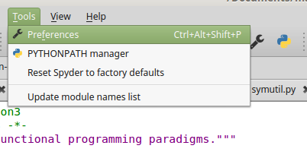
Spyder IDE
Configuring
For settings, see Tools ⊳ Preferences:
One particularly useful option is whether figures open inline or in their own windows:
Tools ⊳ Preferences ⊳ IPython console ⊳ Graphics ⊳ Backend
Color setup for syntax highlighting:
Tools ⊳ Preferences ⊳ Syntax coloring ⊳ Scheme

Slide 48
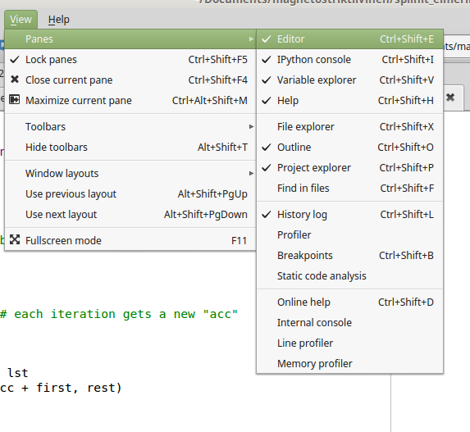
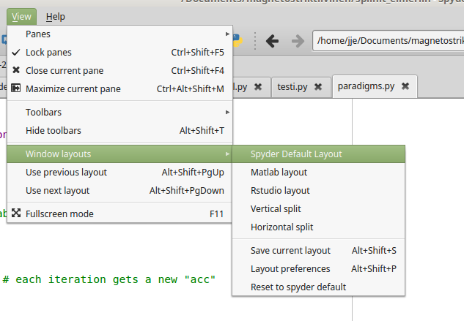
Spyder IDE
Customizing the layout
If you want to change the layout, see View ⊳ Panes and View ⊳ Window layouts

Slide 49

To be continued...
print('See you next week!')
U+28, LEFT PARENTHESIS

