Slide 1


Python 3 for scientific computing
Lecture 5, 21.2.2018
Introduction and overview of scientific libraries
Juha Jeronen
juha.jeronen@tut.fi
Spring 2018, TUT, Tampere
RAK-19006 Various Topics of Civil Engineering

Slide 2
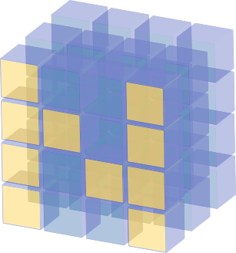

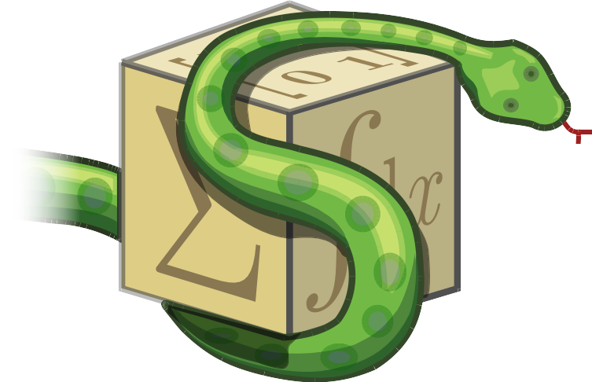
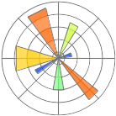
Introduction to scientific Python
The four main libraries
SciPy
https://scipy.org/
SymPy
http://www.sympy.org/
NumPy
http://www.numpy.org/
Matplotlib
http://matplotlib.org/

Slide 3
NumPy
http://www.numpy.org/
MATLAB style API for n-dimensional array operations
  Formalism: cartesian tensors (lecture 1)
  Use: np.array; do not use: np.matrix
  0-based indexing, supports slicing, looks like a list; n-dimensional
  C storage order (by default): the last index changes the fastest
  +, -, *, /, ** operate elementwise (like MATLAB's .+, .-, ...)
  Matrix product @ (Python 3.5+), or a.dot(b)
  Einstein summation notation: np.einsum()
Under the hood: BLAS, LAPACK (like in MATLAB, Fortran)
Python ≠ MATLAB:
  Remember behavior of assignment, call-by-sharing (lectures 1–3)
  Case sensitive; Arr and arr are different names.
Single-threaded, by design (explicit is better than implicit)
Matrices always generic (simple is better than complex)

Slide 4
NumPy
http://www.numpy.org/
Indexing:
import numpy as np
A = np.arange(12).reshape(3,4) # 2-dimensional (rank-2)
A[2,3] # row 2, column 3 → one element, scalar
A[:,3] # all rows, column 3 → vector (rank-1)
A[2,:] # row 2, all columns → vector (rank-1)
A[:,:] # all
A[...] # all; “...” means as many “:” as needed
A[:] # all (special case)
“A” is still a rank-2 -tensor (A.ndim == 2):
A[:] = np.random.random(12) # ValueError
The shape on the RHS (12) is incompatible with the LHS shape (3,4).
A[:] = np.random.random(12).reshape(A.shape) # OK

Slide 5
NumPy
http://www.numpy.org/
C storage order …by default
  When accessing memory sequentially, the last index of the array
  changes the fastest (a.k.a. row-major order).
  Sometimes important to remember, in order to maximize performance.
import numpy as np
A = np.arange(12).reshape(3,4)
B = np.array(A, order='F') # Fortran storage order!
Now, in “B”, the first index changes the fastest (column-major order).
But:
B[2,3] # this still means row 2, column 3
In NumPy, the memory storage order of an array does not affect the order
in which the indices are given. (Contrast C, Fortran.)

Slide 6
NumPy
http://www.numpy.org/
Arrays are created explicitly:
import numpy as np
A = np.arange(10) # [0, 1, ..., 9] → np.array
Z = np.zeros((5,5), dtype=np.float64) # only zeros
O = np.ones((5,5), dtype=np.float64) # only ones
I = np.eye(5, dtype=np.float64) # ident. matrix
D = np.diag(np.arange(10)) # diagonal mat.
M = np.array( [[1, 2, 3], # Python lists → np.array
[4, 5, 6],
[7, 8, 9]], dtype=np.float64)
L = M.tolist() # np.array → Python lists
K = np.array(M) # copy (by calling constructor)
C = M.copy() # copy, more explicit notation
V = M # DANGER: new name, same instance!
W = M[:] # DANGER: new view into the same memory!

Slide 7
NumPy
http://www.numpy.org/
Views – new object instance, same memory:
import numpy as np
A = np.arange(12).reshape(3,4)
L = A.reshape(-1) # Linear (1-index, raveled) view
R = A[0,:] # Also a view (writing mutates “A”)
Coercion into an array and back:
my_scalar = 42.0
B = np.atleast_1d(my_scalar) # → array [42.0]
b = np.squeeze(B) # → scalar 42.0
(Squeeze removes any length-1 axes, a.k.a. singleton dimensions.
Can be used to simplify code that needs to handle both scalars and arrays.
See also atleast_2d, atleast_3d.)

Slide 8
NumPy
http://www.numpy.org/
Subarrays and subsequences:
import numpy as np
A = np.arange(12).reshape(3,4)
r = np.array((0,1,2), dtype=int)
c = np.array((1,2), dtype=int)
A[np.ix_(r,c)] # → subarray, rows r and columns c
r = np.array((0,2), dtype=int)
c = np.array((1,2), dtype=int)
A[r,c] # → subsequence, [A[0,1], A[2,2]]
The latter is equivalent to (but vectorized):
[A[i,j] for i,j in zip(r,c)]

Slide 9
NumPy
http://www.numpy.org/
Index conversion:
  np.ravel_multi_index, np.unravel_index, np.ravel
  https://docs.scipy.org/doc/numpy/reference/arrays.indexing.html
x = np.array([[1,2,3], [4,5,6]])
print(np.ravel(x)) # [1 2 3 4 5 6]
For example:
def genidx2D(nx, ny):
"""Generate index vectors to meshgrid and corresponding raveled array."""
xx = range(nx)
yy = range(ny)
X,Y = np.meshgrid(xx,yy, indexing='ij')
Xlin = np.reshape(X,-1)
Ylin = np.reshape(Y,-1)
XY = np.ravel_multi_index((Xlin,Ylin), (nx,ny))
return Xlin, Ylin, XY

Slide 10
NumPy
http://www.numpy.org/
Creating a vector by slicing:
  In Python, slicing only allowed in index expressions (contrast MATLAB), so np.r_:
a = np.r_[0:100:2] # → [0, 2, 4, …, 98]
  More popular, and also more pythonic:
  a = np.arange(0, 100, 2)
  Sometimes also seen in the wild:
  a = np.linspace(0, 98, 50)

Slide 11
NumPy
http://www.numpy.org/
Broadcasting:
  [NumPy] Performing mathematical operations on arrays, which are differently shaped in a compatible way.
E.g. scalars broadcast to the whole array:
import numpy as np
A = np.arange(12).reshape(3,4)
B = A + 42
C = 2 * np.arange(4)
Arrays broadcast on the leading (first) axes, if the lengths of the trailing (last) axes match:
D = A + C # [row + C for row in A], vectorized
Online material:
  https://docs.scipy.org/doc/numpy/user/basics.broadcasting.html
  https://eli.thegreenplace.net/2015/broadcasting-arrays-in-numpy/

Slide 12
NumPy
Example: creating a tridiagonal matrix:
# create a discretized 1D laplacian
#
n = 10
d = -2 * np.ones((n,), dtype=np.float64)
s = np.ones((n-1,), dtype=np.float64)
d = np.diag(d) # main diagonal
u = np.diag(s, +1) # upper subdiagonal
l = np.diag(s, -1) # lower subdiagonal
T = l + d + u
Slightly more on NumPy, see lecture notes, pp. 17–22; 37; 41–43
User manual:
https://docs.scipy.org/doc/numpy/index.html
Coming from MATLAB? Slightly old, but mostly still good:
https://docs.scipy.org/doc/numpy/user/numpy-for-matlab-users.html
http://www.numpy.org/

Slide 13
Matplotlib
http://matplotlib.org/
The main plotting library in the scientific Python ecosystem.
  Has both procedural (matplotlib.pyplot) and object-oriented APIs.
  The procedural API is very similar in spirit to MATLAB's.
Main goal: high-quality scientific graphics for printing.
Other visualization libraries:
  ggplot (Grammar of Graphics)
  VisPy (GPU, realtime) [YouTube] [paper]
On the lecture, we have only some basic examples.
The official Gallery contains many examples, and codes that produce them:
https://matplotlib.org/gallery.html

Slide 14
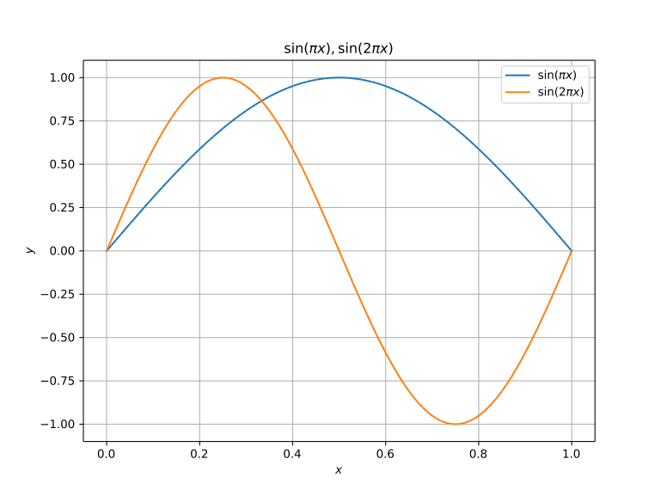
Matplotlib
http://matplotlib.org/
Basic usage:
import numpy as np
import matplotlib.pyplot as plt
xx = np.linspace(0, 1, 101)
yy1 = np.sin(np.pi * xx)
yy2 = np.sin(2 * np.pi * xx)
plt.figure(1, figsize=(8,6)) # size optional
plt.clf() # clear (Spyder does not close)
plt.plot(xx, yy1, label=r'$\sin(\pi x)$') # internal TeX interpreter
plt.plot(xx, yy2, label=r'$\sin(2 \pi x)$') # hold enabled by default
plt.xlabel(r'$x$')
plt.ylabel(r'$y$')
plt.title(r'$\sin(\pi x), \sin(2 \pi x)$') # if you use plt.subplot, see also plt.suptitle
plt.grid(b=True, which='both')
plt.legend(loc='best')
plt.savefig('sin_x.svg') # or .pdf, .png, etc.

Slide 15
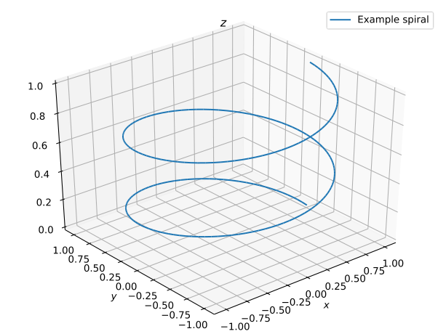
Matplotlib
3D plotting:
import numpy as np
import matplotlib.pyplot as plt
import mpl_toolkits.mplot3d.axes3d as axes3d
tt = np.linspace(0, 4*np.pi, 1001)
xx = np.cos(tt)
yy = np.sin(tt)
zz = np.linspace(0, 1, len(tt))
fig = plt.figure(1)
fig.patch.set_color((1,1,1)) # fig. background, RGB
fig.patch.set_alpha(1.0) # fig. background, opacity
left_bot_w_h = [ 0.02, 0.02, 0.96, 0.96 ] # more space to edges
ax = axes3d.Axes3D(fig, rect=left_bot_w_h)
# see also ax.plot_wireframe, ax.plot_surface, ax.plot_trisurf
ax.plot(xx, yy, zz, label='Example spiral')
ax.view_init(34, -130) # elev, azim
ax.axis('tight')
ax.legend(loc='best')
plt.xlabel(r'$x$')
plt.ylabel(r'$y$')
ax.set_title(r'$z$') # note! No “zlabel” due to Matplotlib's history as a 2D plotter.
plt.savefig('spiral.svg')
http://matplotlib.org/

Slide 16
SymPy
http://www.sympy.org/
CAS (computer algebra system) for Python
  Slower than separate CAS software packages
  But to Python programs, just a library like any other; excellent integration
    Python equivalent for MATLAB's Symbolic Math Toolbox
  Compare e.g. SageMath
Symbolic algebra, differentiation, integration
  As much a CAS construction kit as a CAS system: sometimes useful
  to define custom routines to process symbolic math expressions
User manual:
http://docs.sympy.org/latest/index.html
Tutorial:
http://docs.sympy.org/latest/tutorial/index.html
On this lecture, just a few examples.

Slide 17
SymPy
Symbols:
import sympy as sy
x, y, z = sy.symbols('x, y, z')
Can specify assumptions through kwargs, e.g. real=True
Symbolic expressions in SymPy are Python expressions:
p = x**2 + 2*y**3
...but careful with constants, to prevent Python from converting to float before SymPy gets access to the value:
q = sy.S('5/3') * z
Some predefind constants: sy.S.Zero, sy.S.One, sy.S.exp1, sy.S.Infinity, …
An expression is a tree. If you manipulate with your own routines,
preserve the invariant: for an expression expr, args is either empty,
or expr == expr.func(*expr.args).
http://www.sympy.org/

Slide 18
SymPy
Matrices:
εxx,εyy,εzz,εyz,εzx,εxy = sy.symbols('εxx, εyy, εzz, εyz, εzx, εxy')
exx,eyy,ezz,eyz,ezx,exy = sy.symbols('exx, eyy, ezz, eyz, ezx, exy')
ε = sy.Matrix( [[εxx, εxy, εzx], # Cauchy strain
[εxy, εyy, εyz],
[εzx, εyz, εzz]] )
e = sy.Matrix( [[exx, exy, ezx], # deviatoric strain
[exy, eyy, eyz],
[ezx, eyz, ezz]] )
εM_expr = sy.factor(sy.S('1/3') * ε.trace()) # mean volumetric strain
e_expr = ε - εM_expr * sy.eye(3)
# check the symmetry
assert e_expr[1,0] == e_expr[0,1] # exy
assert e_expr[2,0] == e_expr[0,2] # ezx
assert e_expr[1,2] == e_expr[2,1] # eyz
http://www.sympy.org/

Slide 19
SymPy
Chain rule (lecture 1):
import sympy as sy
from sympy.core.function import UndefinedFunction
def nameof_as_symbol(sym):
if hasattr(sym, 'name'):
return sy.symbols(sym.name, **sym.assumptions0)
else: # an undefined function is anonymous, but its class has __name__
return sy.symbols(sym.__class__.__name__, **sym.assumptions0)
def strip(expr): # for printing: remove (maybe long) argument lists from unknown functions
if isinstance(expr.__class__, UndefinedFunction):
return nameof_as_symbol(expr) # we strip args, no need to recurse into it
elif expr.is_Atom:
return expr
else: # compound other than an undefined function
newargs = [strip(x) for x in expr.args]
cls = type(expr)
return cls(*newargs)
def main():
x = sy.symbols('x')
# Unknown function
λf,λg = sy.symbols('f,g', cls=sy.Function)
# Applied function
g = λg(x) # “g = g(x)”; the symbol name inside must be unique, so λg is single use only
f = λf(g) # f = f(g)
# With the above definitions, SymPy automatically applies the chain rule:
D = sy.diff(f, x).doit()
sy.pprint(strip(D))
main()
http://www.sympy.org/
Original:
d d
─────(f(g(x)))⋅──(g(x))
dg(x) dx
strip(…):
d d
──(f)⋅──(g)
dg dx

Slide 20
SymPy
http://www.sympy.org/
Hermite polynomials:
import sympy as sy
def hermite(k): # Derive C**k continuous Hermite interpolation polynomials for the interval [0, 1]
order = 2*k + 1
*A,x = sy.symbols('a0:%d,x' % (order+1))
w = sum(a*x**i for i,a in enumerate(A)) # as a symbolic expression
λw = lambda x0: w.subs({x: x0}) # as a Python function; subs: symbolic substitution
wp = [sy.diff(w, x, i) for i in range(1,1+k)] # diff: symbolic differentiation
λwp = [(lambda expr: lambda x0: expr.subs({x: x0}))(expr) for expr in wp] # why two lambdas: lecture notes sec. 5.8
zero,one = sy.S.Zero, sy.S.One
w0,w1 = sy.symbols('w0, w1')
eqs = [λw(zero) - w0, λw(one) - w1] # eqs. in form LHS = 0; see sy.solve()
dofs = [w0, w1]
for i,f in enumerate(λwp):
d0_name = 'w%s0' % ((i+1) * 'p') # p = 'prime', to denote differentiation
d1_name = 'w%s1' % ((i+1) * 'p')
d0,d1 = sy.symbols('%s, %s' % (d0_name, d1_name))
eqs.extend([f(zero) - d0, f(one) - d1])
dofs.extend([d0, d1])
coeffs = sy.solve(eqs, A)
solution = sy.collect(sy.expand(w.subs(coeffs)), dofs)
N = [solution.coeff(dof) for dof in dofs] # result
return tuple(zip(dofs, N)) # pairs (dof, interpolating function)
hermite(0) # linear interpolation
((w0, -x + 1), (w1, x))
hermite(1) # beam element
((w0, 2*x**3 - 3*x**2 + 1),
(w1, -2*x**3 + 3*x**2),
(wp0, x**3 - 2*x**2 + x),
(wp1, x**3 - x**2))
hermite(2) # 2nd derivative also continuous
((w0, -6*x**5 + 15*x**4 - 10*x**3 + 1),
(w1, 6*x**5 - 15*x**4 + 10*x**3),
(wp0, -3*x**5 + 8*x**4 - 6*x**3 + x),
(wp1, -3*x**5 + 7*x**4 - 4*x**3),
(wpp0, -x**5/2 + 3*x**4/2 - 3*x**3/2 + x**2/2),
(wpp1, x**5/2 - x**4 + x**3/2))

Slide 21
SciPy
https://scipy.org/
Python/NumPy style API to the libraries under the hood
  LAPACK, ARPACK, SuperLU, UMFPACK
Sparse matrices
  SciPy rather good as-is
  Need more algorithms? Add-on libraries:
    Sparse Cholesky (CHOLMOD) → scikit.sparse
      Note! There is also an old, obsolete scikits.sparse
      The current one called scikit.sparse; module: import sksparse
    SPQR (SuiteSparse QR) → sparseqr
      Highly robust (works also for horribly scaled input)
      Also works for overdetermined (least-squares) problems
      Used also by MATLAB, x = A \ b when A is sparse
SciPy also provides numerical integration (quad), initial value problems (ODE), special functions, signal processing, some basic optimization
  Convex optimization? → CVXOPT

Slide 22
SciPy
https://scipy.org/
User manual:
  https://docs.scipy.org/doc/scipy/reference/index.html
In the API reference, see especially:
  https://docs.scipy.org/doc/scipy/reference/linalg.html
  https://docs.scipy.org/doc/scipy/reference/sparse.html
  https://docs.scipy.org/doc/scipy/reference/sparse.linalg.html
Tutorials included in the manual, e.g.
  https://docs.scipy.org/doc/scipy/reference/tutorial/linalg.html
Sometimes both NumPy and SciPy provide the “same” routine
  NumPy provides a basic API, SciPy an advanced one (more options)

Slide 23
SciPy
https://scipy.org/
Example: creating a sparse matrix:
import scipy.sparse
data = (1, 2, 3) # matrix elements
drow = (0, 1, 4) # their rows
dcol = (3, 2, 4) # their columns
S = scipy.sparse.coo_matrix((data, (drow,dcol)),
shape=(5,5),
dtype=np.float64)
S = S.tocsr() # → Compressed Sparse Row format
print(type(S)) # scipy.sparse.csr.csr_matrix
print(S)
For more, see e.g.
http://www.scipy-lectures.org/advanced/scipy_sparse/index.html
Note that here, too, explicit is better than implicit: SciPy requires the user
to specify the storage format (contrast MATLAB).

Slide 24
Meta
Next time
More NumPy, SciPy, Matplotlib, SymPy.
The third set of exercises.
See you after the spring break, in two weeks!

