Slide 1


Python 3 for scientific computing
Lecture 7, 21.3.2018
Parallel computing; floating point; more libraries
Juha Jeronen
juha.jeronen@tut.fi
Spring 2018, TUT, Tampere
RAK-19006 Various Topics of Civil Engineering

Slide 2
Meta
Updated battle plan
Starting the second (and final) part of the course: introduction to a variety of advanced topics.
  Lecture 7: Parallel programming; behavior of floating point numbers
    Also one slide on more libraries.
  Lecture 8: High-performance computing in Python
    At least Cython; possibly examples of Numexpr, Numba.
  Lecture 9: Introduction to software engineering
  Lecture 10: Gentle introduction to functional programming with Python
  Lecture 11: Beyond Python
Today, we will proceed as far as we have time; the rest, next week.
The slide set on Cython will be shorter, completing next week's lecture.

Slide 3
Meta
About the final assignment
Commented code is enough; no separate report. Keep it readable; no obfuscated Python.
  At the beginning, include a short description of what your program does,
  and which algorithms it uses (if relevant).
  If possible, provide web links (in comments or docstrings) regarding the algorithms,
  so that it's possible for a reader to quickly find out about them.
The assignment can also be just a part for a larger project you're working on.
  It doesn't have to be fully complete, as long as it runs, and does something sensible.
  Just cut the project when some subset of functionality is done, or when the program
  is large enough to submit as a final assignment.
Topic ideas, beside classical numerics:
  Some complex data visualization?
  Pick some interesting library you haven't yet used, figure out a use for it, and try it out.
  Fractals – find a nice-looking one, and write a (parallel?) program to explore it.
  Audio processor? Image processor? GUI app? Web app? Database app?
  Something you eventually intend to deploy on your Raspberry Pi, if you have one?
  Something specific that helps your studies and/or work?
Really, the project can be just about anything, as long as it:
  is implemented in Python (Cython is also ok),
  uses something you have learned on this course,
  is about the right size for a 5-credit course (≈100–1000 SLOC, depending on your background and the information density in those lines of code).
Unsure about topic suitability or the size of your proposed project? Just ask.

Slide 4
Parallel computing
Instruction-level parallelism in a single processing unit (core):
  Pipelining: simultaneous execution of multiple instructions per clock cycle, in the same execution unit (such as ALU) on the processor, by dividing the unit to multiple simultaneously operating phases (steps). Often includes branch prediction.
  Out-of-order execution, by the availability of input data and execution units rather than the original order in the program, taking into account possible dependencies.
  Superscalarity: simultaneous dispatch of multiple instructions from one instruction stream (such as process or thread) per clock cycle, to different execution units.
  Simultaneous multithreading (SMT; e.g. Intel's Hyper-threading): simultaneous dispatch of multiple instructions from multiple instruction streams per clock cycle.
Multi-core processor
Symmetric multiprocessor (SMP)
  System with multiple identical processors, shared memory, connected via a bus.
Distributed computing (contrast cloud computing: comp. resources as a service)
  Processing elements connected via a network.
  Cluster: a group of computers that work together closely. Same task in each node.
  Massively parallel processor: a single computer with many networked processors.
  Grid computing: computers linked over the internet. Nodes may do different tasks.
  Volunteer computing, e.g. Seti@Home, BOINC. Somewhat different from grid.
GPGPU, heterogeneous computing (e.g. OpenCL), NUMA, …
Nowadays everywhere.
☆
A classical solution for servers, e.g. Intel Xeon.

Slide 5
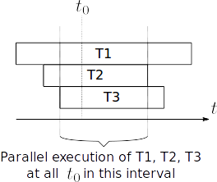
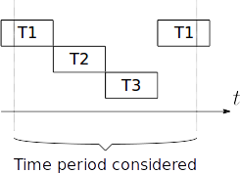
Parallel computing
Concurrency vs. parallelism:
  Concurrent: at least two tasks are making progress during a period of time.
  Parallel: at least two tasks are making progress at the same point in time.
Concurrency useful for I/O-bound workloads, e.g. web servers.
  Each task spends the majority of its time waiting for I/O, can be suspended.
Scientific computing can be CPU-bound, memory-bound or cache-bound.
  Each task spends the majority of its time either computing or transferring data.
  CPU-bound tasks need parallelism for multi-core.
This illustration uses Round-robin scheduling.

Slide 6
Parallel computing
Interaction strategies
Shared memory
  Locking ensures a consistent state when accessing shared data,
  i.e. preserves the program's internal invariants about the shared state.
    This is done by serializing (synchronizing) access to the shared data.
    Makes operations that mutate shared state appear atomic.
    E.g. when a write into a shared data structure is in progress, other tasks must wait (before reading that data) until the write completes.
    Often, advisory implementation; requires each thread to play by the rules.
Transactional memory
  Reads/writes in shared memory actually are atomic (as seen by the user code).
  No explicit locks in user code. Requires hardware or language support.
  Related: non-blocking algorithms, lock-free data structures, compare-and-swap.
  Bartosz Milewski (2010): Beyond locks and messages: The future of concurrent programming
Message passing
  General name for a set of approaches where all memory is private, and tasks communicate by sending messages.
Implicit parallelism
  Built into the language; e.g. Concurrent Haskell, Concurrent ML.
https://en.wikipedia.org/wiki/Parallel_programming_model

Slide 7
Parallel computing
Shared memory
Tasks usually modeled as threads in the same process.
Does not scale when many tasks need access to the same resource;
the mutually exclusive access becomes a bottleneck.
Useful on a single computer, when the amount of shared data is large.
Related term: reentrant code: code that can be safely interrupted and called again (“re-entered”) before its previous invocations finish.
  Documentation will typically warn if a routine is not reentrant (or thread-safe).
Disadvantages:
  Deadlock: two tasks T1, T2 that need two shared resources A, B may get stuck waiting for each other. (Example on next slide.)
  Livelock: each task attempts to dodge the other's locking behavior, making
  no progress (like two people in a hallway trying to pass each other).
  What happens if we don't lock?
    Race condition: the result may depend on the ordering of concurrent events.
    (Example below.)

Slide 8
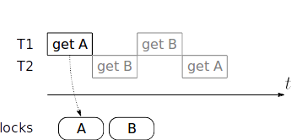
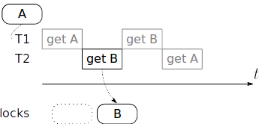
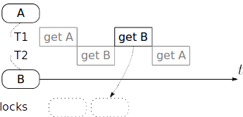
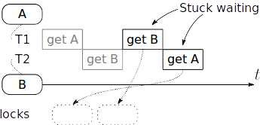
Parallel computing
Deadlock example
➀
➁
➂
➃
...but B is already taken.
Also A is already taken.

Slide 9
Parallel computing
Race condition example
What is the final value of x?
import time
import threading # see standard library docs
def f(k):
global x
y = x # read shared state
time.sleep(1e-6) # wait 1 µs to simulate a “long” computation
y += k # compute (this step does not access x)
x = y # write shared state
x = 1
T1 = threading.Thread(target=f, args=(2,)) # target is the thread's “main function”
T2 = threading.Thread(target=f, args=(3,))
T1.start()
T2.start()
T1.join() # wait until the thread finishes
T2.join()
print(x)
In f(), we could just as well replace the last three lines with x += k, but the
above version makes the read-compute-update steps more explicit.

Slide 10
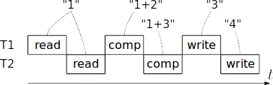
Parallel computing
Race condition example
def f(k):
global x
y = x # read shared state
time.sleep(1e-6) # wait 1 µs to simulate a “long” computation
y += k # compute (this step does not access x)
x = y # write shared state
x = 1
# …T1, T2, …, start(), join(), …
Bug: race condition: the result depends on the order of execution. For example:
The fix is to add locking around the accesses to x. Lock, read, unlock,
and lock, write, unlock; or lock, read-and-update, unlock.

Slide 11
Parallel computing
Race condition example
import time
import threading
import numpy as np
def f(k):
global x
y = x
time.sleep(1e-6)
y += k
x = y
out = []
for i in range(1000):
global x
x = 1
threads = [(lambda k: threading.Thread(target=f, args=(k,)))(k=j) for j in range(1, 21)]
for T in threads:
T.start()
for T in threads:
T.join()
out.append(x)
hist,bin_edges = np.histogram(out)
bin_centers = (bin_edges[:-1] + bin_edges[1:]) / 2
print(hist, bin_centers)
print("Most common bin center: {v}".format(v=bin_centers[np.argmax(hist)]))
Exercises:
Try this version for a real-world test.
Protect accesses to x with Threading.Lock.
Check that the modified program works.
Read about other useful parts of threading, such as thread-local storage and events.
How would you use events to signal
worker threads to exit their main loops when the user presses Ctrl+C (which makes Python raise KeyboardInterrupt
in the main thread)? Hint / material.

Slide 12
Parallel computing
Message passing
Tasks usually modeled as processes.
  All memory is private to each task. No shared data, no need for locking.
  Tasks communicate by sending messages.
Scales well, unless the amount of data to be sent is so large that messaging becomes a bottleneck.
Good for distributed computing.
Tasks fully independent. In principle, may run completely different code.
  For implementing such a collection of parallel programs, see e.g. the ØMQ library.
  However, SPMD (single program, multiple data) is a common design in scientific applications; e.g. the MPI (Message Passing Interface) framework is SPMD.
Time spent communicating is time not spent performing useful work. Eventually scaling leads to parallel slowdown: added communication > added comp. resources.
Excess computation may be needed (compared to the serial case), if the algorithm requiring the least amount of operations is inherently serial.
Synchronous communication used often (but not always): when a task is sending, another one must be listening. In such cases deadlock can still occur.

Slide 13
Parallel computing
SPMD (Single program, multiple data)
All tasks execute (mostly) the same program, independently.
  This simplifies the user code: need to write only one program.
  But beware: it's still a parallel program!
    In general, more difficult to implement correctly than a serial program.
At appropriate places, the program uses conditional statements (branches),
which select the code to run depending on the task identity (number).
  E.g. task 0 acts as a controller, whereas tasks ≥ 1 perform the actual computation.
SPMD leads to some redundant computation, but not an issue:
    Most of the computational workload is in the main solver algorithm;
    re-computing everything else does not cost much.
    May actually be faster to redo “small” computations than compute once,
    then broadcast results.
      Even in a PC, math is cheap, memory transfers expensive. In distributed computing, the messages must be sent over the network; even slower.

Slide 14
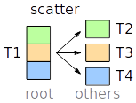

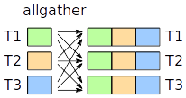

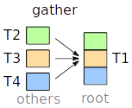
Parallel computing
MPI (Message Passing Interface)
SPMD – single program multiple data. MPI backend provides comm infra for clusters.
MPI rank is the task identity (which is an integer); switch on that in your code.
Some operations have a root process, chosen by the user (often MPI rank 0).
Tasks can be grouped by communicators; default MPI_COMM_WORLD includes all
Operations, in one picture. Finally, barrier waits until all tasks in the group reach it.
For much more, see MPI Tutorials. Specifically for Python, see mpi4py tutorial.

Slide 15
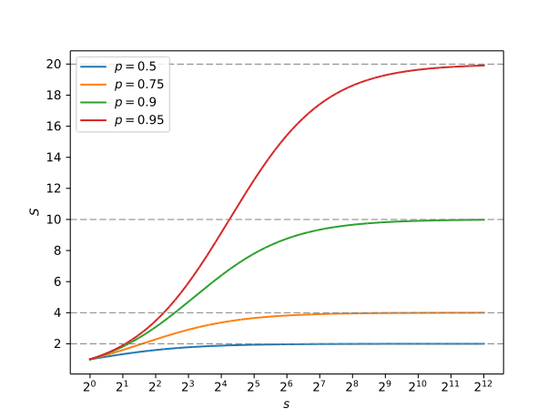


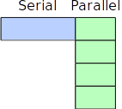

Parallel computing
Scalability: Amdahl's law
To perform the same workload in parallel (strong scaling), the maximum possible speedup (regarding overall latency) is limited by the fraction
of code that cannot be parallelized.
...we run it using
s parallel tasks,
to get it to finish as
soon as possible.
S: theoretical speedup
p: fraction of code that can be parallelized
s: speedup of the parallelized part
Here s = 4.

Slide 16
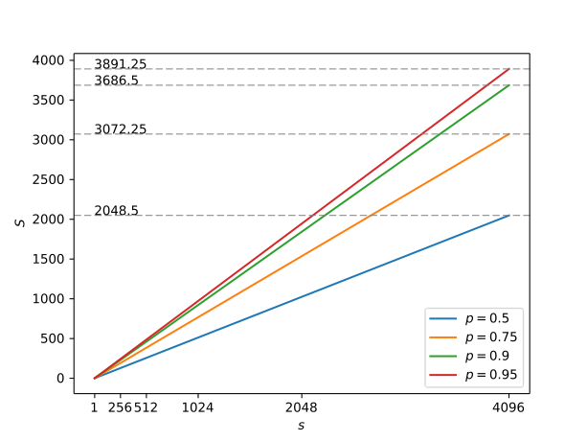

Parallel computing
Scalability: Gustafson's law
When resources increase, the workload is rarely kept the same; increased resources are often applied to a similarly larger workload (weak scaling).
With the same p and s as before, but with S now denoting the theoretical weak-scaling speedup:
Here we scale both the
resources and the workload
size by a factor of s, i.e. by
as much as the parallelized
code can take.
Gustafson's law is much
less pessimistic about the
usefulness of parallelization
than Amdahl's.
Slope = p < 1; a slope of 1 is ideal scaling (fully parallel code).

Slide 17
Parallel computing
Multicore Python
Global interpreter lock (GIL): [1] [2] [3]
  The CPython interpreter is concurrent, not parallel.
  A Python thread can only execute with the GIL acquired.
    Hence, Python threads compete for the GIL.
  However, a Python thread will release the GIL, while:
    Waiting for I/O – such as in server workloads.
      Cannot proceed anyway until data available.
    Executing a low-level function (C, Fortran) – such as those in NumPy and SciPy!
      The low-level code cannot use Python objects. Can opt in to release the GIL.
      If you code your own in Cython (next week), use Cython's with nogil: syntax.
  Hence, whether the GIL presents a problem depends on how your program works:
    Few, huge NumPy or SciPy operations – no problem; Python threads will run mostly in parallel.
    Many small operations – threads not useful; consider a process-based approach.
      multiprocessing, in the standard library. API similar to threading.
      MPI with Python bindings, such as mpi4py. Requires an MPI backend such as Open MPI or MPICH. Scales to clusters (if your algorithm does).
By core dev Nick Coghlan.
Recommended reading.

Slide 18
Parallel computing
Multicore Python
Further resources:
  concurrent.futures.ProcessPoolExecutor – a higher-level abstraction
  based on multiprocessing. Provides a context manager, futures, and
  a parallel map().
  Parallel programming with NumPy and SciPy (old, but still useful)
  A Python introduction to parallel programming with MPI
  David Beazley (2009): An introduction to Python concurrency
Maybe of interest:
  In a threaded Python program, watch out for import lock.
  Parallel design patterns, such as Map and MapReduce.
  PyPy interpreter with Software Transactional Memory (Python 2 only)

Slide 19
Parallel computing
Is it worth it?
Do you really need to parallelize your code?
  If you intend to Monte Carlo, do sample-based uncertainty analysis, or run a parametric study (a.k.a. parameter sweep), then the complete workload is already embarrassingly parallel.
    Simply run multiple serial simulations simultaneously.
  If one large problem, then parallelize (if you really need more speed).
    Take advantage of any easy opportunities for parallelism in your particular problem.
    Parallelizing e.g. a linear equation system solver is difficult, but has been a topic of research, and software exists.
      Parallel methods for linear equation systems (introductory material);
      Dekker et al. (1994); Göddeke (2010) (research)
      ScaLAPACK; PETSc; PLASMA; MAGMA; MUMPS (software).

Slide 20

Floating point
See also Wikipedia for a more detailed introduction.
☆
Floating point arithmetic has an undue reputation as something
that introduces random errors into numerical computations.
  In reality, although subtle in many ways, floating point arithmetic
  is completely deterministic.
Main idea:
  Task: represent ℝ; but for arbitrary x ∈ ℝ, this is impossible.
    Some real numbers are not even computable. Limits of Specker sequences, Chaitin's Ω.
    For use with arbitrary numbers, a fixed-length, approximative storage scheme is desirable.
    But such a scheme can only represent a finite subset of ℚ.
      Choosing this subset is a tradeoff of range vs. precision.
  Floating point: compute with a given number of significant digits, regardless
  of the absolute magnitude. (The decimal point “floats”.)
Material:
  What every computer scientist should know about floating-point arithmetic
    David Goldberg's 1991 classic paper. Not only for CS experts; recommended!
    TL;DR summary: What every programmer should know about floating-point arithmetic
  You're Going to Have to Think!, a series of articles by Richard Harris. (Start here.)
  Bruce M. Bush (1996): The Perils of Floating Point
  Python tutorial: Floating point arithmetic – Issues and limitations
  IEEE Floats and Python
  Comparing Floating Point Numbers, 2012 Edition
  Stupid Float Tricks – e.g. adjacent floats have an adjacent integer representation.
  Computer mathematics – Floating-point representation (course material)
Related to the
halting problem.

Slide 21
Floating point
Roughly, the format is:
    f = s · m · b^{k}
where
s = sign, +1 or -1
m = mantissa; m ∈ ℚ ∩ [1, b)
b = base; integer ≥ 2. Usually b = 2.
k = exponent, integer
Example with b = 10:
f = +1 · 2.99792458 · 10⁸ = 299 792 458
Mantissa given as a binary fraction (like a decimal number, but in base-2).
A bias is added to the exponent so that e.g. [0, 2047] means [-1022, +1023]
Spacing: … ¼ ½ 1
So, roughly, floats
are logarithmically
spaced.
Representable numbers for “toy floats”:
4 bits for m, 3 bits for k, b = 2. Program.
Here k = -3, -2, …, 4. (3 bits ⇒ 8 values)
Note higher density near the origin,
since m uses a fixed number of bits.
exponent
In Python, see sys.float_info.
sign
mantissa
base b = 10
The mantissa always has the same number of significant digits, specified by the storage format.

Slide 22
Floating point
On this course, “float” means
IEEE-754 double precision
unless otherwise specified.
Commonly used floating point standard: IEEE-754. (Lecture note.)
  Single precision: 32 bits; ≈7.22 decimal digits
    23-bit mantissa, 8-bit exponent – video games, graphics; consumer GPUs use this format
    Precision not sufficient for scientific use without special tricks
      Especially, partial differential equation (PDE) solvers often need to handle both
      very small and very large numbers in the same expression.
  Double precision: 64 bits; ≈15.95 decimal digits
    53-bit mantissa, 11-bit exponent – scientific applications
    Used in CPUs and specialist compute boards (AMD FirePro, NVIDIA Tesla, Intel Xeon Phi)
The exponent is normalized. This brings the mantissa into the half-open interval [1, b).
  E.g. in base-10, we can agree to represent 100 as 1 · 10² instead of e.g. 10 · 10¹ or 100 · 10⁰.
  In base-2 (only), the normalization fixes the leading bit of the mantissa as 1, so it does not need to be represented (implicit bit convention).
However, for large negative exponents, we can slightly extend the range – at the cost of some precision – if (for those numbers only!) we skip normalization, and do not use an implicit 1.
  These are known as subnormal numbers (a.k.a. denormal numbers).
  They linearly span the gap at the origin left by the normal floats.
  Computing with subnormal numbers can be very very slow, due to lack of hardware support.
Can also represent the limit-like quantities +∞, -∞, and NaN (not a number, such as 0 / 0).
Zero has a sign; +0.0 and -0.0 are different floats.
  Think limits; e.g. “1 / +∞ = +0.0” ⇔ limx→+∞ 1 / x = 0, the result reaching 0 from the + side.
  The programming language may abstract this detail away; 1 / -float("inf") == 0 # True

Slide 23
Floating point
Error sources?
  Representation, Round-off, Cancellation
Representation. Let's consider an example:
  With base-2 floats, 2^{k} is exactly representable, also for k < 0. But humans use base-10.
    Decimal floating point has not (yet?) caught on in hardware, although in 2008,
    the IEEE-754 standard added decimal64.
    If you really need this capability (e.g. counting money), Python has a software-based
    (i.e. too slow for scientific computing!) decimal module.
    For software-based (slow!) arbitrary precision base-2 floating-point, the mpmath library.
  In base-2, only fractions where the denominator is a power of 2 have terminating expansions.
    Cf. base-10; similarly, expansion terminates if the denominator has powers of 2 and 5 only.
    For example, 0.1 decimal is 0.00011 binary, where the overline denotes repeat.
      An exact 1 / 10 does not exist in binary, no matter how many bits are used!
  Unrepresentable numbers rounded to a representable number, ties usually rounded to even.
  For example, at 28 decimals, float(19 / 20) is actually 0.9499999999999999555910790150
    But in Python, the display handler performs magic to print 0.95. To work around that:
      from decimal import Decimal, getcontext
      print(getcontext()) # show how many decimal places in use
      r = (19 / 20).as_integer_ratio() # create float “0.95”, get exact fraction
      d = Decimal(r[0]) / Decimal(r[1]) # result rounded to getcontext().prec places
      '{:0.18f}'.format(19 / 20) # or just use string formatting

Slide 24
Floating point
Round-off of results.
  0.1 + 0.1 + 0.1 == 0.3 # False
    Actually means float(0.1) + float(0.1) + float(0.1) != float(0.3), which is correct.
      The “+” is not exact: floating-point summation often must round the result.
    A combination of representation and roundoff errors. (As seen with mpmath.)
      Both the above sum and 3 * 0.1 yield the result 0.30000000000000004.
      Multiplying at higher precision, 3 * float(0.1) is 0.30000000000000001665.
      float(0.3) is 0.299999999999999989 (representation error only).
  sum(0.1 for k in range(100)) # 9.99999999999998
    If you need an accurate sum (3 or more terms), consider, at the cost of more arithmetic:
      Kahan summation algorithm (a.k.a. compensated summation), reduces round-off error.
        Keeps a total of round-off, and adds it back to the sum when enough accumulated.
      Hettinger (2005): Binary floating point summation accurate to full precision
        In Python, math.fsum(). Completely eliminates both round-off and cancellation errors.
    Useful for e.g. simulation of undamped vibrations, where errors accumulate.
  Useful: FMA (fused multiply-add); compute x * y + z without rounding the intermediate result.
  Wilkinson's polynomial. An example of an ill-conditioned problem.
    w(x) = ∏k=1²⁰ (x – k) = (x – 1) (x – 2) … (x – 20)
    Task: find the roots numerically. Obviously, w(x) has 20 roots, at x = 1, 2, 3, …, 20.
    Highly sensitive to small perturbations in the coefficients. Changing the coefficient of x¹⁹ from -210 to -210.0000001192 (a shift of -2⁻²³), the value w(20) decreases from 0 to
    -2⁻²³ · 20¹⁹ ≈ -6.25 · 10¹⁷; the root at x = 20 changes to x ≈ 20.8.

Slide 25
Floating point
Cancellation. Be careful when subtracting floats!
  Especially catastrophic cancellation; a special case of loss of significance.
    For example, in decimal, consider this calculation, with 20 significant digits:
    0.1234567891234567890 – 0.1234567890000000000 = 0.0000000001234567890
    However, if we use only 10 significant digits:
    0.1234567891 – 0.1234567890 = 0.0000000001
    As a (normalized) decimal floating point number with 10 significant digits, this answer is
    1.000000000 · 10⁻¹⁰
    Here most of the “significant” digits are doing nothing useful!
    Informally, the problem is that the input numbers are very close to each other. Most of
    the digits of the representation are wasted on digits that are common to both of them,
    then canceling out in the subtraction.
    Serious problem for finite differences. E.g. for ∂v / ∂x | x=x0 ≈ (v(x0 + h) – v(x0 – h)) / (2 h), there is an optimum h, below which cancellation destroys the accuracy.
      (Exercise: try it! Take e.g. v(x) = sin(x). Then analytically, ∂v / ∂x = cos(x). At some x,
      plot the difference between the FD formula and the exact derivative as a function of h.)

Slide 26
Floating point
Solving a quadratic equation:
  a x² + b x + c = 0.
  The schoolbook answer is [if you want to derive it yourself, depress the polynomial]:
  x = (1 / 2 a) ( –b ± (b² – 4 a c)^{1/2} )
  However, if |4 a c| ≪ b², then the magnitudes of b and (b² – 4 a c)^{1/2} are close to each other.
  The combination with different signs (which one it is, depends on the sign of b)
  leads to catastrophic cancellation.
  Solution: use a better algorithm, avoiding the subtraction of almost equal quantities:
  x1 = (1 / 2 a) ( –b – sgn(b) (b² – 4 a c)^{1/2} )
  x2 = (2 c) ( –b – sgn(b) (b² – 4 a c)^{1/2} )⁻¹ = c / (a x1)
For much more on pitfalls and how to avoid them, see Numerical Recipes by Press et al.
  This book is highly useful in that it does not assume exact arithmetic; finite precision floating point arithmetic is accounted for.
  But if you code open source, avoid looking at the code examples; they are all rights reserved.
copysign(1, b) from IEEE-754 is here
better; works also in edge cases.
Python: math.copysign. Also in C99.

Slide 27
Floating point
Some final things:
  ε (machine epsilon): upper bound on the relative error due to rounding in floating point arithmetic.
    ε = spacing between +1.0 and the next larger float
      IEEE-754 double precision: ε = 2.220446049250313e-16
      Despite the name, not the smallest representable float.
        Smallest positive normal float: sys.float_info.min = 2.2250738585072014e-308
        Largest positive finite float: sys.float_info.max = 1.7976931348623157e+308
    import sys
    ε = sys.float_info.epsilon
    print(1 + ε) # 1.0000000000000002
    print(1 - ε) # 0.9999999999999998
    print(1 + ε/2) # “1.0” – exact result not representable, since ε is the spacing at 1.0
    print(1 - ε/2) # 0.9999999999999999 – next smaller exponent; hence spacing is ε/2
  ULP (Unit in the Last Place)
    ULP = the value the least significant digit represents if it is 1.
    Spacing toward the next larger float (in absolute value) at arbitrary x. For normal floats:
    import sys, math
    def ulp(x):
    ε = sys.float_info.epsilon
    m_min = 2**math.floor(math.log2(abs(x))) # abs. value represented by a mantissa of 1.0
    return m_min * ε

Slide 28
Floating point
In IEEE-754, +, –, *, /, and square root are guaranteed to be accurate to the ULP.
  But for “library functions” such as cos and log, this is not mandated!
Often heard in the programming community: “never compare floats for equality.”
  “Never” is overly harsh; should be “almost never”.
    For example, it may make sense to compare for equality when checking whether
    some iterative algorithm has converged all the way to the ULP.
    Mainly useful in low-level building blocks. In the real world, aside from floating point,
    there are often much larger error sources (modeling, truncation, measurements).
  In many cases, a tolerance helps. Paraphrasing the floating point guide:
    An absolute tolerance is almost always wrong: don't abs(x – y) < tol.
      The main idea of floating point is to be flexible for use in a wide variety of applications. Even if the exponents of x and y match, it is impossible to know a priori, in the general case, what the value of that exponent will be.
    A relative tolerance, abs( (x – y) / y ) < tol, can also fail:
      If x = y = 0. Either returns NaN, or raises an exception (Python: ZeroDivisionError).
      If x ≠ 0, y = 0. Either ∞ or an exception. If x > 0, then +∞, which ≥ tol, even if x < tol.
      If x and y are very small but on opposite sides of zero.
        Even when they are the smallest possible non-zero numbers.
      Not commutative: the result depends on which number is x and which is y.
    See the guide for one solution; also see Comparing Floating Point Numbers, 2012 Edition.

Slide 29
Floating point
Try higher precision to be sure?
Rump's example: a reasonable increase in precision does not always help!
  f = lambda x, y: ((333.75 - x**2) * y**6
  + x**2 * (11 * x**2 * y**2 - 121 * y**4 - 2)
  + 5.5 * y**8 + x/(2*y))
  a = f(77617, 33096) # approx. 1.1726039400531787 – with 32-, 64- and 128-bit floats
  import mpmath # How about unreasonable precision (still with base-2 floats)?
  mpmath.mp.dps = 1000 # 1 000 decimal places (≈3 325 bits)
  b = f(mpmath.mpf(77617), mpmath.mpf(33096)) # -0.8273960599468213… – correct value
Totally wrong! Sign, order of magnitude, digits. No indication of problem even at 128 bits!
  To be fair, it's not just numerics; mathematics is full of surprises: Φ105, Weierstrass function, Cantor function, fractals, long line, linear PDE with no solution, right-angled regular pentagon.
Original source: Rump (1988): Algorithm for verified inclusions – theory and practice.
Reliability in computing, Academic Press, pp. 109–126.
Loh & Walster (2002): Rump's Example Revisited. Reliable computing, 8(3), 245–248.
  Updated version that fails also under IEEE-754 arithmetic.
Taschini (2008): Interval Arithmetic: Python Implementation and Applications.
Proceedings of the 7th Python in Science Conference (SciPy 2008), pp. 16–22.
  Includes essentially the above Python code snippet to evaluate the updated example.

Slide 30

More libraries
As collected from lecture material, section 2. Links added.
Accelerators:
  Easy parallelization of NumPy expressions: NumExpr
  JIT compiler for a subset of Python: Numba
  GPGPU: Theano
Data analysis for relational and labeled data: Pandas
Machine learning: scikit-learn
Image processing: scikit-image
Splines:
  B-splines for low-level work: bspline
  For simple least-squares fitting, scipy.interpolate.LSQUnivariateSpline is fine
Conformal mapping: cmtoolkit
PDE (boundary value problem or initial-boundary value problem) solvers:
  SfePy: Simple Finite Elements for Python – solver construction kit
  The FEniCS computing platform – features automatic discretization of weak forms
  Importing meshes: GmshTranslator (for Gmsh .msh files, good for academic work)
Toolkits for graphical user interfaces (GUI):
  Tkinter [tutorial]: based on Tcl/Tk. In the standard library; module tkinter.
  PyQt: based on Qt (developed since 1995), which is widely used. Spyder uses this.
  PyGTK: based on GTK (developed since 1998), which is also widely used.
  wxPython: based on wxWidgets (developed since 1992) [Wikipedia].
  Kivy (developed since 2011): main target smartphones, but can run unmodified also on PCs.
  Plotting in a GUI: PyQtGraph, or Kivy's garden.matplotlib
Frameworks for web applications: Flask, Django
Databases:
  SQL: sqlite3 (in standard library), python-sql (for queries), MySQL Connector/Python [docs].
  NoSQL: TinyDB, redis-py [for redis] [docs] [tutorial], python-memcached [for memcached]

Slide 31
Meta
Next time
High-performance computing in Python.
  At least Cython; possibly examples of Numexpr, Numba.
See you next week!

