Slide 1
01 · HOOK
0:00–0:12
30:00 one lecture, 1,800 seconds
about 0:40 one short video for the audience you choose
Opening
Clip
Bridge
Clip
Bridge
Clip
Ending
Approved by a person
Brevio Studio
One long lecture. One short, reviewed video.
Notes:
[0:00–0:12] Say:
A thirty-minute lecture goes in. A forty-second video comes out, written for the audience you choose and approved by a person before anyone sees it. This is Brevio Studio.
On screen: a 30:00 lecture bar condenses into a roughly 40 s short video; the title lands on the last sentence.

Slide 2
02 · PROBLEM
0:12–0:44
Great lectures. Too long to watch. Too risky to automate.
6.9M
71%
90%
video-watching sessions in an edX study
of video marketers say 30 seconds to 2 minutes works best
of viewers are concerned about AI content, including inaccuracies
Shorter videos are much more engaging
Guo, Kim & Rubin, L@S 2014
Wyzowl, State of Video Marketing 2026 (n=266)
TechSmith, 2026 Video Statistics
By hand: slow
Fully automatic: chases virality, hard to trust
Teams are stuck between slow and untrustworthy.
Sources: Guo, Kim & Rubin, L@S 2014 (doi 10.1145/2556325.2566239); Wyzowl, State of Video Marketing 2026 (266 respondents); TechSmith, 2026 Video Statistics.
Notes:
[0:12–0:44] Say:
Universities and training teams record hours of expert knowledge, then struggle to get anyone to watch it. A study of six point nine million video sessions found that shorter videos are much more engaging. Marketers say the sweet spot is thirty seconds to two minutes. But cutting highlights by hand is slow, and fully automatic clippers chase virality, not accuracy. Ninety percent of viewers worry that AI content may be wrong. Teams are stuck between slow and untrustworthy.
On screen: three stat cards, then the two failure modes, then the conclusion.

Slide 3
03 · SOLUTION AND PROCESS
0:44–0:52
Four steps, with a human gate before export
Human approval
1
Source
2
Clips
3
Studio
4
Export
Pick the lecture and the audience: researcher, general public or kids
Local transcript, strongest clips, and a story plan: opening, bridges, ending
Narrated preview with captions, music and illustrations, each beside its source evidence
A technical check and a structure check: does the story follow the plan?
Plan
→
Build
→
Check
→
Approve
Technical check
Media, captions and loudness measured on the exported file.
Structure check
Order, bridges, narration and the plan: does the finished story follow it?
Notes:
[0:44–0:52] Say:
Brevio works in four steps. First, choose the lecture and the audience: researchers, the general public, or kids.
Say the next line of narration while moving to slides 4 and 5, which show the real app.

Slide 4
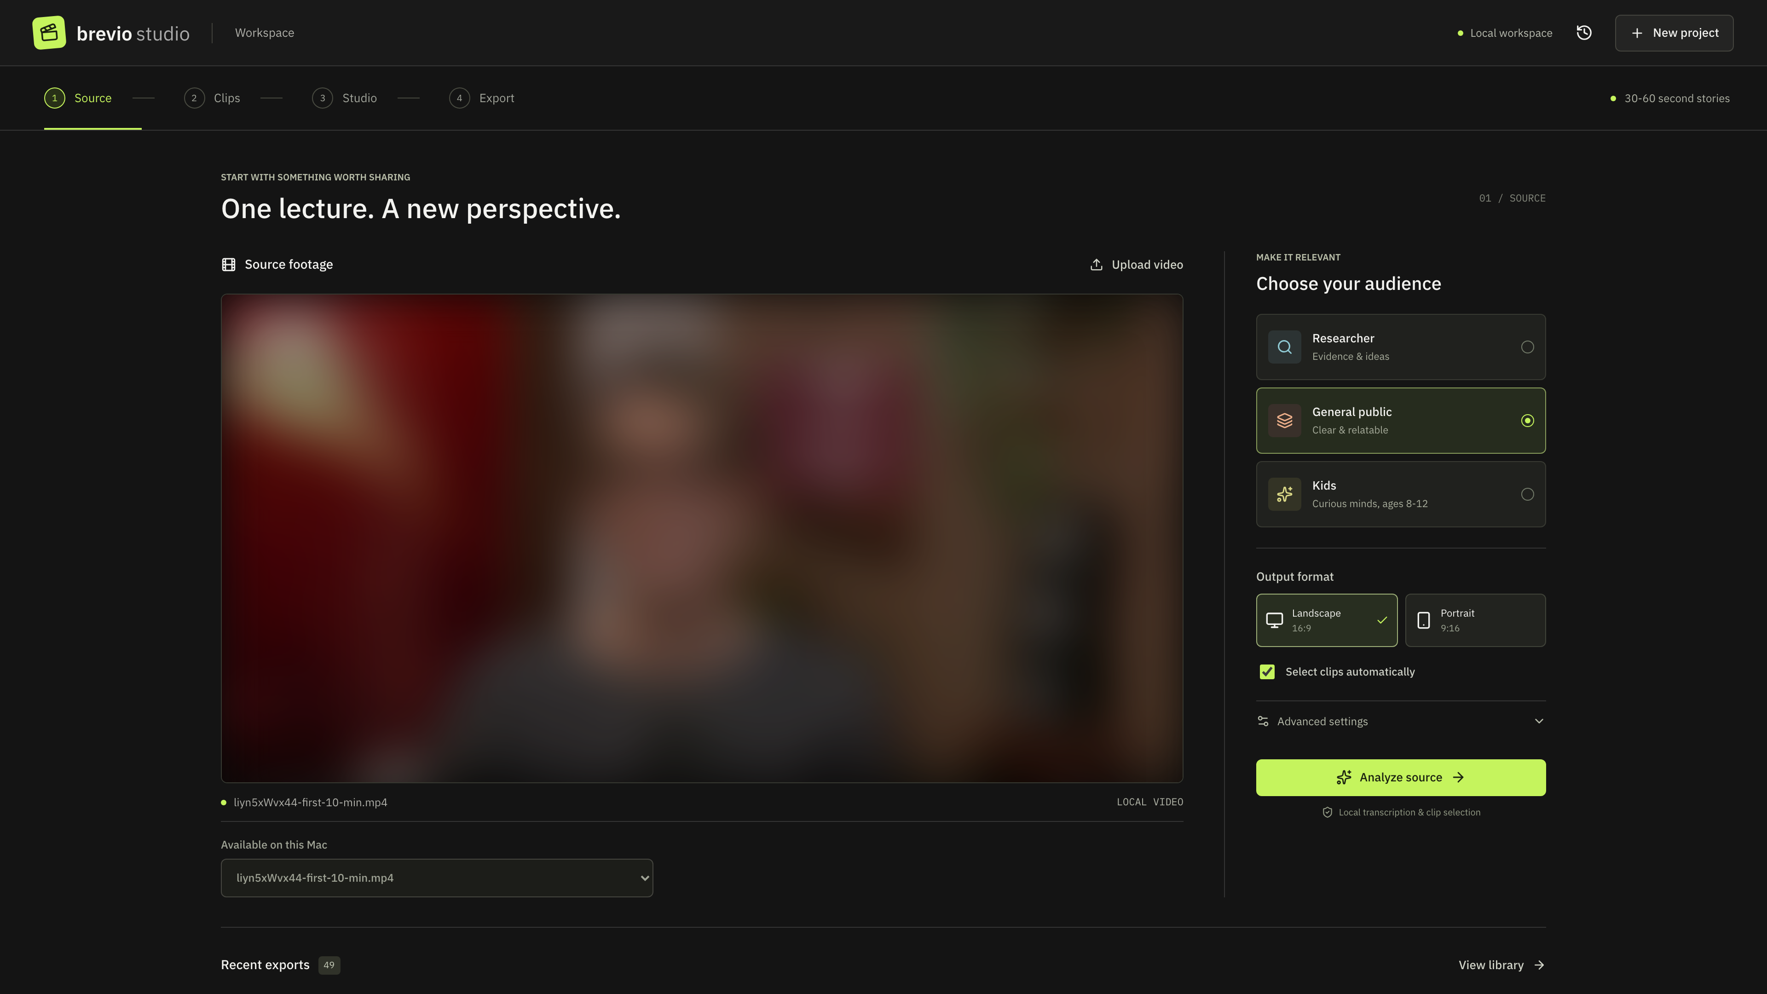
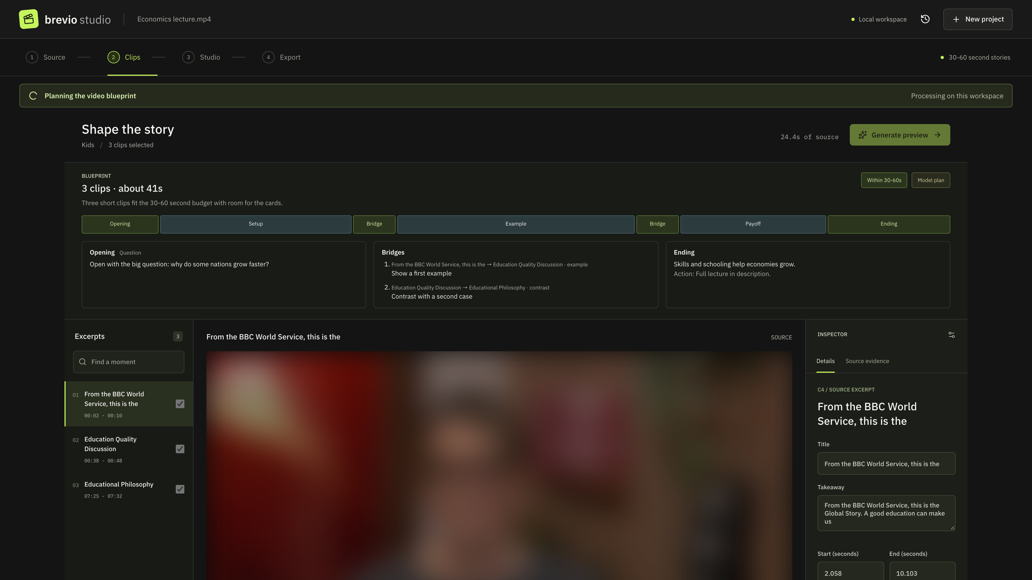
04 · DEMO: THE REAL APP (1 OF 2)
0:53–1:02
From source to a planned story
1 Pick the lecture and the audience
2 Plan first: opening, bridges and ending
The blueprint is written before any narration, so the finished video can be checked against it.
Screens: Brevio Studio proof of concept, captured at 2x in a scripted demo session (frontend/scripts/capture-pitch-stills.mjs). Plan data mocked, no cloud calls; lecture picture blurred.
Notes:
[0:53–1:02] Say:
Second, it transcribes on your own computer, finds the strongest clips, and plans the story before writing a word: the opening, the bridges, and the ending.
On screen: the real UI. Point at the audience picker, then the blueprint panel.

Slide 5
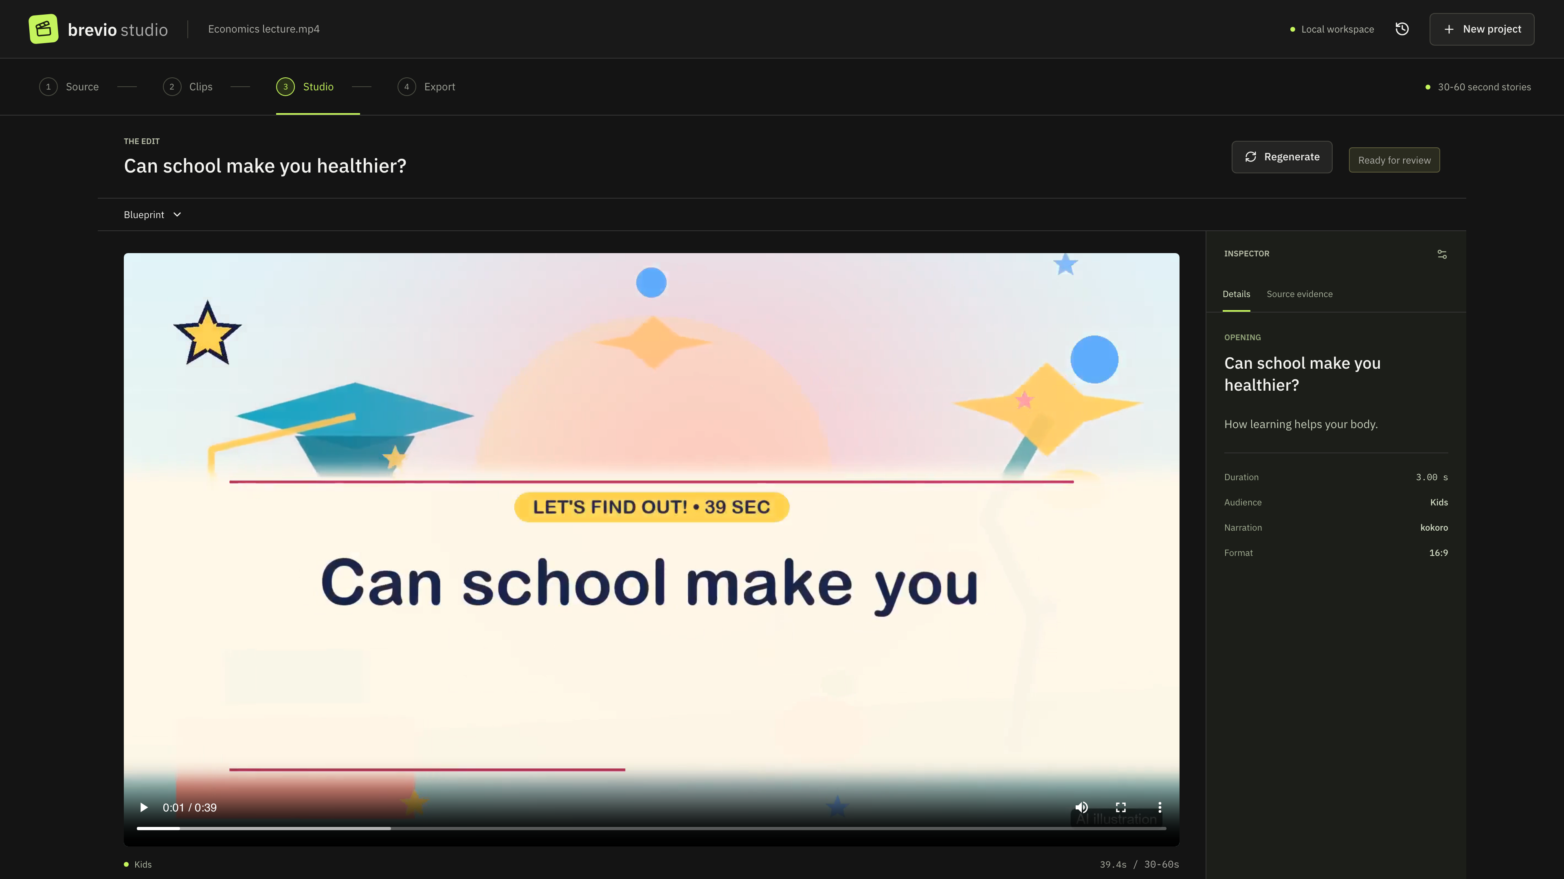
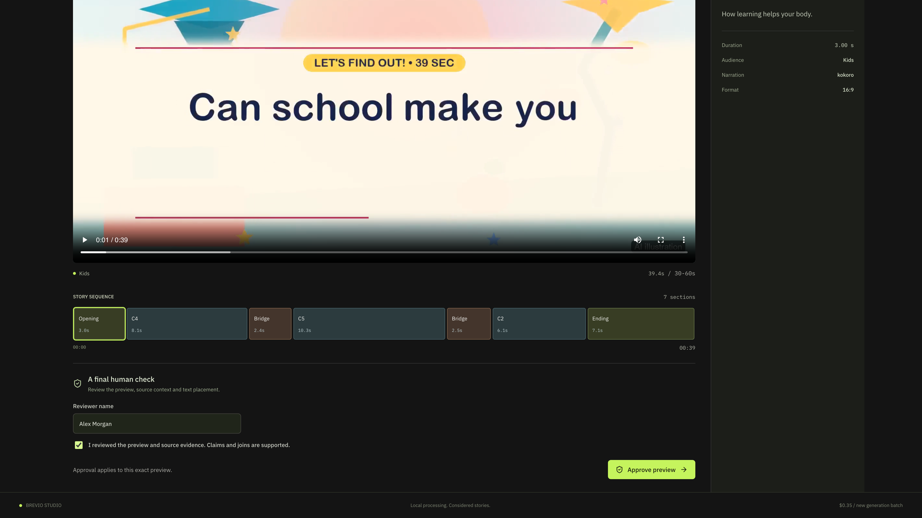
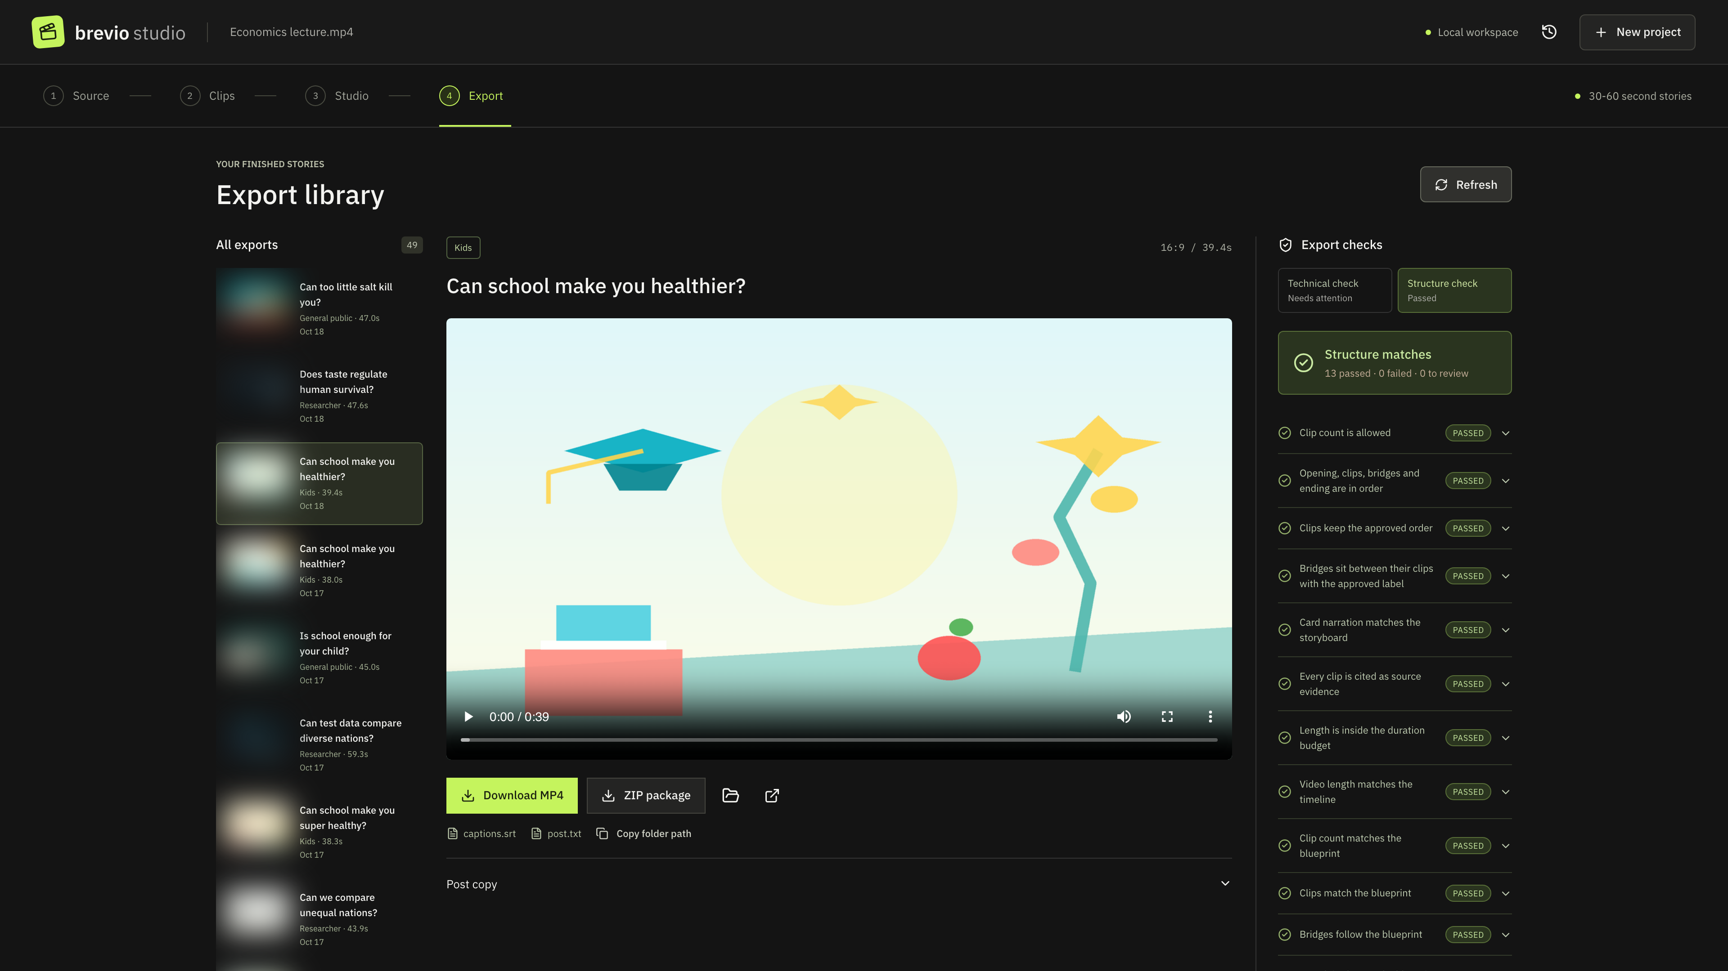
05 · DEMO: THE REAL APP (2 OF 2)
1:02–1:29
Review, approve, check
Studio
Approval
Export
Narrated preview, story sequence and source evidence
A named reviewer approves the exact preview before export
Technical check and the “does the story follow the plan?” check
Nothing is published automatically
Screens: Brevio Studio proof of concept, captured at 2x in a scripted demo session. Export checks are from an existing export; lecture picture blurred.
Notes:
[1:02–1:29] Say:
Third, it builds a narrated preview with captions, music and illustrations, and every section sits beside its source evidence. A named reviewer must approve it. Fourth, export. Every export gets a technical check on media, captions and loudness, and a structure check that asks one question: does the finished story follow the plan? Plan, build, check, approve. Nothing is published automatically.
On screen: Studio preview, the named-reviewer approval, then the export checks.

Slide 6
06 · MARKET AND USERS
1:29–2:12
Who needs it, and where it fits
TARGET USERS
MARKET: AI VIDEO GENERATORS
LANDSCAPE
University teaching and communications teams
2025
USD 788.5M
Source-grounded learning
Brevio Studio
Lectures to short explainers
2033
USD 3,441.6M
Synthesia
Panopto
Corporate learning and development
20.3% a year (2026–2033)
Descript
Training and briefings
OpusClip
63%
Research communicators
of video marketers already use AI to make or edit video (51% a year earlier)
Social virality
Findings for the public
← Fully automatic
Human-approved →
Our positioning from vendor descriptions. Not a benchmark.
Sources: Grand View Research, AI Video Generator Market 2026–2033; Wyzowl 2026; vendor websites (OpusClip, Descript, Synthesia, Panopto). Positioning is our judgement, not a benchmark.
Notes:
[1:29–2:12] Say:
Who needs this? University teaching and communications teams, corporate learning and development, and research communicators. They sit in a fast-growing market. AI video generation is estimated at seven hundred and eighty-nine million dollars in twenty twenty-five, heading for three point four billion by twenty thirty-three. And sixty-three percent of video marketers already use AI to make or edit video. Existing tools cover pieces of the job: OpusClip chases viral clips, Descript edits by text, Synthesia generates presenters. In our review, none is built around source-grounded, human-approved learning video.
On screen: three target users, market growth, then the landscape map.

Slide 7
07 · VALUE PROPOSITION
2:12–2:38
Faster. Consistent. Human-led.
Faster highlights
Consistent quality
A human in control
≈5 min
14
87%
of local processing in our test run on a 15-minute lecture, before human review.
technical measures plus a “story follows the plan” check on every export.
of viewers still prefer a human speaker, so the expert’s own voice and words stay central.
Time saved versus manual editing is not yet measured.
A named reviewer approves before export.
Sources: TechSmith, 2026 Video Statistics (87% prefer a human speaker); Brevio baseline run and 15 Oct 2026 validation (docs/four-week-plan.md, docs/project-overview.html).
Notes:
[2:12–2:38] Say:
Our value proposition is simple: faster highlights, consistent quality, and a human in control. In our test run, a fifteen-minute lecture took about five minutes of local processing, before human review. Every export is checked against its plan and fourteen technical measures. And since most viewers still prefer a human speaker, Brevio keeps the expert's own voice and words at the centre.
On screen: three pillars; each number appears with its sentence.

Slide 8
08 · FEASIBILITY
2:38–3:07
It already runs end to end
919.6 s test lecture → 298.6 s of local processing
Transcribe
Nominate
Preview
120.5 s
111.5 s
12 s
54.5 s
3 audiences
37.6–45.6 s
14 checks
Researcher, general public, kids
of finished 1080p video per run
technical measures passed
On your machine
Transcription, voices and rendering
Cloud gateway
Short text requests only, at most 5 per run
Internal measurements: baseline 919.6 s lecture (docs/four-week-plan.md); validation 15 Oct 2026 (docs/project-overview.html). Stage times exclude cloud storyboard, export and human review.
Notes:
[2:38–3:07] Say:
Is it feasible? It already runs end to end. On a fifteen-minute test lecture, transcription, clip selection, ranking and preview took under five minutes on a laptop. Runs for all three audiences produced high-definition videos between thirty-eight and forty-six seconds that passed fourteen technical checks. Transcription, voices and rendering stay on the machine. Only short text requests go to a cloud gateway, capped at five per run.
On screen: measured stage times, three results, then the local versus cloud split.

Slide 9
09 · RISK AWARENESS
3:08–3:35
What could go wrong, and what we do
Model summaries can be wrong
→
Every claim tied to a quote. Named human approval before export.
Caption reading speed failed on lecture excerpts
→
Measured, not hidden: reported in every check.
On the fix list
Some older renderer tests still fail
→
Seven assertions were open at the 15 Oct snapshot.
On the fix list
No user trial yet
→
No time-saving claim. The pilot measures it.
Reuse rights and a synthetic voice
→
Rights-cleared lectures only; voice disclosed.
Cloud gateway access and pricing unverified
→
Capped requests; reviewed pricing before the pilot.
Sources: Brevio 15 Oct 2026 validation snapshot (docs/project-overview.html); README cloud setup notes (pricing configuration is operator-accepted and unverified).
Notes:
[3:08–3:35] Say:
We are candid about the risks. Model summaries can be wrong, so every claim is tied to a quote and a person must approve. Caption reading speed on original lecture excerpts failed our check, and some older renderer tests still fail. Both are on the fix list. We have not run a user trial, so we claim no time savings yet. And we use only lectures with clear reuse rights, and we disclose the synthetic voice.
Say the failures plainly; they are in the checks, not hidden.

Slide 10
10 · CALL TO ACTION
3:35–4:02
Help us prove it in a real pilot
FUNDING BODIES
INDUSTRY PARTNERS
INVESTORS
Co-fund a six-month supervised pilot
Bring two or three real lectures
A small seed to move from proof of concept to pilots
Eligible work may qualify for the R&D Tax Incentive.
Rights-cleared sources, a named reviewer and honest feedback.
Supervised, measured, no auto-publishing.
Illustrative: AUD 150,000
We will measure:
Time saved
Reviewer approvals
Audience understanding
Try Brevio on one lecture.
The ask is illustrative, for a course assessment. R&D Tax Incentive: business.gov.au (current rules until 1 July 2028). Voice-over is synthetic (local Kokoro).
Notes:
[3:35–4:02] Say:
Here is the ask. Funding bodies: co-fund a six-month supervised pilot; eligible work may qualify for the R and D Tax Incentive. Industry partners: bring two or three real lectures. Investors: a small seed to move from proof of concept to pilots. Together we will measure time saved, reviewer approvals, and audience understanding. Try Brevio on one lecture.
Close on the last line and stop; do not add new claims.

Slide 11
11 · REFERENCES (APPENDIX)
Sources behind the numbers
• Guo, P. J., Kim, J. & Rubin, R. (2014). How video production affects student engagement: an empirical study of MOOC videos. L@S ’14. doi 10.1145/2556325.2566239
• Wyzowl (2026). State of Video Marketing 2026. 266 respondents, fieldwork late 2025. wyzowl.com/video-marketing-statistics
• TechSmith (2026). 2026 Video Statistics: Key Viewer Insights. techsmith.com/blog/video-statistics
• Grand View Research (2026). AI Video Generator Market Size, Share & Trends Analysis Report, 2026–2033.
• Vendor websites for the landscape view: opus.pro, descript.com, synthesia.io, panopto.com (positioning is our judgement).
• Australian Government, business.gov.au: R&D Tax Incentive (current rules until 1 July 2028).
• Internal: docs/four-week-plan.md (baseline run) and docs/project-overview.html (15 Oct 2026 validation snapshot).
• The funding ask (AUD 150,000, six-month pilot) is illustrative for a course assessment. The voice-over is synthetic.
Notes:
Appendix only; not part of the 4-minute run.

