Slide 1
Interim presentation

Slide 2
Overview
Personal development
Methodology: Gaps in modelling/ measurements
Applications of results

Slide 3
Personal development
Understanding of technical background relating to project
Reading
Experimental

Slide 4
Heat transfer mechanism
Heat loss by evaporation at outer surface
Main measurement
Conduction through container wall due to temperature change
Considered in conjunction with evaporation
Conduction within water in container
Conduction coefficient water changes with temperature
Since temperature change is small, it can be neglected
Convection within water in container
Greater effect at bottom of container
Much greater complexity if considered in detail

Slide 5
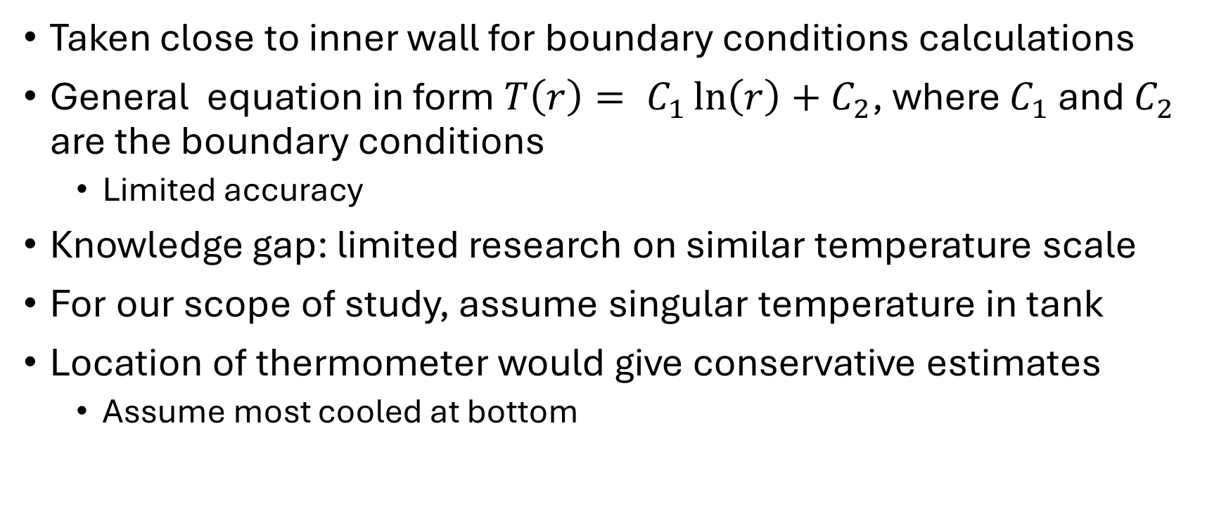
Measuring water temperatures
Taken close to inner wall for boundary conditions calculations
General equation in form $T\left(r\right)= C_{1}\ln\left(r\right)+C_{2}$, where $C_{1}$ and $C_{2}$ are the boundary conditions
Limited accuracy
Knowledge gap: limited research on similar temperature scale
For our scope of study, assume singular temperature in tank
Location of thermometer would give conservative estimates
Assume most cooled at bottom

Slide 6
Measuring water temperatures – follow-up
1-2 trials for thermometer at alternative location to check validity of assumptions
Further considerations into how relevant this will be to the outlet water temperature

Slide 7
Applications – interaction with active cooling
Effect on passive cooling with addition of external heat flux
Increase in ambient air temperature allow for further evaporation
Experimental limitations
Follow-ups:
Better understanding of expected heat dissipated
Holistic overview in conjunction to material characteristics

Slide 8
Applications – material selection
Key material characteristics identified include water absorption and evaporation rate
These affect lowest temperature achievable and how long it can keep it cool
Experimental limitations: short time, restricted observation on subsequent temperature rise (when, rate)
Cotton used as benchmark, but would be difficult to be used in real-life scales
Durability concerns

Slide 9
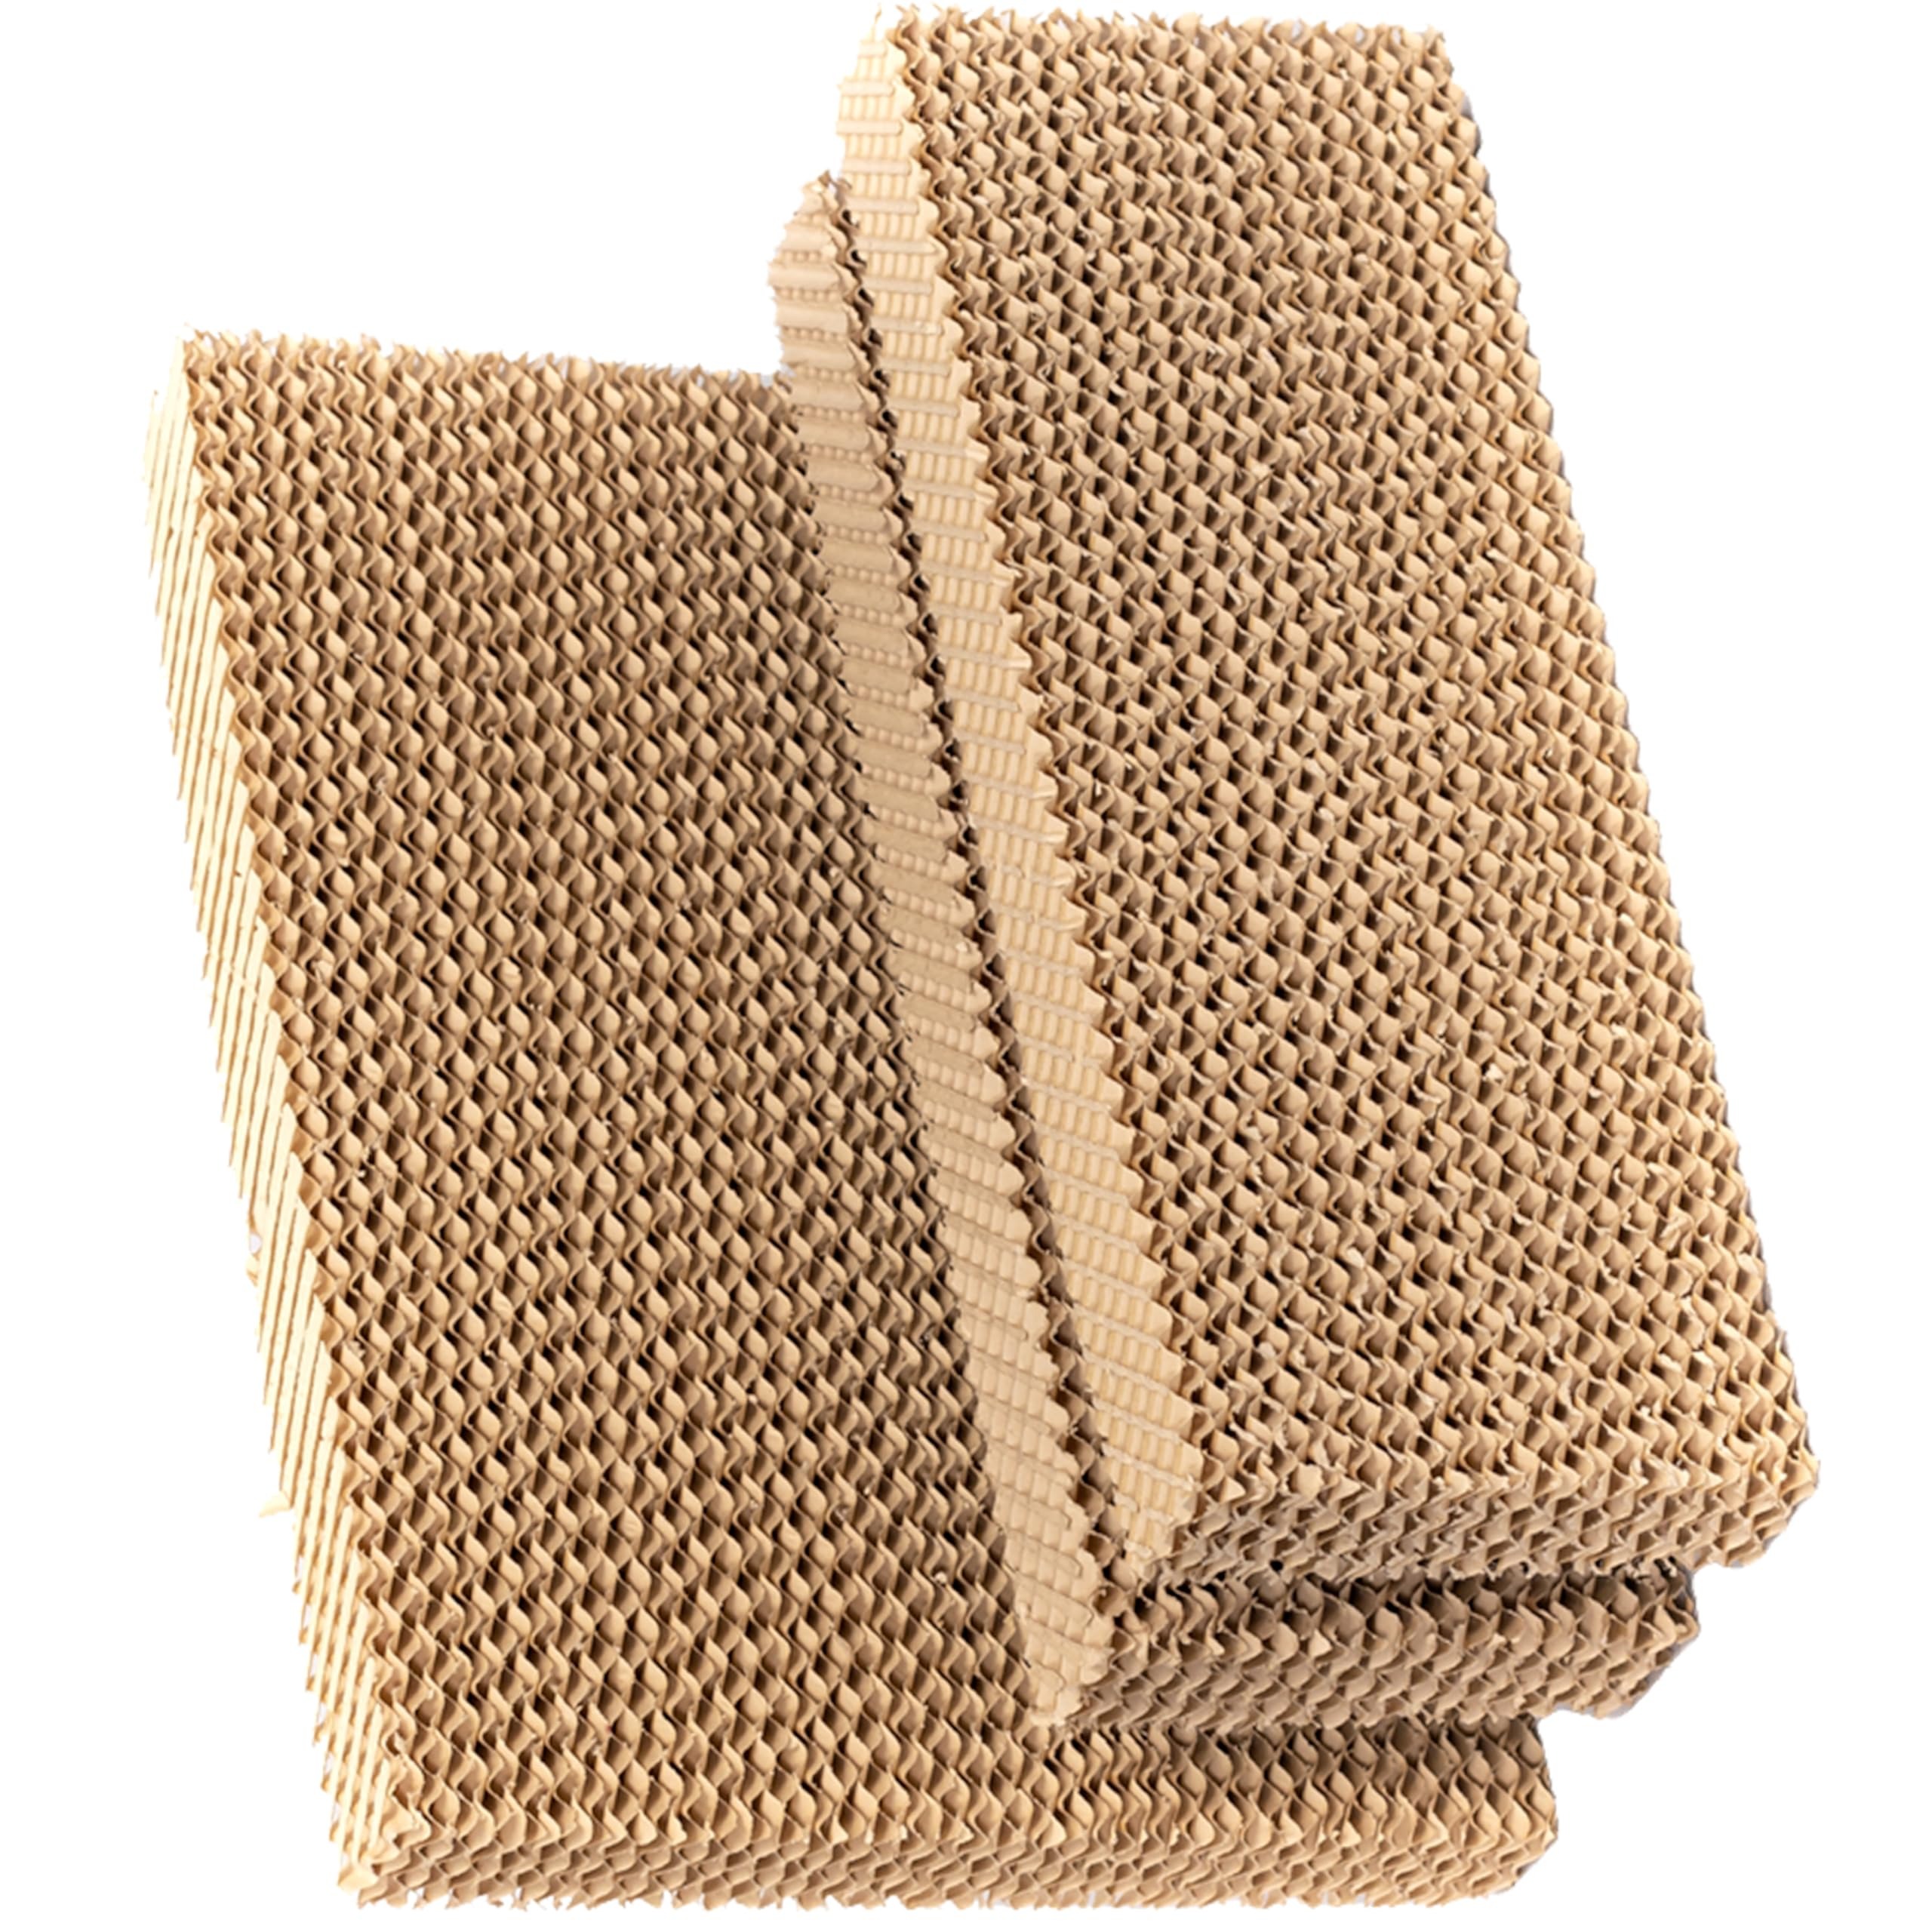
Applications – material selection
Jute corresponds to micro fibre cooling pads
Common, readily found
Difficult with circular packaging
May be made from recyclable materials

Slide 10
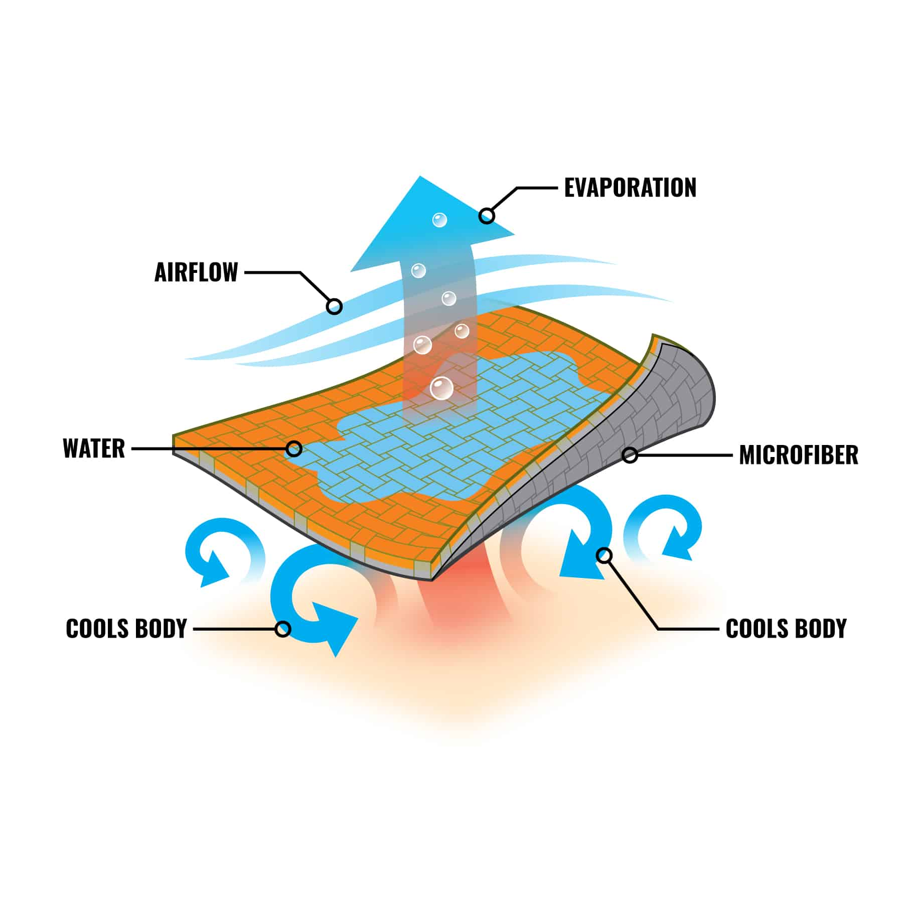
Applications – material selection
Linen corresponds to fabric based cooling surfaces
Similar to those found on sportswear
Easy packaging

Slide 11
Applications – material selection – follow-up
Analysis on efficiency of cooling
Temperature reduction per unit water mass lost
Multi-layer set-up
How is the water distributed? This may lead to potential problems for linen based materials

