Slide 1
Unit 1
Basic Python programs, functions
Special thanks to Roy McElmurry, John Kurkowski, Scott Shawcroft, Ryan Tucker, Paul Beck for their work.
Except where otherwise noted, this work is licensed under:
http://creativecommons.org/licenses/by-nc-sa/3.0

Slide 2
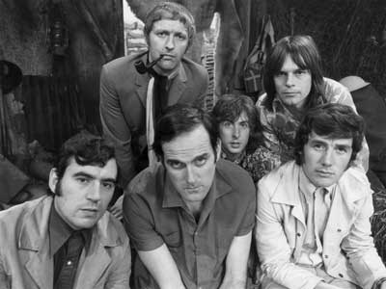
Python!
Created in 1991 by Guido van Rossum (now at Google)
  Named for Monty Python
Useful as a scripting language
  script: A small program meant for one-time use
  Targeted towards small to medium sized projects
Used by:
  Google, Yahoo!, Youtube
  Many Linux distributions
  Games and apps (e.g. Eve Online)

Slide 3
Installing Python
Windows:
Download Python from http://www.python.org
Install Python.
Run Idle from the Start Menu.
Mac OS X:
Python is already installed.
Open a terminal and run python or run Idle from Finder.
Linux:
Chances are you already have Python installed. To check, run python from the terminal.
If not, install from your distribution's package system.
Note: For step by step installation instructions, see the course web site.

Slide 4
Interpreted Languages
interpreted
  Not compiled like Java
  Code is written and then directly executed by an interpreter
  Type commands into interpreter and see immediate results
Java:
Code
Compiler
Runtime
Environment
Computer
Python:
Code
Interpreter
Computer

Slide 5
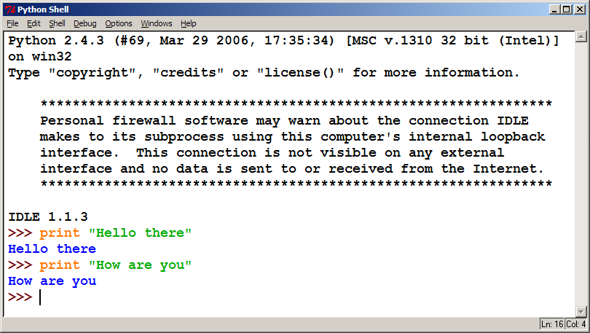
The Python Interpreter
Allows you to type commands one-at-a-time and see results
A great way to explore Python's syntax
  Repeat previous command: Alt+P

Slide 6
Our First Python Program
Python does not have a main method like Java
  The program's main code is just written directly in the file
Python statements do not end with semicolons
hello.py
1 | print("Hello, world!")

Slide 7
The print Statement
  print("text")
  print() (a blank line)
  Escape sequences such as \" are the same as in Java
  Strings can also start/end with '
swallows.py
1 2 3 4 | print("Hello, world!") print() print("Suppose two swallows \"carry\" it together.") print('African or "European" swallows?')

Slide 8
Comments
Syntax:
  # comment text (one line)
swallows2.py
1 2 3 4 5 6 | # Suzy Student, CSE 142, Fall 2097 # This program prints important messages. print("Hello, world!") print() # blank line print("Suppose two swallows \"carry\" it together.") print('African or "European" swallows?')

Slide 9
Functions
Function: Equivalent to a static method in Java.
Syntax:
  def name():
  statement
  statement
  ...
  statement
  Must be declared above the 'main' code
  Statements inside the function must be indented
hello2.py
1 2 3 4 5 6 7 | # Prints a helpful message. def hello(): print("Hello, world!") # main (calls hello twice) hello() hello()

Slide 10
Whitespace Significance
Python uses indentation to indicate blocks, instead of {}
  Makes the code simpler and more readable
  In Java, indenting is optional. In Python, you must indent.
hello3.py
1 2 3 4 5 6 7 8 | # Prints a helpful message. def hello(): print("Hello, world!") print("How are you?") # main (calls hello twice) hello() hello()

Slide 11
Exercise
Rewrite the Figures lecture program in Python. Its output:
  ______
  / \
  / \
  \ /
  \______/
  \ /
  \______/
  +--------+
  ______
  / \
  / \
  | STOP |
  \ /
  \______/
  ______
  / \
  / \
  +--------+

Slide 12
Exercise Solution
def egg():
top()
bottom()
print()
def cup():
bottom()
line()
print()
def stop():
top()
print("| STOP |")
bottom()
print()
def hat():
top()
line()
print()
def top():
print(" ______")
print(" / \\")
print("/ \\")
def bottom():
print("\\ /")
print(" \\______/")
def line():
print("+--------+")
# main
egg()
cup()
stop()
hat()

