Slide 1
IC HACK 2.0
TEAM NAME : TECHESPRESSO
TEAM LEADER NAME : SHRESHTA KUSHWAHA
DOMAIN : TRANSPORTATION
TITLE : ENHANCING SAFETY IN TRANSPORTATION

Slide 2
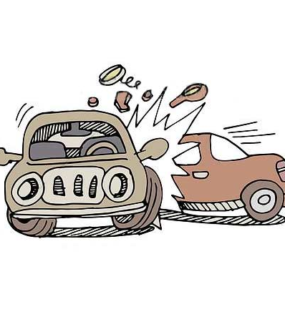
Problem Statement
To creating innovative solutions that leverage modern technology to
improve safety in transportation. Solutions could include real-time risk
detection systems, predictive accident prevention methods, or
improved communication between vehicles and infrastructure.
The objective is to reduce accidents across all modes of transportation,
promoting safety for drivers, pedestrians, and cyclists.

Slide 3
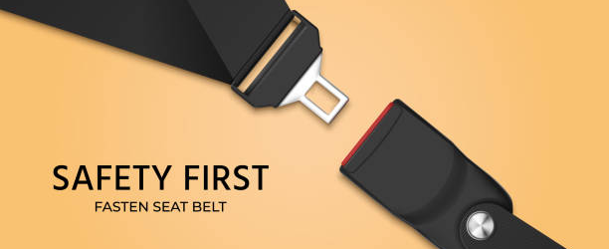

AREAS OF FOCUS
1. Buckle Up for Safety: -
"Seatbelt: Your Lifesaver on the Road!“
2. Stay Sober Behind the Wheel: -
"Don't Drink and Drive: Arrive Alive!"

Slide 4
Proposed Solution:
PROBLEM I
COMPONENTS USED:
Pressure Sensor
Microcontroller
Arduino
Power Supply
Problem at hand: Some people wear seatbelts behind their backs to silence the beeping warning .
Solution: Incorporation of an occupancy sensor in the seatbelt dispenser.
Sensor Function: The occupancy sensor will detect if the seatbelt is improperly worn and trigger a warning beep.
Preventing Improper Use: If there is no occupancy between the seatbelt and the car seat, the belt will not lock.

Slide 5
Detailed Solution
Vacant Seat (Minimum Pressure):Resistance: Around 10,000 Ω10,000Ω (relaxed state)
Occupied Seat (Maximum Pressure):Resistance: Around 200−500 Ω200−500Ω (when maximum
pressure is applied)
Threshold Setting (Moderate Pressure):Resistance: Between 2,000−5,000 Ω2,000−5,000Ω (for
moderate pressure)

Slide 6
Proposed Solution:
PROBLEM II
COMPONENTS USED:
Problem: Drink and driving
Solution: If the alcohol level exceeds a certain threshold,
Alcohol Sensor : Capable of measuring alcohol levels in the driver's breath.
Speed Sensor : To measure the speed of the vehicle.
Microcontroller :To process data and control vehicle functions.
Display Unit : A screen for displaying warnings and messages.
The system triggers a WARNING.
An audio message informs the driver that 10 minutes are given to find a safe space for parking.
If alcohol levels are extremely high and the speed is high, the system initiates gradual deceleration and sets a speed limit (e.g., 30/40 mph

Slide 7
Team Member Details
Team Leader Name: SHRESHTA KUSHWAHA
Team Member 1 Name: AASHI
Team Member 2 Name: PAYAL
Team Member 3 Name: HARMANPREET

