Slide 1
B.TECH MICRO-PROJECT · FINAL PRESENTATION
Fragment-Level Source
Mapping for Patchwork
Plagiarism Analysis
PATCHWORK DEMO · LIVE RUN
6 fragments · 4 sources
fragment → assigned source · cosine
F1
renewable energy
→ A
0.93
F2
medical imaging
→ C
0.92
A browser prototype that connects each sentence of a submission to the reference document it most closely resembles — and shows the evidence behind the match.
F3
grid balancing
→ A
0.93
F4
air-quality sensing
→ B
0.89
F5
carbon pricing
→ D
0.87
SUBMITTED BY
Aditya Singh Tomar · BTMC25O1010
Aryaman Goyal · BTMC25O1021
F6
clinical AI
→ C
0.93
A ×2 C ×2 B ×1 D ×1 0 unmatched
SUBMITTED TO
Dr. Dheeraj Kumar Dixit · Head of Department (HOD)
Department of Engineering Mathematics and Computing (MAC) · MITS Gwalior
Scores: actual patchwork run · 20 Oct 2026
October 2026
Notes:
OPENING (about 60 seconds)
Good morning. We are Aditya Singh Tomar and Aryaman Goyal. Our B.Tech micro-project is “Fragment-Level Source Mapping for Patchwork Plagiarism Analysis”, submitted to Dr. Dheeraj Kumar Dixit, Head of the Department of Engineering Mathematics and Computing.
The title is the whole idea: instead of one similarity percentage for an entire submission, we split the submission into sentence-level fragments and ask, for each fragment, which reference document it most resembles. The panel on the right is the actual patchwork demo from our local build: six fragments, four sources, and the cosine scores produced by Sentence-BERT. The mapping is A, C, A, B, D, C.
We will cover the problem, four concrete objectives, the real pipeline, the results, the validation evidence, and the limits. The claim is deliberately narrow: this is an explainable source-mapping prototype and a lead for a human reviewer, not a plagiarism verdict and not a benchmark against commercial systems.
Likely viva question: “Why fragment-level?” Short answer: a patchwork submission can contain sentences from several documents; one whole-document score hides where each piece came from. The fragment map keeps both the location and the evidence.

Slide 2
02 · INTRODUCTION
Patchwork plagiarism: many sources, one submission.
Patchwork plagiarism is copying a sentence or two from several different documents and joining them into one submission.
SUBMITTED DOCUMENT
REFERENCE SET
F1
→ A
A
2 fragments
No single source matches the whole text. A whole-document check can therefore miss the pattern — and rarely says which part came from where.
Renewable sources such as wind…
Renewable energy
source document
F2
→ C
Machine learning models can recognise…
B
1 fragment
01
THE PROBLEM
One overall score can hide that different sentences came from different places.
F3
Urban air quality
Since sunlight and wind are intermittent…
→ A
source document
F4
→ B
C
2 fragments
02
THE SHIFT
Compare sentence-sized fragments against the reference set, not only whole documents.
Sensors placed throughout a city record…
Clinical AI
source document
F5
→ D
Making polluters pay for every tonne…
03
THE OUTPUT
A fragment → source map: exact source passage, score, status and a trace for every row.
D
1 fragment
F6
→ C
Carbon policy
Trained on large annotated datasets…
source document
Actual demo mapping: F1→A · F2→C · F3→A · F4→B · F5→D · F6→C
It produces checkable leads for a reviewer — not a verdict.
Short topic labels; full fragment text appears on the Results slide.
Mapping shown at right: src/data/demos.ts, patchwork demo.
Fragment-Level Source Mapping · B.Tech Micro-Project
02 / 07
Notes:
EXPLAINING PATCHWORK (about 75 seconds)
Patchwork plagiarism is not “copying one document”. It is stitching: a sentence from a textbook, two sentences from a paper, a paragraph from a web page, joined together with connective text. In our demo, the submission has six sentences and four different reference documents. The mapping is F1 to A, F2 to C, F3 to A, F4 to B, F5 to D and F6 back to C.
Why is fragment-level useful? A whole-document score answers “how similar is this submission to one source?” It does not answer “which part came from which source?” Once we split the text, each fragment becomes a small, checkable claim: this sentence has its best match in Source A, sub-fragment A1, with this score. A reviewer can open the exact passage and decide.
The method does not remove human judgement. In fact, that is the point: it narrows the search and preserves the evidence. The four sources in this prototype are short synthetic reference passages written for the project, so the demo mapping is unambiguous. That is useful for showing the mechanism, but it is not a real-world corpus.
Likely viva questions: “Is patchwork the same as paraphrasing?” Patchwork is the stitching of multiple sources; the individual pieces may be verbatim or paraphrased. We test both. “Why not just one score?” It tells you how much, not where. The map gives location and source-level evidence.
Transition: “So what did we actually set out to build?”

Slide 3
03 · OBJECTIVES
What this prototype set out to do.
Four concrete objectives, all implemented in the running prototype.
01
Fragment the submission
02
Compare two ways
Split a document into sentence-sized fragments. Very short sentences are merged where possible so every fragment carries enough text to compare.
Measure lexical overlap with Jaccard and semantic closeness with Sentence-BERT embeddings plus cosine similarity, for every fragment–source pair.
03
Map every fragment
04
Make it inspectable
Assign each fragment its best source and best sub-fragment, rank all four sources, and apply fixed, documented thresholds to decide strong, possible or no match.
Expose the arithmetic in a trace panel and validate the produced mapping against declared expectations — including honest failures.
PROTOTYPE SCOPE
4 reference documents · 16 reference sub-fragments · 4 demo submissions · 2 analysis modes
browser-only
no server
The measured claim is about the prototype’s own closed demo set — not accuracy on real student submissions.
Fragment-Level Source Mapping · B.Tech Micro-Project
03 / 07
Notes:
THE FOUR OBJECTIVES (about 60 seconds)
There are four objectives, and each one maps to something visible in the prototype.
First, fragmentation: split the submission into sentence-sized pieces. If a sentence is very short, the code merges it with the previous one when it can, so the model is not asked to compare a three-word fragment. Second, compare each fragment with every reference passage in two ways: Jaccard word overlap and Sentence-BERT cosine. Third, map: for each source keep its best-scoring sub-fragment, rank the four sources, and apply thresholds. Fourth, explain and test: a trace panel exposes the exact tokens, vectors and arithmetic, and the validation view compares expected and actual mappings.
The scope strip matters. The prototype ships four short synthetic reference documents, four sub-fragments each, and four demo submissions. It runs in the browser with no server. So the result is a demonstration of the mapping mechanism, not a claim about real-world accuracy.
Likely viva questions. “What is the novel contribution?” Not the Sentence-BERT model itself; the contribution is the fragment-level mapping workflow that keeps lexical and semantic evidence parallel, explains every result, and reports failures honestly. “Which objective was hardest?” Explainability: keeping the table, the trace panel and the method section numerically consistent. We test that directly.
Transition: “Here is the actual pipeline, step by step.”

Slide 4
04 · WORKFLOW / METHODOLOGY
How a fragment becomes a source lead.
The real order of computation in src/lib/engine.ts. Jaccard and Sentence-BERT are parallel evidence streams; only cosine ranks and decides.
03A
JACCARD · BASELINE
01
02
Shared stemmed words ÷ all unique words. Transparent; blind to paraphrase.
04
05
06
INPUT
FRAGMENTATION
F1–A1: 10 / 19 = 0.53
COSINE
CANDIDATE MAPPING
HUMAN REVIEW
Paste text, open a .txt file, or load a bundled demo. The patchwork demo has six sentences.
Split at sentence boundaries; merge very short sentences when possible. The patchwork demo → 6 fragments.
cos θ = (A · B) / (‖A‖ ‖B‖)
Best of 4 sub-fragments per source; rank 4 sources; apply 0.70 / 0.52.
Check the exact passage and citation. A match is a lead, not a verdict.
03B
SENTENCE-BERT · SEMANTIC
A 384-number meaning vector per fragment; paraphrases can land close.
0–1. Higher means closer.
F1–A1 cosine: 0.93
JACCARD · THE BASELINE
SENTENCE-BERT · THE MEANING
COSINE + MAPPING · THE DECISION
Counts overlap, not meaning.
Captures similarity beyond wording.
The semantic score ranks sources.
Compares the sets of stemmed content words after stop-words are removed. It is cheap, deterministic and easy to audit — but a paraphrase shares few exact words.
It is reported beside the semantic score and never used to rank a source.
all-MiniLM-L6-v2 encodes each fragment as one 384-dimensional vector. The model mean-pools and L2-normalises it; everything runs locally through ONNX / WebAssembly.
Cosine then compares the direction of the two vectors, not their length.
For each source, keep its best-scoring sub-fragment. Sort the four sources by cosine. The top source is the candidate if it passes the threshold.
≥ 0.70 strong · 0.52–0.69 possible · < 0.52 no source assigned.
F1–A1: 10 shared tokens of 19 in the union = 0.53
Actual F1–A1: Jaccard 0.53 · cosine 0.93
F1 → Source A · A1 (0.93 ≥ 0.70)
The semantic engine is the real all-MiniLM-L6-v2 model, not a mock. If its weights cannot load, the app switches to a labelled TF-IDF fallback rather than silently showing numbers.
Fragment-Level Source Mapping · B.Tech Micro-Project
04 / 07
Notes:
WALKING THE PIPELINE (about 2 minutes)
Read the diagram left to right, but notice the branch. An input document is split into sentence-sized fragments. From the same fragment text, two independent evidence streams are computed.
The upper stream is Jaccard: remove stop-words, apply Porter stemming, build token sets, and compute the intersection over the union. For F1 against A1, 10 shared tokens out of 19 unique tokens gives 0.53. The lower stream is Sentence-BERT: all-MiniLM-L6-v2 turns each fragment into a 384-dimensional vector, mean-pooled and L2-normalised, running locally in the browser through ONNX and WebAssembly.
Those two streams are parallel, not sequential. Jaccard does not feed Sentence-BERT, and Jaccard does not enter the cosine. Only the embedding vectors go to cosine. That is why the trace panel labels Jaccard as “lexical evidence — does not rank”. The semantic score decides: for each source, keep the best of its four sub-fragments, rank the four sources, and apply the thresholds. The top source becomes the candidate. Human review is the final step, outside the algorithm.
Why keep Jaccard? Because it is a useful honesty check. In the paraphrased demo, Jaccard falls to 0.04–0.29 while cosine stays at 0.57–0.77, and the mapping remains correct. Jaccard alone would miss it; SBERT alone is harder to audit. Showing both is the point.
Likely viva questions. “Why cosine and not Euclidean distance?” The embedding magnitude is not meaningful; cosine compares direction, and the vectors are normalised. “What is 0.70?” A documented design threshold, not a universal law. “Is the model real?” Yes — the screenshot and the trace show all-MiniLM-L6-v2 q8, 384 dimensions, genuine local inference.
Transition: “Here is what that produces on the patchwork demo.”

Slide 5
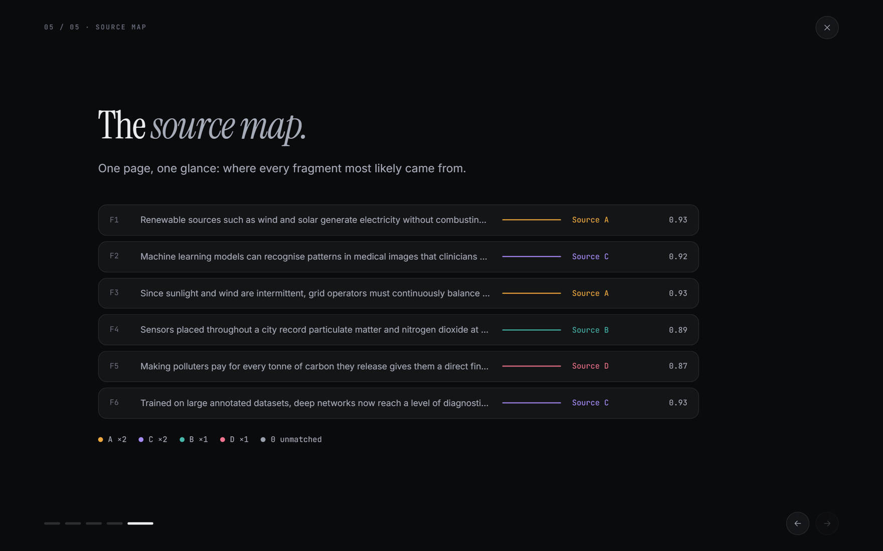
05 · RESULTS / IMPLEMENTATION
A fragment-level map, with the working shown.
WORKED EXAMPLE · F1 → SOURCE A
“Renewable sources such as wind and solar generate electricity without combusting fossil fuels, sharply lowering greenhouse gas emissions.”
JACCARD · BASELINE
10 / 19 = 0.53
10 shared stemmed tokens of 19 in F1 ∪ A1
COSINE · SEMANTIC
0.9298 ≈ 0.93
dot 0.9298 / (‖A‖ 1.0000 × ‖B‖ 1.0000)
ALL FOUR SOURCES, RANKED BY COSINE
1. A
Source A
0.93
2. D
Source D
0.46
3. B
Source B
0.20
4. C
Source C
0.00
0.93 ≥ 0.70 → STRONG MATCH
F1 → Source A · A1
Source score = best of its 4 sub-fragments. Jaccard is read on A1; it never ranks.
Figure 1 · Actual source-map view from the local build, patchwork demo (website_visual_audit.pdf, p. 34). Sentence-BERT · all-MiniLM-L6-v2 · q8.
All numbers in this deck are actual outputs of the local build. No illustrative, estimated or vendor score is used.
Fragment-Level Source Mapping · B.Tech Micro-Project
05 / 07
Notes:
READING THE RESULT (about 90 seconds)
This is the actual source-map view of the patchwork demo. The rows are the six submitted fragments; the colours and labels on the right are the assigned sources. Six of six fragments matched, across four distinct sources.
Take F1. It is the renewable-energy sentence. The engine compared it with all four reference documents, using each source’s best-scoring sub-fragment. Source A’s best passage is A1, the first sentence of the renewable-energy document. The cosine similarity is 0.9298, which the UI displays as 0.93. Because the vectors are L2-normalised, the norms are 1.0000, so the cosine is just the dot product.
Why Source A and not Source D? The ranking is A 0.93, D 0.46, B 0.20, C 0.00. D is a distant second. The top score is above the strong threshold of 0.70, so F1 is labelled strong match and mapped to Source A, sub-fragment A1. The Jaccard score for that same pair is 0.53: 10 shared stemmed tokens out of 19 unique tokens. It is shown as lexical cross-check; the ranking is driven by cosine.
The screenshot is not a mock-up. It is the local build’s own source-map view, and the same numbers appear in the trace panel and the validation table. The app also has a side-by-side reference panel that is explicitly labelled illustrative; that panel is not used anywhere in this deck.
Likely viva questions. “Why A1?” Because each source keeps the maximum cosine over its four sub-fragments, and A1 won. “Are the numbers hard-coded?” No; they are produced by the engine at run time. “Why 0.93?” Dot product 0.9298 divided by 1.0000 times 1.0000.
Transition: “The next question is whether the mapping is right — and what ‘right’ can mean here.”

Slide 6
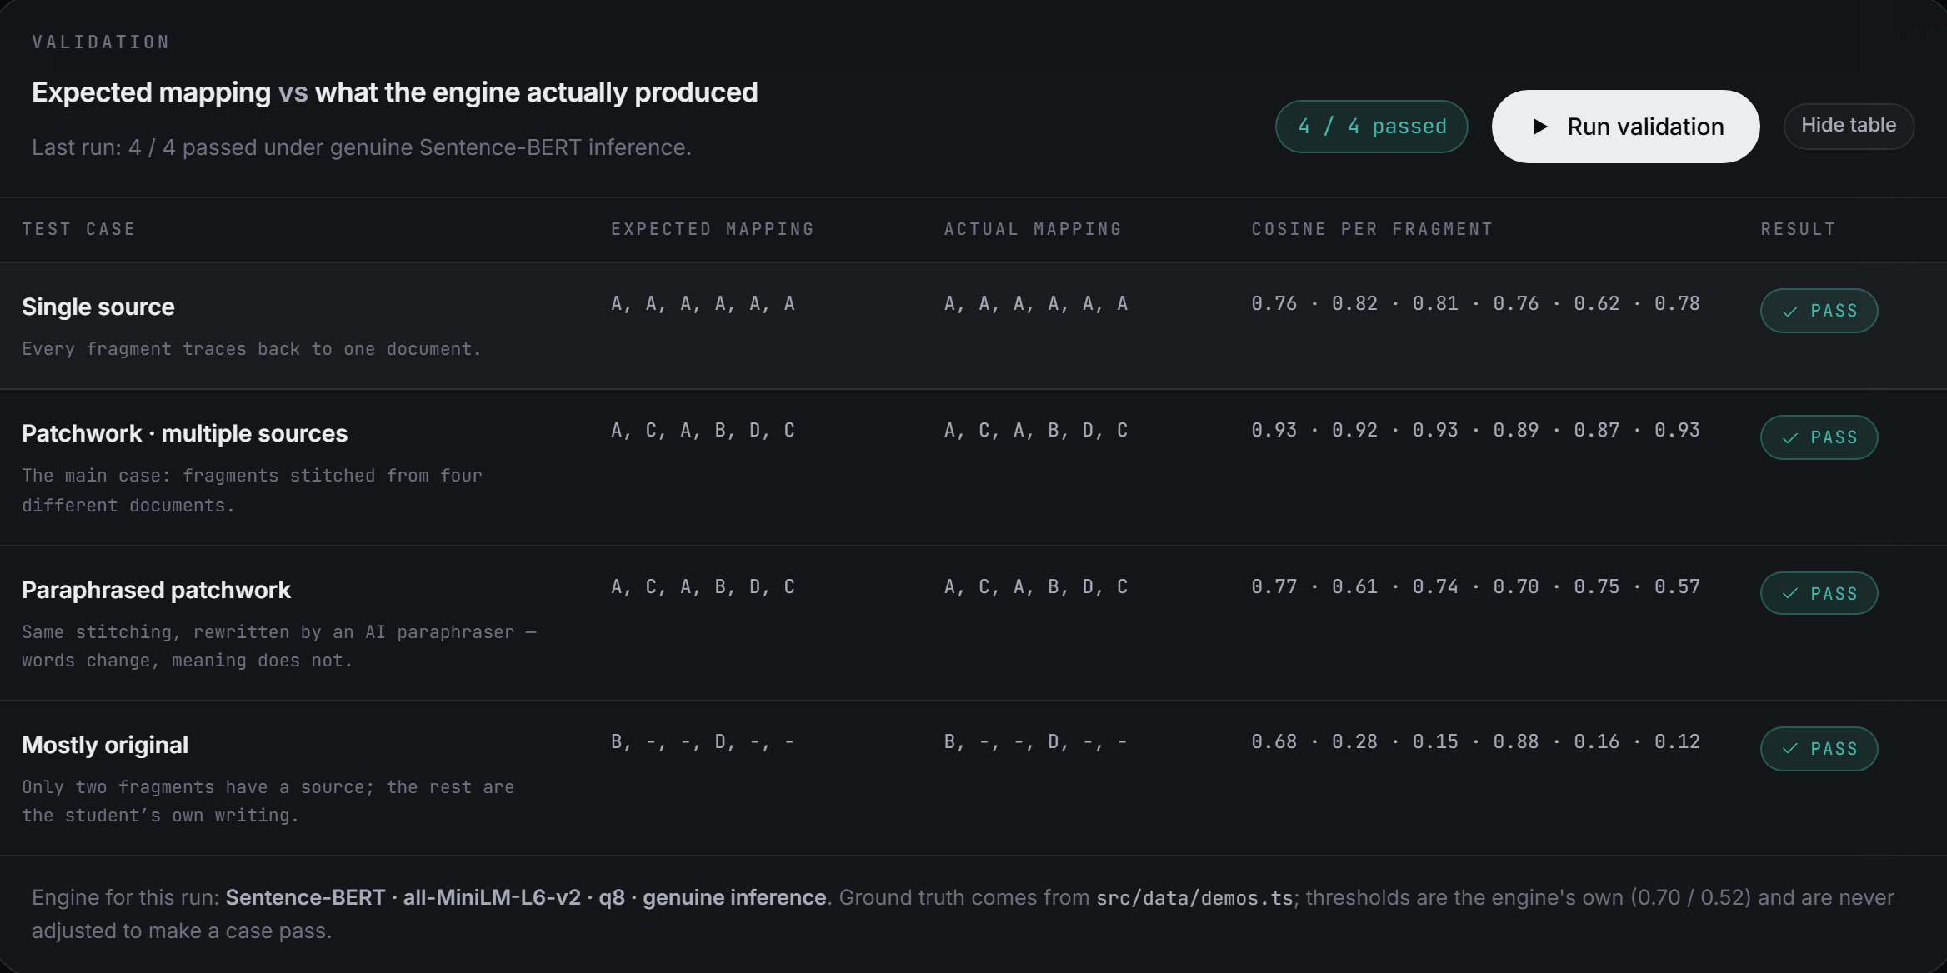
06 · RESULTS / VALIDATION AND LIMITATIONS
Validation: what the tests prove, and what they do not.
WHAT THE RUN ESTABLISHES
4 / 4 bundled demos reproduced their declared mapping under genuine Sentence-BERT.
Negative control “Mostly original” leaves four fragments unmatched; the tool can say “no source”.
Explainability trace and table agree row for row; 22/22 calculation tests pass.
WHAT IT DOES NOT ESTABLISH
Accuracy on real student submissions. Proof of plagiarism. A benchmark against commercial tools. The test set is four bundled demos against four synthetic references.
Figure 2 · Actual validation view (also in website_visual_audit.pdf, p. 38): 4/4 bundled demos matched their declared mapping under genuine SBERT (0.70 / 0.52). Ground truth is declared in src/data/demos.ts — a consistency check, not held-out evaluation.
REFERENCE SCOPE
FALLBACK BEHAVIOUR
SIMILARITY ≠ PROOF
4 short synthetic documents × 4 sub-fragments; English only. A closed demo set, not a web-scale corpus.
If the ~23 MB SBERT weights cannot load, the app automatically switches to a labelled TF-IDF heuristic and says so. Under that fallback, validation reports 2/4; failures are shown, not hidden.
Shared topic, shared vocabulary or a cited quotation can score highly. The tool does not model intent; a human must verify the passage.
Fragment-Level Source Mapping · B.Tech Micro-Project
06 / 07
Notes:
VALIDATION AND LIMITS (about 2 minutes)
The validation view re-runs all four bundled demos through the real engine and compares the produced mapping with the mapping declared in src/data/demos.ts. Under genuine Sentence-BERT, all four pass: single source, patchwork, paraphrased patchwork, and mostly original. The last one is the important negative control: F1 maps to B as a possible match, F4 maps to D as strong, and F2, F3, F5 and F6 stay unmatched. The tool can say “no source”.
What does that prove? It proves the implementation is internally consistent on this closed demo set, and that the declared expectations are reproduced. It does not prove accuracy on real student submissions, because the reference corpus is four short synthetic documents and the test submissions are four bundled demos. The ground truth is declared in the same project, so this is a consistency check, not a held-out benchmark. The calculation suite also passes 22/22, including checks that the trace numbers equal the table and that Jaccard is read on the cosine-winning sub-fragment.
The fallback matters. Sentence-BERT downloads about 23 MB of quantised weights on first use. If the CDN is blocked or the machine is offline, the app automatically falls back to a labelled illustrative TF-IDF engine, with a different threshold pair, and says that in the UI. Validation then drops to 2/4: the single-source and paraphrased cases fail at fragment 5. That is reported honestly, not tuned away. The illustrative engine is a heuristic, not an ML result.
And a high score is not proof. Documents on the same topic share vocabulary; a properly cited quotation can also score high; the tool does not parse citation intent. A match is a lead for a human reviewer.
Likely viva questions. “Does 4/4 mean 100% accuracy?” No. It means four bundled demos matched their declared mappings. “What happens offline?” The labelled fallback, with 2/4 and visible failures. “Is 0.93 proof of plagiarism?” No. “Did you compare with Turnitin?” No vendor report was obtained; the app’s reference panel is explicitly labelled illustrative and is not used in this deck.

Slide 7
07 · CONCLUSION
A useful map, with its boundaries drawn.
The prototype turns one opaque similarity number into a fragment-by-fragment source map that a reviewer can inspect.
01
02
03
WHAT WE BUILT
WHY IT IS USEFUL
THE NEXT STEP
A browser-only prototype: sentence fragmentation, parallel Jaccard + Sentence-BERT, cosine ranking, thresholds, source map, trace panel and validation view.
It answers “which part came from where?” and shows the exact source passage plus the arithmetic behind each lead. The decision stays with a human reviewer.
Evaluate on a labelled, licensed reference corpus and calibrate the thresholds — then add quotation and citation awareness before making any accuracy claim.
One run, one map, no server.
Evidence, not an automated verdict.
Measure first; claim later.
CURRENT LIMITS
A match is a lead,
not a verdict.
4 synthetic references · English only · 4 demo submissions · weaker offline fallback
Fragment-Level Source Mapping · B.Tech Micro-Project
07 / 07
Notes:
CLOSING (about 75 seconds)
To conclude: we built a working, browser-only prototype that maps sentence-level fragments of a submission to a small reference set. It runs Sentence-BERT locally, keeps Jaccard as a transparent lexical cross-check, ranks sources by cosine, and shows the exact source passage and arithmetic behind every lead. The validation view reports the four bundled demos honestly, including the negative control.
The practical value is not a replacement for a similarity service. It is the question a reviewer actually needs answered: which part of this submission resembles which document, and can I check it? The fragment map keeps the location, the source and the evidence together.
The limits are equally clear: four short synthetic references, English only, four demo submissions, a weaker offline fallback, and no model of intent or citation. Similarity is evidence, not proof. The next sensible step is to evaluate on a labelled, licensed reference corpus and calibrate the thresholds; citation awareness would come after that. Only then would an accuracy claim be meaningful.
Likely viva questions. “Can this replace Turnitin?” No. It is a small, explainable prototype, not a validated detection service. “What is the contribution?” The fragment-level mapping workflow with parallel lexical and semantic evidence, an inspectable trace, and honest validation. “What would you do next?” Expand to a real labelled corpus, calibrate, then evaluate.
Thank you. We are happy to take questions.

