Slide 1
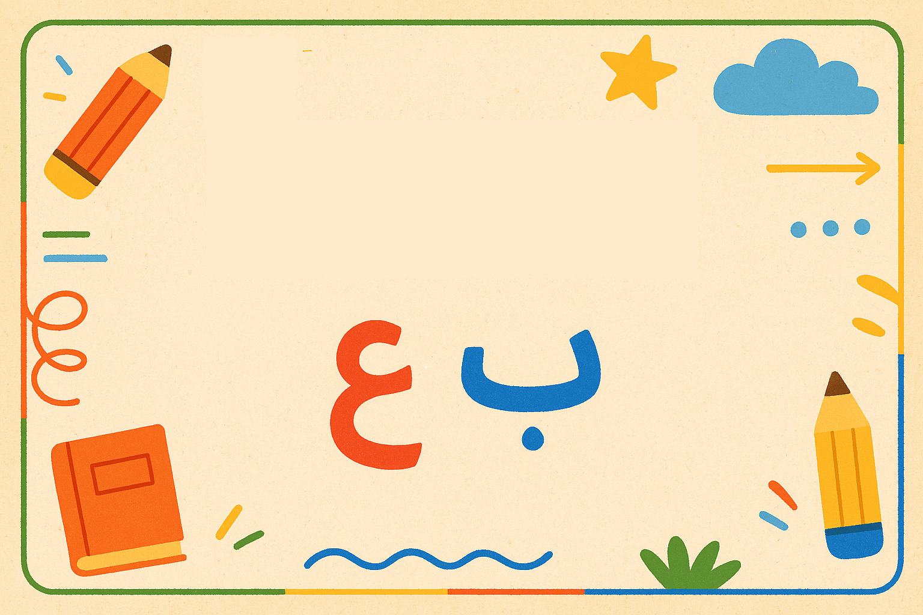
اللُّغَةُ العَرَبِيَّةُ

Slide 2






بِسْمِ ٱللَّهِ ٱلرَّحْمَٰنِ ٱلرَّحِيمِ
In the name of Allah, the Most Gracious, the Most Merciful
👉 We use it before we start doing anything, like, reading, eating, drinking, working and so on .
It’s like saying, “Please Allah help me to do this the right way.

Slide 3
السَّلَامُ عَلَيْكُمْ
What does it mean?
When do we use it?
→ Peace be upon you.
→ It is the Islamic way of greeting.
How to reply?
وَعَلَيْكُمُ السَّلَامُ
What does it mean?
→ And peace be upon you too.
وَعَلَيْكُمُ السَّلَامُ
⬅
السَّلَامُ عَلَيْكُمْ

Slide 4
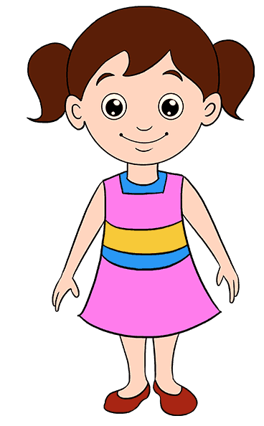

ما إسْمُك؟
What does it mean?
→ What is your name
When we ask a Boy
ما إسْمُكَ
ما إسْمُكِ
When we ask a Girl
How to reply?
إسْمي يوسف
إسْمي لونا

Slide 5
كَيْفَ حالُك؟
What does it mean?
→ How are you
كَيْفَ حالُكَ؟
When we speak to a Boy
كَيْفَ حالُكِ؟
When we speak to a girl
How to reply?
أَنَا بِخَيْر، الْحَمْدُ لِلَّه
What does it mean?
→ I’m fine, praise be to God.
أَنَا بِخَيْر، الْحَمْدُ لِلَّه
⬅
كَيْفَ حالُكِ؟
كَيْفَ حالُكَ؟

Slide 6
كَيْفَ حالُك؟
What does it mean?
→ How are you
How to reply?
إسْمي يوسف
إسْمي لونا

Slide 7
أنا إسْمي
ما إسْمُكَ
I
My Name
أنا
إسمي

Slide 8
كَيْفَ حالُكَ
أنا بِخَيْرٍ الحمدُ لله

Slide 10
السَّلَامُ عَلَيْكُمْ
What does it mean?
Peace be upon you.
When do we use it?
It is the Islamic way of greeting.

