Slide 1
Argus
FINAL YEAR PROJECT
A guarded AI analyst that answers business questions from data, in plain English
PRESENTED BY
PROJECT GUIDE
Harinand AS
Alen T Binu
B.Tech AI & ML · S7
Chinmaya Vishwa Vidyapeeth (Deemed to be University)
Assistant Professor, CST
Chinmaya Vishwa Vidyapeeth
Notes:
Good morning. My name is Harinand AS, from B.Tech AI and ML, S7, and my project guide is Alen T Binu sir. My project is called Argus. In Greek mythology, Argus was a giant with a hundred eyes who never slept, the perfect guard. My app works the same way: it watches every query the AI writes before it touches the data. In one line: it lets anyone ask questions about business data in plain English and get correct answers, safely, without knowing any database language.

Slide 2



The problem, and our idea
The problem
Our idea
Data needs SQL
Company data sits in databases, and getting answers out needs SQL, a special database language.
Ask in plain English, the way you would ask a colleague.
AI writes the SQL, and the app checks it before it runs.
The answer comes back as a chart or a number, with the SQL shown so anyone can check it.
People have to wait
Most managers don't know SQL, so even simple questions wait days for a data analyst.
EXAMPLE
“Which product categories earned the most money?”
Answered in about a second, from 99,441 real orders
AI alone isn't safe
AI can write SQL, but it sometimes guesses wrong, or writes a query that could damage the data.
Notes:
Here is the problem. Companies keep their data in databases, and to get any answer out you need SQL. Most managers don't know SQL, so they wait for an analyst, sometimes for days, even for simple questions. AI tools can write SQL, but they sometimes guess wrong, and a wrong query could even damage the data. My idea: let people ask in plain English. The AI writes the SQL, but my app checks it before it runs, and the answer comes back as a chart or a number, with the SQL shown so anyone can verify it.

Slide 3
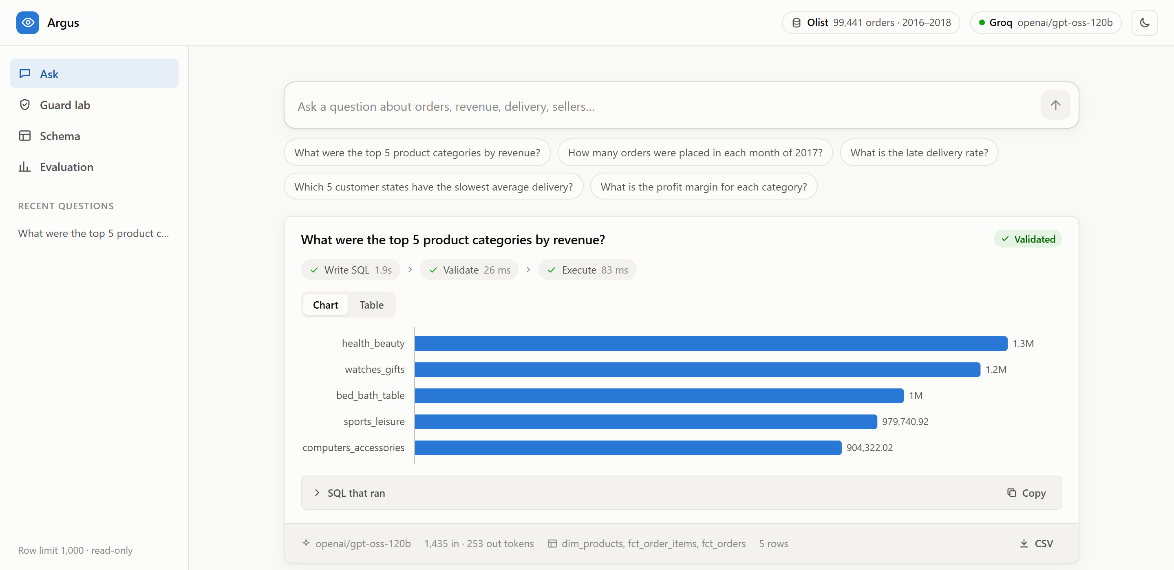
How it works
1
Ask
Type a question in plain English.
2
Write
AI turns it into a SQL query.
3
Check
The guard blocks anything unsafe.
4
Answer
Get a chart or table, plus the SQL.
The live app answering a real question. Each step shows how long it took.
Notes:
This is how it works, in four steps. One: you type a question in plain English. Two: the AI turns it into a SQL query. Three: before anything runs, my guard checks the query and blocks anything unsafe. Four: the query runs on the data and you get the answer as a chart, a number or a table. On the right is the real app. I asked for the top five product categories by revenue, and you can see all three steps with their timings: the whole answer took about a second.

Slide 4
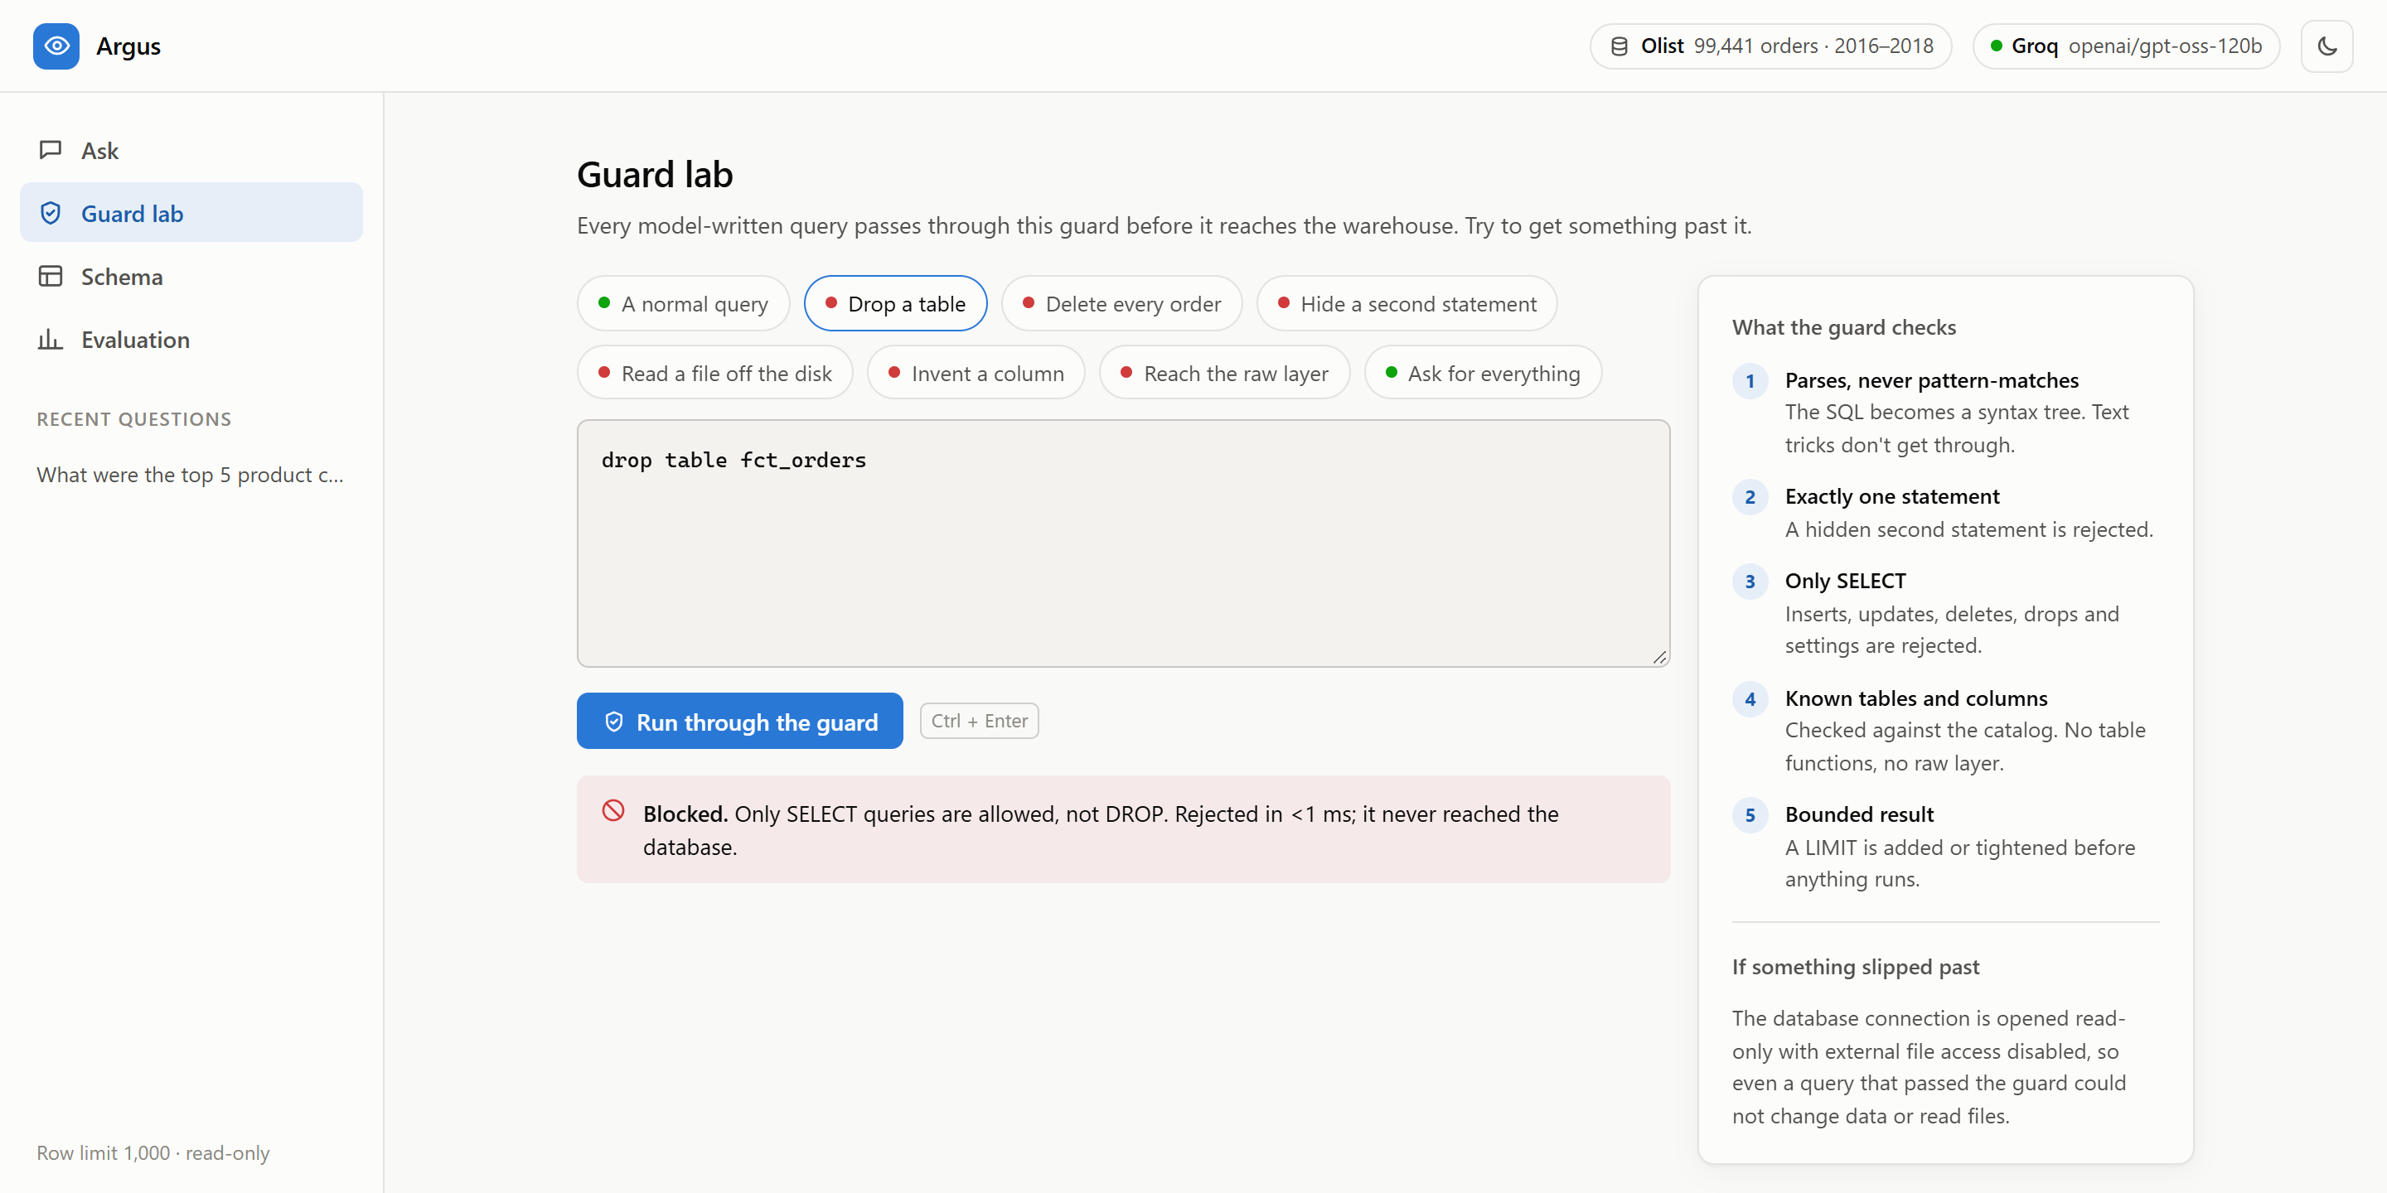



Safe and honest by design
Checks every query
Every query is read before it runs. Anything that deletes, changes or reaches outside the data is stopped.
Says no instead of guessing
If the data can't answer, like profit when there is no cost data, the app says so instead of making up a number.
Same rules every time
Words like “revenue” have one fixed formula, so answers stay consistent every time.
Guard lab: a query that tries to delete a table is stopped before it reaches the data.
Notes:
What makes this project different is that it is safe and honest. First, every query the AI writes is checked before it runs. On the left is the Guard lab, where I try to attack my own app: here a query tries to delete a whole table, and it is blocked in less than a millisecond. Second, if the data can't answer a question, the app says so. For example, there is no cost data, so it refuses to calculate profit instead of inventing a number. Third, words like revenue have one fixed formula, so the same question always gives the same answer.

Slide 5
Results on real data
Tested like an exam: 22 questions with known answers, on 99,441 real orders from a Brazilian online store.
20/20
2/2
100%
1.3s
Regular questions
answered correctly
Impossible questions
correctly refused
Queries ran
without errors
Typical time
to answer
What the testing caught
What comes next
While building, the tests found two mistakes: a test question that had two right answers, and an instruction that confused the AI. Both were fixed, and the tests now check for them.
Grow the test to 200 harder questions; 22 is still an easy test.
Let the app ask back when a question is unclear.
Put the app online so anyone can try it.
Notes:
To prove it works, I tested it like an exam: 22 questions where I already know the correct answer, on the real data of 99,441 orders. It answered all 20 regular questions correctly and correctly refused the 2 impossible ones. Every query ran without errors, and a typical answer takes about 1.3 seconds. The testing also caught two mistakes while I was building, which I fixed. I want to be honest: 100% on 22 questions means the test is still easy. Next, I will grow it to 200 harder questions, let the app ask back when a question is unclear, and put it online.

Slide 6
Thank you
Questions are welcome
Harinand AS
B.Tech AI & ML · S7 · Chinmaya Vishwa Vidyapeeth
Project guide: Alen T Binu, Assistant Professor, CST
Notes:
Thank you for listening. I'm happy to take any questions, and I can show the app live if you'd like.

