Slide 1
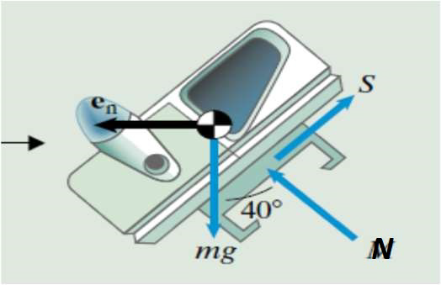
Implementation of a Controller into Prototype Vehicle
Submitted by- Omkar Gaikwad, Shivangi Sharma, Dhiram Buch, Harshal Tingre
Our Major Goals-
To assure the vehicle's stability and safety.
To optimize the vehicle's motion efficiency.
Some necessary assumptions made by our team-
Vehicle model is already equipped with required sensors and actuators.
An appropriate controller with necessary power and memory.
Environment & Operational circumstances of the vehicle are constant.
Dynamics used by the controller-
Case I- When do we get the maximum tilt?
The maximum tilt when the radius of curvature of the turn is minimum. In other words, the lower the angle, the more the tilt and hence lower the radius, R.
Case II- When the lateral force(S) is zero, how the controller responds?
If we keep the values of R and m constant and vary the angle of tilt alone, then the velocity will increase as the angle of tilt increases and vice-versa. From FBD, we get two equations:
Ncos(alpha) = mg ; Nsin(alpha) = mv²/R
Case III- What is the behavior of the masses?
The square of the velocity of the mass is directly proportional to the angle of tilt. As the angle of tilt changes, the normal force exerted by the mass changes and so does its velocity.

Slide 2
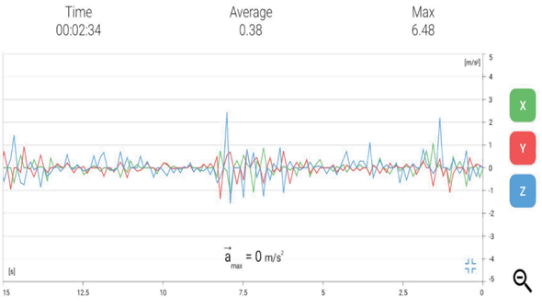
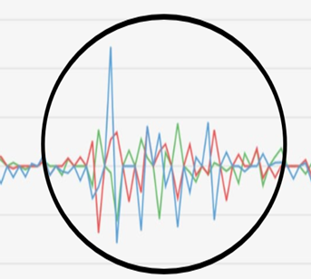
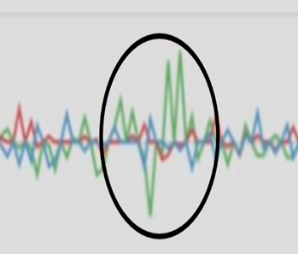
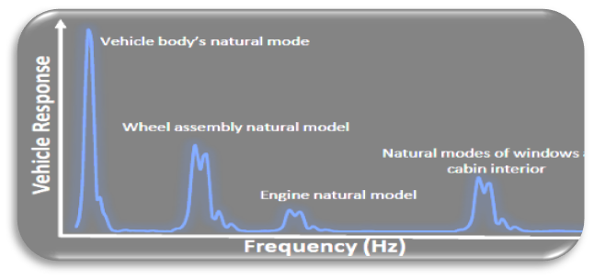
Ride Dynamics analysis using Accelerometer on Phone
Submitted by- Omkar Gaikwad, Shivangi Sharma, Dhiram Buch, Harshal Tingre
Testing Set-up:
Using the Vibration meter app data related to the accelerometer X,Y & Z axis in m/s^2 is taken on a moving vehicle on for various events such as steady state, acceleration, braking, and bump.
Main Goals-
Perform statistical analysis on accelerometer data.
The data is noisier when car in acceleration expected even for when car is in steady-state driving.
What level physical actuator can nullify Z acceleration and noise perception of the driver?
Noise perception mostly isn’t affected much by an actuator as noise perception works much above the 400 to 3000 Hz range.
Bump scenario with peak acceleration at 3m/s^2
Sudden brake scenario

