Slide 1
Neural Networks
Deriving Gradient Descent optimization method mathematically
Hands on session – Making multi-class classification model
Understanding Basic terminologies related to Neural Networks

Slide 2
Keras
High level API for Neural Networks.
It runs on top of TensorFlow.
It’s one of the most popular Deep Learning Libraries.
Easy to use.
Can be combined with scikit learn.

Slide 3
One Hot Encoding
0 - Is this image an apple? No.
1- Is this image a bear? No.
2 - Is this image candy? No.
3 - Is this image a dog? Yes.
4- Is this image an egg? No
Y(i) = [0,0,0,1,0]

Slide 4
Softmax
Softmax assigns decimal probabilities to each class in a multi-class problem. Those decimal probabilities must add up to 1.0
Class Probability
apple 0.001
bear 0.04
candy 0.008
dog 0.95
egg 0.001
sum(P(i)) = 1 (almost)

Slide 5
Softmax – taking example from logistic regression
This formula basically extends the formula for logistic regression into multiple classes.

Slide 6
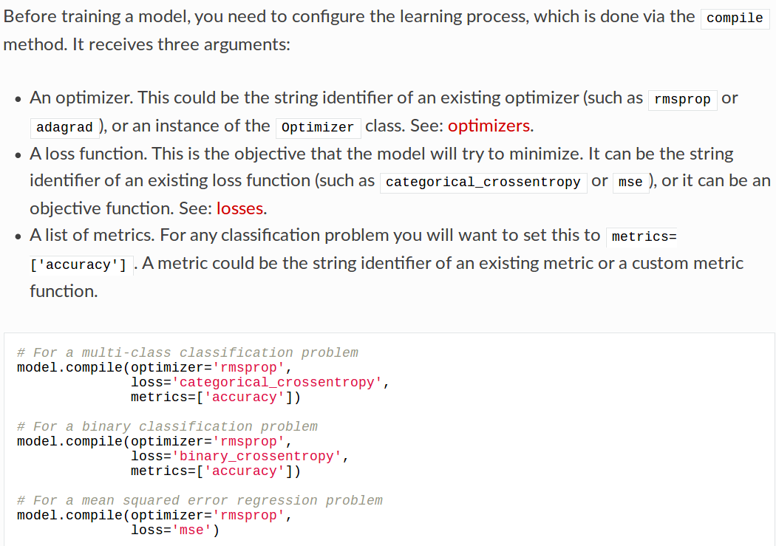
Compiling the model

Slide 7
Adam
Adam is an optimization algorithm that can used instead of the classical stochastic gradient descent procedure to update network weights in training data.
The name Adam is derived from adaptive moment estimation

Slide 8
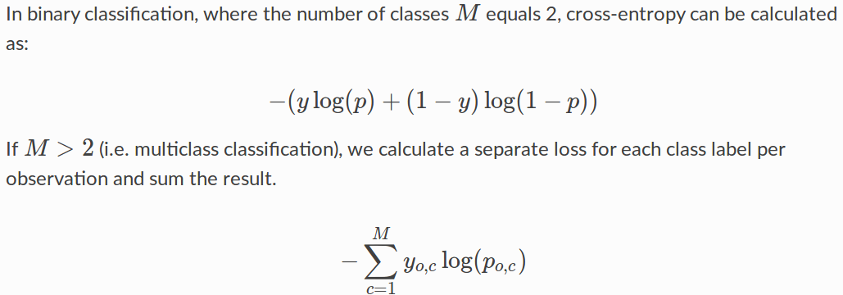
Categorical-Cross Entropy
A loss funtion
Cross-entropy loss, or log loss, measures the performance of a classification model whose output is a probability value between 0 and 1 – softmax.

Slide 9
Cross Validation
Self validating the model
Kfold cross validation

