Slide 1

AI BUSINESS INTELLIGENCE & AUTOMATION
Transforming Orders & Customer Reviews into Actionable Business Intelligence
NLP · Google Gemini · PostgreSQL · Flask · Streamlit
01

Slide 2



01 · OBJECTIVE
What This Project Set Out To Answer
Traditional dashboards tell you what happened. The objective here was to go further — build a system that also explains why, and recommends what to do next, by combining order data and customer reviews under one AI-driven view.
How is the business performing?
Are customers satisfied?
Orders, revenue, returns, and average order value at a glance.
Sentiment measured directly from review text, not just star ratings.
What problems keep recurring?
What should we do next?
Surface repeated complaints — delivery delays, sizing, quality issues.
Gemini turns raw patterns into concrete, prioritized recommendations.
02

Slide 3





02 · SOLUTION
One Connected System, Not Four Separate Tools
Orders and reviews flow into a single pipeline: NLP scores sentiment, Gemini reasons over the aggregated patterns, and an AI agent coordinates the workflow end-to-end — all surfaced through one live dashboard.
Customer Feedback Intelligence
Sentiment analysis + recurring issue detection, linked back to orders.
Gemini AI Recommendations
Business, product, and marketing suggestions generated from real patterns.
DATA → AI ANALYSIS → INSIGHTS → RECOMMENDATIONS → DASHBOARD
AI Automation Agent
Coordinates data processing, analysis, and summary generation automatically.
Every screen in the app traces back to this same five-step flow — nothing is a one-off script.
Interactive Dashboard
Revenue, ratings, sentiment, returns, and trends in one live Streamlit view.
Shared data model. Feedback intelligence, AI insights, and the automation agent all read from the same orders + reviews pipeline — one source of truth, not four.
03

Slide 4




03 · SYSTEM ARCHITECTURE
From Raw Data to Business Decisions
Orders + Reviews
Preprocessing
NLP Sentiment
PostgreSQL
Gemini LLM
AI Agent
Flask API
Streamlit
Orders and reviews are cleaned and joined, scored for sentiment, and stored in PostgreSQL. Gemini reasons over the combined signal to generate insights, the AI Agent automates that workflow end-to-end, and Flask serves it all to the Streamlit dashboard.
Why this matters: traditional BI stops at “what happened.” This pipeline adds “why it happened” and “what to do next” — automatically, on every run.
04

Slide 5

04 · TECH STACK
Built With
FRONTEND
BACKEND & AI
Flask
Gemini API
REST API backend service
LLM-powered insights & recommendations
Streamlit
Interactive dashboard: KPIs, sentiment charts, AI insights, and a live review-tester UI.
NLP
Python
Sentiment analysis on review text
Core application & data processing
AI Agent — automates the analysis workflow end-to-end
05

Slide 6
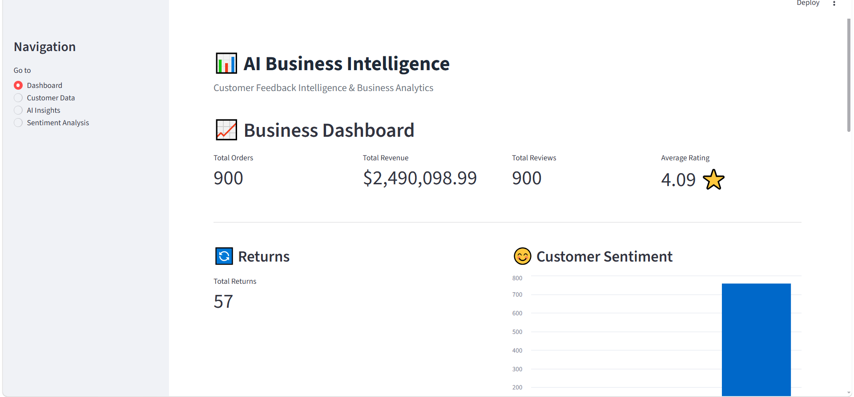
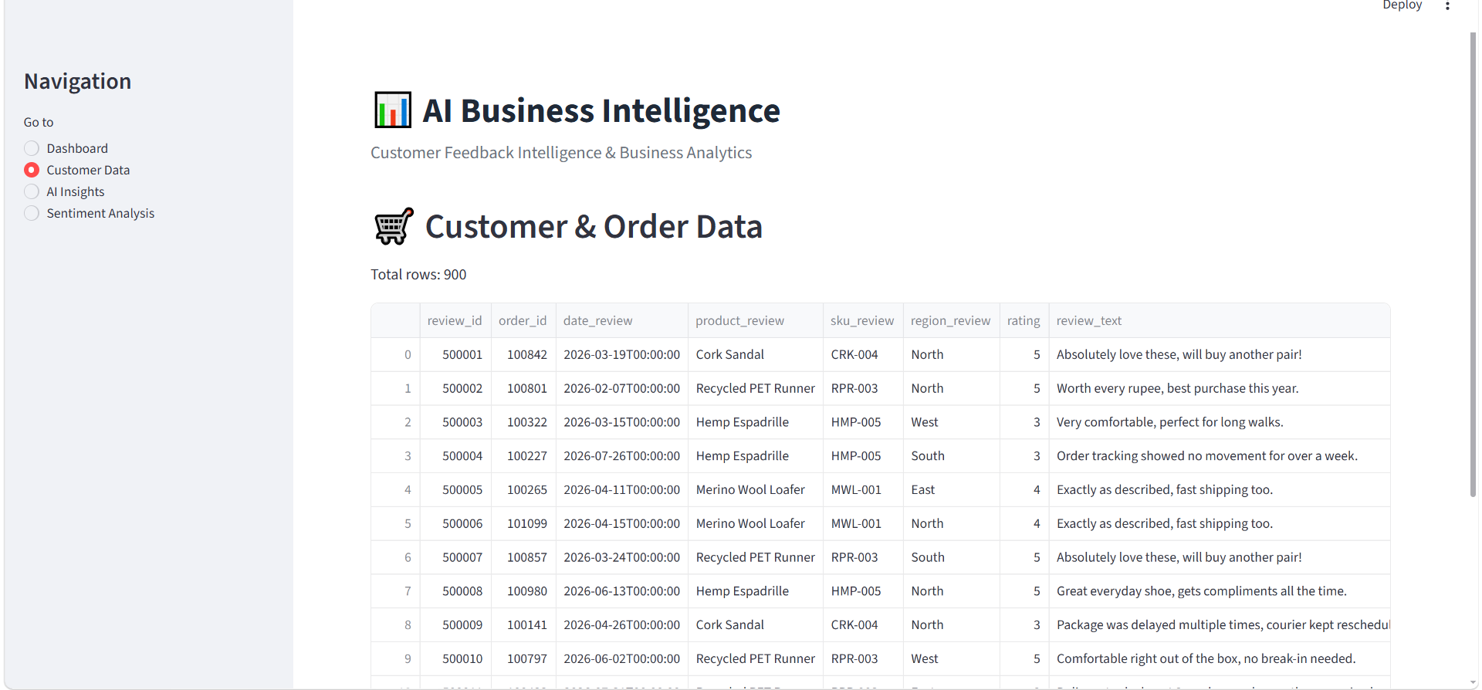
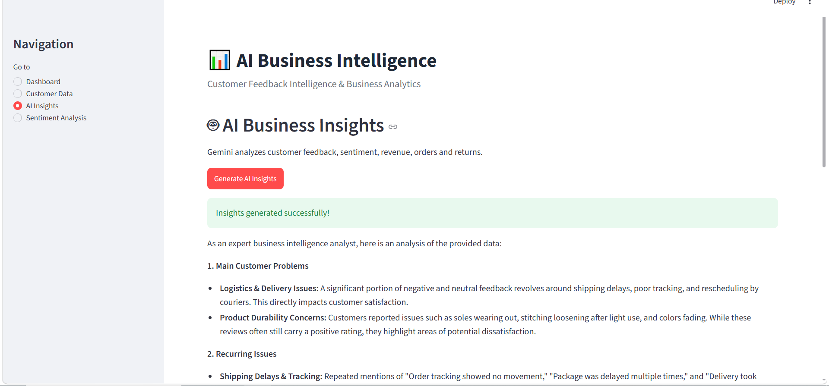
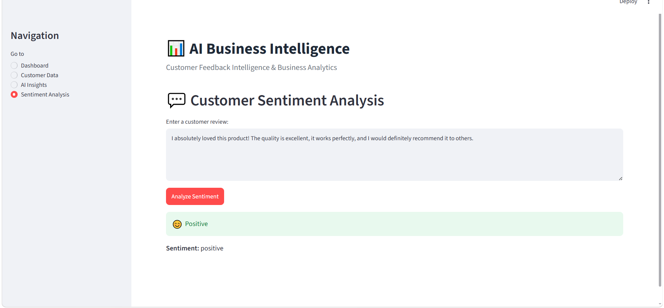
05 · LIVE DEMO
The App, Running
Business Dashboard
Customer & Order Data
Orders, revenue, returns & sentiment at a glance
900 combined review + order records
06
AI Business Insights
Sentiment Analysis
Gemini-generated recurring issues & recommendations
Live NLP scoring on any customer review

Slide 7


06 · HOW TO RUN
From Zero to Live Dashboard
1. Add your Gemini API key
GEMINI_API_KEY=your_gemini_api_key
Create a .env file in the project root and set:
2. Terminal 1 — Streamlit Dashboard
uv run streamlit run Dashboard\app.py
Launch the frontend:
3. Terminal 2 — Flask API
uv run uvicorn Dashboard.api:app --reload
Launch the backend, and keep both terminals running:
Keep both terminals running — the Streamlit UI calls the Flask API, which calls Gemini.
07

