Slide 1

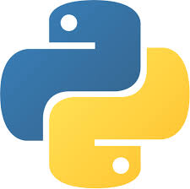

Introductions to Computer Vision & its Libraries

Slide 2
01.
02.
03.
Introduction to Computer Vision
Application of Computer Vision
Libraries of Computer vision
04.
Computer Vision examples
Evolution & applications
Available libraries and Installing OpenCV
CV & Image processing vs CV
Basic OpenCV functions

Slide 3
What is Computer Vision?.
Early experiments in computer vision took place in the 1950s, using some of the first neural networks to detect the edges of an object and to sort simple objects into categories like circles and squares.
Computer vision is an interdisciplinary scientific field that deals with how computers can gain high-level understanding from digital images or videos.

Slide 4
Image Processsing vs Computer vision.
Image processing, an image is "processed", transformations are applied to an input image to get output image.
Computer vision, an image or a video is taken as input, and the goal is to understand the image and its contents which uses image processing algorithms to solve some of its tasks like human brain

Slide 5
Applications.
Evolution.
Object recognition
Face recognition
Autonomous vehicle
Disease detection
Emotion recognition
Agriculture
Satellite image analysis
Robot vision
Search engines
Mobile & camera
Pattern recognition
Image Segmentation
Edge Detection
Watermarking
Steganography
Cryptography
Moving object Detection
Object recognition
Autonomous Vehicle
Satellite image analysis
Medical image analysis
OCR

Slide 6

Basic programs on Computer Vision

Slide 7
Installing OpenCV
OpenCV: pip install opencv-python
or
Installing it from the source

Slide 8
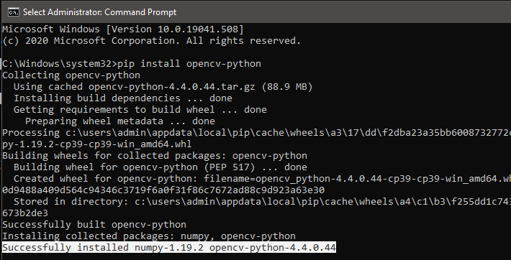
Successfully Installed OpenCV in Python 3.9. But not all library

Slide 9
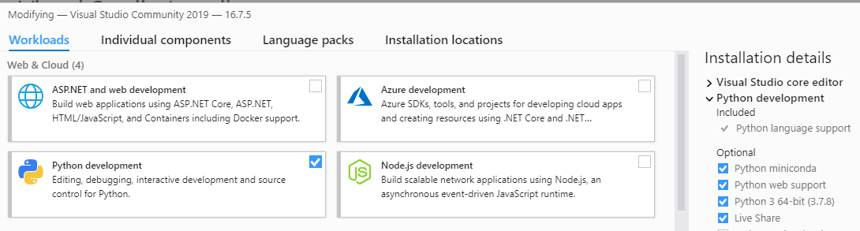
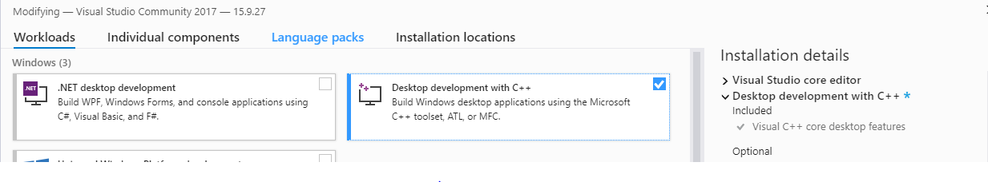
Alternate way of Installing OpenCV & Its libraries without any error
Installing Python from Visual Studio
Or Install stable version of Python

Slide 10

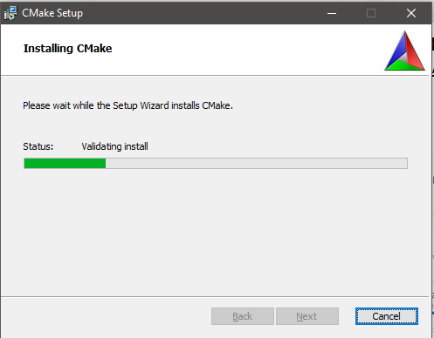
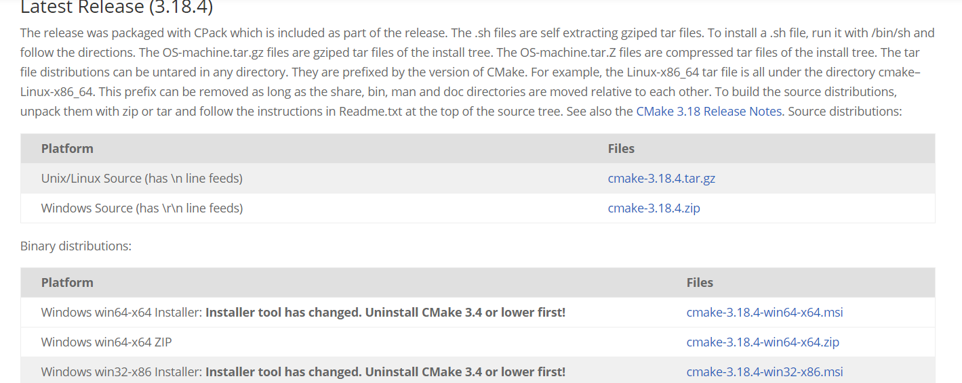
CMAKE: https://cmake.org/download/

Slide 11
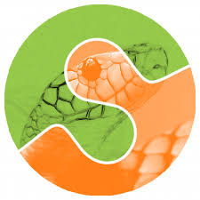
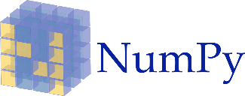
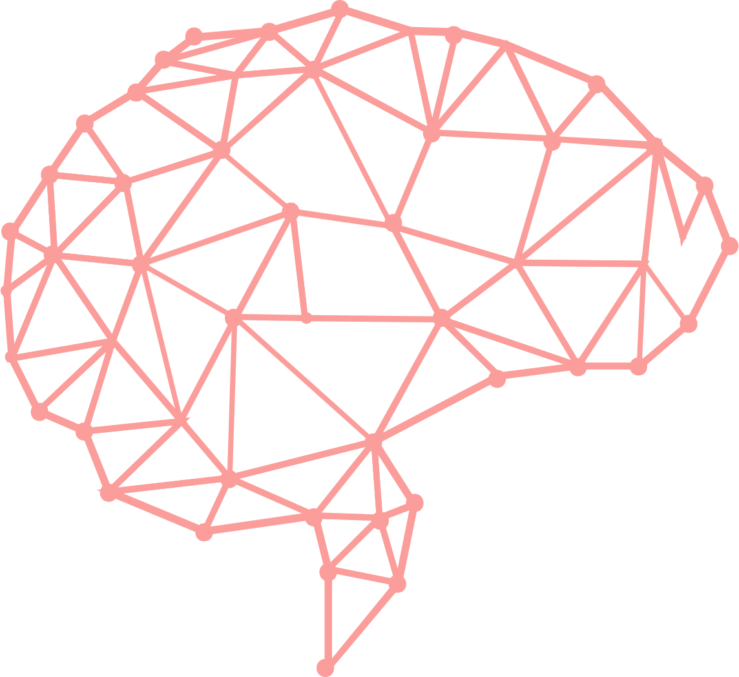
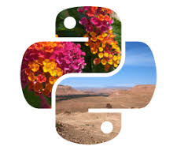



Libraries.
Numerical Python
Scikit-image
NumPy is a library for the Python programming language, adding support for large, multi-dimensional arrays and matrices, along with a large collection of high-level mathematical functions to operate on these arrays.
It includes algorithms for segmentation, geometric transformations, color space manipulation, analysis, filtering, morphology, feature detection, and more.
Scientific Python
PIL
SciPy contains modules for optimization, linear algebra, integration, interpolation, special functions, FFT, signal and image processing
It adds support for opening, manipulating, and saving many different image file formats.
Mahotas
Open CV
Mahotas is a includes many algorithms implemented in C++ for speed while operating in numpy arrays and with a very clean Python interface.
OpenCV is a library of programming functions mainly aimed at real-time computer vision.

Slide 12
Installing Libraries
Wheel: pip install wheel
Matplotlib: pip install matplotlib
Imutils: pip install imutils
Scipy: pip install scipy

Slide 13
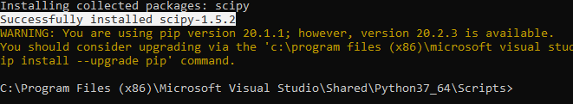
Successfully Installed OpenCV and other libraries in Python 3.7

Slide 14
Read, Show & Write an Image.
import numpy as np
import cv2
img = cv2.imread(‘sample2.jpg') cv2.imshow(‘show',img)
cv2.imwrite(‘photo.jpg',img)
cv2.waitKey(0)
cv2.destroyAllWindows()

Slide 15
Converting Color Image to Greyscale Image.
import cv2
image = cv2.imread(‘sample1.png')
greyImage = cv2.cvtColor(image, cv2.COLOR_BGR2GRAY)
cv2.imwrite('gray_image.png', greyImage)
cv2.imshow(‘Color_image',image)
cv2.imshow(‘Grey_image', greyImage)
cv2.waitKey(0)
cv2.destroyAllWindows()

Slide 16
Image Properties.
Import cv2
img = cv2.imread(‘sample2.jpg')
print (img.shape) #(342, 548, 3)
print (img.size) #562248
print (img.dtype) #uint8

Slide 17

Thanks!
Submitted by-
Srishti Mishra
2300521635007

