Slide 1







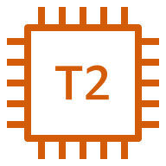

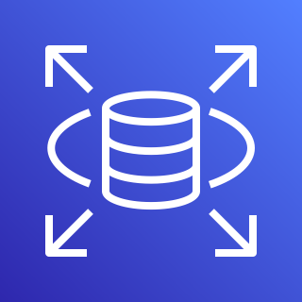
An Architect of data flow from web server to data server
AWS Cloud
VPC-1
VPC-2
subnet1
subnet2
EC2
IAM
S3 bucket
EC2
instance1
instance2
Role
Permissions
Endpoint
Endpoint
RDS
RDS
Database-1
Database

