Slide 1
RADAR SIGNAL PROCESSING
IWR1843 + DCA1000
ADC Capture & Range FFT Pipeline
Custom UDP packet extraction → complex sample reconstruction → windowed FFT → calibrated range output

Slide 2
System Overview
IWR1843
Boost
DCA1000
EVM
UDP
Stream
PC Host
Script
mmWave
Radar Sensor
Raw ADC
Capture Board
Ethernet
Port 4098
dca1000_lite.py
.dcaudp file
What happens on the PC → this work
1
2
3
4
Packet Extraction
IQ Reconstruction
Radar Cube
Range FFT
Parse .dcaudp binary, recover raw ADC bytes per packet
Rearrange int16 stream from [I I Q Q] → complex (I+jQ)
Reshape into (chirps × RX × samples) 3D array
Apply Hanning window, run FFT along fast-time axis

Slide 3


.dcaudp File Format & Packet Structure
File Layout (.dcaudp)
UDP Payload (DCA1000 header)
8 bytes
Magic header: DCAUDP1\0
bytes 0–3
Sequence number (uint32 LE)
bytes 4–9
Byte counter (48-bit LE)
─── repeat per packet ───
8 bytes
timestamp_ns (uint64 LE)
bytes 10+
Raw ADC payload → int16 samples
4 bytes
packet_length (uint32 LE)
Why store packets, not raw bytes?
› Sequence numbers → detect dropped packets
N bytes
Raw UDP payload →
› Byte counter → verify continuity
› Last packet can differ in size — boundaries matter
› Timestamps → replay / offline analysis

Slide 4
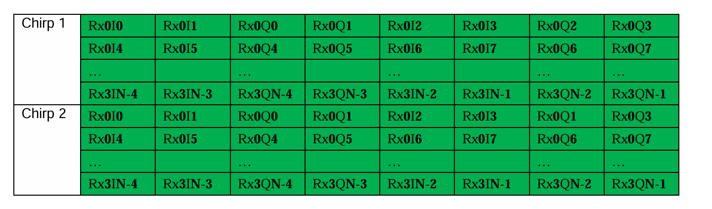
IQ Sample Reconstruction from ADC Stream
⚠ The raw ADC stream is NOT standard [I, Q, I, Q, …] interleaving — it requires explicit rearrangement.
Raw int16 layout (as received)
After rearrangement (correct IQ pairs)
I₀
I₁
Q₀
Q₁
I₂
I₃
Q₂
Q₃
→
I₀+jQ₀
I₁+jQ₁
I₂+jQ₂
I₃+jQ₃
group of 4
group of 4
complex samples
# Reshape into blocks of 4 → [I₀ I₁ Q₀ Q₁]
data = adc_int16.reshape(-1, 4)
I = data[:, 0:2].reshape(-1) # columns 0-1
Q = data[:, 2:4].reshape(-1) # columns 2-3
complex_samples = I + 1j * Q
Reference: Texas Instruments mmWave Studio GUI Guide

Slide 5
Radar Cube Construction & Range FFT
Reshape
RX
Antennas
(×4)
1
complex_samples.reshape(num_chirps, 4, 256)
Chirps
(slow time)
Samples
/ chirp
(256)
Hanning Window
2
Radar Data Cube
[ chirps × 4 RX × 256 ]
Reduces spectral leakage on fast-time axis (256 pts)
FFT (axis = 2)
3
np.fft.fft(windowed, axis=2) → range bins
Use first N/2 bins
4
Negative frequencies are mirrors — discard second half

Slide 6
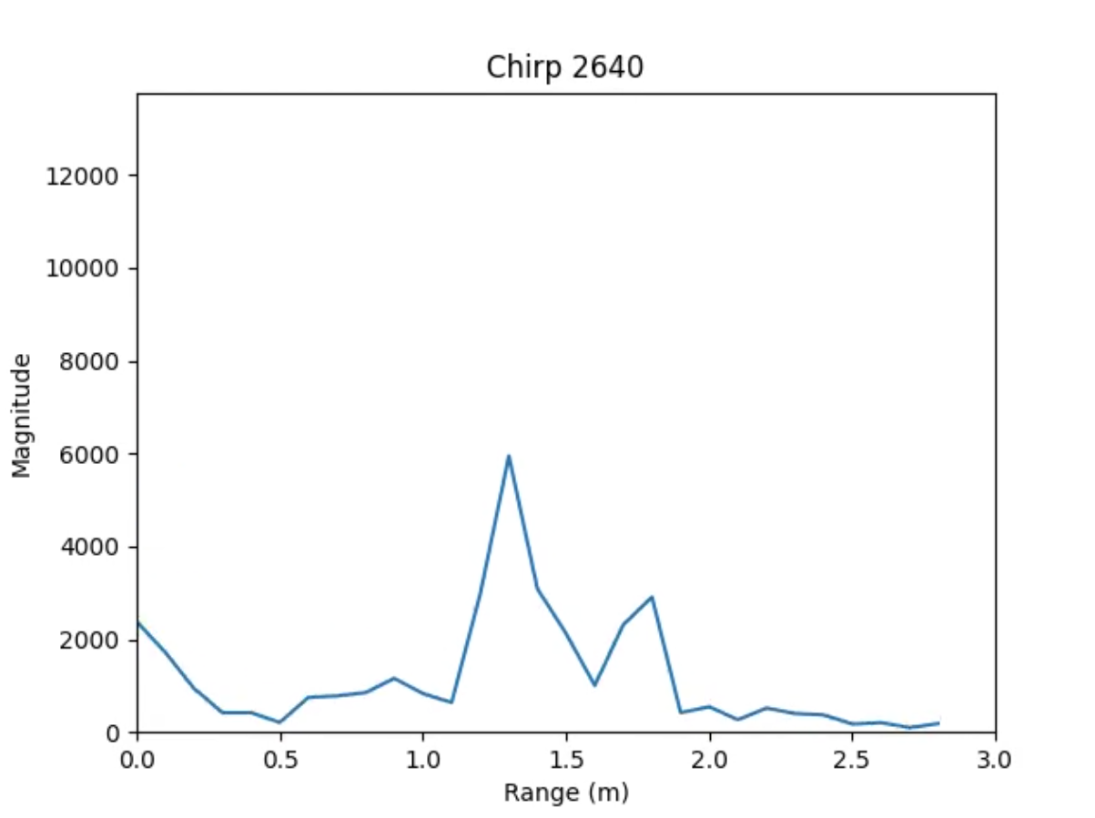
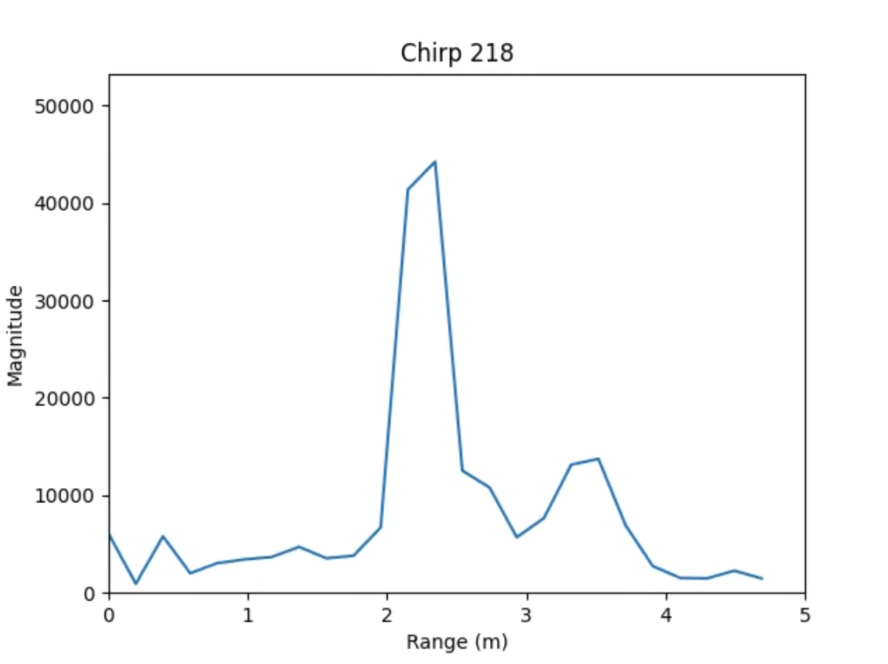
Range Calibration
Range Resolution Formula
❌ Previous approach
Δr = c / (2B) where B = slope × ramp_time
Inaccurate — ignores ADC sampling rate & FFT length
✔ Current correct formula
Range FFT (previous formula)
Δr = (c × fs) / (2 × slope × N)
c = 3×10⁸ m/s | fs = 10 MHz | N = 256 | slope = 29.982 THz/s
Result: each FFT bin = one range_res step in metres
Range FFT (Updated formula)

Slide 7

Output Visualization
def animate_line_mp4(fft_cube, ranges,name):
fig, ax = plt.subplots()
num_bins = fft_cube.shape[2] // 2
# Find bins within 0–n meters
max_range = 5 # meters
valid_bins = np.where(ranges <= max_range)[0]
max_bin = valid_bins[-1]
# Precompute global max ONLY for this region
global_max = np.max(np.abs(fft_cube[:, 0, :max_bin]))
line, = ax.plot(ranges[:max_bin], np.zeros(max_bin))
# Fix axes
ax.set_xlim(0, max_range)
ax.set_ylim(0, global_max * 1.2)
ax.set_xlabel("Range (m)")
ax.set_ylabel("Magnitude")
def update(i):
rp = np.abs(fft_cube[i, 0, :max_bin])
line.set_ydata(rp)
ax.set_title(f"Chirp {i}")
return line,
Animated Range Profile (.mp4)
x-axis
Range in metres (calibrated bins × Δr)
y-axis
Magnitude — fixed scale using global_max
Radar Data Cube
[ chirps × 4 RX × 256 ]
Frame step
Every 20th chirp → 10 fps output
Max range shown
5 m (only valid distance bins plotted)
ani = animation.FuncAnimation(
fig,
update,
frames=range(0, fft_cube.shape[0], 20)
)
writer = FFMpegWriter(fps=10)
ani.save(name, writer=writer)
plt.close(fig)
Clutter removal
Mean subtraction across chirps in heatmap
Output: vid_test_may292nddata.mp4

Slide 8

Summary & Next Steps
What was achieved
Next steps
Custom .dcaudp packet parser in Python
Doppler FFT
Non-standard [I I Q Q] → complex IQ remap
2nd FFT across chirps → velocity axis
CFAR Detection
3D radar cube (chirps × 4 RX × 256 samples)
Adaptive threshold for target detection
Hanning-windowed Range FFT
Angle (AoA)
Corrected range-bin calibration formula
Use 4-RX phase differences for direction
Animated range profile + heatmap (.mp4)
Point Cloud
Combine range, velocity, angle → 3D points
IWR1843BOOST + DCA1000EVM · Python / NumPy · ADC Capture → Range FFT

