Slide 1
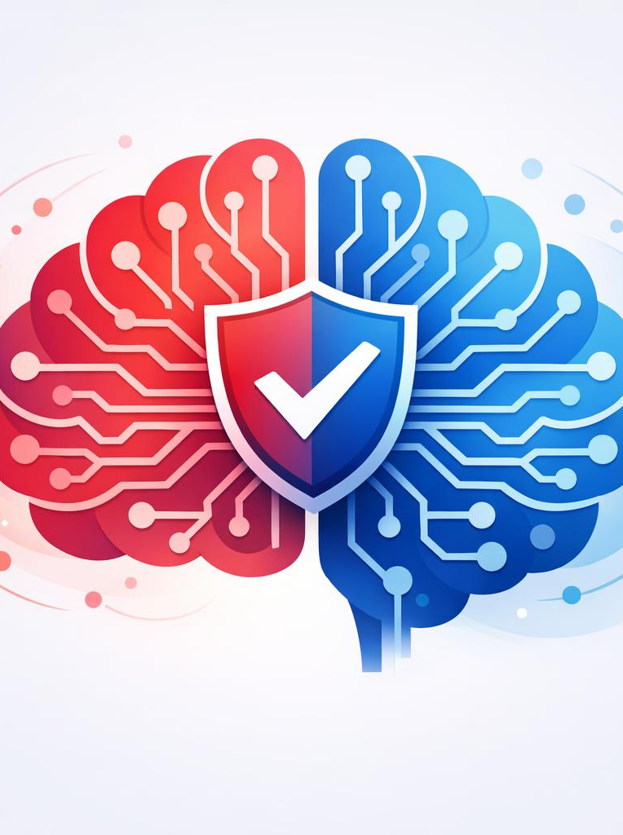
AI HIGH-RISK
IDENTIFICATION
EU AI Act | Article 6 + Annex III
Practical Guide for AI Teams
https://www.linkedin.com/in/imeh-etuk/

Slide 2



Is Your AI System Part of a Regulated Product?
e.g. medical device, machinery, aviation components
YES + requires third-party conformity assessment
NO, not a regulated product
HIGH-RISK
CONTINUE
Full lifecycle compliance required
Proceed to Annex III use case check
Article 6(1) Logic
AI systems embedded in products covered by EU harmonisation legislation listed in Annex I are automatically classified as high-risk if they require a third-party conformity assessment under that legislation.
https://www.linkedin.com/in/imeh-etuk/

Slide 3








ANNEX III USE CASES
Does It Fall Into These Categories?
Biometric
Identification
Critical
Infrastructure
Education &
Training
Employment &
Workforce
Facial recognition,
remote biometrics
Energy, transport,
water, digital
Grading, admissions,
learning assessment
Hiring, monitoring,
performance eval
Financial
Services
Law
Enforcement
Migration &
Border Control
Justice &
Democracy
Credit scoring,
insurance pricing
Predictive policing,
evidence analysis
Visa assessment,
risk profiling
Sentencing support,
election influence
YES → Continue to Exception Test
NO → MINIMAL RISK (basic validation only)
https://www.linkedin.com/in/imeh-etuk/

Slide 4

EXCEPTION TEST
Critical Step: Can You Exempt Your System?
1
Does it materially influence decisions?
The AI output directly affects outcomes for individuals without meaningful intermediate steps.
2
Can humans meaningfully override it?
A qualified professional can review, challenge, and reverse the AI's recommendation before action is taken.
3
Is it purely supportive / recommendation-based?
The system only assists human decision-making without autonomous authority over final outcomes.
These questions determine whether Article 6(3) exemptions apply. Document your answers thoroughly.
https://www.linkedin.com/in/imeh-etuk/

Slide 5
Determine Your Classification
HIGH-RISK
POSSIBLY NOT
HIGH-RISK
TREAT AS
HIGH-RISK
Influences outcomes
Supports + strong oversight
Unclear classification
AI materially affects decisions about individuals. Full lifecycle controls required under Article 6.
System is purely supportive with meaningful human override. Must document justification per Art. 6(3).
When in doubt, apply the safe approach. Classify as high-risk until a thorough assessment proves otherwise.
When your AI impacts people's rights, access or safety at scale → classify as high-risk until proven otherwise
https://www.linkedin.com/in/imeh-etuk/

Slide 6


IF HIGH-RISK
Activate Compliance Controls
Governance (ISO 42001)
Risk Management (NIST AI RMF)
Policies & accountability frameworks
1
GOVERN
Establish policies, roles, accountability
Data governance & quality assurance
2
MAP
Human oversight mechanisms
Identify & categorize AI risks
Audit trails & logging systems
3
MEASURE
Assess & quantify risk levels
Transparency documentation
4
MANAGE
Post-market monitoring
Treat, monitor, and report risks
https://www.linkedin.com/in/imeh-etuk/

Slide 7

QUICK SUMMARY
EU AI Act Risk Classification
UNACCEPTABLE
HIGH-RISK
LIMITED RISK
MINIMAL RISK
Prohibit
Full lifecycle controls
Transparency obligations
Basic validation
Social scoring, real-time mass biometric surveillance, manipulation of vulnerable groups
Annex III use cases + regulated products requiring conformity assessment
Chatbots, Deepfakes, Emotion recognition
AI-enabled games, spam filters, inventory management
PRO TIP
If your AI impacts people's rights, access or safety at scale, it's high-risk until proven otherwise.
https://www.linkedin.com/in/imeh-etuk/

