Slide 1
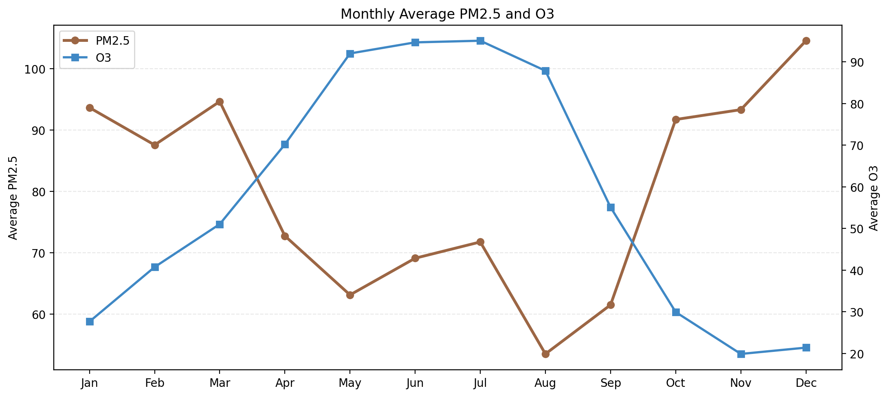
Beijing Multi-Site
Air Quality
Week 2 Activity 2
Statistical analysis story
This presentation continues Week 2 Activity 1 and turns the statistical analysis into a short insight-led story.
Rows
Stations
Tasks
420,768
12
2-6
Weizhao Tan · MSE803 Data Analytics
Seasonal contrast between PM2.5 and O3
1

Slide 2
SCOPE
Dataset structure and Task 2-6 workflow
Blackboard task wording was not locally available, so the analysis follows a standard statistical sequence.
Dataset structure
Task 2
Task 3
Task 4
Outer ZIP: beijing+multi+site+air+quality+data.zip
Nested ZIP: PRSA2017_Data_20130301-20170228.zip
12 station CSV files
18 columns per hourly record
Missing values recorded as NA
Check missing values and identify data quality risks.
Summarise the main pollutant and weather variables.
Find monthly and hourly pollution patterns.
Task 5
Task 6
Outcome
Measure pollutant and weather correlations.
Compare stations and turn results into insights.
Code, results, PPT, and a short talk script ready for GitHub.
2

Slide 3
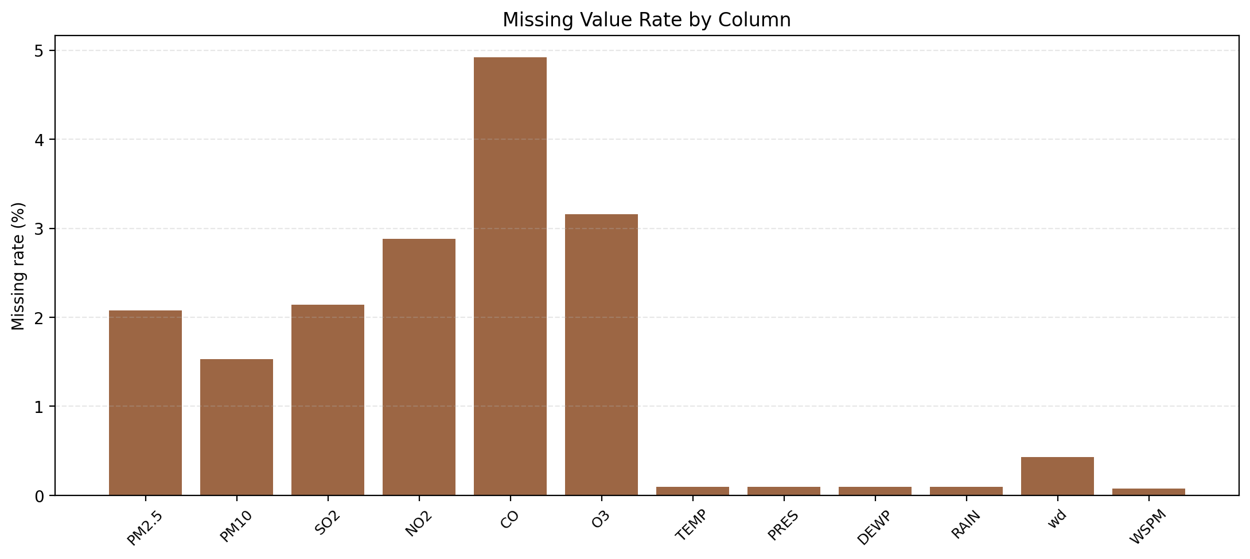
QUALITY
Task 2 and Task 3: data quality and descriptive statistics
The first step was checking which variables were most incomplete before interpreting the averages.
CO had the highest missing rate at 4.92%.
The missing-value pattern is small enough to continue with descriptive analysis, but it should be acknowledged.
Average PM2.5 was 79.79 and average PM10 was 104.60, showing a generally polluted dataset.
The median values are lower than the means for several pollutants, which suggests right-skewed pollution spikes.
PM2.5 mean
PM10 mean
79.79
104.60
Missing values are concentrated in pollutant variables, not the date fields.
3

Slide 4
SEASONALITY
Task 4: monthly pollution patterns tell the main story
The data shows a strong seasonal contrast: PM2.5 is worst in winter while O3 rises in summer.
Peak PM2.5 month
Dec · 104.58
Peak O3 month
Jul · 95.09
Cold-season PM2.5 suggests heavier particulate pollution in late autumn and winter.
Warm-season O3 suggests stronger photochemical activity during summer.
This matters because one single mitigation strategy will not work equally well for all pollutants.
December is the PM2.5 peak month and July is the O3 peak month.
4

Slide 5
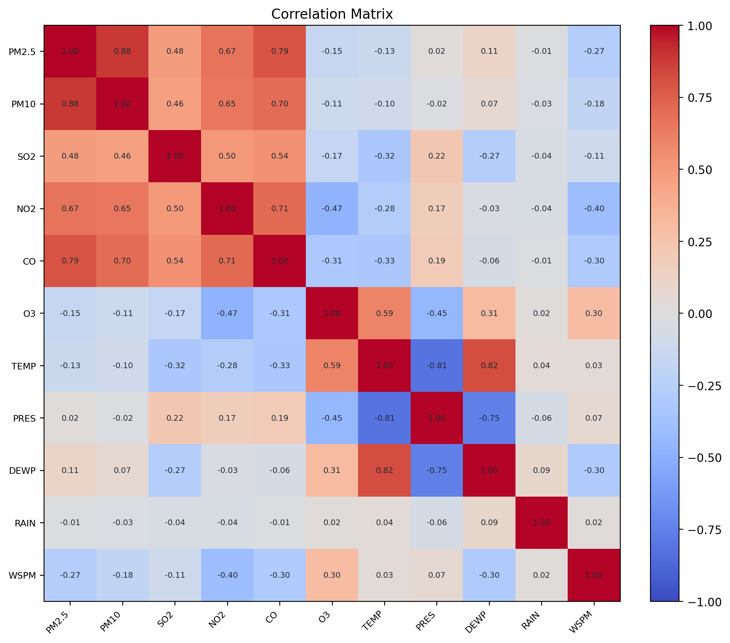
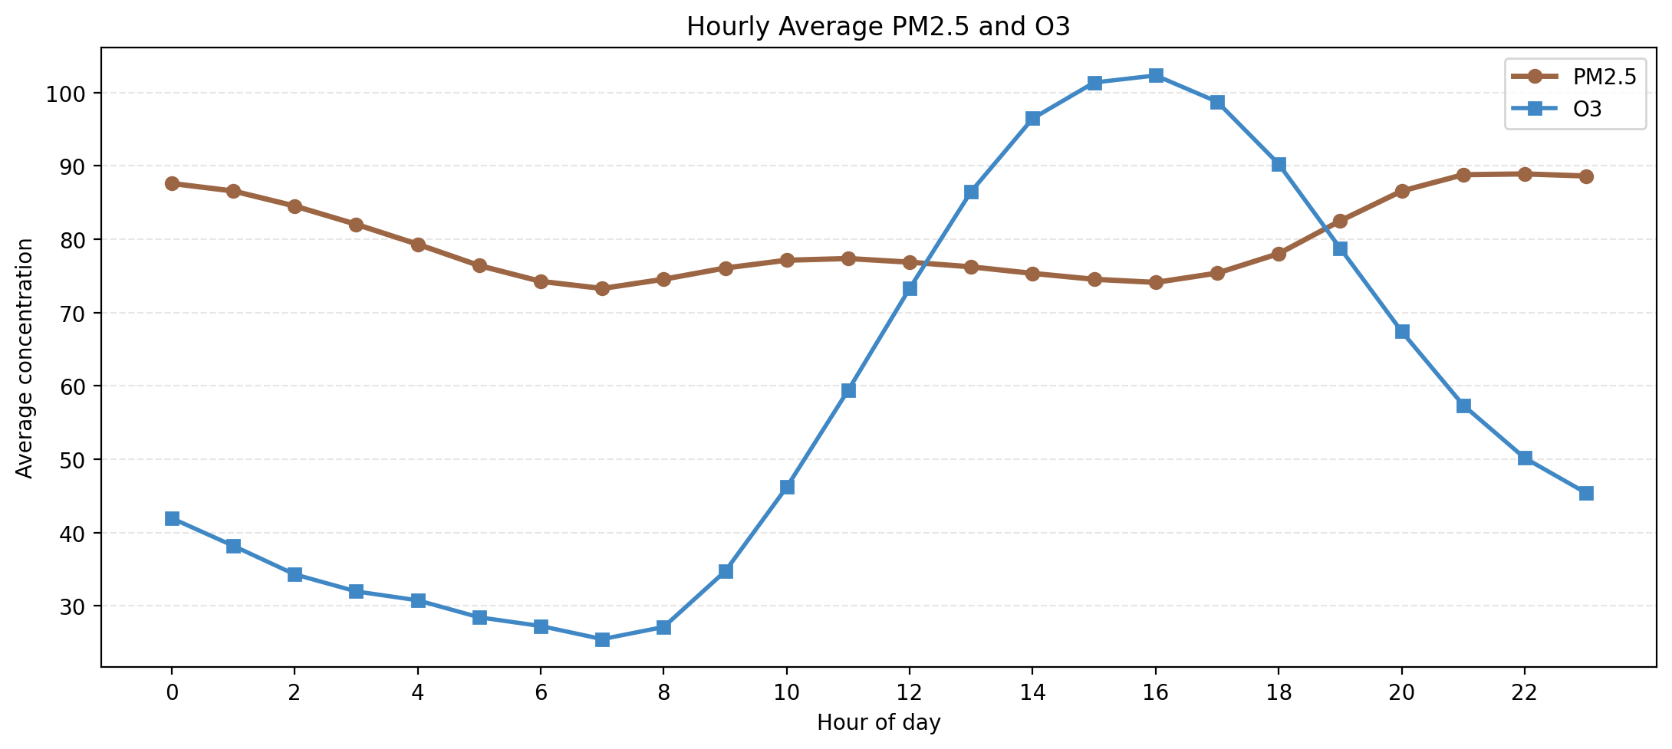
PATTERNS
Task 4 and Task 5: hourly cycle and pollutant relationships
Daily timing and pairwise correlations help explain which variables move together.
PM2.5 peaks at 22:00 while O3 peaks at 16:00.
PM2.5 is strongly linked to PM10 and moderately opposed to wind speed.
PM2.5 strongest positive correlation: PM10 (0.88)
PM2.5 strongest negative correlation: WSPM (-0.27)
5

Slide 6
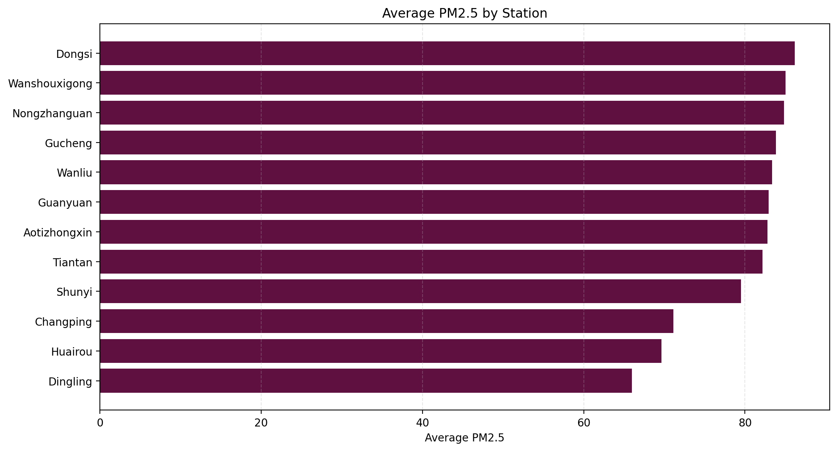
STATIONS
Task 6: station comparison and final interpretation
Comparing station averages shows where particulate pollution was consistently higher across the whole dataset.
Dongsi had the highest average PM2.5 at 86.19.
Dingling had the lowest average PM2.5 at 65.99.
The combined evidence supports a story of winter particulate pollution, summer ozone peaks, and cleaner conditions when wind speed is stronger.
This gives a clear presentation narrative for a short 3-minute explanation.
GitHub folder
https://github.com/Ted323-NZ/YoobeeMSE800/tree/codex/mse803-week02-w2-a2/MSE803DataAnalytics/Week02/W2-A2
Dongsi has the highest average PM2.5 and Dingling the lowest.
Deliverables
analysis code · result tables · figures · PPT · talk script
6

