Slide 1
Airline Passenger
Prediction Pipeline
DATA ANALYTICS
WEEK 11 - ACTIVITY 1.1
Linear Regression | XGBoost | ANN
LSTM | ARIMA
Performance comparison and recommendations
Notes:
Open by stating the objective: build an end-to-end prediction pipeline for monthly airline passengers.
Mention that five model families are compared using the same train/test period and common evaluation metrics.
The dataset is small but useful because it contains trend and seasonality, which makes model comparison meaningful.

Slide 2
Presentation Flow
1. Dataset and project objective
2. Data preprocessing and feature engineering
3. Exploratory data analysis
4. Prediction methodology
5. Model comparison results
6. Findings, limitations, and recommendations
Notes:
Use this slide to set expectations for a 10-minute presentation.
Spend most of the time on EDA, methodology, and the comparison results rather than code details.

Slide 3
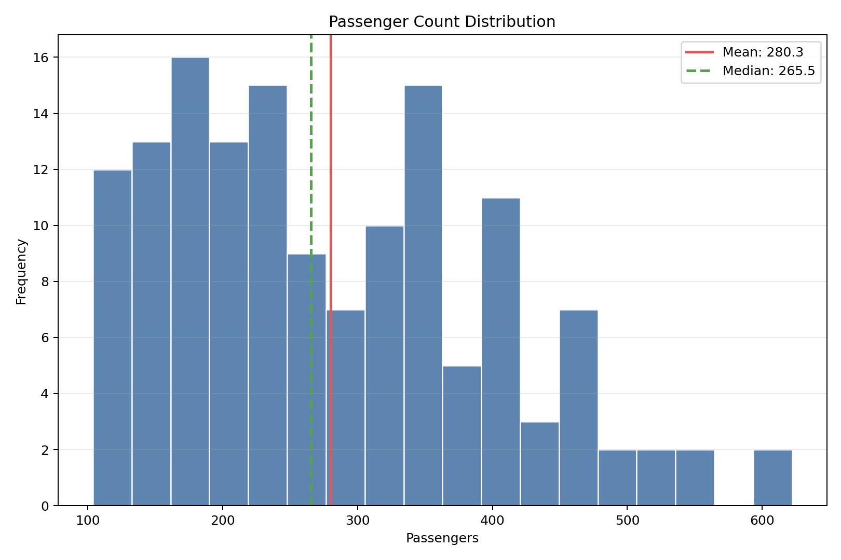
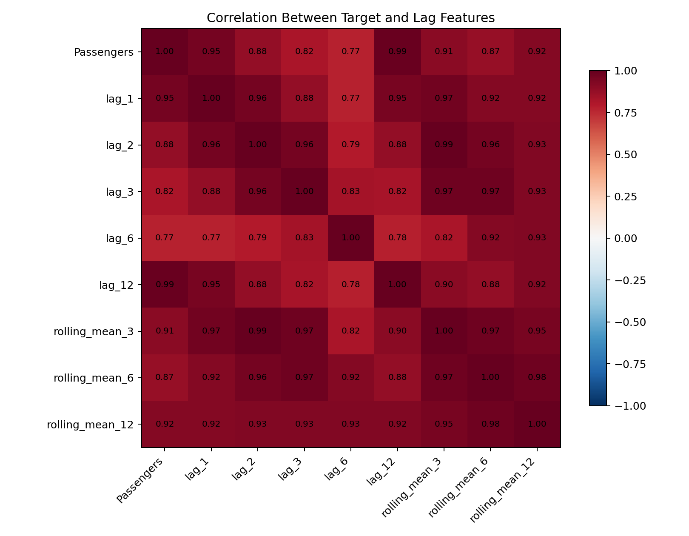
Dataset Understanding and Preparation
Dataset
Monthly international airline passengers from 1949-01 to 1960-12.
Objective
Predict passenger counts for the last 24 months and compare five models fairly.
Preprocessing
Parsed Month as a datetime, sorted chronologically, checked duplicates and missing values, then created lag, rolling, trend, and seasonal features.
Distribution
Passenger counts are right-skewed because demand grows over time.
Key features
Lag-12 and rolling features capture yearly seasonality and recent demand.
Notes:
Explain the dataset shape: 144 monthly observations, no missing passenger values, and no duplicate months.
The distribution is not stationary because passenger numbers increase over the years.
Lag and rolling features were created because past passenger counts are highly informative for future months.

Slide 4
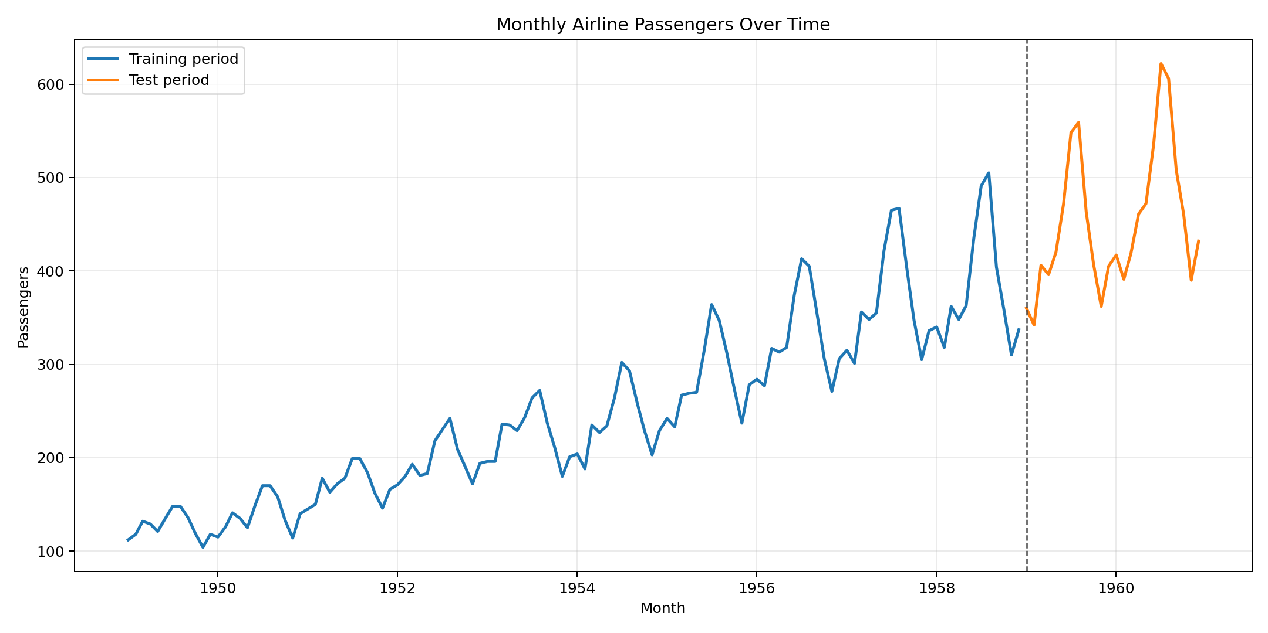
EDA: Trend and Train/Test Split
Trend insight
Passenger demand rises strongly over the 12-year period. The final 24 months are held out as the test set, so models must predict into the highest-demand part of the series.
144
24
raw records
1949-01 to 1960-12
test months
from 1959-01
Notes:
Point to the upward trend and the clear separation between training and test periods.
The last 24 months are difficult because they represent the highest passenger volumes in the dataset.
This is why models that cannot extrapolate trend well may perform worse.

Slide 5
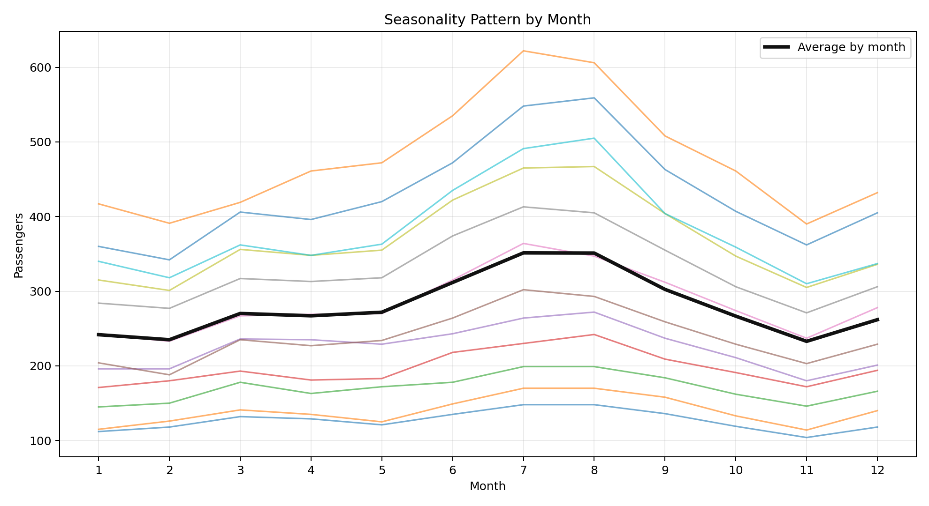
EDA: Seasonality Pattern
Seasonality insight
Passenger demand repeatedly peaks in the middle of each year. The feature set therefore includes month, quarter, sine/cosine seasonality, lag-12, and rolling summaries.
Jul-Aug
Lag-12
typical seasonal
peak period
captures yearly
pattern
Notes:
Explain that the repeated mid-year peak is visible across many years.
This is why pure trend alone is insufficient; month and lag features are needed.
Mention that feature engineering converts the time series into a supervised learning format for regression and neural models.

Slide 6
Prediction Pipeline Methodology
Prepare data
Load CSV, parse dates, validate quality, sort monthly records, and split by time.
Engineer features
Create trend, month, quarter, sine/cosine seasonality, lags, and rolling statistics.
Train and compare
Fit Linear Regression, XGBoost, ANN, LSTM, and ARIMA; evaluate with RMSE, MAE, R2, and MAPE.
Data
Features
Models
Notes:
Walk through the pipeline from left to right.
Emphasize that the test split is chronological, not random, because this is forecasting.
Explain that RMSE and MAE measure absolute error, R2 explains variance captured, and MAPE gives percentage error.

Slide 7
Model Comparison Results
Lower RMSE, MAE, and MAPE are better; higher R2 is better. ANN performed best after scaling both inputs and target values. Linear Regression remained the strongest interpretable baseline.
Model |  | RMSE |  | MAE |  | R2 |  | MAPE
ANN |  | 27.37 |  | 20.08 |  | 0.866 |  | 4.50%
Linear Regression |  | 42.12 |  | 39.01 |  | 0.682 |  | 8.86%
XGBoost |  | 64.74 |  | 56.07 |  | 0.248 |  | 11.81%
ARIMA |  | 88.16 |  | 64.01 |  | -0.394 |  | 12.56%
LSTM |  | 94.96 |  | 77.32 |  | -0.617 |  | 16.38%
Best model by RMSE: ANN
Notes:
State the ranking: ANN is best by RMSE, with RMSE 27.37 and MAPE 4.50%.
Explain that Linear Regression performs well because trend and lag features are highly predictive.
XGBoost performs worse because tree models often struggle to extrapolate beyond the training range.

Slide 8
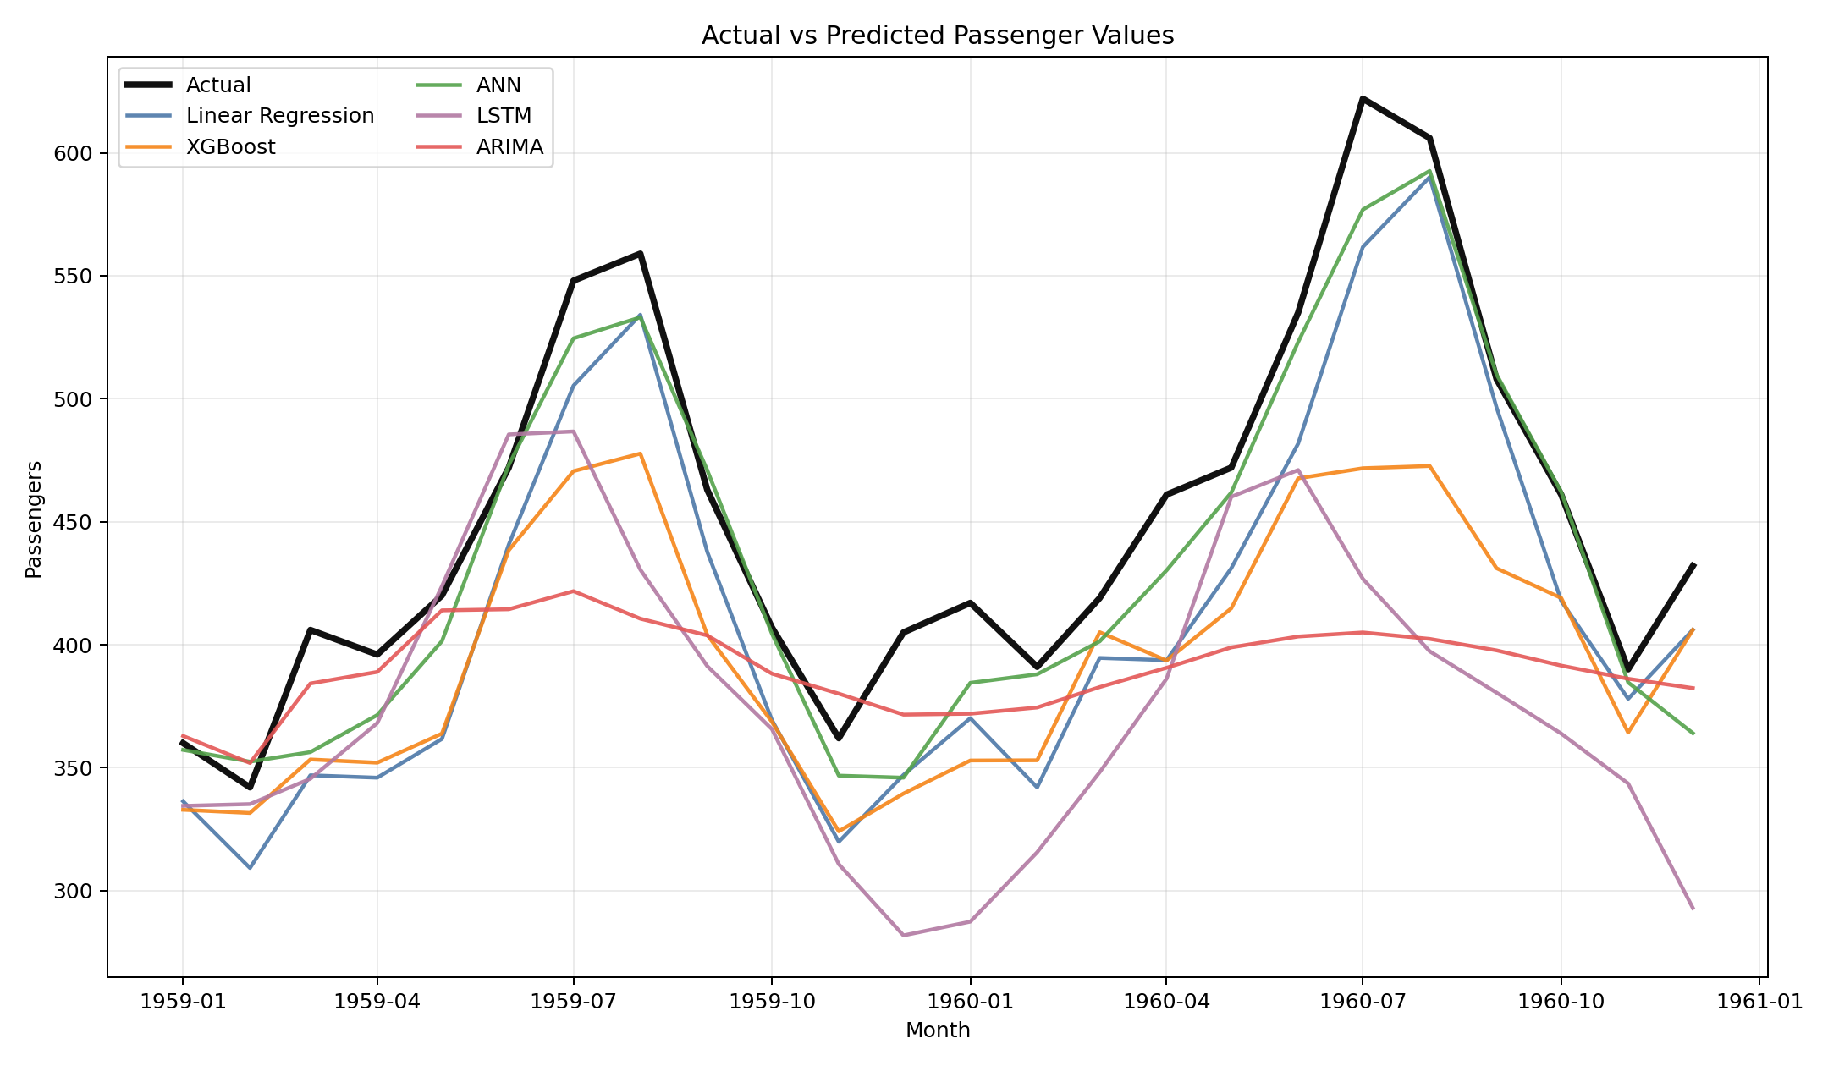
Actual vs Predicted Values
Prediction insight
The best models follow the seasonal rises and falls, but errors increase near the highest passenger peaks. This shows the challenge of forecasting into new high-demand levels.
27.37
4.50%
ANN RMSE
lowest test error
ANN MAPE
percentage error
Notes:
Use the black line as the actual values and compare how closely the model lines follow it.
ANN tracks the shape of the test period most closely overall.
Peak-month underprediction is still visible, so the result is useful but not perfect.

Slide 9
Strengths, Limitations, and Performance Differences
ANN
Best accuracy after target scaling. Captures nonlinear interactions between trend, lag, rolling, and seasonal features.
Linear and XGBoost
Linear Regression is transparent and extrapolates trend. XGBoost captures nonlinear rules but struggles with unseen higher future levels.
ARIMA and LSTM
Statistical and sequence-based baselines are useful, but plain ARIMA and a small LSTM underfit this short seasonal dataset.
Strength: strongest RMSE, MAE, R2, and MAPE.
Limitation: less interpretable and sensitive to scaling.
Use: best short-term accuracy.
Strength: simple baseline explains feature effects.
Limitation: XGBoost does not naturally extrapolate trend.
Use: explainable baseline and comparison.
Strength: aligned with time-series forecasting logic.
Limitation: needs seasonal ARIMA or more data for better performance.
Use: statistical benchmark.
Notes:
Use this slide to show that the comparison is not just about the winner.
ANN wins on metrics, but Linear Regression is easier to explain.
ARIMA and LSTM are appropriate model families, but this implementation is limited by the short dataset and plain settings.

Slide 10
Key Findings and Recommendations
Best overall model
Forecast accuracy
Next improvement
ANN
4.50%
SARIMA
RMSE 27.37 | R2 0.866
Lag and rolling features are essential
Test seasonal ARIMA and longer history
Notes:
Summarize the three key findings: ANN wins, error is around 4.5 percent MAPE, and seasonality is central.
Recommend using ANN for short-term prediction, with Linear Regression as a transparent baseline.
For future work, use SARIMA or SARIMAX and test more robust validation if more historical data is available.

Slide 11
GitHub Submission and 10-Minute Presentation Readiness
Source code and outputs
Include run_pipeline.py, requirements.txt, README, raw/processed data, generated tables, and EDA/model charts.
Presentation slides and notes
Use this deck plus the supporting presenter script to explain the pipeline in about 10 minutes.
Final message
Share the GitHub repository link after pushing. In the talk, focus on why ANN performed best and where the approach is limited.
Notes:
Close by naming the final deliverables: source code, generated outputs, presentation, and supporting documentation.
Remind the audience that the GitHub link should point directly to the project folder.
End with the practical conclusion: ANN is best for this experiment, but SARIMA/SARIMAX is a strong next step.

