Slide 1

DATA7202 Practical 2
Date: 3/22/2021

Slide 2
Agenda
Lab 2 Q1-Q2 (60 min)
Assignment description (15 min)
Other questions

Slide 3
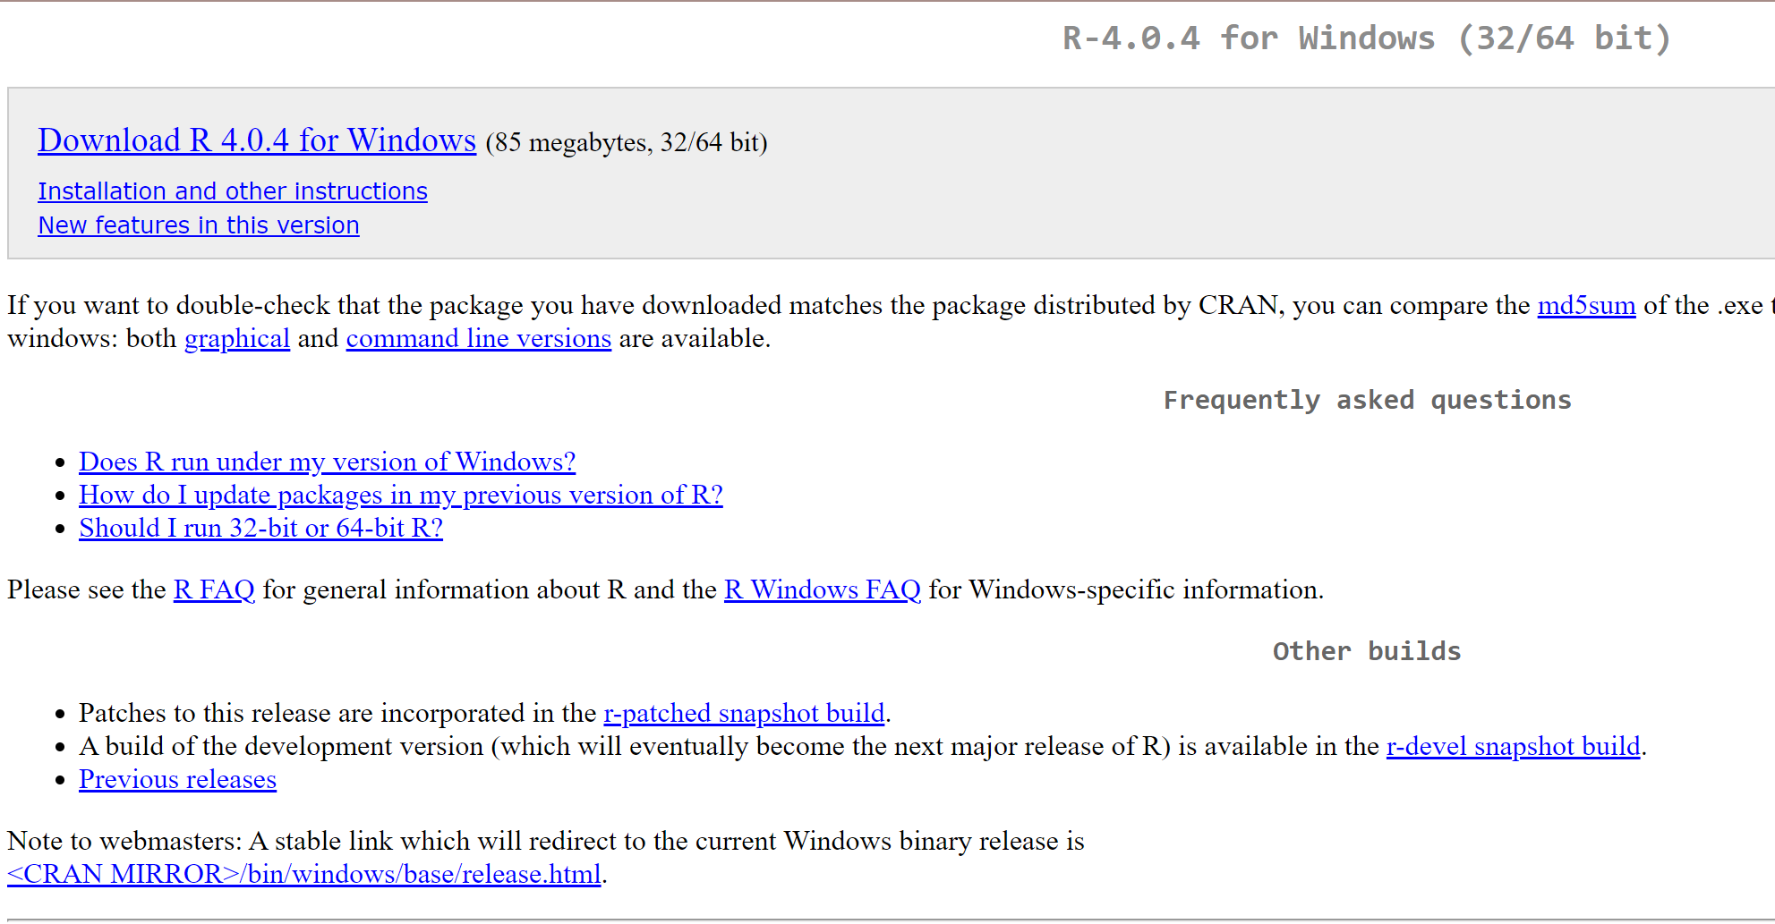
1. Install R
https://cran.r-project.org/bin/windows/base/

Slide 4
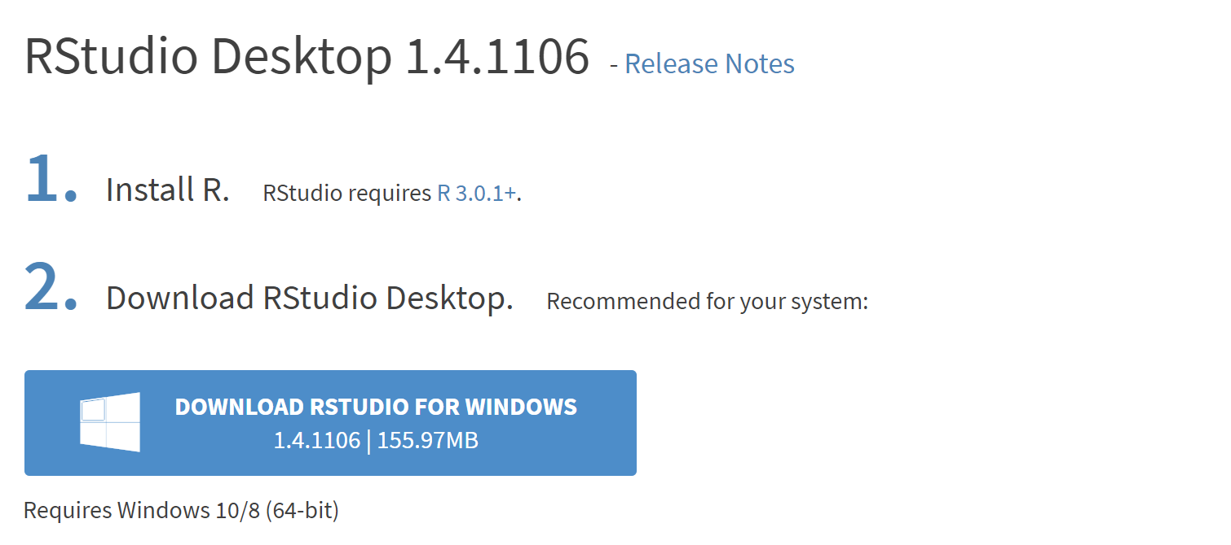
2. Install R Studio
https://rstudio.com/products/rstudio/download/

Slide 5

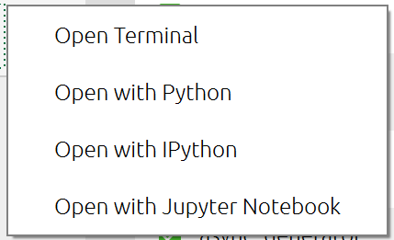
3. R on Jupyter
https://docs.anaconda.com/anaconda/navigator/tutorials/r-lang/
Notes:
https://docs.anaconda.com/anaconda/navigator/tutorials/r-lang/

Slide 6
Q1.b
F-value
The F-value in statistics test the overall significance of the regression model.
The null hypothesis that all of the regression coefficients are equal to zero.
The F value is the ratio of the mean regression sum of squares divided by the mean error sum of squares.
$F =$ $\frac{\text{MSM} (\text{Mean} \text{of} \text{Squares} \text{for} \text{Model}) }{\text{MSE}\text{ (}\text{Mean} \text{of} \text{Squares} \text{for} \text{Error}\text{)}}$ = $\frac{\text{SSM}\text{ / }\text{DFM}}{\text{SSE}\text{ / }\text{DFE}}$ = $\frac{DFE}{DFM}∗$ $\frac{SSM}{SSE}≝\frac{\sum{{(\hat{y_{i}}−\overline{y})}^{2}}}{\sum{{(y_{i}−\hat{y_{i}})}^{2}}}$
Its value will range from zero to an arbitrarily large number.
Notes:
http://www.nlreg.com/results.htm
R²=1 - (SSE/SST)(n - 1) / (n - p) =1 - (1 - R²)(n - 1) / (n - p)

Slide 7
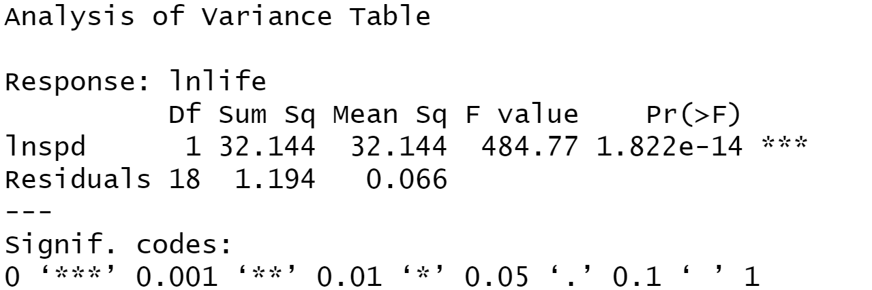
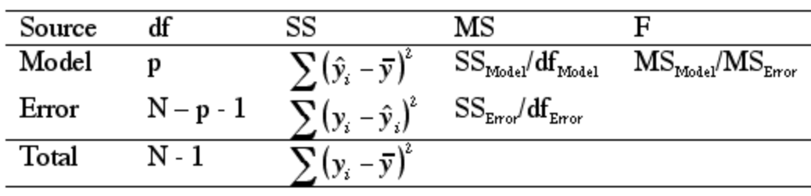
ANOVA
Notes:
https://psychology.illinoisstate.edu/jccutti/psych340/fall02/oldlecturefiles/multiregression.html

Slide 8
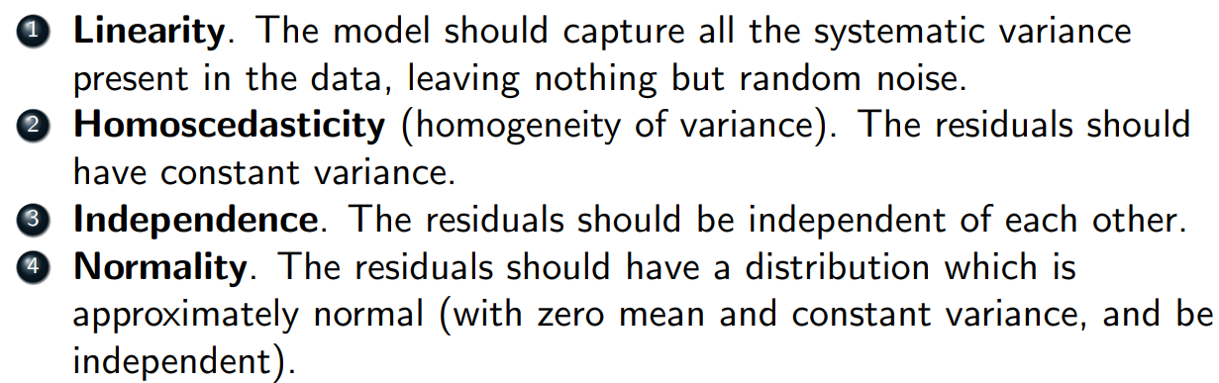
Q1.c
Linear regression assumptions
Also include Multicollinearity ?

Slide 9
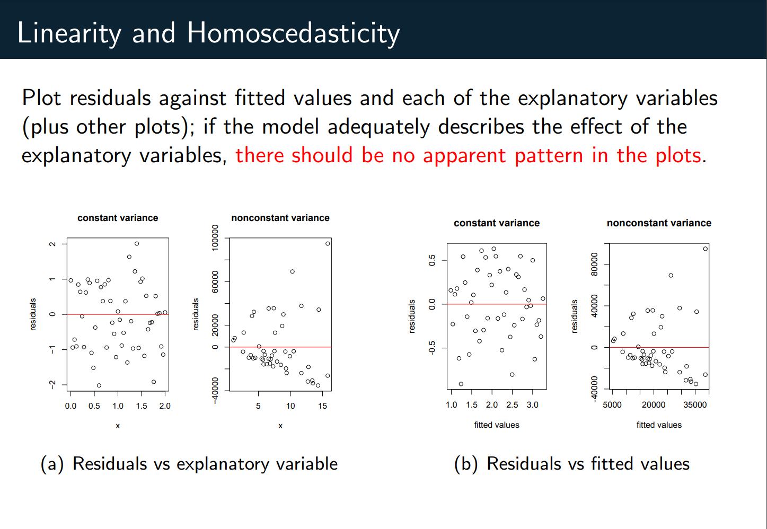

Slide 10
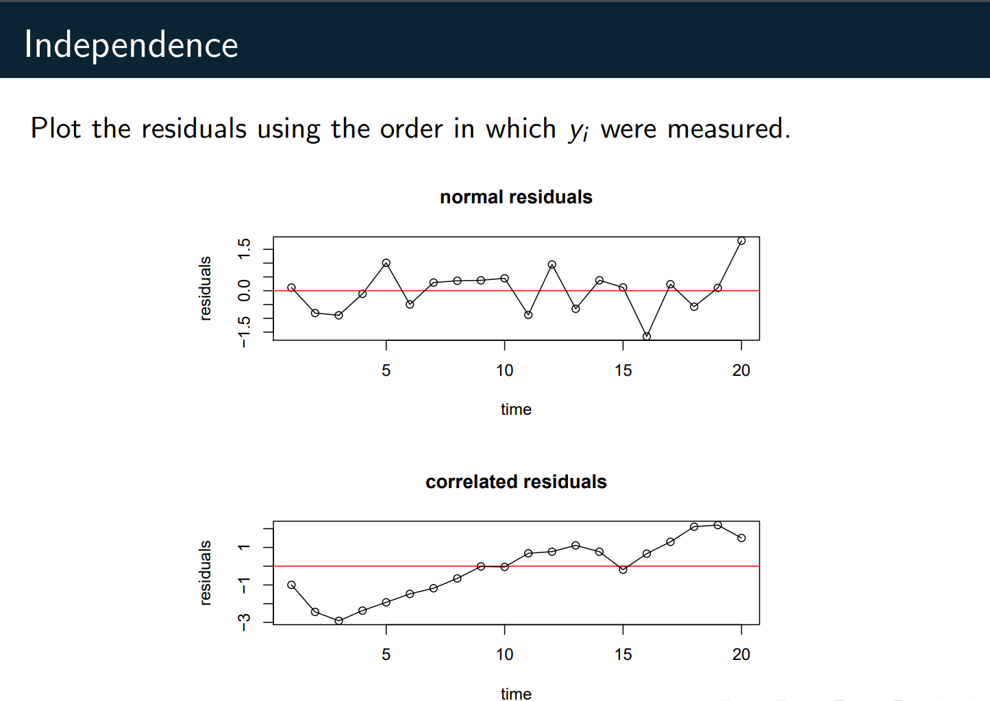

Slide 11
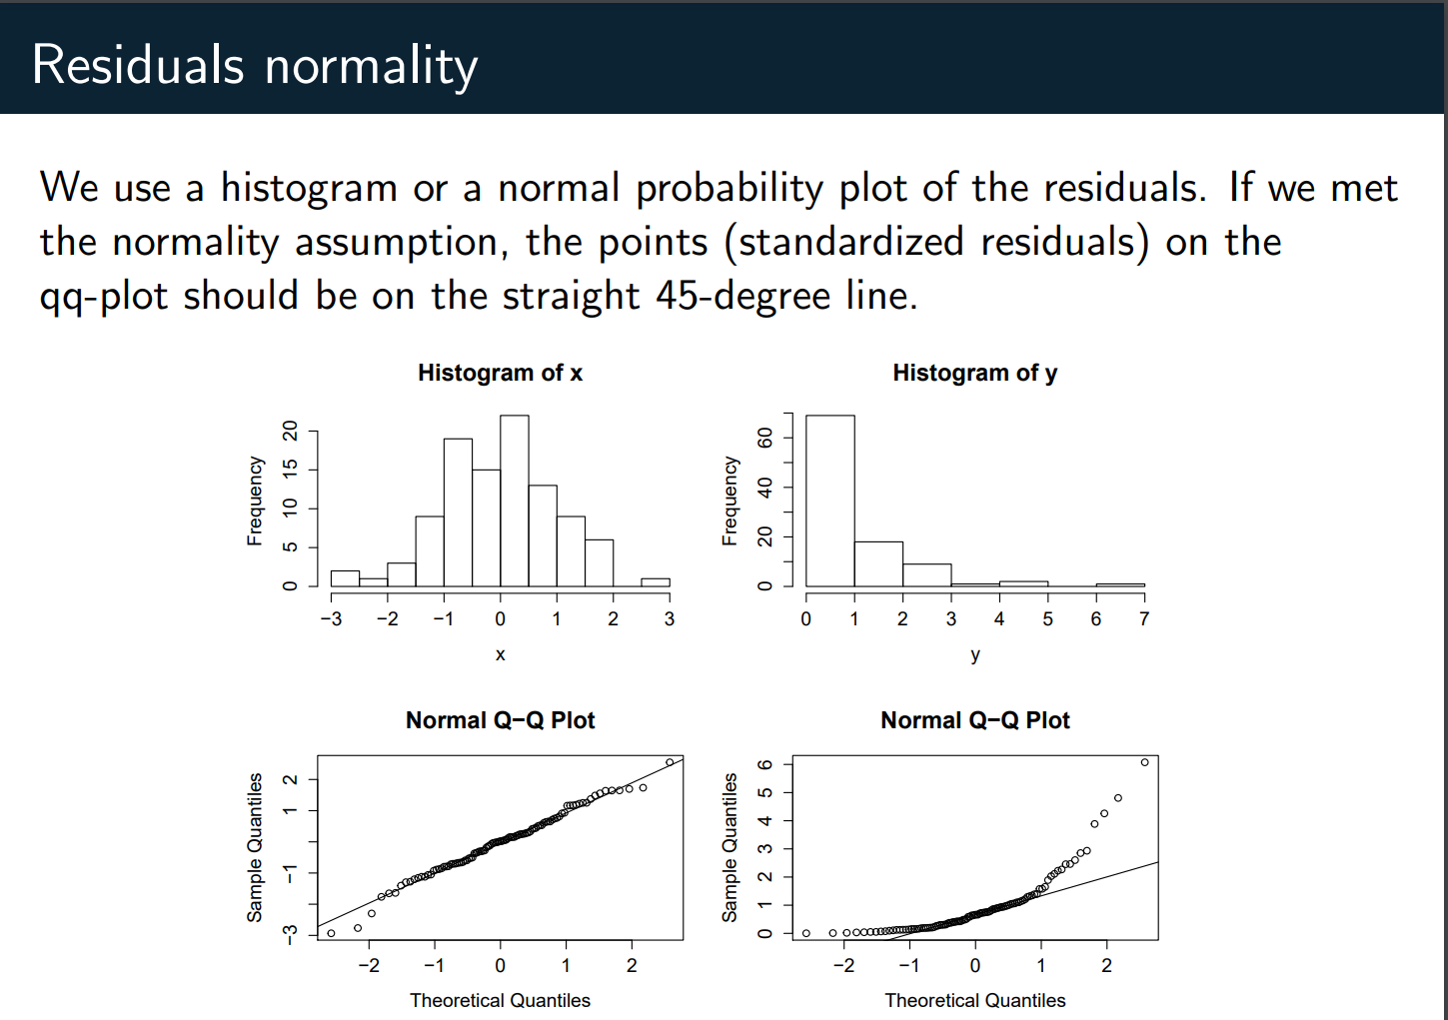

Slide 12
Q1.d
Influence point
(1) We say Leverage is the ability of a design point to strongly influence the fit of a regression model.
(2) We quantify high leverage using the hat matrix elements.
(3) Thus, we can check the influence of an observed (or unobserved) Yi by examining just the hii value(s).
Source: https://www.math.arizona.edu/~piegorsch/571A/STAT571A.Ch10.pdf
https://online.stat.psu.edu/stat462/node/173/
Notes:
https://www.math.arizona.edu/~piegorsch/571A/STAT571A.Ch10.pdf

Slide 13
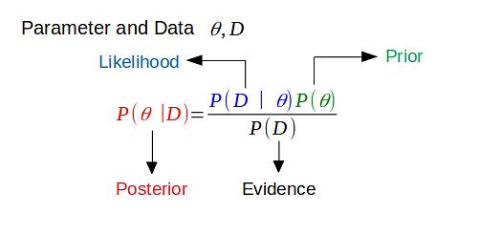
Q2
prior
posterior

Slide 14

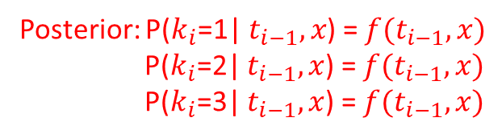
Q4
$t_{i}$ ~ $Gamma(x+1,10k_{i}+\frac{2}{k_{i}})$
Route 1
p1
p2
Route 2
p3
Route 3
Posterior: P($k_{i}$=1| $t_{i−1},x$) = $f(t_{i−1},x)$
P($k_{i}$=2| $t_{i−1},x$) =$f(t_{i−1},x)$
P($k_{i}$=3| $t_{i−1},x$) = $f(t_{i−1},x)$

