Slide 1
DATA7202 Tutorial 1
Date: 3/2/2021

Slide 2
Agenda
ECP introduce (10 min)
Lab 1 Q1-Q2 (60 min)
Assignment description (15 min)
Other questions

Slide 3
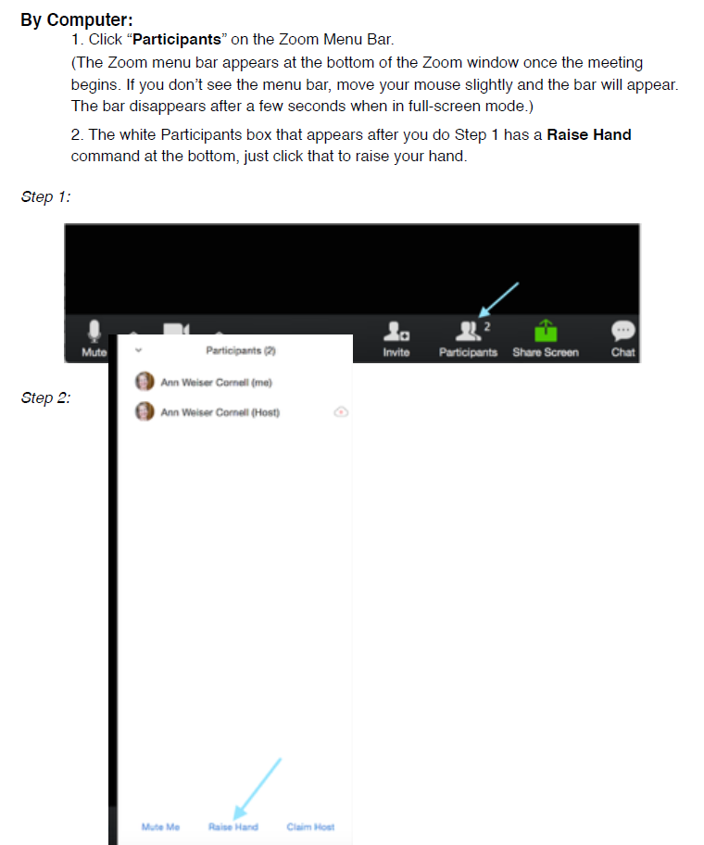
How to use Zoom for prac: * 20-30 mins for each part of question/each step; * Raise hand if you need help > breakout room one by one * Feel free to ask general questions or type the question in the chat

Slide 4
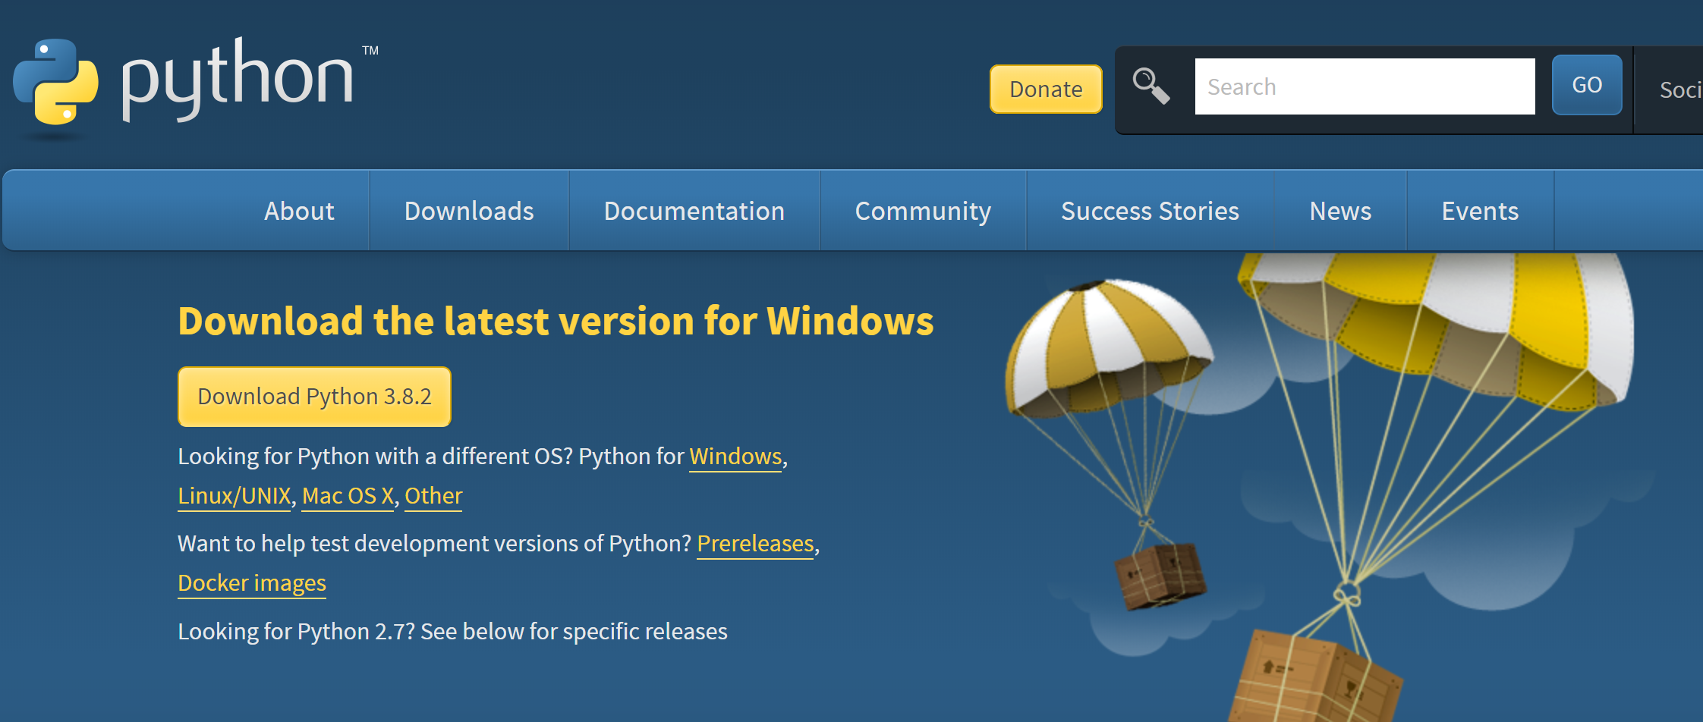
1. Install python
https://www.python.org/downloads/

Slide 5
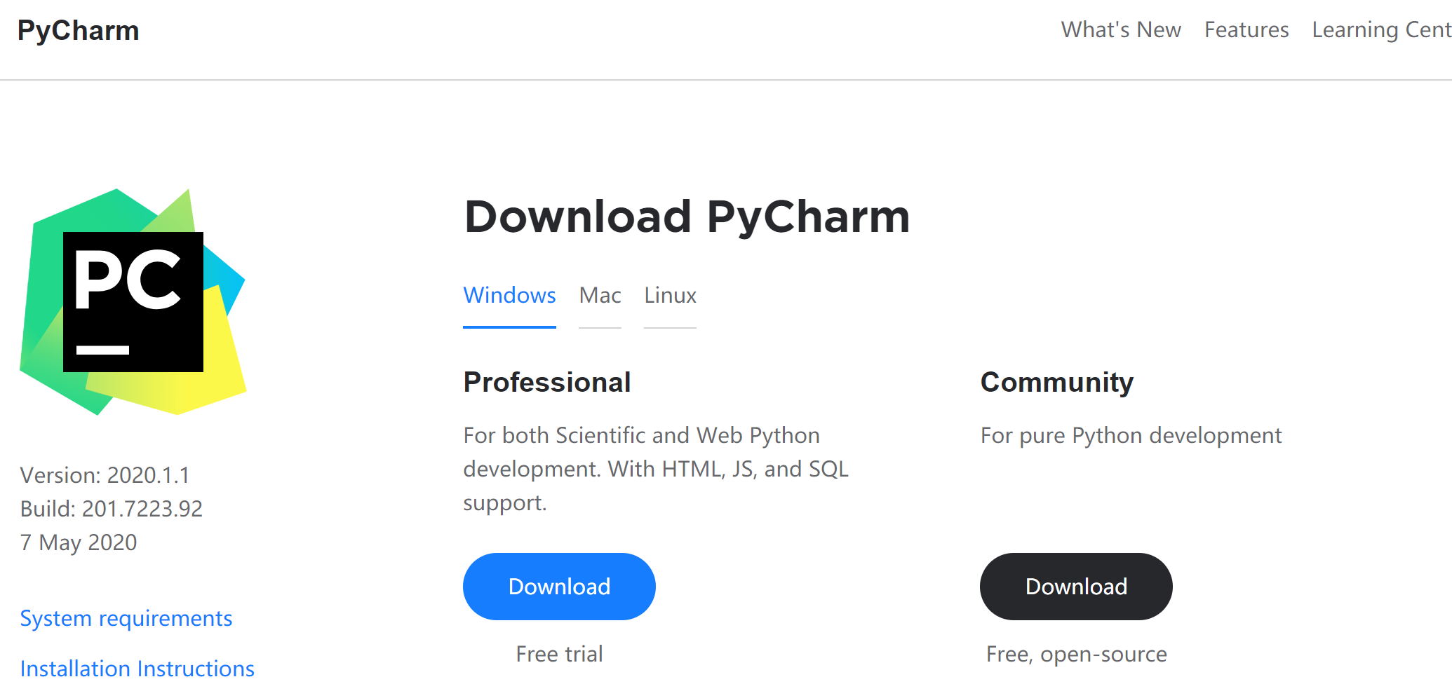
Install pycharm
https://www.jetbrains.com/pycharm/download/#section=windows

Slide 6
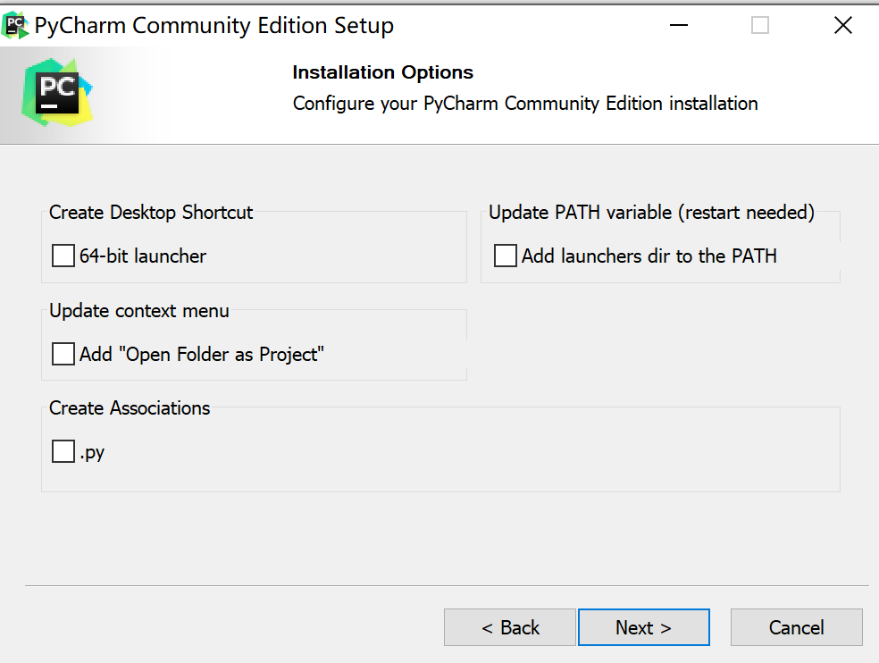
Install option for pycharm

Slide 7
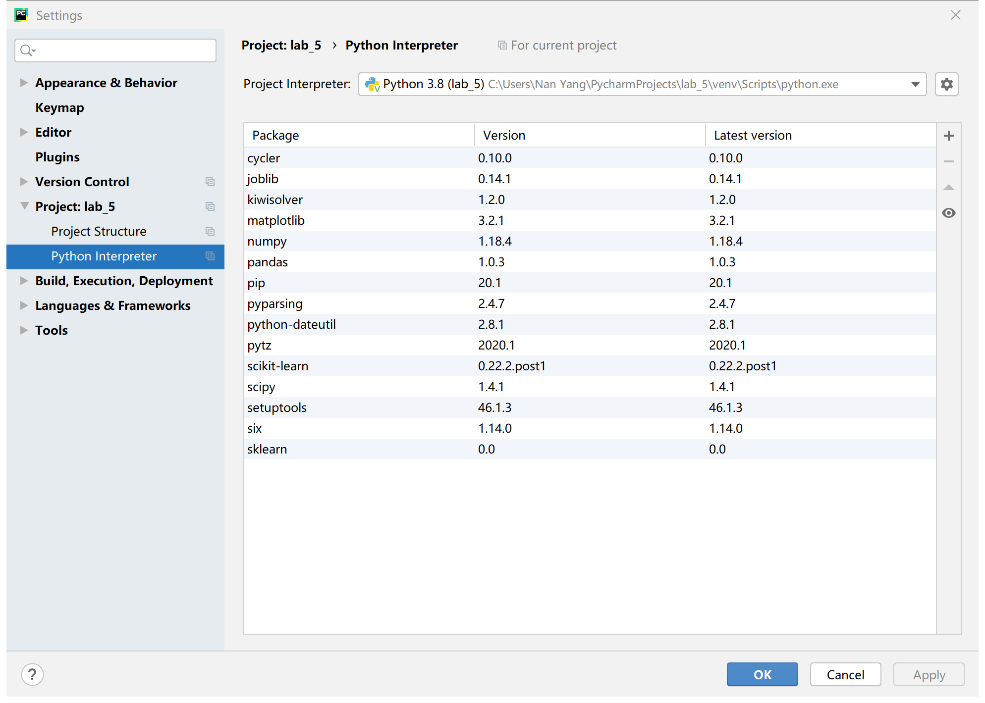
Install package
File -> setting

Slide 8
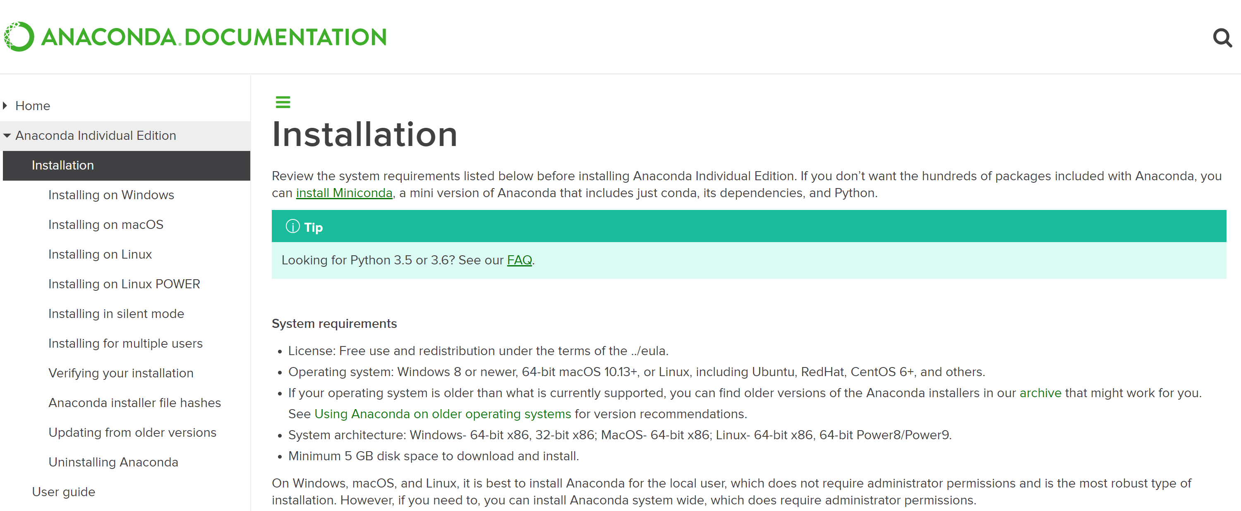
2. Install Jupyter
Anaconda: https://docs.anaconda.com/anaconda/install/

Slide 9
Q1 packages
from sklearn.datasets import make_regression from sklearn.datasets import make_classification import numpy as np import pandas as pd
Q2 packages
from sklearn.model_selection import train_test_split
from sklearn import neighbors import numpy as np import pandas as pd
import matplotlib.pyplot as plt

Slide 10
Q3 packages
import numpy as np import pandas as pd from sklearn.linear_model import LogisticRegression from sklearn.metrics import confusion_matrix from sklearn.metrics import zero_one_loss

Slide 11
Q1
Regression model
y
x

Slide 12
KNN model ( 2 dimension as example)
y
x

