Slide 1
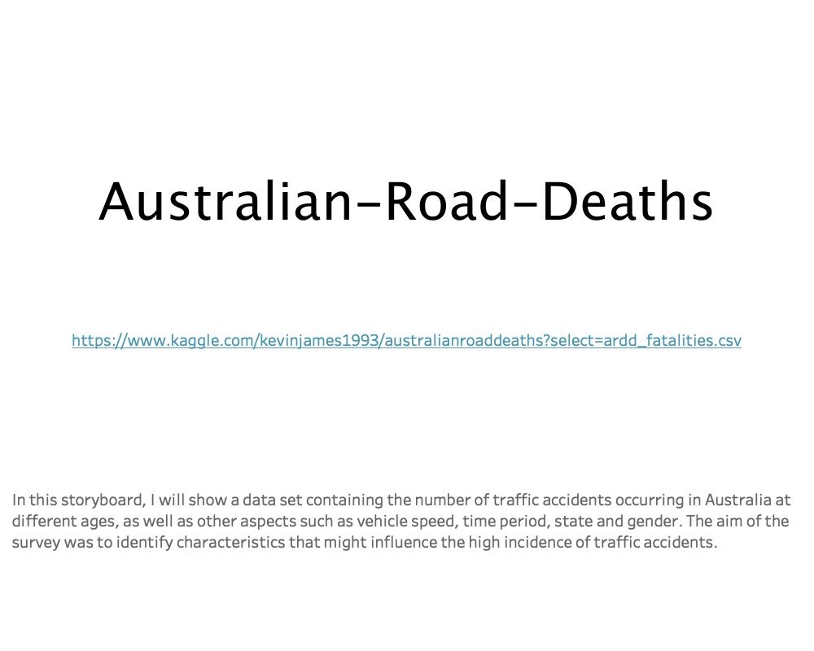
Notes:
Do you drive safely in Australia?
Are men more likely to be expert drivers while the women tend to be the road killers?
In this storyboard, the number of Australian road deaths will be analysed in gender, age, travel time as well as region. The aim of this investigation is to help understand how these factors may impact the road fatalities in Australia.

Slide 2
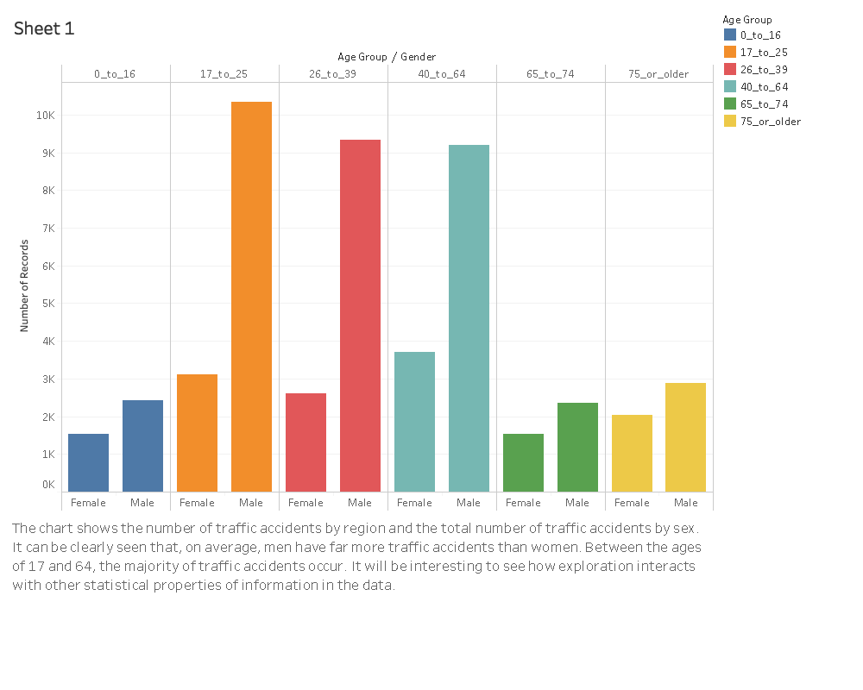
Notes:
This chart shows the number of road fatalities in different age group, by sex.
It can clearly be seen that on average, male drivers tend to suffer higher rate of mortality than female in each different age group. The number of road fatalities is significantly higher among male drivers aged 17-64 years, whereas the numbers are slightly higher in women aged 40-46 years.
It is worth exploring how age and sex factor may affect the number of Australian road facilities, thereby improving the chance of survival in traffic accidents.

Slide 3
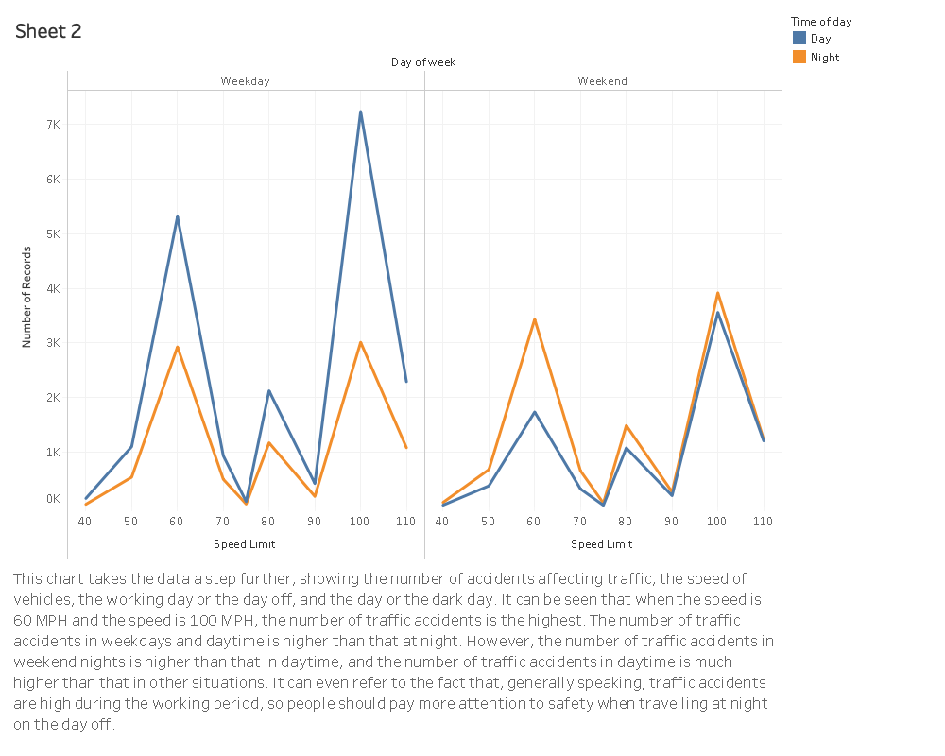
Notes:
This chart dives further into the data, revealing a statistical comparison of the number of traffic accident fatalities by speed limit, the time of a day and the day of a week. In general, the overall trend of Australian road fatalities is much higher at daylight than night-time during the weekday, while the overall trend of fatalities is slightly lower during the day than at night on the weekend. Moreover, the trend of numbers of road fatalities shows a multimodal distribution with speed limit between 40 to 110 mph and reaches three peaks at 60mph,80mph and 100mph respectively.
This graph reveals that travel safety is more likely to be guaranteed at night-time during the weekday and at daylight on the weekend, which may be associated with the routine travel habits because people tend to travel for work during the weekday and hand out on the weekend. In addition, as shown in the chart speed limit is another risk factor that significantly affects the number of road fatalities in Australia. Further statistical and social analysis would be helpful to understand the relationship between speed limit and number of fatalities.

Slide 4
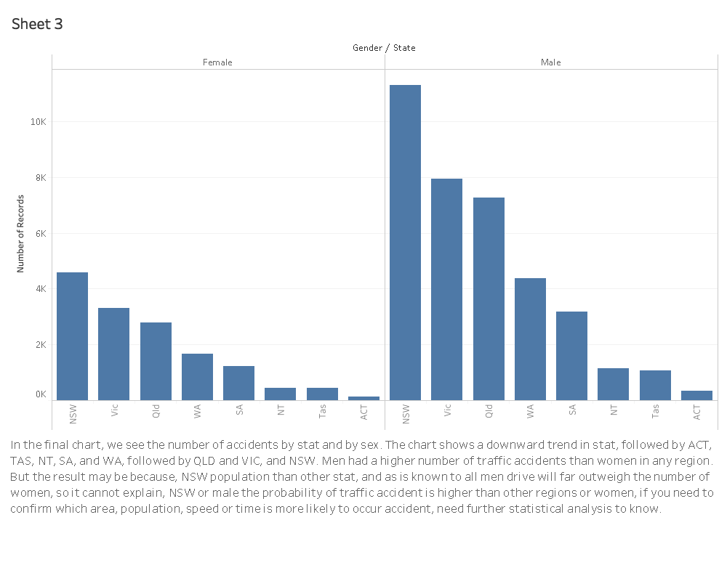
Notes:
The final chart demonstrate the overall number of road fatalities in different state of Australia, by sex.
It is evident to see that the number of male fatalities is much higher than female in any state of Australia.
In spite of the influence by gender, the number of road fatalities are highest in NSW, then followed by VIC and QLD, and with ACT having the lowest numbers of fatalities in Australia. This may be related to the overall population and traffic condition in each state.

