Slide 1
Data7002 Group1
Sukhitha S4601208
Sharma S4628569
YiChang Liu S4518728
Yang Jiao S4558323
Shuoyuan Zhang S4607609
Peng Yu S4663588
Yiping Xia S4487409

Slide 2
INTRODUCTION
Notes:
Hi everyone, this is group one of online resource class.

Slide 3
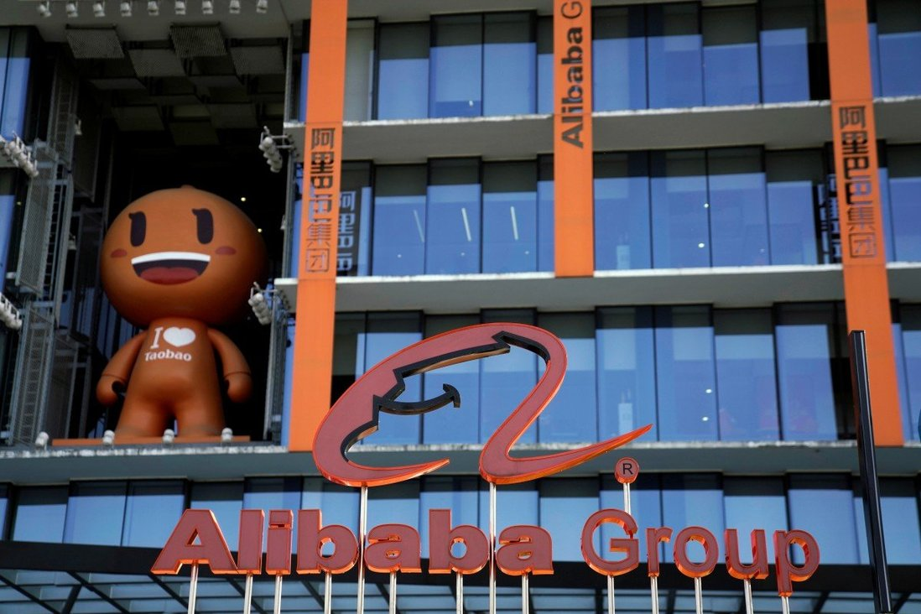
Web crawling with Alibaba
1.1 Billion record been leaked in this scenario.
Crawler develops and employer imprisoned for three years
Fine worth 450,000 Yuan (about $90,000)
Notes:
In recent years, data analysis and big data have become an indispensable part of people's lives. When browsing shopping websites, people often come across websites that post what they have searched recently. This is a very convenient function. However, once the information you have searched for or purchased is known to others, it may be a very embarrassing or serious event for some people. Regarding this information leakage behavior, our team found a case and discussed it: Taobao (the online shopping site of Alibaba Group) has leaked 1.18 billion user information since November 2019. In this case, XX Li first implemented data crawling on Taobao for eight months, stealing a large amount of user data in the process. After that, XX Li established 1,100 WeChat groups and used robots to send Taobao coupons in the group to earn rebates and illegally profited more than 340,000 CNY. In this case, our group is going to combine the scenario and discuss about web crawling from three different perspectives. Now I am going to pass my group mate Shuoyuan to introduce the web crawling technology.

Slide 4
TECHNICS

Slide 5
What is web scraping?
Web scraping is a term for various methods used to collect information from across the Internet.
Simulates human Web surfing
Collect specified bits of information from different websites
Purpose:
Collect certain data to sell to others
Or to use for promotional purposes on a website
Also called Web data extraction, screen scraping or Web harvesting

Slide 6
Examples of web scraping are used:
If you want the current prices of 50 different stocks on the stock exchange.
Or, if you want to print the headlines of all the latest stories on a news site.
Or you just want to list the prices of all the items on your website and compare them in Excel.
Also, some of illegal use, which will be discussed later

Slide 7
The basic principles and process of Web Scraping (using Python as an example) :
Send
Send a Request to the server and then receive a Response. (HTML file)
e.g. res = requests.get(url, headers=headers)
Process
Process the Response we received and find the text we need. (BeautifulSoup4)
e.g. soup = BeautifulSoup(res.content,'lxml')
Code
Code flows need to be designed to handle repetitive tasks.
Export
Export our data, preferably in a nice Excel spreadsheet. (Pandas)

Slide 8
What problems are easily caused by Web Scraping techniques? Why?
Web scraping is essentially a form of data mining.
Many expert developers can easily access most of the data on the web using web crawlers
even use some vulnerabilities to obtain a lot of encrypted, unpublished information.
A lot of information on the website is not public.
These unpublic data may contain a lot of private information.
So, scraping of website data is easy to trigger laws.

Slide 9
Back to Alibaba’s Taobao Data Leaking Issue
A marketing consultant illegally obtained user data such as user ids, mobile phone numbers and customer reviews through web scraping software.
Mobile phone numbers are sensitive — register official information on SIM cards
Universality of web scraping technology, many non-professionals can also use some encapsulated web scraping software to easily obtain the information in the web page.
How to disguise the scraping program to escape the anti-crawler program?
Add a header to disguise it as a request from the browser:
e.g. “req.add_header('User-Agent', 'Mozilla/4.0 (compatible; MSIE 5.5; Windows NT)’)”

Slide 10
LAW & PRIVACY

Slide 11
What information does Alibaba’s Taobao take?
Taobao provides e-commerce transaction platform services and collect information:
Member registration
Product search
Placing orders and executing transactions
Customer service and dispute handling
Comment, share and other information release
Security assurance

Slide 12

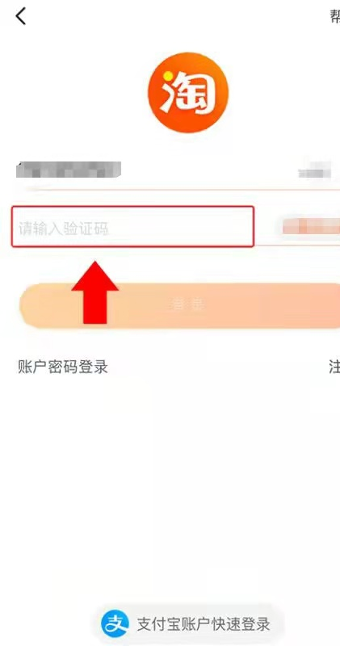
Sensitive term
Taobao User ID
Mobile phone number
Customer’s reviews and comments

Slide 13
The Criminal Code of the People's Republic of China
According to Article 253a which read -
Any staff member of a State body, or an organization of finance, telecommunication, transportation, education, or health care, etc.
violates the State regulations, by selling or illegally providing the citizens' personal information obtained during the course of performing duties or providing services,
and in such cases if the circumstances are serious, then such staff member shall be sentenced to a fixed-term imprisonment of not more than three years or criminal detention

Slide 14
Case Result
Li xxx-Three years and six months in prison and fined 350,000 yuan
Lu xxx-Three years and three months in prison and fined 100,000 yuan
But！1.18 billion information data was leaked!

Slide 15
Ethics

Slide 16
Ethical Aspects of Web Scraping
Digitization has led to large volumes of data to be available on web.
Allow researchers to find answers with more rigor and precision.
Findings may compromise privacy, violate rights or may contribute to bias and discrimination.
Notes:
Introduction to ethics in web scraping
During this course We talked about how concerns about ethics is being applied to data science and technology. And how it shapes data science advances as well.
As we have seen, Web scraping is so easy, just a couple of python codes. So, its responsible use of it is more important, because something that can be done so easily can be exploited in unethical ways easily also.
https://aisel.aisnet.org/cais/vol47/iss1/22/
these vast volumes of Big Web Data present academic researchers with ample opportunities for answering new and old research questions with more rigor, precision, and timelines (Constantiou and Kallinikos 2015). Practitioners can leverage this data for developing a better understanding of their customers, formulating strategies based on these findings, and, ultimately, improving organizational performance (Ives et al. 2016).
a finding derived from a research project relying on data collected from a website may unintentionally compromise privacy of individuals, violate their rights as research subject, lead to erroneous decisions, or contribute to bias and discrimination. Web data can also reveal confidential information about organizations participating in the activities afforded by the website or the organization that owns the website. It is also possible that some uses of data may reduce perceived value of the website in the eyes of the intended audience.

Slide 17
Unethical Use cases
Use solely for commercial gains
Plagiarism
Privacy concerns
Spamming
Identity theft
Notes:
Some adversarial companies use web scraping in large volumes for commercial gain, with nothing going to the owner of the website. Using web sites merely as a means. Not a means to an end.
Web scraping is also used in plagiarism. Scraped content is shared without any acknowledgement to the source.
More commonly, personal details like contact details is scraped without consent, this is used for spamming of marketing material or scams.
There are some cases of social profile scraping for identity theft as well.

Slide 18
Ethical Use cases
Research and development.
Market analysis and price comparison.
Notes:
Some researchers or students gather some web data from some blog posts for personal projects. It’s a valuable tool for learning.
Also organizations can use scraping in competitor web sites, for Market analysis and price comparison.
Google itself is an ethical web scraper, which all web sites wants to be scraped by.

Slide 19
Alibaba’s Case Study
Marketing consultant used web-scraping for personal gain, violated privacy and confidentiality.
Alibaba’s platform lacked security mechanisms to prevent such incidents.
Notes:
In the case of this Alibaba scandal, the marketing consultant definitely acted in an unethical way, using readily available data from Alibaba TaoBao platform for their client’s personal gains, as merely as a means.
Of course the data they scraped was private and personal data like phone numbers. Through phone numbers any personal detail can be accessed because the Chinese government requires that sim cards be registered with official details. So scraping those phone numbers is a huge invasion of privacy and confidentiality of Alibaba users.
Alibaba’s TaoBao platform acted unethically here as well. Being one of the largest organizations in the world, their negligence allowed this to happen, they should be able to devote more resources on stopping something like that from happening. Maybe due to the lack of legal liabilities they didn’t prioritse protection from this kind of attack, but for ethical reasons they should have.

Slide 20
Web scraper’s responsibilities.
Use other ways such as Public APIs if possible.
Provide details in the request to allow web site owners to reach out.
Acknowledge , not plagiarize.
Limit the scraping to absolute minimum.
Be mindful of privacy and other concerns.
Be respectful of the website owner’s guidelines on what’s allowed.
Notes:
There are some principals we can consider for an ethical web scraper, looking at an angle of virtue ethics.
Use Public API if available. Not all data needs scraping.
In the web scraping requests, provide USER AGENT, and provide ways on how to contact the scraper. Let the intentions be known. I will always respond timely if the owner reaches out to me.
Request data at a reasonable rate.
Scrape in a way that it wouldn’t be flagged as a DDoS attack.
Save only the data which is absolutely necessary.
Never pass the content as my own.
Look for ways to return value to the web site owners. Value, not invasion of privacy.
I will scrape only to create value, not to duplicate or plagiarize.
Look for robots.txt if scraping is prohibited for the website

Slide 21
Website owner’s responsibilities.
Invest in resources to prevent malicious web scraping
Reasonable effort to allow scraping without compromising on privacy and site’s performance.
Reach out to the scrapers to understand their intentions.
Provide alternate means such as a public API.
Notes:
Site owners also has a responsibility here. Because if there are ethical web scrapers, who strive to create more value through web scraping, ethically those scrapers should be allowed to web scrape, for utilitarian means.
Site Owner responsibilities
I understand that scrapers are a reality of the open web.
I will allow ethical scrapers as long as they don’t affect the site’s performance.
I will respect User agent strings rather than blocking them.
I will reach out to the scraper before blocking them permanently.
I will provide a public API within my means, as an alternative to scrapers.

Slide 22
Conclusion
Notes:
In summary, the disclosure of personal information discussed in our group is a very serious behavior that does not conform to laws and ethics. However, web scraping and data analysis are very important technologies in the era of big data. What we need to do is not to prohibit web crawling technology, but how to improve the quality of practitioners so that they do not disclose information while contacting information, or to establish a more complete law to protect everyone who is at risk of privacy leakage.

Slide 23
Q&A
Notes:
Are there any Australia law protecting from the web scraping?
What we think are the most important questions that a scraper should ask before they start a web-scraping project.
And the same for website owners- what are the most important aspects in protecting the website from being used with malicious intentions?

